Slide 1
VegBank
A vegetation field plot archive
Produced at:
  The National Center for Ecological Analysis and Synthesis
Principal Investigators:
  Robert K. Peet, University of North Carolina
  Michael D. Jennings, U.S. Geological Survey
  Dennis Grossman, NatureServe
  Marilyn D. Walker, USDA Forest Service
Primary collaborators:
  Don Faber-Langendoen, NatureServe
  Michael Lee, University of North Carolina
  Mark Anderson, NCEAS
  Gabriel Farrell, NCEAS
  John Harris, NCEAS

Slide 2






VegBank is made possible
by the support and cooperation of:
Ecological Society of America
National Center for Ecological
Analysis and Synthesis
Federal Geographic Data Committee
Gap Analysis Program
National Biological Information Infrastructure
National Science Foundation

Slide 3
A vegetation plot archive?
Currently there is no standard plot data repository.
A repository is needed for:
  Plot storage and preservation
  Plot access and identification
  Plot documentation in literature/databases
In addition, data exchange standards are needed to support alternative data archive initiatives.

Slide 4
VegBank
The ESA Vegetation Panel is currently developingVegBank (www.vegbank.org) as a public vegetation plot archive
VegBank is expected to function for vegetation plot data in a manner analogous to GenBank.
Primary data will be deposited for reference, novel synthesis, and reanalysis, particularly for classification.

Slide 5
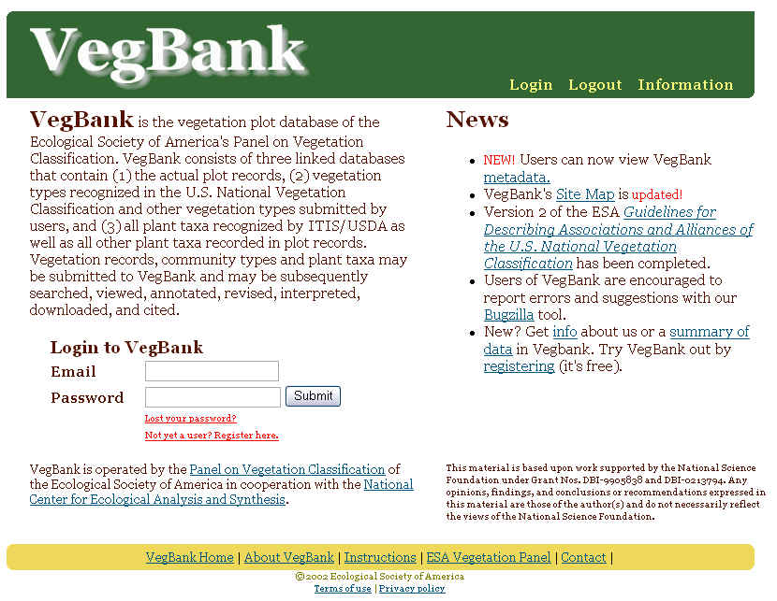

Slide 6
Why are we here?
Education of the audience:
Demonstrate the benefits of using VegBank.
Develop a group of knowledgeable users to try out the tools and come out feeling they can be and want to be users.
Instill in our user community a sense of common ownership. We need VegBank “beta-testers” and good honest critiques.
Demonstrate how these tools can improve the vegetation classification enterprise.

Slide 7
Education of the VegBank team:
Determine the problems users encounter in functionality and interface of both VegBank and VegBranch.
Learn the training needs in anticipation of future workshops with more naive users?
Learn which uses are anticipated and which features are needed.
Determine what are the most important inhibiters for getting data into and out of VegBranch and VegBank?

Slide 8
Traditional Community Ecology
The questions:
How are communities structured?
How do taxa interact?
The solutions :
Simple observations.
Simple experiments.
The scale:
Stand or landscape.

Slide 9
Emerging data sources
Site data: climate, soils, topography, etc.
Taxon attribute data: identification, phylogeny, distribution, life-history, function attributes, etc.
Occurrence data: attributes of individuals (e.g., size, age, growth rate) and taxa (e.g., cover, biomass) that co-occur at a site.

Slide 10
EcoInformatics ?
Massive plot data have the potential to create new disciplines and allow critical syntheses.
  Remote sensing. What is really on the ground?
  Community ecology. Who occurs together, and where, and following what rules?
  Monitoring. What changes are really taking
  place in the vegetation?
  Restoration. What should be our restoration targets?
  Vegetation & species modeling. Where should
  we expect species & communities to occur after environmental changes?

