Slide 1
13 September 2023
UxS Data Interoperability: Establishing Foundational Guidelines for Metadata and Standardization
Dr. Andrew Evans, Geospatial Data Scientist, U.S. Naval Meteorology and Oceanography Command
Katharine Weathers, UxS Data Coordinator, NOAA/NCEI

Slide 2
Commercial Engagement through Ocean Technology Act of 2018
Require NOAA to establish procedures for the agency to assess and acquire uncrewed systems tech
Encourage NOAA to partner with the Secretary of the Navy on uncrewed maritime systems tech
Direct NOAA to engage in partnerships with the private and academic sectors to improve their observation capabilities, which would increase cost effectiveness and capitalize on emerging technological advances

Slide 3
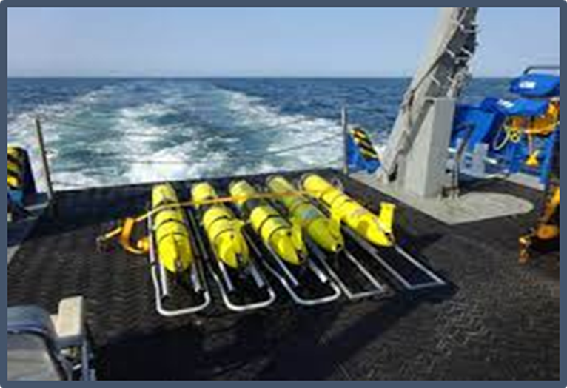
CENOTE Act of 2018 Joint NOAA/Navy Activities
Plan of Actions & Milestones for Data Exchange Standards
Define data exchange standards for UxS
Identify existing interface and exchange standards for UxS sensors
Identify minimum requirements for platform health tracking
Identify common UxS vocabularies used in data exchanges
Inbound/raw data and
Outbound / processed data
Develop plan to enable cross-agency UxS data exchange
Notes:
As more and more sensors and platforms come online and collect more and more data we are rapidly outpacing our ability to analyze and process all of the data being collected
While all of this happening, the number of people ie analyst at firms or agencies who can process and understand the information being collected is remaining relatively static
So what do we do? This is where leveraging new technologies and automation of data processing becomes required, not optional
But first we have to put all of our ducks in a row
Without standardization and metadata requirements, there will be difficulties in automation and leveraging AI/ML to process the flood of data
Heterogeneity is the enemy of automation
So where do we start?

Slide 4
Complimentary Missions
Understand and predict our changing environment, from the deep sea to outer space
Ensure citizens, planners, emergency managers and other decision makers have reliable information they need when they need it
Conserve and manage coastal and marine ecosystems and resources
Define the physical environment from the bottom of the ocean to the stars
Decades of pioneering development and use of uncrewed systems
Ensure the U.S. Navy has freedom of action to deter aggression, maintain freedom of the seas and win wars

Slide 5
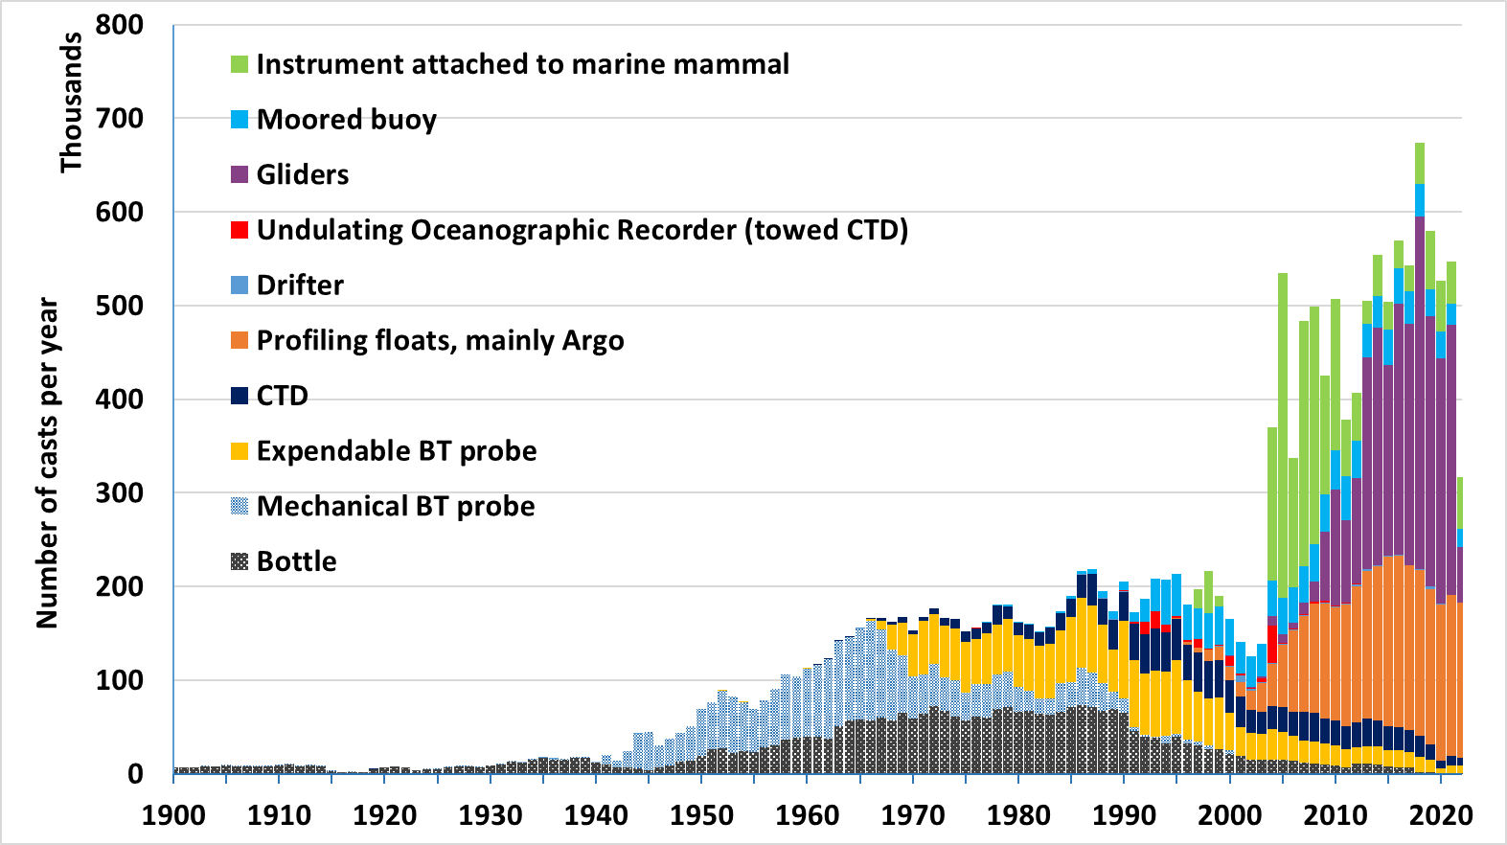
Proliferation of UxS: NCEI Ocean Climate Lab World Ocean Database

Slide 6
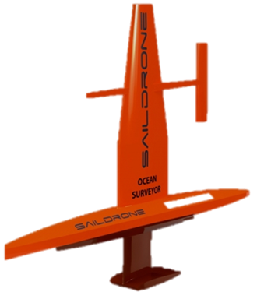

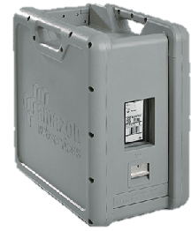
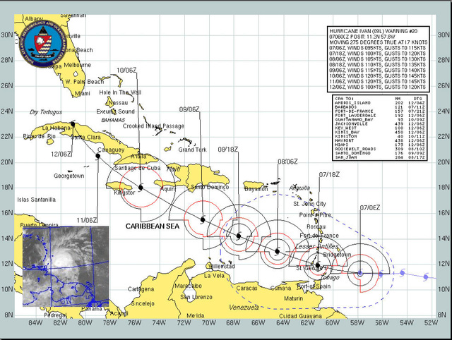

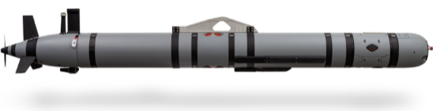
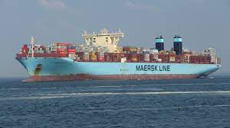
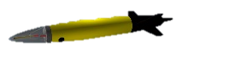
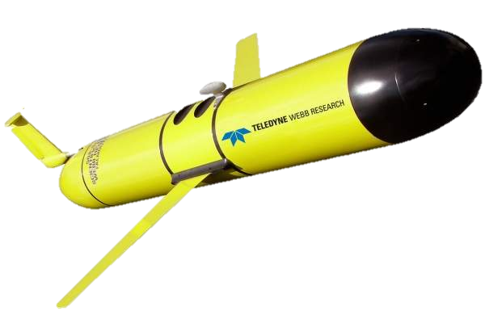
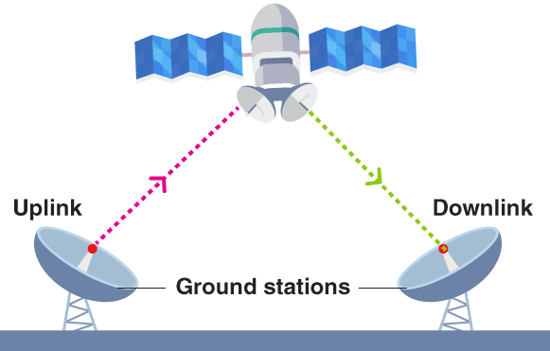
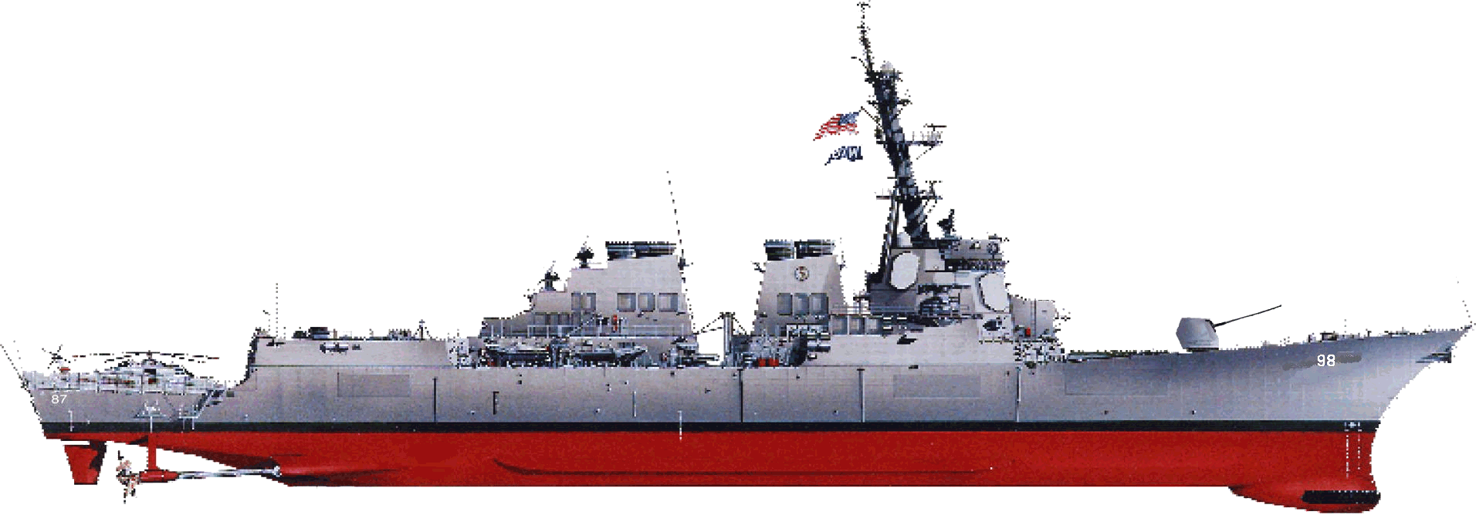
The Current State of UxS Data
HDD/Edge Devices
Shipboard Servers
Satellite Comms
Notes:
Right now there is a data black box
UxS data is collected by platforms all over the world for weather, shipping, armed forces, and scientific research but how it gets from the sensor to the analyst depends on who you ask and where they work
Small data like salinity or temperature being communicate by satellite communications and larger data like sonar or bathymetric data having to be physically removed from the platform and transported to a data center
We can go to various data repositories both internal and external and access UxS data collected all over the world in both near real time and post mission, but how often can you find what platform collected that data using what sensor, was there any extenuating circumstance during collection, etc.
There is little or no guidance on what metadata or information about the data should be collected or maintained with regards to who, what, how the UxS data was collected which is how we got here today

Slide 7
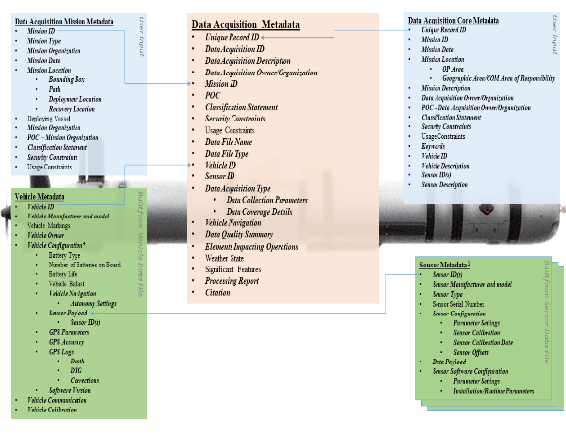
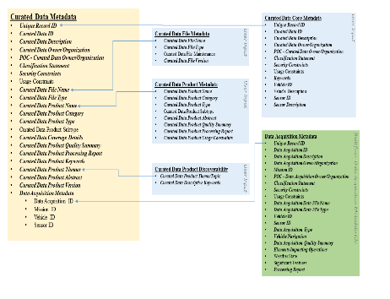
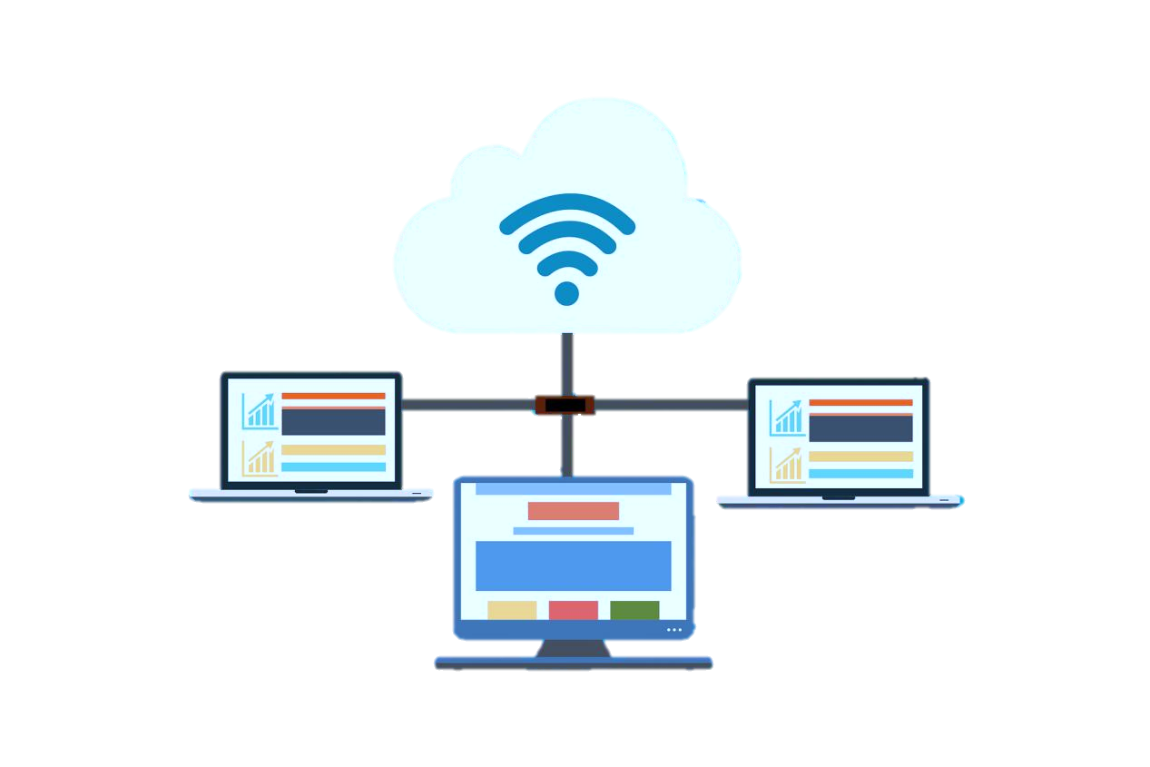
Flexibility and Modularity are Key Implementation Guidance is Crucial
Notes:
Our Logical data Model is broken into two steps Acquisition and Curation
This was developed to align UxS data with ISO metadata standards and was designed to be collected easily through automation while maintaining the relevant data
At the acquisition stage, in addition to the actual data, this metadata is collected which improves both search ability and legacy of the data
The sensor metadata is meant to be repeatable as platforms typically have multiple sensors on them and include the parameter settings for each sensor
The idea is to maintain the ancillary metadata alongside the a UxS dataset for both post mission analysis and data lineage so that as new techniques and algorithms are developed in the future we are able to go back and easily find the data

Slide 8
Proposed File Naming Convention
FILE NAMING CONVENTION FOR METOC DATA AND PRODUCT
EXCHANGE FOR NATO AND WMO COMPLIANCE
pflag_productidentifier_oflag_originator_yyyyMMddhhmmss_CCC_DDD_Platform_RRRR_TTTT_LL_XXX.type[.compression]
Currently, the NATO METOC FNC only allows the unique “C” character.
UTC (Zulu) Date – Time file created
Recommend netCDF4
Originating center's local product identifie
CCC – security classification
DDDD – distribution statement
Platform – platform used to collect data
RRRR – approximate resolution of the data
TTTT – temporal period of time series data or potential data expiration
LL – processing status of the file
XXX – Optional additional identifying information
4 Digit CCCC Code
Based on WMO designators*
*Only Meteorological Center Currently Listed
3 Digit Code
Most UxS Data will be
110: Oceanographic Products

Slide 9

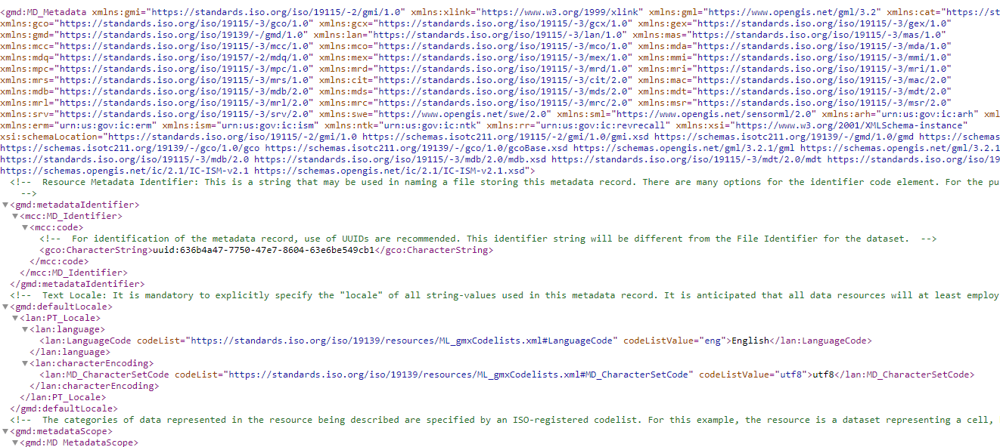



Metadata Acquisition
Platform and Sensor Log Files
Industry and Government Standards
Machine Readable XML files
Vehicle Serial NumberSN 001 ë¾
" Vehicle Owner and IDWHOI (OSL) ëW
E Vehicle rev(WHOI 600 (W)) be3fab709 RELEASE Jun 13 2022; 18:07:55 ëé
Vehicle sub revisionBathy ë
A Vehicle configurationA6C1C3D5ECFOGXIRKDM3NBNPNTPCPIPSTPUMVPWB ëf
Includes:
Separate XML Files for Acquisition & Curation
Engineering data
Keyword tagging
Mission Information
Data Quality and Lineage
Mission Organization / Group
Mission Goal / Target
Sponsor Information
Data Handling Constraints/Security Information
Soft Metadata

Slide 10
Data Lineage Guidelines
Level 0: full resolution data as it comes off the platform with minimal processing applied to remove artifacts but lacks information regarding geo-referencing or time calibration
Level 1
Level 1A: full resolution data with time calibration, and geo-referencing parameters added
Level 1B: full resolution data processed to Level 1A with the addition of data precision and accuracy information added
Level 2: derived geophysical variables from full resolution data such as bathymetric products, point features of contacts, and other information at the same resolution of the raw data
Level 3: geophysical variable Level 2 data that has been merged or combined with other datasets to create a dataset on a uniform space time grid
Level 4: Derived outputs from models, or other products resulting from the analysis of lower level data
Original data should be maintained in native format for reanalysis and archival purposes
Intermediate data and derived products should be maintained at the discretion of owning organization
High level data outputs should be used for IPOE, BMA, and Common Tactical Picture

Slide 11
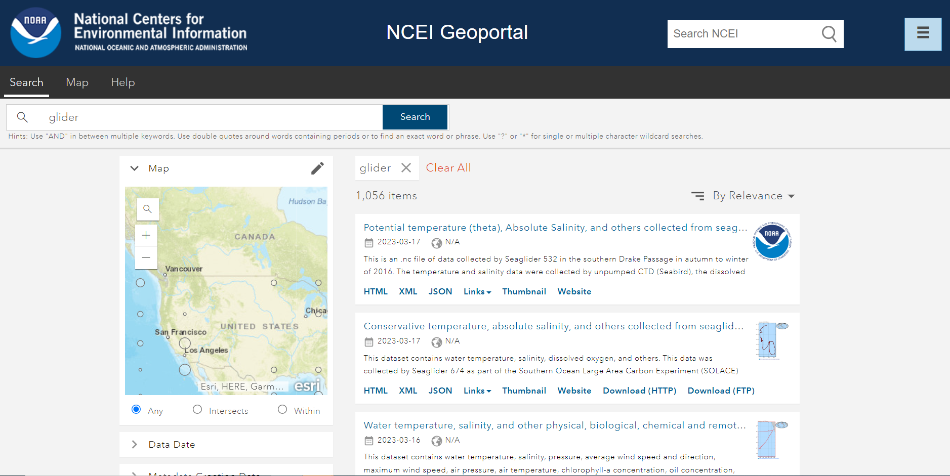
Metadata Curation
Data Discovery
Data Accessibility
Data Interoperability

Slide 12


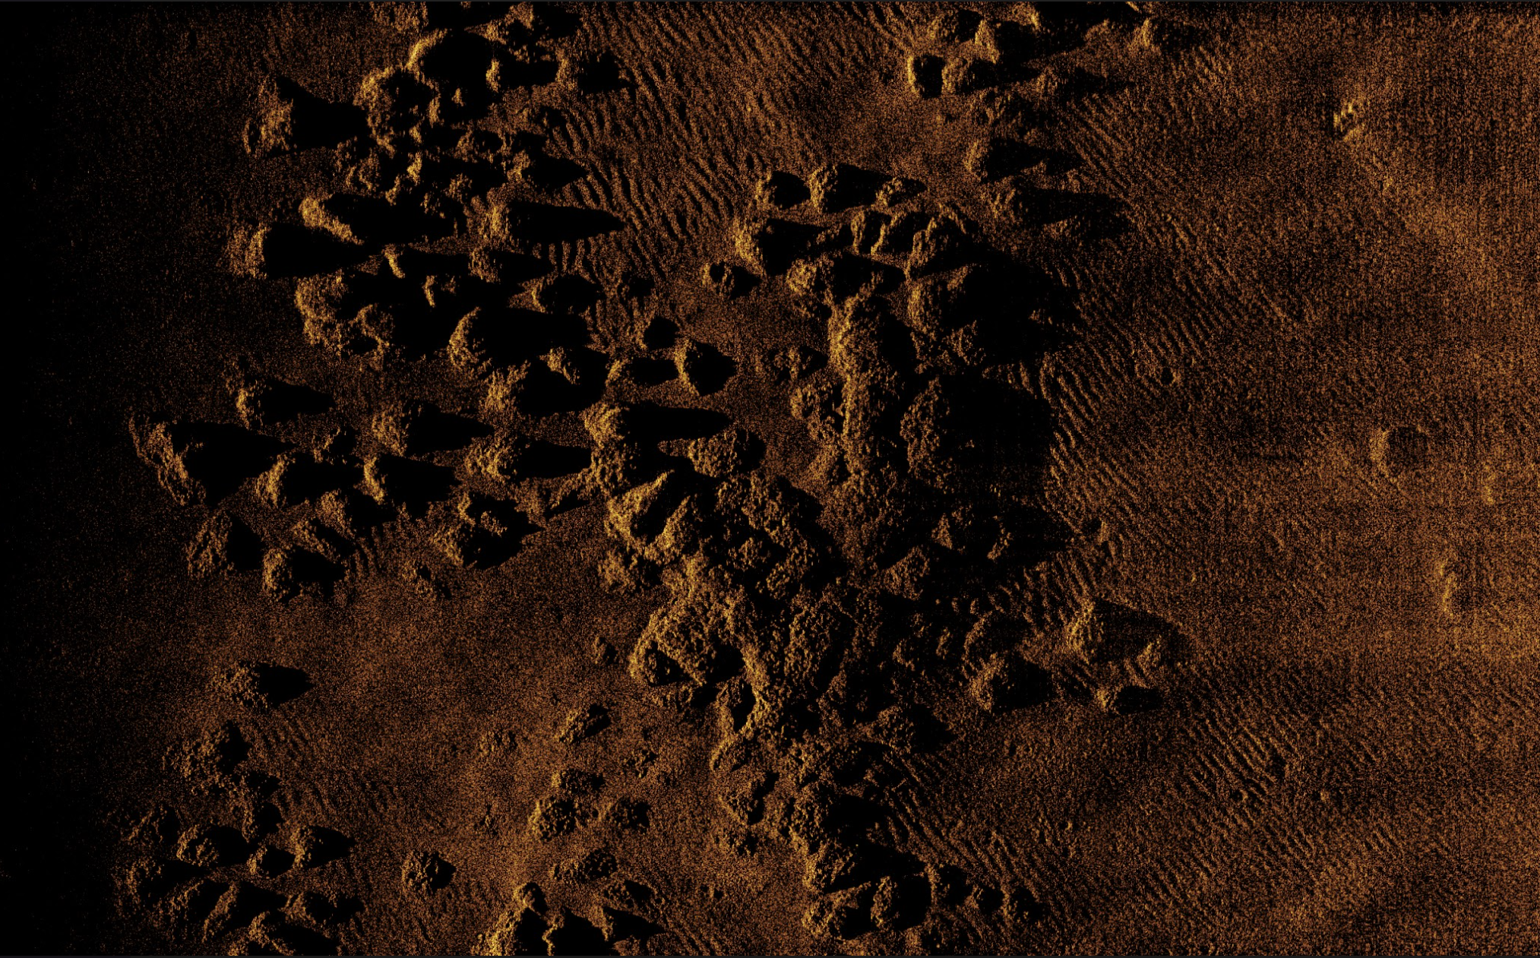


Leveraging Standardized Data and Metadata
Automated UxS Data Processing Capabilities
Data Scan and Pre-processing
Metadata
Visualization
Format
Store
Data Upload
Drop Zone
(.zip)
Standard Schema Format
Generate Standard XML
Navigation Tracks
Coverage Polygons
Sonar Mosaics
Standard File Format
QC
Standard corrections
Raw Data
Web accessible file
Links to file
Discoverable
STORAGE
UxS Data Output
NetCDF (.nc)
UNISIPS (.u)
Raw Sensor Data
WMS, KML
Public
USA
Photo courtesy of Tim Batista, Erik Ebert and Chris Taylor of NOAA NOS
Searchable Keyword Enabled Archives
Data as a Service (DaaS)

Slide 13
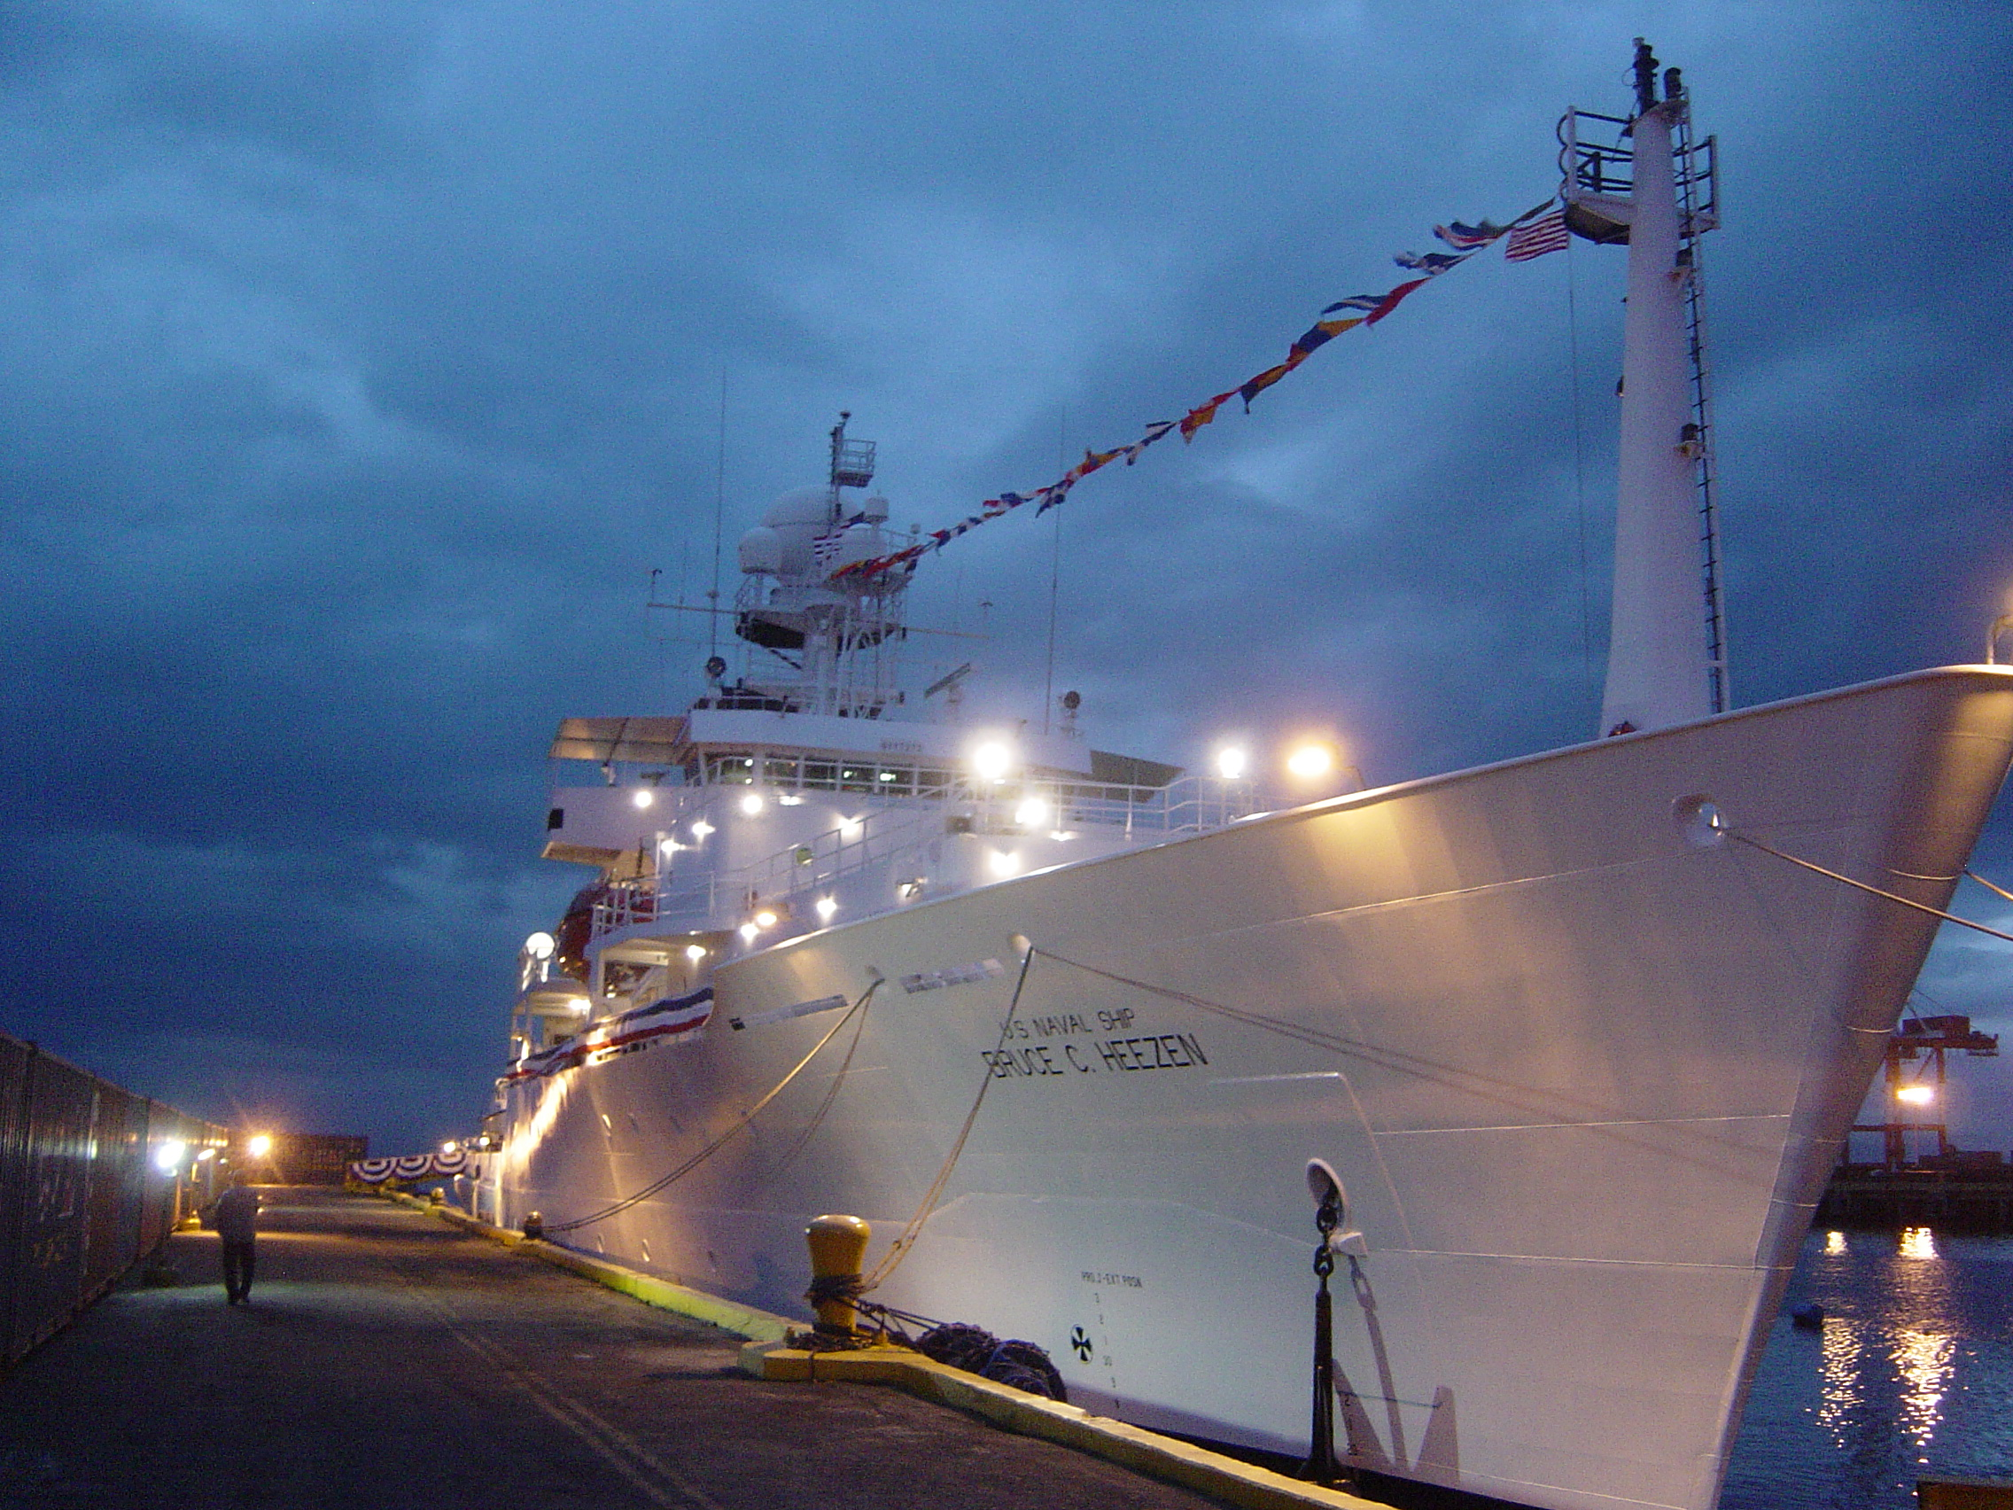


Naval Oceanography
@NavyOceans
@CNMOC
@NavalOceanography
QUESTIONS?
Naval Meteorology and Oceanography Command
1100 Balch Boulevard
Stennis Space Center, MS 39529-5005

