Slide 1
RNA-Seq – basic pipeline
Carrie Ganote
Le-Shin Wu
Tom Doak
Ram Podicheti

Slide 2
Broad overview
Raw Data
Quality Control
Is there a good reference genome?
No
Yes
Assembly
Trinity
Tophat+Cufflinks
Hisat + Stringtie
Quantification
RSEM/eXpress
Cuffdiff
Ballgown
Expression
EdgeR/DeSeq
cummeRbund
Kallisto
Annotation
Trinotate
Maker
Notes:
Historical significance

Slide 3
FASTQ Format
@CCRI0219:135:D243EACXX:1:1101:1682:1955 1:N:0:ACAGTG
CGTTCAGTCATAATCCAGCGCACGGTAGCTTCGCGCCACTGGCTTTTCAA
+
@@?DFFFFHGHHHIJJJJIIJJJJIHGHIEIIIFIEI>BHIJIIJIJEGI
Sequence Identifier
Read Sequence (A, G, T, C, N)
‘+’ character (Can be followed by the same Sequence Identifier from Line1)
Base Quality Scores (Phred33) for the sequence in Line2 (Must contain the same number of characters as those in the sequence)
Notes:
Historical significance

Slide 4
Quality Scores
Sequencers estimate the probability that a given base call is NOT correct
P | -10*log10(p) | Est. Accuracy = 1-P
0.1 | 10 | 0.9
0.01 | 20 | 0.99
0.001 | 30 | 0.999
0.0001 | 40 | 0.9999
P = probability call is not correct
PHRED Score is defined as q = -10 x log₁₀(p) (Erwing 1998)

Slide 5
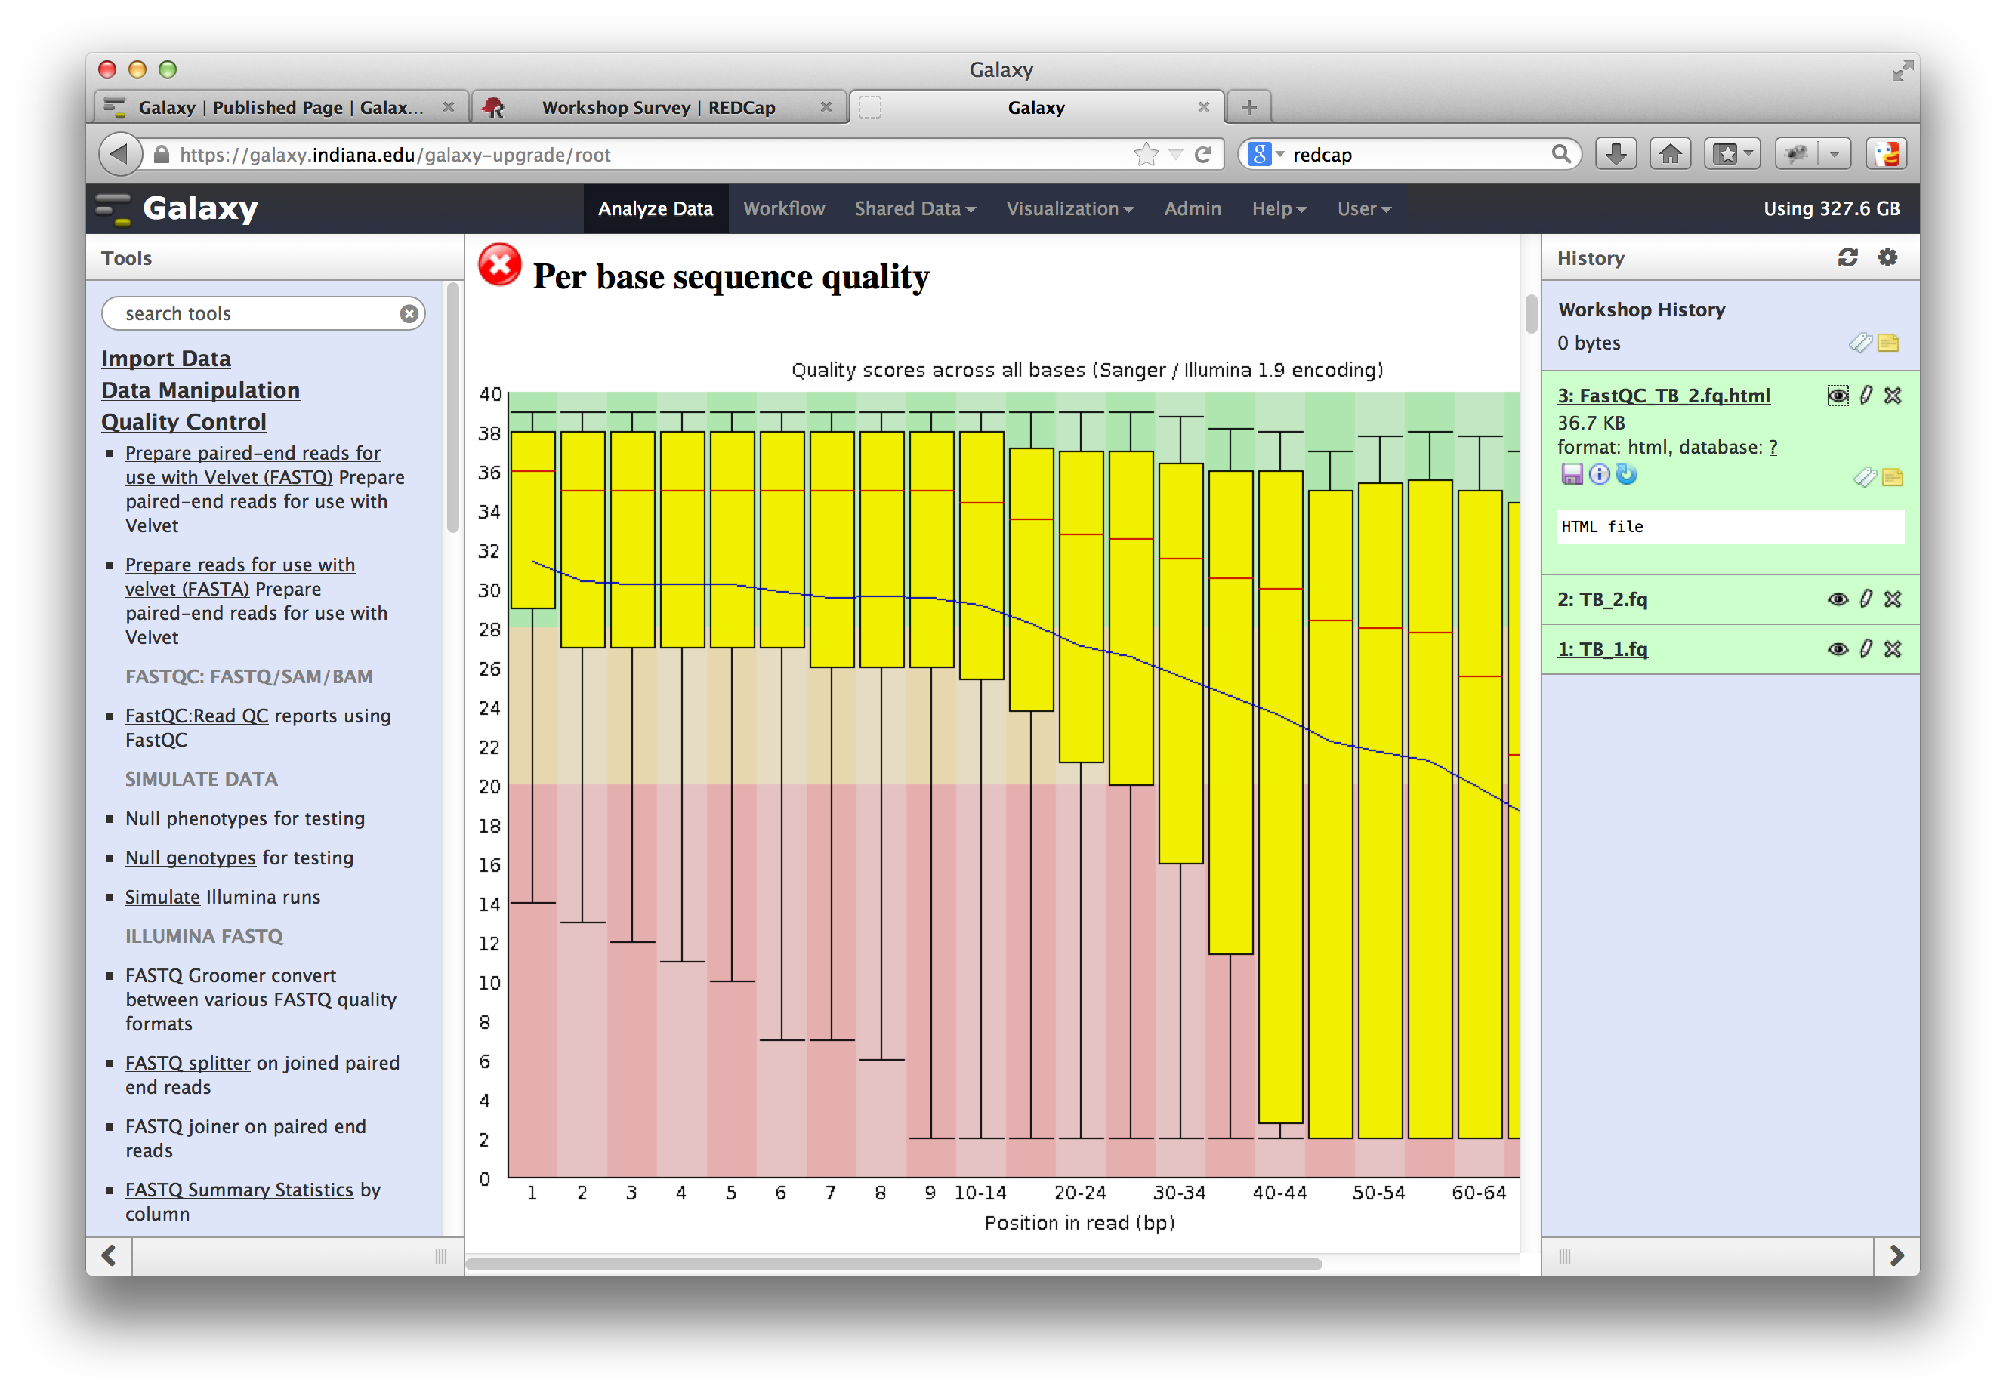
Quality Scores
FastQC is an excellent program for visualizing the overall quality of all reads in a fastq file
FastQC is developed by the Babraham Bioinformatics Group: http://www.bioinformatics.babraham.ac.uk
Notes:
Explain box and whisker plot, explain the per bas position thing

Slide 6
Trimming Based on Quality
Wholesale cutting by base position

Slide 7
Trimming Based on Quality
Sliding windows and minimum vs. average quality scores
25
36
2
ACGAAAACGGTGAGGCCT
::::::EEEEEE######
Average:
Min:
Max:
25
25
25
Target:
Average below 20

Slide 8
Trimming Based on Quality
Sliding windows and minimum vs. average quality scores
25
36
2
ACGAAAACGGTGAGGCCT
::::::EEEEEE######
Step Size = 5
Window Size = 6
Average:
Min:
Max:
34.2
25
36
Target:
Average below 20

Slide 9
Trimming Based on Quality
Sliding windows and minimum vs. average quality scores
25
36
2
ACGAAAACGGTGAGGCCT
::::::EEEEEE######
Step Size = 5
Window Size = 6
Average:
Min:
Max:
13.3
2
36
Target:
Average below 20

Slide 10

Trimming Based on Quality
Sliding windows and minimum vs. average quality scores
25
36
2
ACGAAAACGGTGAGGCCT
::::::EEEEEE######
Step Size = 5
Window Size = 6
Average:
Min:
Max:
13.3
2
36
Target:
Average below 20

Slide 11
Trimming Software
Trimmomatic
Trim Galore! developed by the Babraham Bioinformatics Group: http://www.bioinformatics.babraham.ac.uk
FASTX Toolkit http://hannonlab.cshl.edu/fastx_toolkit

Slide 12
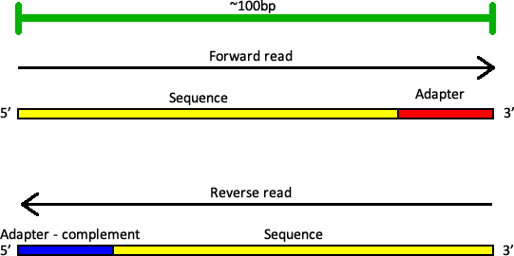
Primers and Adapters
When fragments are shorter than total length of the read, adapters will be sequenced on both mates of a paired-end read.
For example, if we use technology that can sequence up to 100 bp:

Slide 13
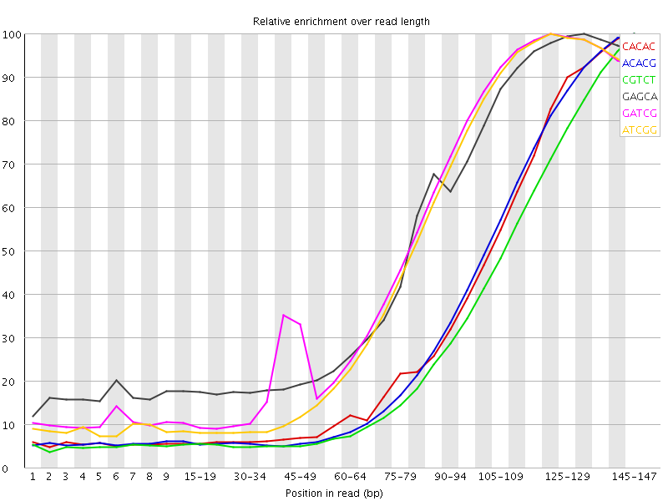
Primers and Adapters
When to suspect this:
Patterns toward ends of reads

Slide 14
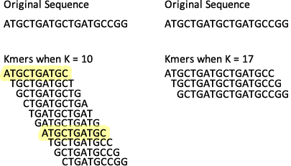
Kmers
What’s a Kmer?
For a given sequence and a number, K, how many sub-sequences of length K are there?
Notes:
Original is 19 bp

Slide 15
Primers and Adapters
Software for removing adapters
Cutadapt
FASTX-Toolkit http://hannonlab.cshl.edu/fastx_toolkit
Scythe https://github.com/ucdavis-bioinformatics/scythe

Slide 16
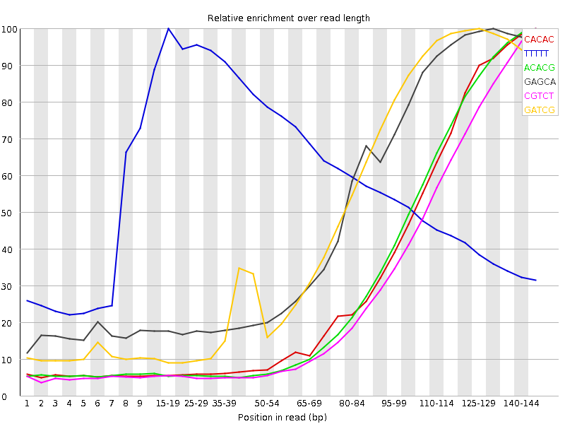
Poly-A Tails and Other Artifacts
Library Prep – retained and sequenced poly-As/poly-Ts
When to suspect this:

Slide 17
Poly-A Tails and Other Artifacts
PRINSEQ for trimming poly-Ts – takes a % of the read that contains T’s and sorts them out
Conservatively, 60% of a read is T? Kick it out.
Filter on % base, sequence complexity, duplicates

Slide 18

Assembly
Trinity remains the best de novo RNA-Seq assembler.
Bo Li, Nathanael Fillmore, Yongsheng Bai, Mike Collins, James A. Thompson, Ron Stewart, Colin N. Dewey. Evaluation of de novo transcriptome assemblies from RNA-Seq data.

Slide 19
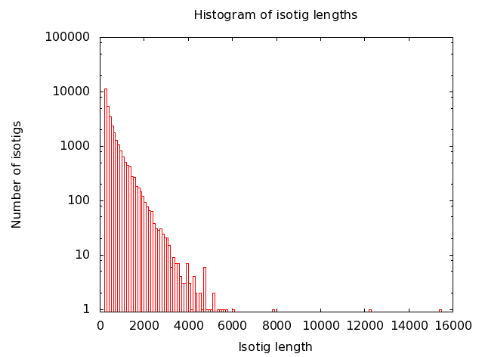
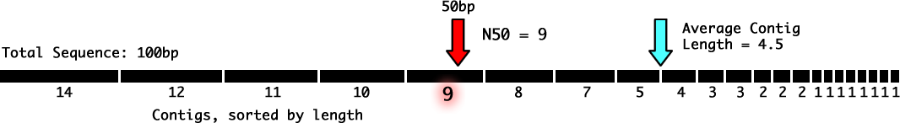
Assessing Quality of Assembly
Important statistics for assembly quality:
Contig Length Distribution
Assemblies will typically produce a number of complete contigs representing whole transcripts, and a large number of partial transcripts. This biases the average contig length toward the low end. The N50 is a measure weighted by total sequence length in the assembly.
Notes:
I would move this to later, and put it under something like: what goes wrong!

Slide 20
Assessing Quality of Assembly
Important statistics for assembly quality:
Contig Length Distribution
Assemblies will typically produce a number of complete contigs representing whole transcripts, and a large number of partial transcripts. This biases the average contig length toward the low end. The N50 is a measure weighted by total sequence length in the assembly.
Notes:
I would move this to later, and put it under something like: what goes wrong!

Slide 21

Assessing Quality of Assembly
Certain genes will be conserved amongst most members of large groups of organisms, such as all arthropods, fungi, plants.
These should also be present in most tissues.
Search for these in your assembly to make sure they were recovered using Busco.
Notes:
I would move this to later, and put it under something like: what goes wrong!

Slide 22
References
Ewing B, Green P (1998). "Base-calling of automated sequencer traces using phred. II. Error probabilities". Genome Res. 8 (3): 186–194. doi:10.1101/gr.8.3.186. PMID 9521922.
Trimmomatic: Bolger, A. M., Lohse, M., & Usadel, B. (2014). Trimmomatic: A flexible trimmer for Illumina Sequence Data. Bioinformatics, btu170.
Cutadapt: Martin, M. (2011). Cutadapt removes adapter sequences from high-throughput sequencing reads. 2011, 17(1). doi: 10.14806/ej.17.1.200 pp. 10-12
BUSCO: assessing genome assembly and annotation completeness with single-copy orthologs. Felipe A. Simão, Robert M. Waterhouse, Panagiotis Ioannidis, Evgenia V. Kriventseva, and Evgeny M. Zdobnov Bioinformatics, published online June 9, doi: 10.1093/bioinformatics/btv351
PRINSEQ: Schmieder R and Edwards R: Quality control and preprocessing of metagenomic datasets. Bioinformatics 2011, 27:863-864. [PMID: 21278185]
Cufflinks: Trapnell, C., Hendrickson, D. G., Sauvageau, M., Goff, L., Rinn, J. L., and Pachter, L. (2013). Differential analysis of gene regulation at transcript resolution with RNA-seq. Nature biotechnology, 31(1):46-53.
HISAT: Kim, D., Langmead, B., and Salzberg, S. L. (2015). HISAT: a fast spliced aligner with low memory requirements. Nat Meth, 12(4):357-360.
Ballgown: Bray, N., Pimentel, H., Melsted, P., and Pachter, L. (2015). Near-optimal RNA-seq quantification.

Slide 23
Fin
Thanks for watching!
Questions and comments:
Email help@ncgas.org

