Slide 1
Efficient and Robust Schemes for Accuracy-Guaranteed Sensor Data Aggregation
Yao-Chung Fan
Multimedia and Knowledge Engineering Lab
The Department of Computer Science
National Tsing Hua University
Advisor: Prof. Arbee L.P. Chen

Slide 2
Outline
Background
Problem Formulation
The Proposed Solutions
Performance Evaluation
Conclusion
Notes:
Go over, and concisely point idea

Slide 3
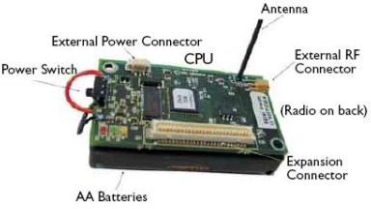
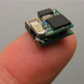
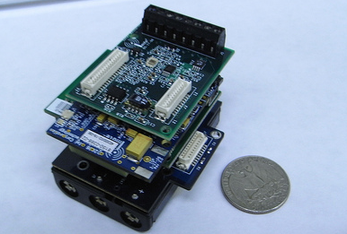
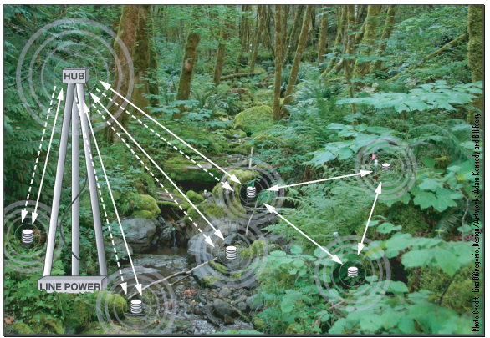
Sensor Networks
Sensor nodes
  Tiny computers with:
    Sensing hardware
    Radios
Sensor network
  A collection of sensor nodes
  Various applications
    Environmental monitoring
    Surveillance
Notes:
First, I give a brief introduction to sensor networks
In general, a sensor network is a group of sensor nodes.
And you can think the sensor node as a tiny computer, with computation, memory, and communication abilities.
However, there are three features that make sensors different to typical computers.
First, sensor node often are equipped with a sensing device to take reading from physical world, such as temperature and light readings,
Second, sensor nodes often are powered by batteries. Once the battery is run out of, the sensor node become useless.
Third, sensor nodes communicate via radio, among each other.
Sensor networks provide a new way of collecting data.

Slide 4



Sensor Data Aggregation
Statistical aggregates such as Sum and Avg over the readings of a group of sensor nodes are often needed in sensor application.
Possible applications are the average reading reporting, the number of active sensor counting, and the maximal noxious-gas density region finding.
Sum, Avg, Max, Histogram, …
Notes:
統計值

Slide 5

Challenges on Sensor Data Aggregation
Resource-constrained
  Batteries
  Power conservation
  Tree-based Aggregation
5
10
100
30
Notes:
Here I provide an example to show the problem we want to solve
Given a sensor network, each node has a single sensed value.
In this environment, we often need to answer the aggregate query for this network.
For example, what is the maximum reading for this network?
To answer the query, we can compute the aggregate along a spanning tree.
The base idea for the compuation is first to form a spanning tree that connects the whole network.
And then, for each node sends max value they observed to their parents.
The aggregate computation proceeds level-by-level from the leaves to the root.
Keep the same track, eventually, we can get the max value at the root.
However, Here comes a problem.
A major shortcoming with the tree-based aggregation is that it is not robust against communication failures, which are common in sensor networks.
For instance, at here, if this value is dropped, the max value will change to 5 instead of one hundred, which is very inaccurate.
However, In a real sensor network, it does happen.

Slide 6


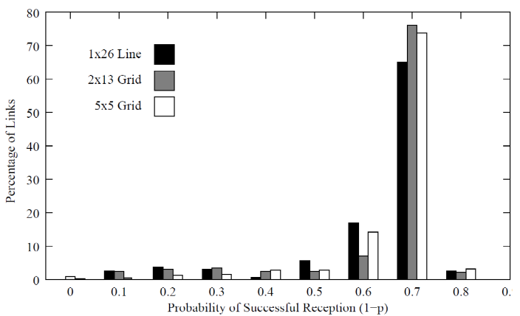
Challenges on Sensor Data Aggregation
Resource-constrained
  Batteries
  Power conservation
  Tree-based Aggregation
Failure-prone communication
  The communication between sensor nodes usually provides only limited quality of services.
145
5
140
10
5
10
130
30% loss rate
5
10
100
30
TODS04
5
10
100
30
Notes:
Here I provide an example to show the problem we want to solve
Given a sensor network, each node has a single sensed value.
In this environment, we often need to answer the aggregate query for this network.
For example, what is the maximum reading for this network?
To answer the query, we can compute the aggregate along a spanning tree.
The base idea for the compuation is first to form a spanning tree that connects the whole network.
And then, for each node sends max value they observed to their parents.
The aggregate computation proceeds level-by-level from the leaves to the root.
Keep the same track, eventually, we can get the max value at the root.
However, Here comes a problem.
A major shortcoming with the tree-based aggregation is that it is not robust against communication failures, which are common in sensor networks.
For instance, at here, if this value is dropped, the max value will change to 5 instead of one hundred, which is very inaccurate.
However, In a real sensor network, it does happen.

Slide 7
Related Work [TODS09][TOSN08]
235
Multi-path routing enhances the robustness by having each node broadcasts its reading to multiple neighbors.
The robustness comes from the duplicates and only when all the duplicates fail the reading gets lost.
However, the multi-path routing suffers from the problem of overcounting readings.
For some aggregates, if more than one of the duplicates arrives the base station, the reading will be overcounted.
125 110
15 110 110 130
5 10 10
100 100 30
5
10
100
30
Notes:
Multi-path 的好處

Slide 8
Related Work [TODS09][TOSN08]
Multi-path based aggregation further employs techniques that avoid overcounting sensor readings.
Duplicate-insensitive property
a duplicate-insensitive function S( )
with the following two properties:
S(v₁)+S(v₁)=S(v₁)
S(v₁)+S(v₂)=S(v₁+v₂)
5
10 10
100
(A, 5)
(B, 10)
(C, 100)
A
B
C
5
10
100
5
10
100

Slide 9
The Framework
Sensor Reading Representation
  A synopsis to represent a sensor reading.
Addition Operation
  A function to add two given synopses.
Query Answering
  A procedure to derive the result from a given synopsis.
synopsis
synopsis
synopsis
synopsis
synopsis
synopsis
synopsis
synopsis
synopsis
synopsis
5
10
100
30
Notes:
Focus on the design of duplicate-insensitive synopses

Slide 10
The Problem Formulation
The goal: an (ε, δ)-approximation
  Compute the aggregate n = f (v₁, v₂, ..., v_{k}) under the tolerance that the error in reporting n must be within the interval [n - εn, n + εn] with probability at least (1- δ).
For example
if n = 100 and (ε, δ) = ( 0.1, 0.1 ),
then report an approximation within [90, 110]
with probability 0.9.
n | Sum aggregate
k | Number of sensor nodes
ε, δ | Error parameters
n- εn
n+εn
n
90
110

Slide 11

Outline
Background
Problem Formulation
The Proposed Solutions
  Linear Counting (TODS90)
  Super Linear Counting
  Scalable Counting
  Scalable Counting with Suppression
  Flexible Counting
Performance Evaluation
Conclusion
synopsis

Slide 12



Linear Counting (1/2)
S(v₁)+S(v₁)=S(v₁)
S(v₁)+S(v₂)=S(v₁+v₂)
Sensor Reading Representation
Addition Operation
A
4 = 1 + 1 + 1 +1
1 | 0 | 1 | 0 | 0 | 1 | 0 | 0
0
0
0
0
0
0
0
0
1 | 0 | 0 | 0 | 0 | 0 | 0 | 0
0 | 0 | 0 | 0 | 0 | 0 | 0 | 0
1 | 0 | 0 | 0 | 0 | 1 | 0 | 0
1/8 1/8 1/8 1/8 1/8 1/8 1/8 1/8
1 | 0 | 1 | 0 | 0 | 1 | 0 | 0
1/8 1/8 1/8 … 1/8
A
4 = 1 + 1 + 1 +1
B
4 = 1 + 1 + 1 +1
1
0
1
0
0
1
0
0
0
1
1
0
1
0
0
1
S(V_{A})
S(V_{A})
1
1
0
0
1
1
0
0
0
0
1
1
0
0
0
0
=
+
=
+
1
1
1
0
1
1
0
0
1
0
1
1
0
0
1
S(V_{A})
0
S(V_{B})
S(V_{A})
0
S(V_{A}+V_{B})
1
1
0
1
1
0
0
1
0
1
0
0
0
1
0
Notes:
隨機且均勻hash

Slide 13
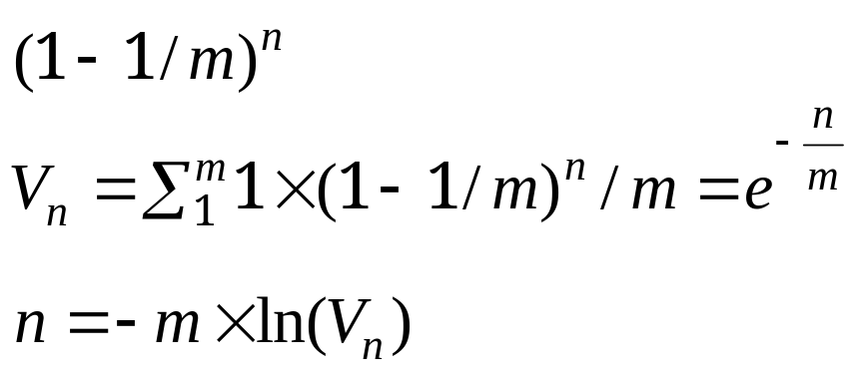



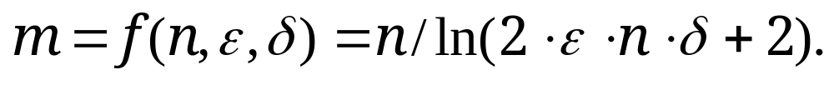
Linear Counting (2/2)
Query Answering
Space Allocation
1
1
1
0
1
1
0
1
m=8
V_{n}=2/8
m
n | Sum aggregate
ε, δ | Error parameters
m | Sketch size
V_{n} | Zero-bit fraction

Slide 14
Base Station
V_{B}=0
B
C
V_{C}=1
0
0
0
0
0
0
1
0
A
V_{A}=2
0
0
1
0
1
0
0
0

Slide 15

Base Station
0
0
1
0
1
0
1
0
0
0
1
0
1
0
0
0
0
0
1
0
1
0
1
0
V_{B}=0
B
C
V_{C}=1
=
0
0
1
0
1
0
1
0
+
0
0
0
0
0
0
1
0
0
0
1
0
1
0
0
0
A
V_{A}=2
O(n)
Energy-limitation Concern

Slide 16
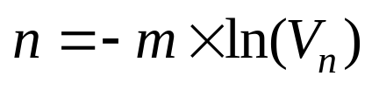
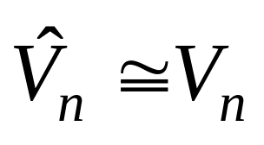
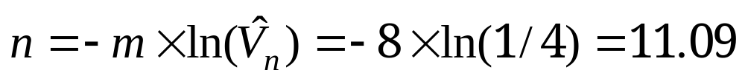
Super Linear Counting
An observation in using linear counting
Base Station
m=8
V_{n}=2/8
1
1
1
0
1
1
0
1
V_{n}=1/4
How about the (ε, δ)-approximation ?

Slide 17
Base Station
V_{B}=0
B
C
V_{C}=1
0
0
0
0
0
0
1
0
A
V_{A}=2
0
0
1
0
1
0
0
0

Slide 18

Base Station
0
0
1
0
0
0
1
0
0
0
1
0
V_{B}=0
B
C
V_{C}=1
=
0
0
1
0
0
0
0
0
+
0
0
1
0
A
V_{A}=2
O(n)

Slide 19
Outline
Background
Problem Formulation
The Proposed Solutions
  Linear Counting
  Super Linear Counting
  Scalable Counting
  Scalable Counting with Suppression
  Flexible Counting
Performance Evaluation
Conclusion

Slide 20
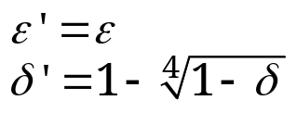


Scalable Counting
0
0
0
0
0
0
0
0
0
0
0
0
0
0
0
0
0
0
0
0
0
0
0
0
Sensor Reading Representation
Addition Operation
Query Answering Operation
1
0
0
0
0
0
0
1
0
11=(1011)₂
2
0
0
1
0
0
0
0
0
4
0
0
0
0
0
0
0
0
8
1
0
0
0
0
0
0
0
0
0
0
0
0
0
1
0
1
0
0
1
0
0
0
0
0
2
1·D₁ + 2·D₂ + 4·D₄ + 8·D₈ = Answer
0
0
0
0
0
0
0
0
4
1
0
0
0
0
0
0
0
8

Slide 21
Base Station
SC_{B}
SC_{C}
B
C
11 = (1 0 1 1)₂
5 = (0 1 0 1)₂
A
8 = (1 0 0 0)₂

Slide 22
Base Station
SC_{B}
SC_{C}
B
C
11 = (1 0 1 1)₂
0
0
0
0
0
0
1
0
2⁰
5 = (0 1 0 1)₂
0
0
1
0
0
0
0
0
2⁰
0
0
1
0
0
0
0
0
2¹
0
0
0
0
0
0
0
0
2¹
0
0
0
0
0
0
0
0
2²
0
0
0
0
1
0
0
0
2²
1
0
0
0
0
0
0
0
2³
0
0
0
0
0
0
0
0
2³
A
SC_{A}
8 = (1 0 0 0)₂
0
0
0
0
0
0
0
0
2⁰
0
0
0
0
0
0
0
0
2¹
0
0
0
0
0
0
0
0
2²
0
0
0
0
0
0
1
0
2³

Slide 23
Base Station
SC_{A+B}
SC_{A+C}
0
0
0
0
0
0
1
0
2⁰
0
0
1
0
0
0
0
0
2⁰
0
0
1
0
0
0
0
0
2¹
0
0
0
0
1
0
0
0
2²
1
0
0
0
0
0
1
0
2³
0
0
0
0
0
0
1
0
2³
B
C
SC_{C}
SC_{A+C}
0
0
1
0
0
0
0
0
2⁰
0
0
1
0
0
0
0
0
2⁰
SC_{A}
2¹
2¹
+
0
0
0
0
0
0
0
0
0
0
0
0
0
0
0
0
=
0
0
0
0
0
0
1
0
2³
0
0
0
0
1
0
0
0
2²
0
0
0
0
1
0
0
0
2²
0
0
0
0
0
0
0
0
2³
0
0
0
0
0
0
1
0
2³
A
SC_{A}
8 = (1 0 0 0)₂
0
0
0
0
0
0
0
0
2⁰
0
0
0
0
0
0
0
0
2¹
0
0
0
0
0
0
0
0
2²
0
0
0
0
0
0
1
0
2³

Slide 24
An Observation
0
0
0
0
0
0
0
0
0
0
0
0
0
0
0
0
0
0
0
0
0
0
0
0
Sensor Reading Representation
1
0
0
0
0
0
0
1
0
67=(1000011)₂
2
0
0
1
0
0
0
0
0
4
0
0
0
0
0
0
0
0
:
64
1
0
0
0
0
0
0
0
To reduce the communication cost !!
0
0
0
0
0
0
1
0
1
0
0
1
0
0
0
0
0
2
1·D₁ + 2·D₂ + 4·D₄ + 64·D₆₄ = Answer
0
0
0
0
0
0
0
0
4
insignificant !?
1
1
0
1
1
0
0
0
64

Slide 25
An Observation (2/2)
Case 1
Case 2
0
0
0
0
0
0
1
0
1
0
0
1
0
0
0
0
0
2
1·D₁ + 2·D₂ + 4·D₄ + 2¹⁰·D₁₀₂₄ = Answer
:
1
0
0
0
0
0
0
0
1024
0
0
0
0
0
0
1
0
1
0
0
1
0
0
0
0
0
2
1·D₁ + 2·D₂ + 4·D₄ + 64·D₆₄ = Answer
0
0
0
0
0
0
0
0
4
1
1
0
1
1
0
0
0
64

Slide 26


Scalable Counting with Suppression
Sensor Reading Representation
Suppression Error
67 = (1 0 0 0 0 1 1)₂
0
0
0
0
0
0
1
0
2⁰
0
0
1
0
0
0
0
0
2¹
:
:
1
0
0
0
0
0
0
0
0
0
0
0
2⁶
n-εn
n+εn
If reduced error >
suppression error
n
Then, suppress!
Reduced Error
n

Slide 27
The Error Analysis
The suppression error
The reduced error
0
0
0
0
0
0
1
0
2^{x}
Suppression Error = 2^{x}×k
1
0
1
0
0
1
0
0
1
0
0
0
2^{y}
Reduced Error = ½ × ε ×2^{y}×D_{y}
½ ×ε ×D_{y}
D_{y}
ε ×D_{y}

Slide 28
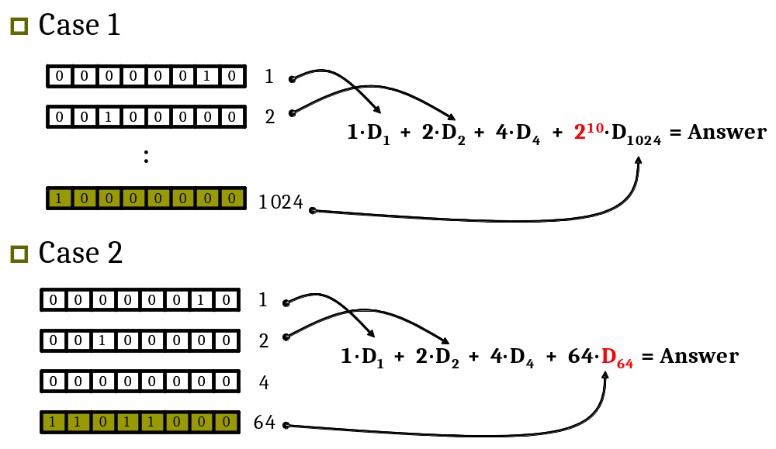
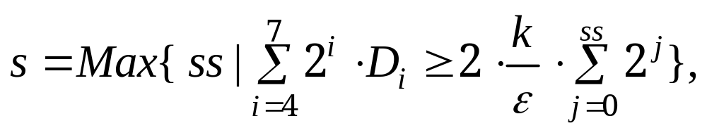
The Suppression Operation
2⁰
2¹
2²
2³
2⁴
2⁵
2⁶
2⁷

Slide 29
Base Station
B
C
67 = (1 0 0 0 0 1 1)₂
66 = (1 0 0 0 0 1 0)₂
A
65 = (1 0 0 0 0 0 1)₂

Slide 30
Base Station
ASC_{B}
B
C
ASC_{C}
67 = (1 0 0 0 0 1 1)₂
66 = (1 0 0 0 0 1 0)₂
2⁰
0
0
0
0
0
0
1
0
2⁰
0
0
0
0
0
0
0
0
0
0
1
0
0
0
0
0
2¹
0
0
0
0
0
0
0
1
2¹
:
:
:
:
1
0
0
0
0
0
0
0
0
0
0
0
2⁶
0
1
0
0
0
0
0
0
0
0
0
0
2⁶
A
ASC_{A}
65 = (1 0 0 0 0 0 1)₂
1
0
0
0
0
0
0
0
2⁰
0
0
0
0
0
0
0
0
2¹
:
:
0
0
0
0
0
0
1
0
0
0
0
0
2⁶

Slide 31
Base Station
B
C
ASC_{C}
ASC_{A+C}
ASC_{A}
0
0
0
0
0
0
0
0
2⁰
=
1
0
0
0
0
0
0
0
2⁰
1
0
0
0
0
0
0
0
2⁰
+
0
0
0
0
0
0
1
0
0
0
0
0
2⁶
0
0
0
0
0
0
0
1
2¹
0
0
0
0
0
0
0
1
2¹
:
:
:
:
0
1
0
0
0
0
0
0
0
0
0
0
2⁶
0
1
0
0
0
0
1
0
0
0
0
0
2⁶
A
ASC_{A}
65 = (1 0 0 0 0 0 1)₂
1
0
0
0
0
0
0
0
2⁰
0
0
0
0
0
0
0
0
2¹
:
:
0
0
0
0
0
0
1
0
0
0
0
0
2⁶

Slide 32
Base Station
ASC_{A+C}
B
C
1
0
0
0
0
0
0
0
2⁰
64×2 = 128
2×3×10×(2⁰) = 60
128 > 60
0
0
0
0
0
0
0
1
2¹
:
:
0
1
0
0
0
0
1
0
0
0
0
0
2⁶
s = 0
A

Slide 33
Base Station
ASC_{A+B}
ASC_{A+C}
0
0
1
0
0
0
0
0
2¹
0
0
0
0
0
0
0
1
2¹
1
0
0
0
0
0
1
0
0
0
0
0
2⁶
0
1
0
0
0
0
1
0
0
0
0
0
2⁶
B
C
1
0
0
0
0
0
0
0
2⁰
64×2 = 128
2×3×10×(2⁰) = 60
128 > 60
0
0
0
0
0
0
0
1
2¹
:
:
0
1
0
0
0
0
1
0
0
0
0
0
2⁶
s = 0
A

Slide 34

Base Station
ASC_{A+B+C}
= 2⁶×(-ln(9/12))×12
+2¹×(-ln(6/8))×8 = 225.54
0
0
1
0
0
0
0
1
2¹
1
1
0
0
0
0
1
0
0
0
0
0
2⁶
B
C
A

Slide 35

Summarize so far
Linear Counting
Super Linear Counting
Scalable Counting
Scalable Counting with suppression
O(n)
O(n)
11
1
1
0
1
1
1
0
1

Slide 36
Summarize so far
Linear Counting
Super Linear Counting
Scalable Counting
Scalable Counting with suppression
O(n)
O(n)
O(k·log₂v_{max})
1
0
0
0
0
0
0
1
0
11=(1011)₂
11
2
0
0
1
0
0
0
0
0
4
0
0
0
0
0
0
0
0
8
1
0
0
0
0
0
0
0

Slide 37
Summarize so far
Linear Counting
Super Linear Counting
Scalable Counting
Scalable Counting with suppression
O(n)
O(n)
O(k·log₂v_{max})
O(k·log₂v_{max})
1
0
0
0
0
0
0
1
0
11=(1011)₂
11
2
0
0
1
0
0
0
0
0
4
0
1
0
0
0
0
1
0
0
0
0
0
8
0
1
0
0
0
0
1
0
0
0
0
0

Slide 38
Flexible Counting
Sensor reading Representation
1
0
0
0
0
0
0
1
0
11=(1011)₂
2
0
0
1
0
0
0
0
0
4
0
0
0
0
0
0
0
0
8
1
0
0
0
0
0
0
0
Scalable
Counting
Super Linear
Counting
+
1
0
0
0
0
0
0
1
0
2
0
0
1
0
0
0
0
0
4
0
0
0
0
0
0
0
0
8
1
0
0
0
0
0
0
0
Flexible Counting Synopsis

Slide 39
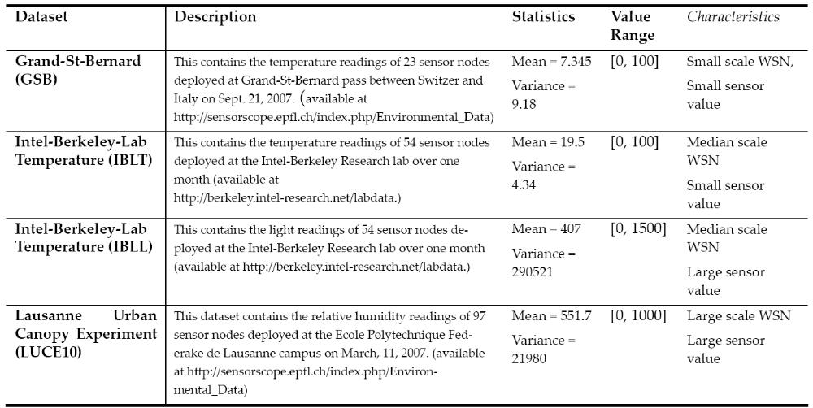
Performance Evaluation

Slide 40
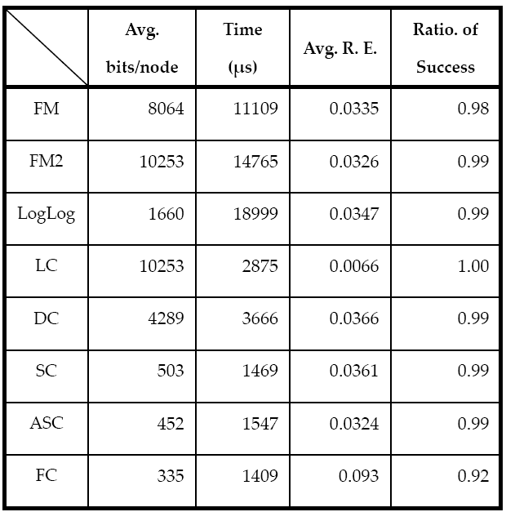
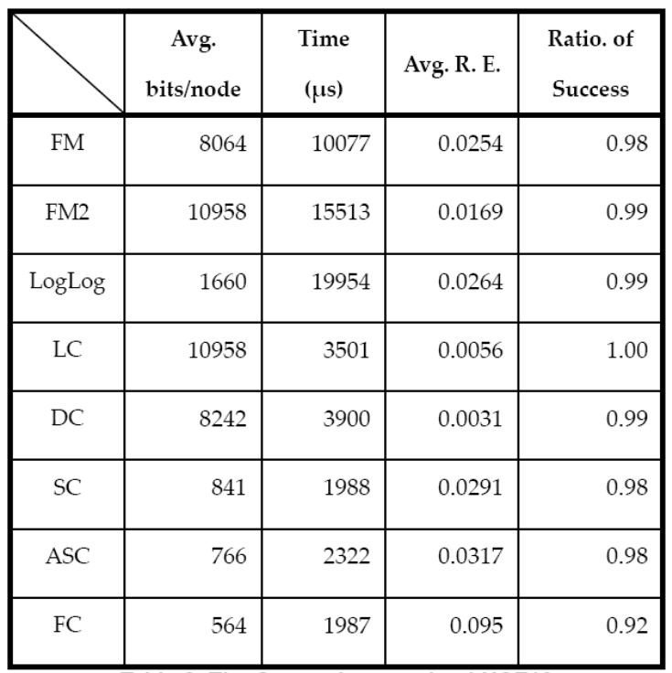
Performance Evaluation
IBLL dataset
LUCE dataset

Slide 41
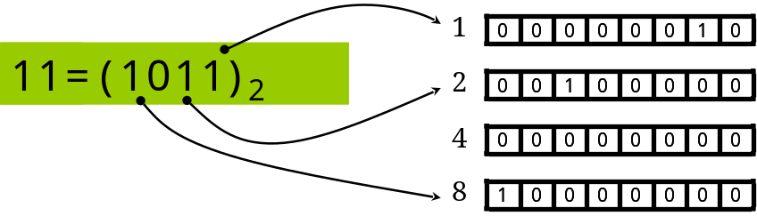

Conclusion
Scalable Counting
Contribution
Low variance
The Category of Distinct Counting Sketches
O(logv_{max}) space for use
FM-Sketches (JCSS85)
Linear Counting Sketches (TODS90)
pos
1 | 1 | 1 | 1 | 0 | 0 | 0 | 0
1/2 1/4 1/8 1/16 1/32 .. .. .. ..
high variance
O(logn) space for use
1 | 0 | 1 | 0 | 0 | 1 | 0 | 0
1/8 1/8 1/8 1/8 1/8 1/8 1/8 1/8
low variance
O(n) space for use

Slide 42
Research Map
Linear Counting Technique
  IEEE Symp. on Parallel and Distributed Processing 08 (with Student Travel Award)
  IEEE Trans. on Parallel and Distributed System
Scalable Counting Technique
  IEEE Trans. on Knowledge and Data Engineering
Super-Linear Counting, Flexible Counting Technique
  IEEE International Conference on Data Engineering 2011 (Under Review)

Slide 43

Thank you!!

