Slide 1
大數據分析: 白酒偏好預測
組員: 7111019015 蘇亮羽 Su Liang Yu, 黃柏皓
組別: 7
助教:

Slide 2
Introduction

Slide 3
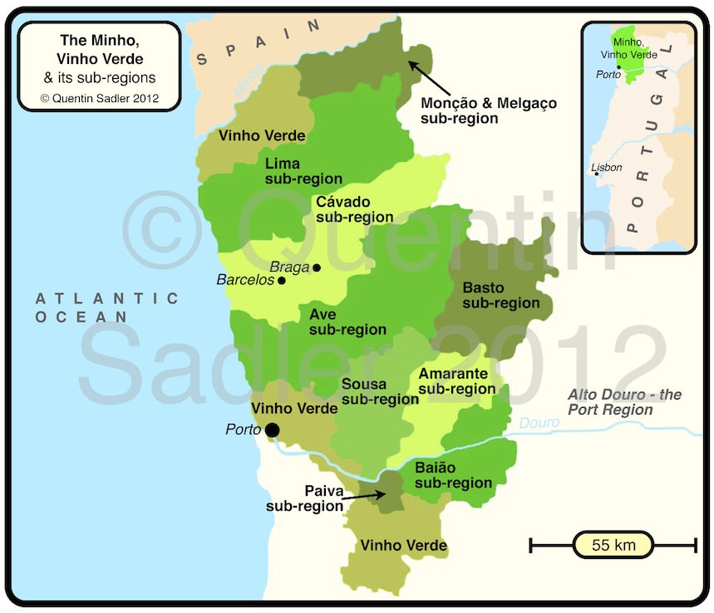

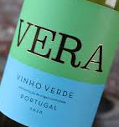



Portuguese wine - Vinho Verde
出產於葡萄牙西北部Minho的酒
受CVRVV (Comissão de Viticultura da Região dos Vinhos Verdes)規範
口感輕盈、清爽，帶有蘋果與柑橘的風味，常與當地的日常美食做搭配
認證與行銷vinho verde
希望能開發出能預測人們對vinho verde偏好程度的模型

Slide 4
Portuguese wine - Vinho Verde
出產於葡萄牙西北部Minho的酒
受CVRVV (Comissão de Viticultura da Região dos Vinhos Verdes)規範
口感輕盈、清爽，帶有蘋果與柑橘的風味，常與當地的日常美食做搭配
認證與行銷vinho verde
希望能開發出能預測人們對vinho verde偏好程度的模型

Slide 5
Material and methods

Slide 6





Data set
Collected: May/2004 ~ Feb/2007
Fixed acidity (g(tartaric acid)/dm³)
Volatile acidity (g(acetic acid)/dm³)
檸檬酸(g/dm³)
Residual sugar (g/dm³)
氯化物 (g(NaCl)/dm³)
Free SO₂(mg/dm³)
Total SO₂(mg/dm³)
Density (g/cm³)
pH
Sulphates (g( KSO₄)/dm³)
Alcohol (vol.%)
0 (terrible) ~ 10 (excellent)
Total 6497 data: 1599 rad wine and 4898 white wine

Slide 7
Performed algorithms
5-fold cross-validation
Decision tree: J48
A tree-like model where decisions are made at each node based on feature splits
Random Forest
An ensemble method that builds multiple decision trees
Boosting: AdaBoostM1
Trains model focuses on correcting the mistakes of the previous model
Logistic Regression
A linear model used for classification tasks
Support Vector Machines: SMO
Finds the hyperplane that maximizes the margin between classes

Slide 8
Evaluation Metrics: overall performance
Correctly Classified Instances:
Overall accuracy
Incorrectly Classified Instances:
Proportion of errors
Kappa Statistic:
Measures the agreement between predicted and actual classifications
Root Mean Squared Error (RMSE):
Indicates the magnitude of prediction errors
Root Relative Squared Error (RRSE):
Evaluates model performance relative to a baseline

Slide 9
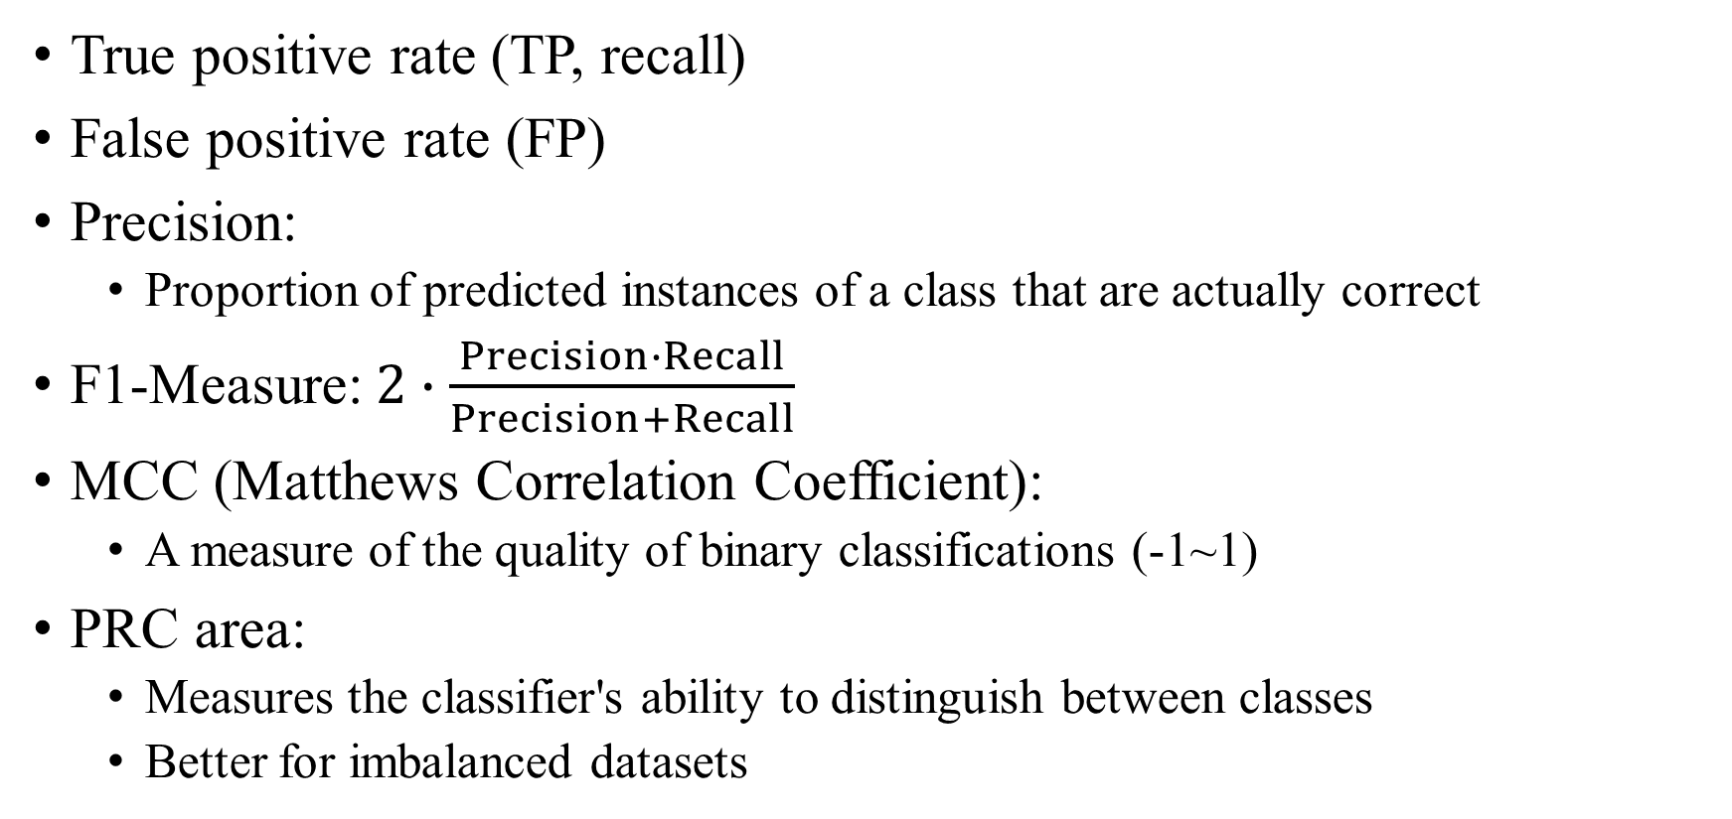
Evaluation Metrics: class-level
True positive rate (TP, recall)
False positive rate (FP)
Precision:
Proportion of predicted instances of a class that are actually correct
F1-Measure:$2∙\frac{Precision∙Recall}{Precision+Recall}$
MCC (Matthews Correlation Coefficient):
A measure of the quality of binary classifications (-1~1)
PRC area:
Measures the classifier's ability to distinguish between classes
Better for imbalanced datasets

Slide 10
Result and discussion

Slide 11
Conclusion
Random forest shows the best performance of all
Decision tree models are more suitable than linear models
Although random forest shows 80% in PRC in class 6, the prediction of other class are still need improvement

Slide 12
Conclusion

Slide 13
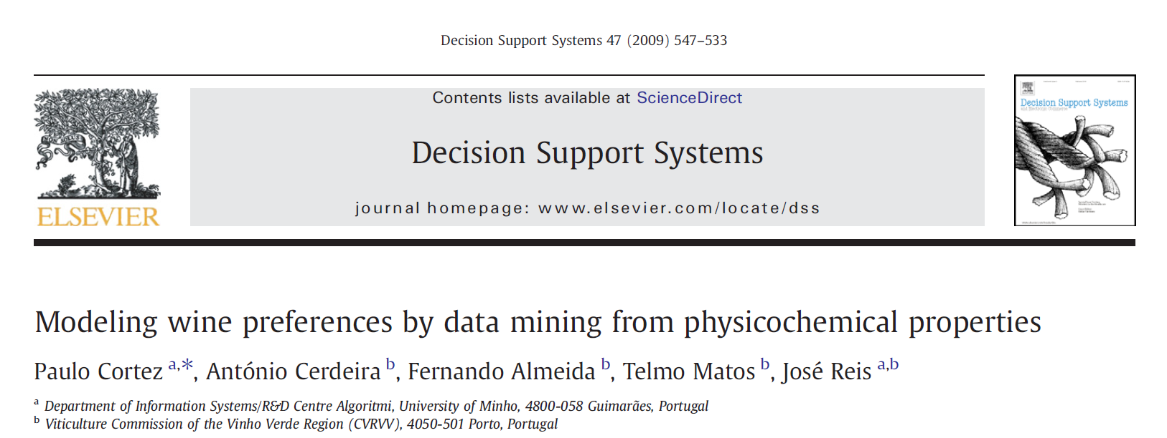
References
Paulo Cortez et al., “Modeling Wine Preferences by Data Mining from Physicochemical Properties,” Decision Support Systems 47, no. 4 (November 2009): 547–53, https://doi.org/10.1016/j.dss.2009.05.016.

Slide 14
Thanks for your attention

Slide 15
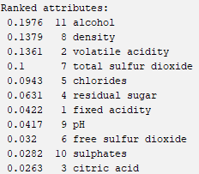
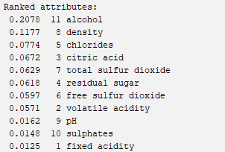
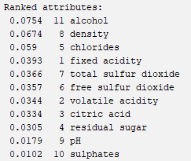
Feature selection
Pearson correlation coefficient
Information gain
Information gain ratio

Slide 16

Overall performance:
 | Logistic regression | J48 | Random forest | Adaboost | SMO
Correctly classified (%) | 50 | 53.55 | 61.31 | 44.87 | 49.08
Incorrectly classified (%) | 50 | 46.45 | 38.69 | 55.12 | 50.91
Kappa statistic | 0.1857 | 0.2933 | 0.4114 | 0.1819 | 0.1591
RMSE | 0.2978 | 0.3124 | 0.2711 | 0.3016 | 0.3182
RRSE (%) | 95.85 | 100.56 | 87.27 | 97.1 | 102.44

Slide 17

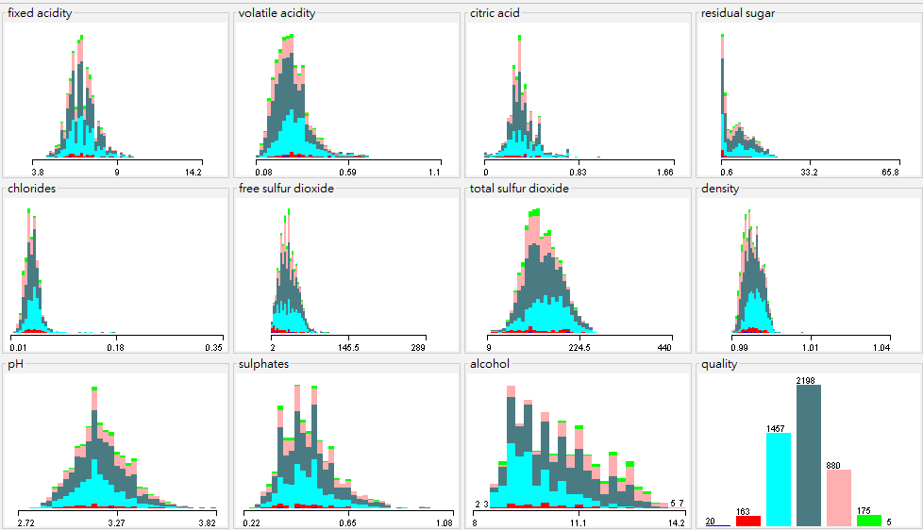
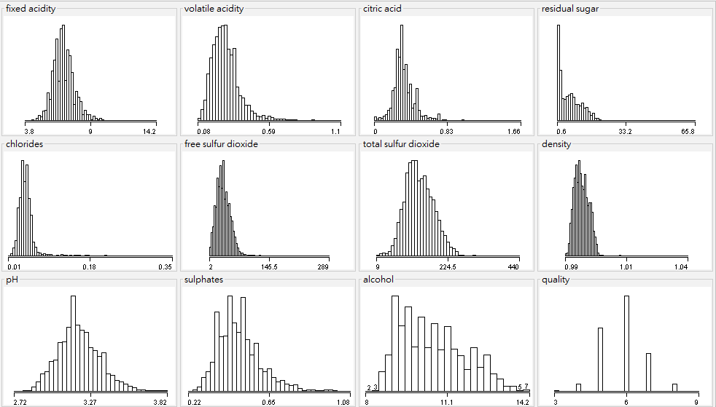
Feature format
3
4
5
6
7
8
9

Slide 18
Overall performance
DT is better than linear models
Random forest show the best performance
 | Logistic regression | J48 | Random forest | Adaboost | SMO
Correctly classified (%) | 53.67 | 58.73 | 68.72 | 63.74 | 52.24
Incorrectly classified (%) | 46.32 | 41.26 | 31.27 | 36.25 | 47.75
Kappa statistic | 0.2491 | 0.3852 | 0.5141 | 0.4523 | 0.1932
RMSE | 0.291 | 0.3209 | 0.2462 | 0.3028 | 0.3168
RRSE (%) | 93.68 | 103.3 | 79.25 | 97.46 | 101.97

Slide 19
Class-level: Logistic regression & SMO
Logistic regression
SMO
Linear models are not suitable for predicting this dataset

Slide 20
Class-level: J48
DT model preforms better than linear model
Class5~7 perform better may because the larger sample size

Slide 21
Class-level: Adaboost & Random forest
Ensemble learning enhance the model performance

