Slide 1
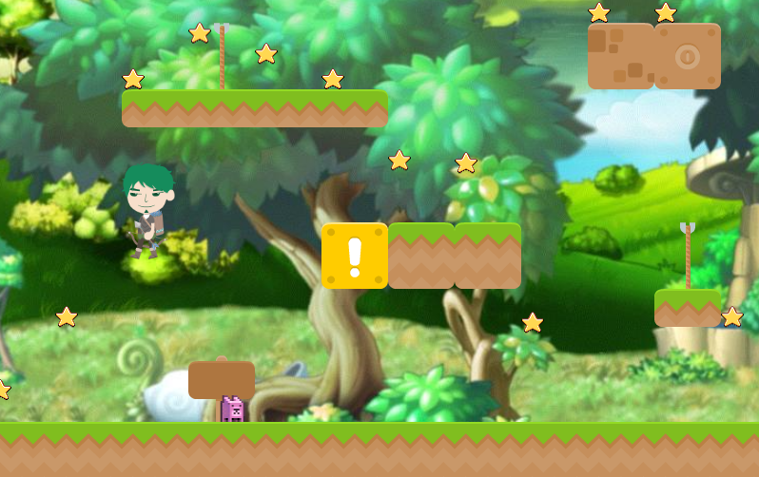
Phaser — 網頁版楓之谷
中興大學資訊社

Slide 2
Phaser基本架構
var game = { new: function(witdh, height, canvas_selector){ this.phaser = new Phaser.Game(witdh, height, Phaser.AUTO, canvas_selector, this) }, preload: function(){ var phaser = this.phaser; }, create: function(){ var phaser = this.phaser; }, update: function(){ var phaser = this.phaser; },

Slide 3
Preload – 載入遊戲素材
phaser.load.image('sky', 'assets/bg.jpg'); phaser.load.image('star', 'assets/star.png'); phaser.load.spritesheet('dude', 'assets/dude2.png', 95, 160); phaser.load.spritesheet('baddie', 'assets/baddie.png', 32, 32); phaser.load.tilemap('map', 'tilemap/map.json', null, Phaser.Tilemap.TILED_JSON); phaser.load.image('kenney', 'tilemap/kenney.png');
背景、人物、地圖

Slide 4
Create - 啟用這個世界的ARCADE 物理系統!
phaser.physics.startSystem(Phaser.Physics.ARCADE);
絕不是因為太混所以放一張投影片，而是因為他很重要 (根本就是

Slide 5
Create – 背景與地圖
//加入背景 並宣告背景物件 var background = phaser.add.sprite(0, 0, 'sky'); // 加入地圖 宣告地圖物件 var map = phaser.add.tilemap('map'); map.addTilesetImage('kenney'); //kenny為地圖素材 // 設定"碰撞"性質 map.setCollision(PhaserHelper.getCollisionIndexes(phaser, 'map')); var layer = map.createLayer('layer1'); layer.bringToTop(); layer.resizeWorld(); var tiles = map.layers[0].data //// 設定背景和地圖同大小 background.height = layer.height background.width = layer.width

Slide 6
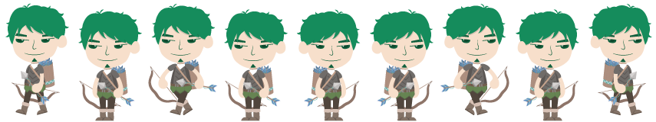
Create – 加入主角
// 啟用人物的物理效果 phaser.physics.arcade.enable(player); // 重力場強度
player.body.gravity.y = 1200; // 向左向右 人物移動時的動畫效果 player.animations.add(‘left’, [0, 1, 2, 3], 10, true); player.animations.add(‘right’, [5, 6, 7, 8], 10, true); player.bringToTop phaser.camera.follow(player); // 設定地圖碰撞 player.body.checkCollision.up = false; player.body.checkCollision.left = false; player.body.checkCollision.right = false;

Slide 7

Create – 加入怪物
var monster = phaser.add.sprite(100, 350, 'monster'); phaser.physics.arcade.enable(monster);
//彈跳效果 monster.body.bounce.y = 0.2; monster.body.gravity.y = 300; monster.body.collideWorldBounds = true; monster.animations.add('left', [0, 1], 10, true); monster.animations.add('right', [2, 3], 10, true); monster.bringToTop; monster.body.checkCollision.up = false; monster.body.checkCollision.left = false; monster.body.checkCollision.right = false; monster.body.velocity.x = 100; monster.animations.play('right');

Slide 8
Create – 吃星星並計算分數
var stars = phaser.add.group(); // group的用途?? // 對星星啟用物理引擎 stars.enableBody = true; stars.bringToTop; // 在這個group用迴圈製造12個星星 for (var i = 0; i < 12; i++) { // 每顆星星之間距離相等 var star = stars.create(i * 70, 0, ‘star’); // 星星的重力加速度 star.body.gravity.y = 300; // 讓每顆星星落下時隨機彈跳 star.body.bounce.y = 0.7 + Math.random() * 0.2; } // 計分器 this.score = 0; var scoreText = phaser.add.text(16, 16, 'score: 0', { fontSize: '32px', fill: '#000' });

Slide 9
Create – 加入鍵盤控制
var cursors = phaser.input.keyboard.createCursorKeys();

Slide 10
延長變數的生命週期
this.map = map; this.layer = layer; this.tiles = tiles; this.player = player; this.stars = stars; this.scoreText = scoreText; this.cursors = cursors; this.monster = monster;

Slide 11
Update – 宣告變數
var phaser = this.phaser;
var cursors = this.cursors;
var player = this.player;
var layer = this.layer;
var stars = this.stars;
var monster = this.monster;

Slide 12
Update – 偵測物體間的碰撞
var touching_ground = phaser.physics.arcade.collide(player, layer);
phaser.physics.arcade.collide(stars, layer);
phaser.physics.arcade.collide(monster, layer);
// 宣告變數touching_ground，之後會用到

Slide 13
Update – 偵測人物與星星的重疊
phaser.physics.arcade.overlap(player, stars, this.collectStar, null, this);

Slide 14
Update - 鍵盤控制人物行為
player.body.velocity.x = 0; if (cursors.left.isDown) //左、右鍵被按壓時的行為 { player.body.velocity.x = -150; player.animations.play(‘left’); if (!touching_ground) { //未觸地時不可動作 player.animations.stop(); if (player.frame < 4) { player.frame = 0; } } } else if (cursors.right.isDown) { player.body.velocity.x = 150; player.animations.play('right'); if (!touching_ground) { player.animations.stop(); if (player.frame >= 4) { player.frame = 8; } } }

Slide 15
Update – 鍵盤控制人物行為
else { // 人物停止時的動作 player.animations.stop(); if (player.frame < 4) { player.frame = 3; } if (player.frame >= 4) { player.frame = 5; } } //按壓上並且觸地時跳躍 if (cursors.up.isDown && touching_ground) { player.body.velocity.y = -720; }

Slide 16
Update – 怪物的行為
if (monster.body.x > 350) { monster.body.velocity.x = -100; monster.animations.play('left'); } if (monster.body.x < 180) { monster.body.velocity.x = 100; monster.animations.play('right'); }

Slide 17
collectStar – 記分板
collectStar: function(player, star){ var phaser = this.phaser; // var star = this.star; var scoreText = this.scoreText; // Removes the star from the screen star.kill(); // Add and update the score this.score += 10; scoreText.text = 'Score: ' + this.score; } };

