Slide 1
Bi
JS
Combining and integrating BioJS components
Leyla Jael García Castro
December 2015

Slide 2

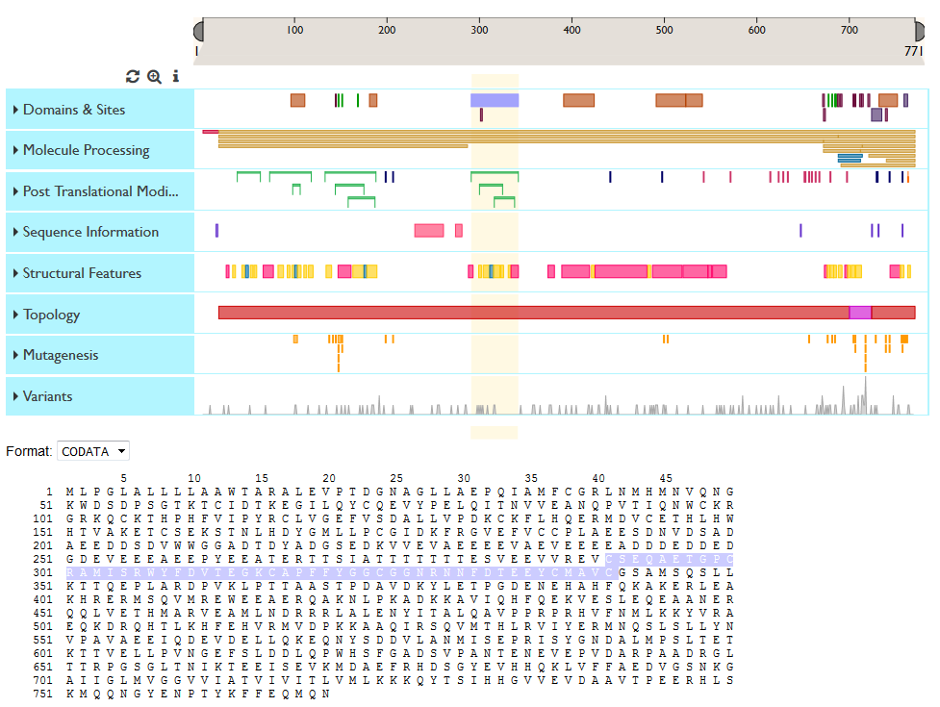
What do we want to achieve?

Slide 3

Let’s get started
Go to https://github.com/ebi-uniprot/biojs-vis-proteinFeaturesViewer
Select the branch hands-on
Clone it in your desktop
Create an empty folder named “tutorial”

Slide 4
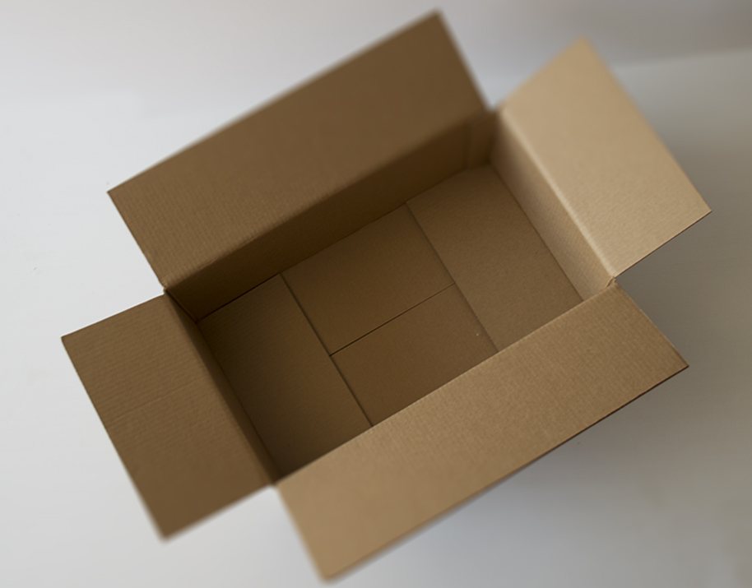
Empty page
We need a page ready to display protein features and sequence
<!DOCTYPE html> <html> <head> <meta charset="UTF-8"/> </head> <body> <div id=""></div>
Create two divs, both with a width of 1200px. One for the features identified as target_ft and another one identified at target_seq
</body> </html>

Slide 5
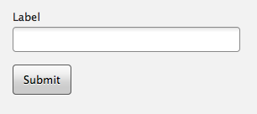
Input data
In order to get protein data, we need to get a protein accession
<!DOCTYPE html> <html> <head> <meta charset="UTF-8"/>
→ Add a script tag and create the getData function. By now, it will capture any text at accession and will clear any content inside target_ft and target_seq. You can use document.getElementById to access elements in the DOM
</head> <body> <div id=""></div>
Create one div with an input identified as accession and a button identified as submit
On the onClick event for the button, call the getData function
target_ft
target_seq
</body> </html>

Slide 6
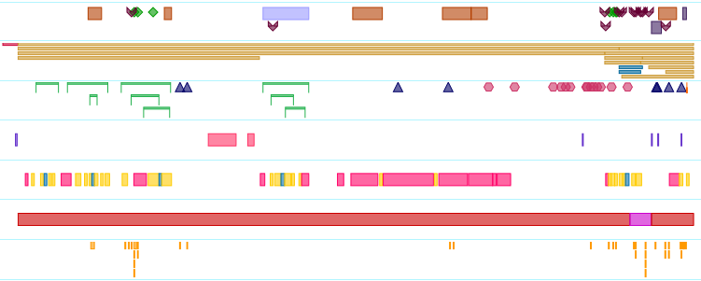


Get the ProteinFeaturesViewer component
Include ProteinFeaturesViewer JavaScript and CSS
Instantiate the component
<!DOCTYPE html> <html> <head> <meta charset="UTF-8"/> <script src="../ftviewer/biojs-vis-proteinFeaturesViewer.js"></script> <link href="../ftviewer/main.css" rel="stylesheet"/> ... </html>
var getData = function() {
(From previous step) Capture any text at accession and will clear any content inside target_ft and target_seq
Create variable app and require the component "biojs-vis-proteinfeaturesviewer“
Create variable instance and instantiate the component with the accession at accession
Make sure you get the “ready” notification
Hint: Take a look to the simple_example snippet in the master branch of https://github.com/ebi-uniprot/biojs-vis-proteinFeaturesViewer
};

Slide 7

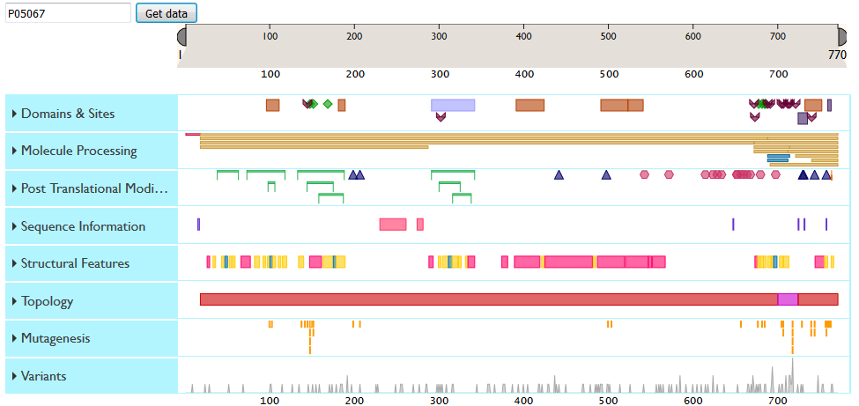
Is everything working so far?
Go to uniprot.org, look for app or p53
Get the protein accession for human
Try it out on your page (use Chrome or Mozilla)
This is how it should look

Slide 8
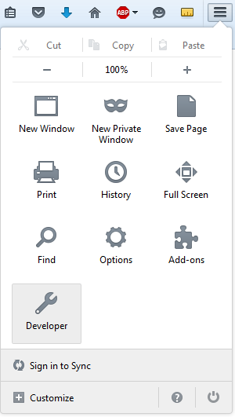
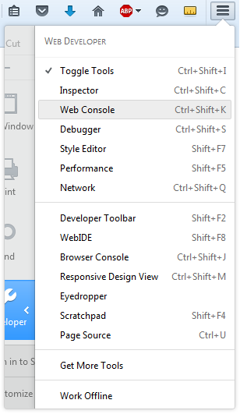
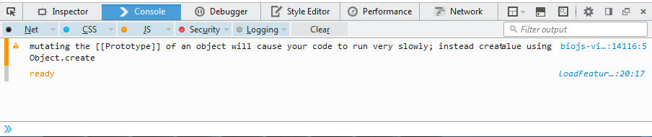
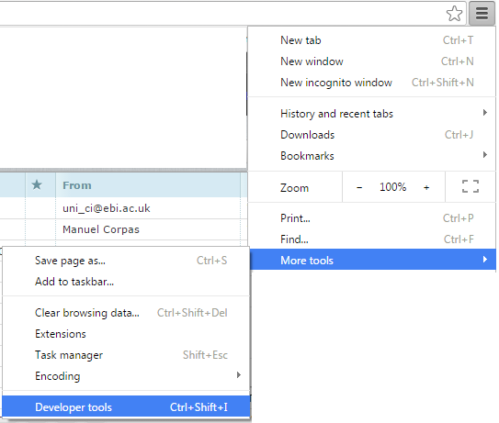
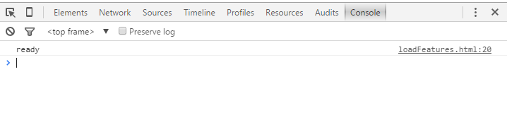
Is everything working so far?
Open the console tab in the web developer tools
Do you see a “ready” text there?
Mozilla
Chrome

Slide 9
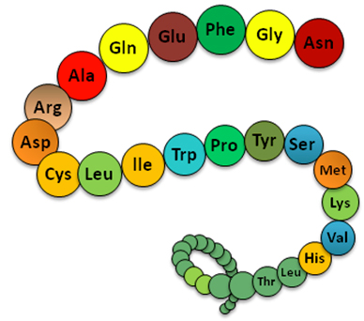
Get the SequenceViewer component
Include SequenceViewer JavaScript and jQuery
Instantiate the component when the features are ready
<!DOCTYPE html> <html> <head> <meta charset="UTF-8"/> <script src="http://code.jquery.com/jquery-1.9.1.min.js"></script> <script type="text/javascript"> jQuery = $; </script> <script src="../sequence/biojs-vis-sequence.js"></script> <script src="../sequence/jquery-browser-plugin.js"></script>
var getData = function() { ...
var mySequence; instance.getDispatcher().on("ready", function() { $.browser = require("jquery-browser-plugin"); var Sequence = require("biojs-vis-sequence"); mySequence = new Sequence({ sequence: instance.sequence, target: "target_seq",
format: 'CODATA', formatOptions: {title: false, footer: false}, columns: {size: 50, spacedEach: 10}, selectionFontColor: 'black', selectionColor: 'lightgray', highlightOpacity: 1, priorityOnHighlight: true }); mySequence.removeAllHighlights(); }); };

Slide 10
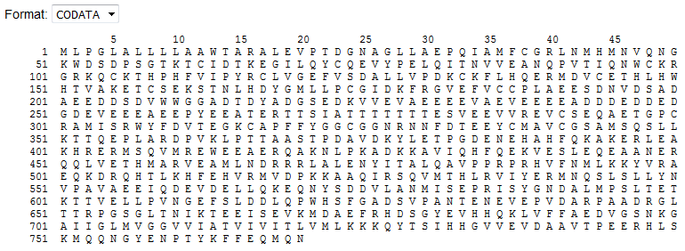
Is everything working so far?
Try any accession on your page (use Chrome or Mozilla)
Can you see the sequence now?

Slide 11

Let’s highlight the sequence on feature selection
Whenever a feature is selected, the featureSelected event is triggered
Listen to the event and highlight the feature in the sequence
Whenever a feature is deselected, the featureDeselected event is triggered
Listen to the event and highlight the feature in the sequence
instance.getDispatcher().on("featureSelected", function(data) { mySequence.addHighlight({ "start": +data.feature.begin, "end": +data.feature.end, "color": "white", "background": data.color }); });
instance.getDispatcher().on("featureDeselected", function(obj) { mySequence.removeAllHighlights(); });

Slide 12
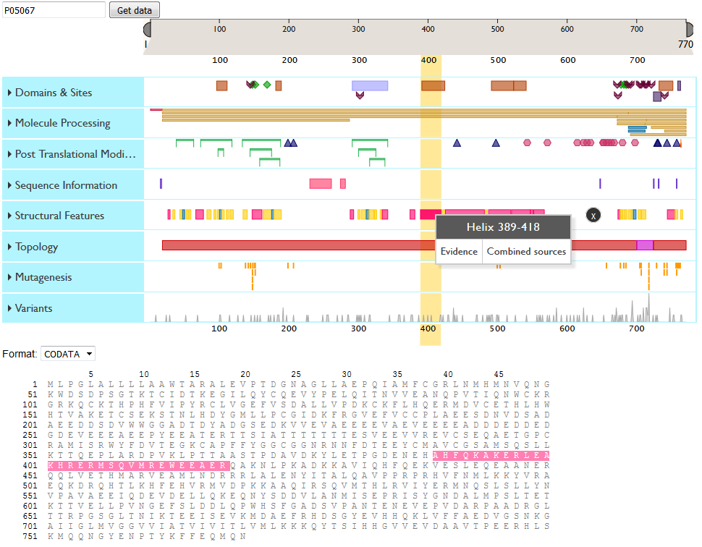
Is everything working at the end?
Try any accession on your page (use Chrome or Mozilla)
This is how it should look

Slide 13

Image credits
Goal - http://www.viraheinz.pitt.edu/node/109
Github logo - https://github.com/logos
Empty box - http://www.pacbasic.com/images/empty_box_blured.jpg
JS icon - http://static.iconarchive.com/show/adobe-cs4-icons-by-hopstarter/File-Adobe-Dreamweaver-JavaScript-icon.html
CSS icon - http://www.veryicon.com/icons/application/adobe-cs4-1/file-adobe-dreamweaver-css-01.html
Protein sequence - https://www.robotics.tu-berlin.de/menue/theses/completed_theses/
Highlight marker - http://www.softicons.com/sport-icons/pretty-office-vii-icons-by-custom-icon-design/highlight-marker-icon
Checkpoint - http://cliparts.co/clipart/2395312

Slide 14
Thanks to:
The BioJS project members and collaborators
biojs.net biojs.io
biojs@googlegroups.com
ProteinFeaturesViewer has been developed by EMBL-EBI UniProt team
SequenceViewer was originally developed by EMBL-EBI IntAct team

