Slide 1
Bi
JS
A short introduction to BioJS
Leyla Jael García Castro
December 2015

Slide 2
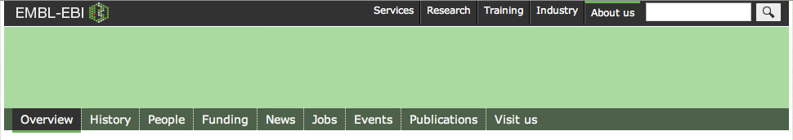
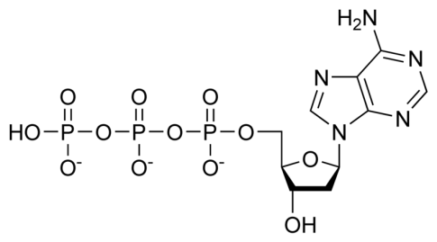
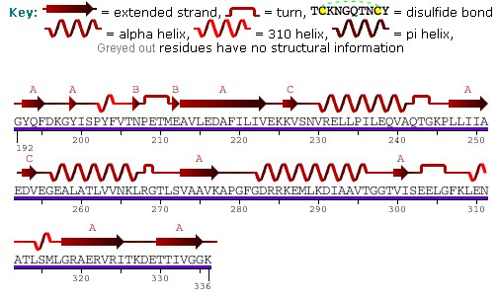
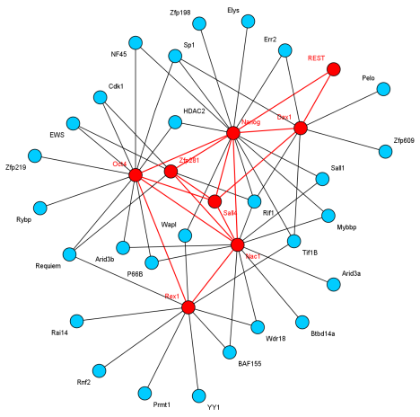
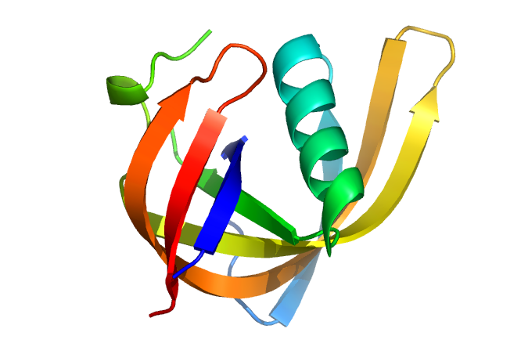
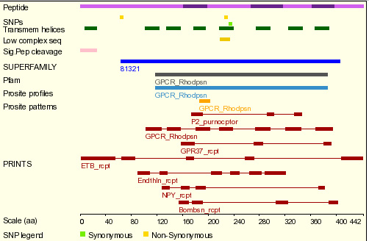
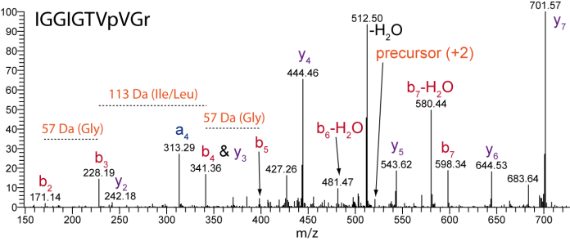
Motivation
Modularity and reuse
Unify efforts, avoid duplication
Components
Application

Slide 3
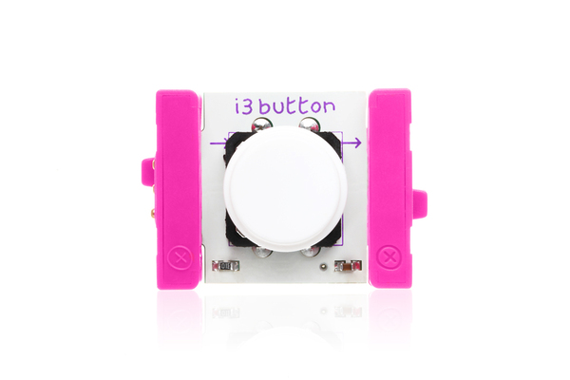




BioJS at a glance
Bi
JS
What
A collection of JavaScript components following a common guideline to represent biological data
When
Feb 2013 – AppNote in Bioinformatics
Early 2014 – First F1000 research
2015 – Workshops and hackathons
Aug 2011 – Student project
Dec 2012 – First release at EBI
Who
Users
Developers
Collaborators
Where
To use→ registry at biojs.io, code at github, installers at npm
To create → tutorials at edu.biojs.net

Slide 4



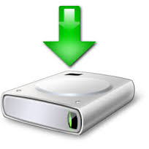
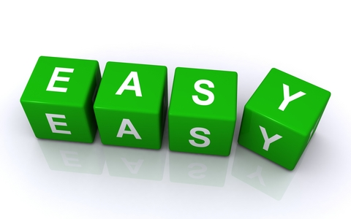

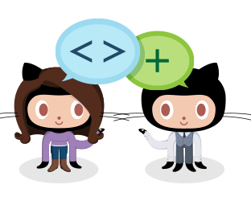




BioJS principles
Use: install, configure, go
Extend
Discover
Combine and integrate
Maintain
Example

Slide 5
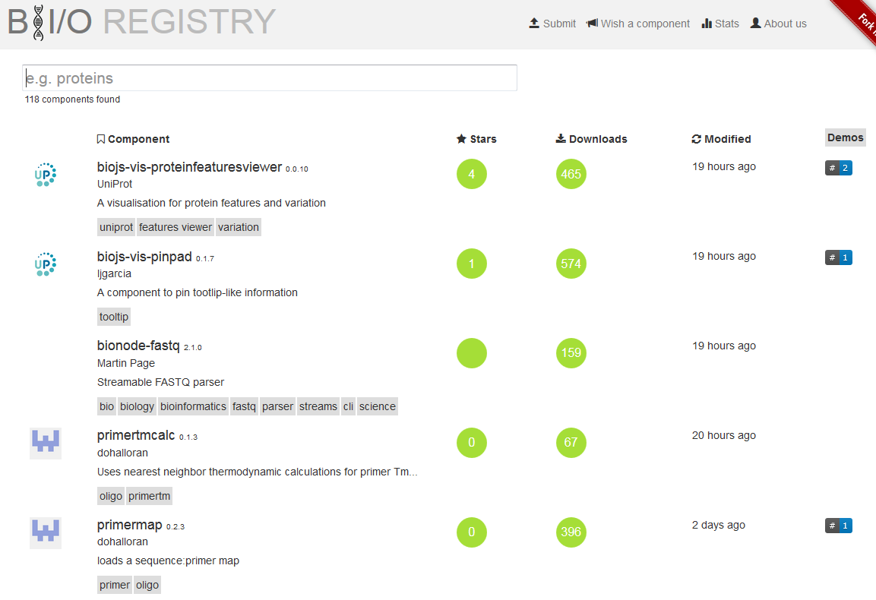
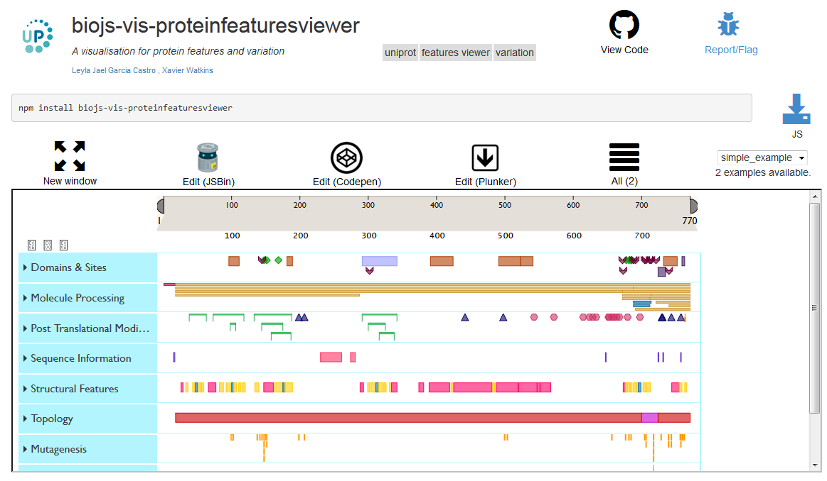
Easy to
Bi
JS
discover

Slide 6
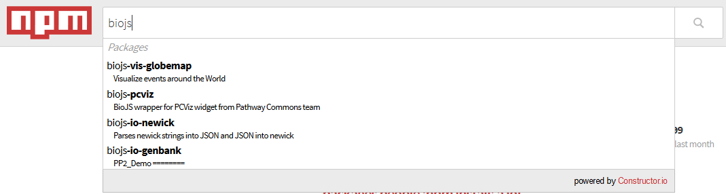
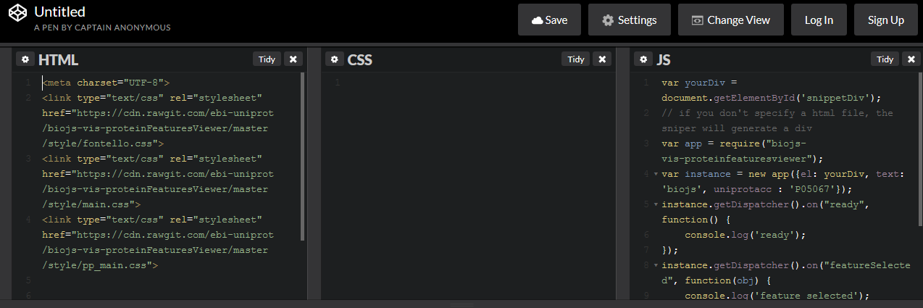
Easy to
Bi
JS
Example
use
Install, configure, go

Slide 7
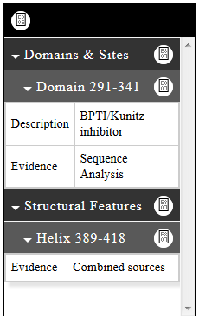


Easy to
Bi
JS
combine & integrate
onSelection
highlight
event
action

Slide 8

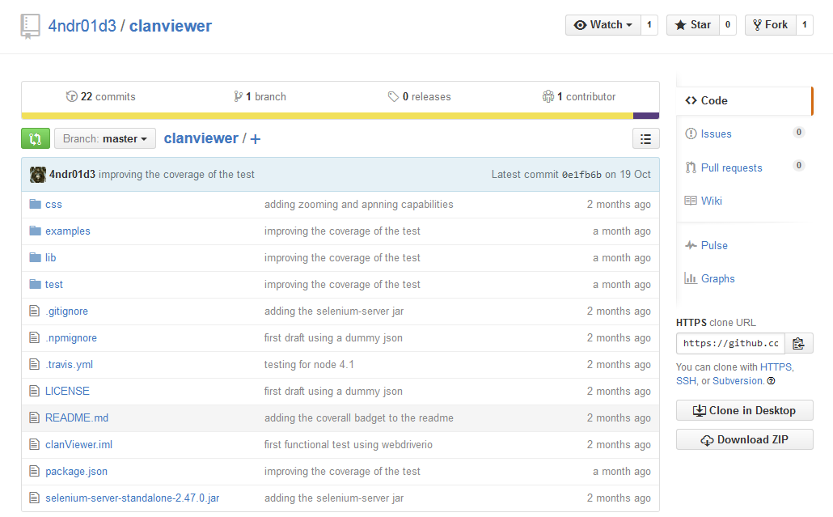
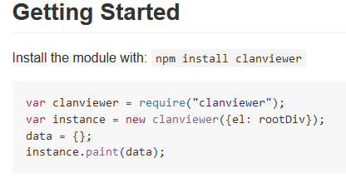
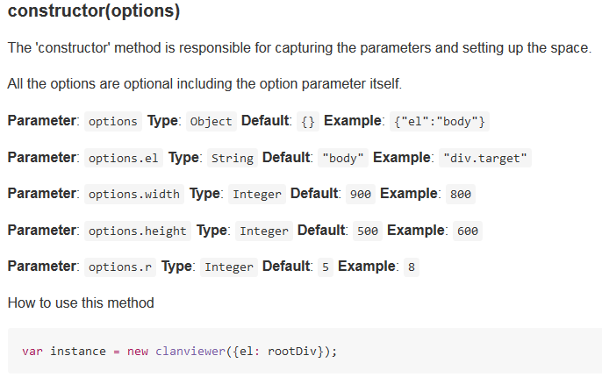
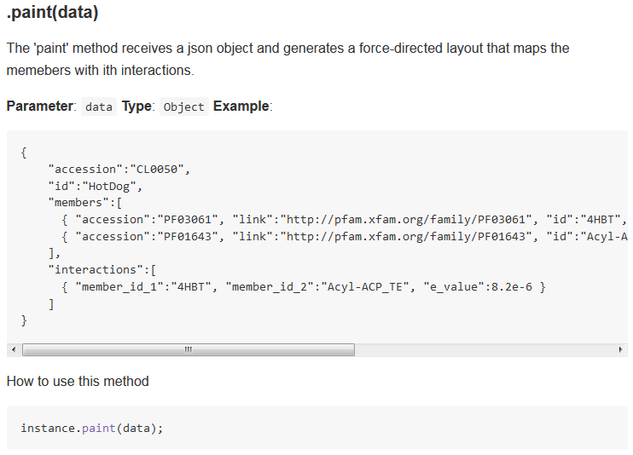
Easy to
Bi
JS
extend

Slide 9








Easy to
Bi
JS
maintain

Slide 10
Benefits
Bi
JS
create
Share development
Enhance the visibility of your widget
Make components not just for you but for the community
Isolate visualization from your web framework
Easy to add functionality by extending a component

Slide 11
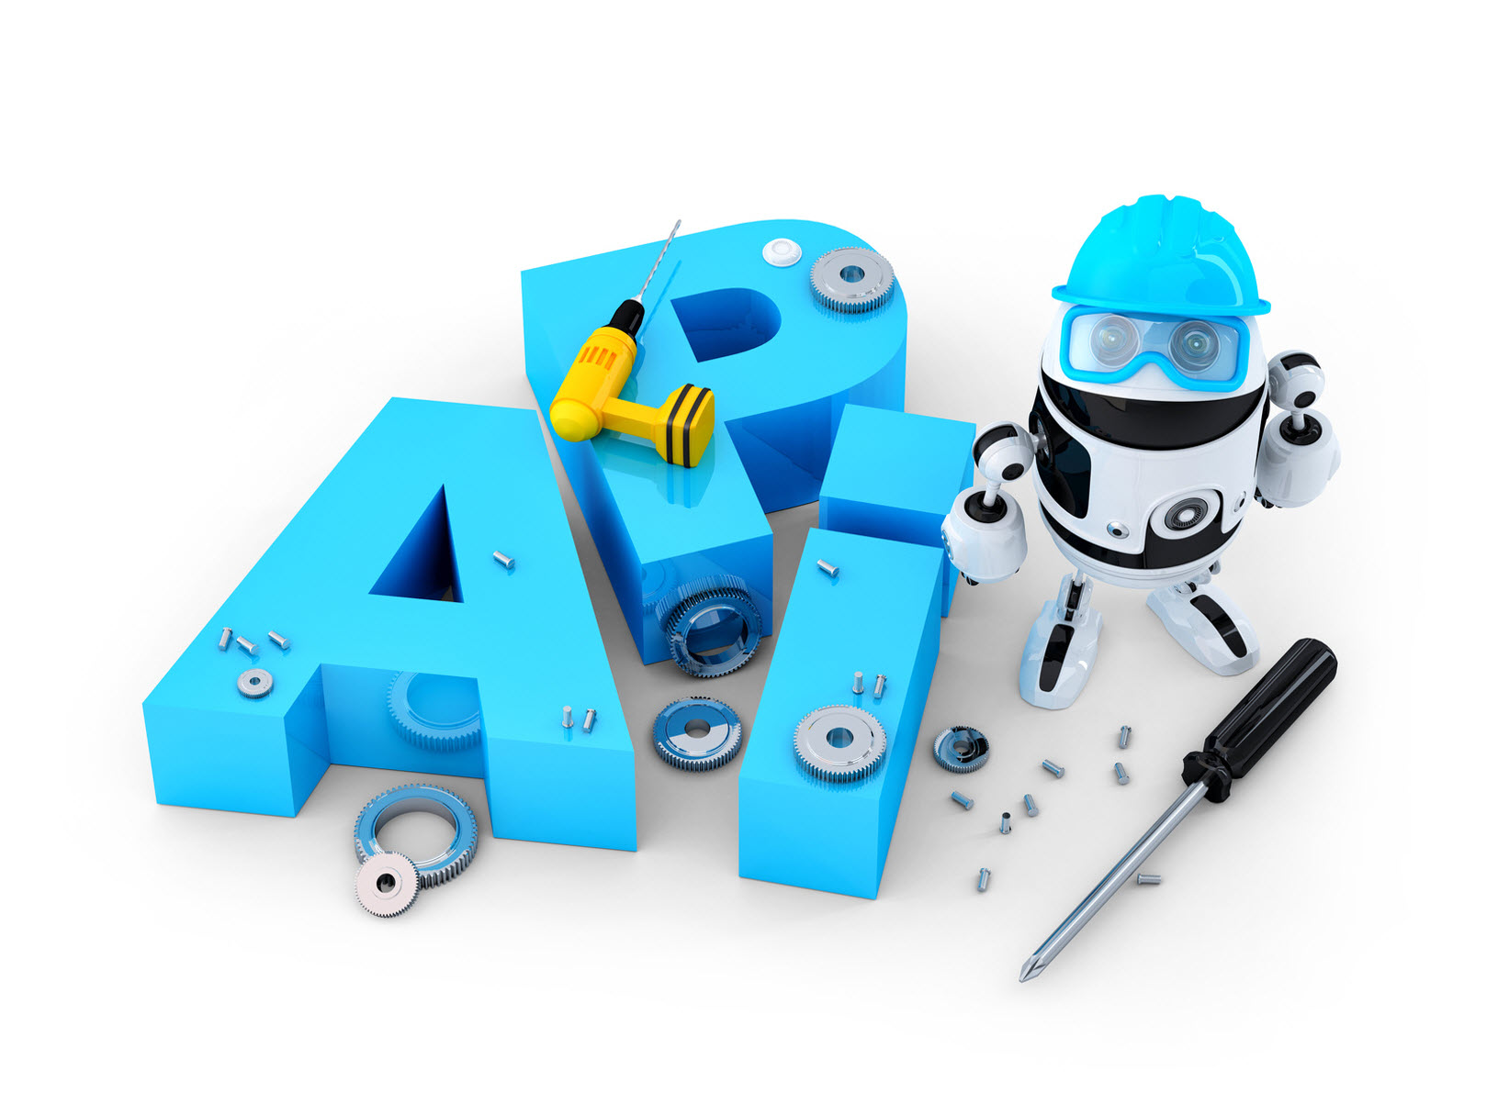

Image credits
LittleBits - http://uk.pcmag.com/toys-products/37593/news/littlebits-serves-up-diy-smart-home-kit
Calendar - http://squashbarbados.org/tournaments/calendar/
People avatar - http://images.clipartpanda.com/headway-clipart-ABstract-People-Clip-Art.png
Where? - http://www.clipartpanda.com/categories/university-student-clipart
Person at computer - http://cliparts.co/clipart/2436481
Download - http://www.veryicon.com/icons/application/toolbar-icons-6/download.html
Settings - https://fpimage.cdnpk.net/free-icon/settings-gears_318-76225.png
Documentation - http://hubpages.com/business/When-You-Are-Bullied-At-Work
Modules - http://static1.formtools.org/site/images/modules_icon.gif
Test - http://xiostorage.com/wp-content/uploads/2015/10/test.png
Man with tool - http://www.webknitindia.co.in/software-maintenance.aspx
API robot - https://serpstat.com/site/api
Your/their app - https://moz.com/blog/apis-for-datadriven-marketers
Broadcast - http://www.equisys.com/solutions/broadcast_faxing.html
Listen - http://www.clipartpanda.com/clipart_images/which-customers-to-listen-to-49175400
Icons and logos from BioJS, Github, NPM, Browserify, Gulp, Grunt, jQuery, D3, Mocha, Phantom, React, CommonJS

Slide 12
Thanks to:
The BioJS project members and collaborators
biojs.net biojs.io
biojs@googlegroups.com
Main contributors
EMBL-EBI
TGAC
RostLab

