Slide 1




MiMI Plugin for Cytoscape
Jing Gao
National Center for Integrative Biomedical Informatics
Center for Computational Medicine and Biology
University of Michigan

Slide 2



Overview
DIP
BIND
MDC
MCODE
Cytoscape
HPRD
MiMI
dynamicXp
MiMIplugin
GRID
Agilent
LiteratureSearch
IntAct
EnhancedSearch
MINT
CCSB

Slide 3
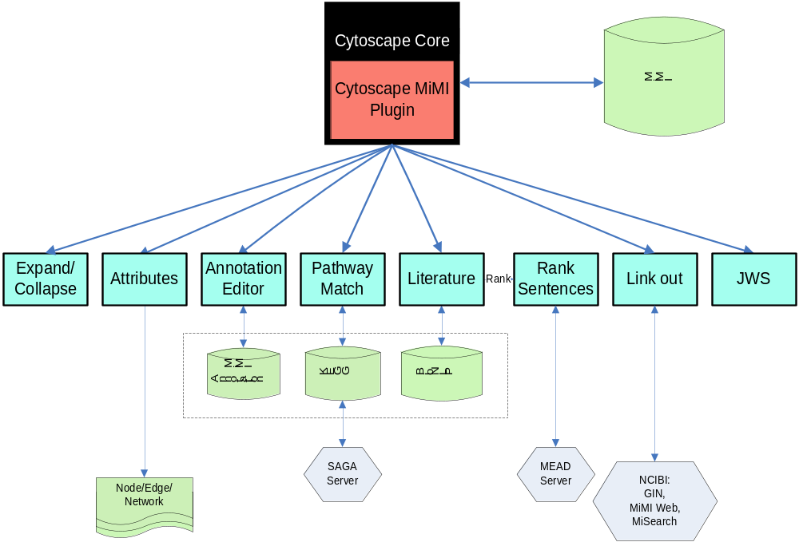
MiMI Plugin Functionalities

Slide 4
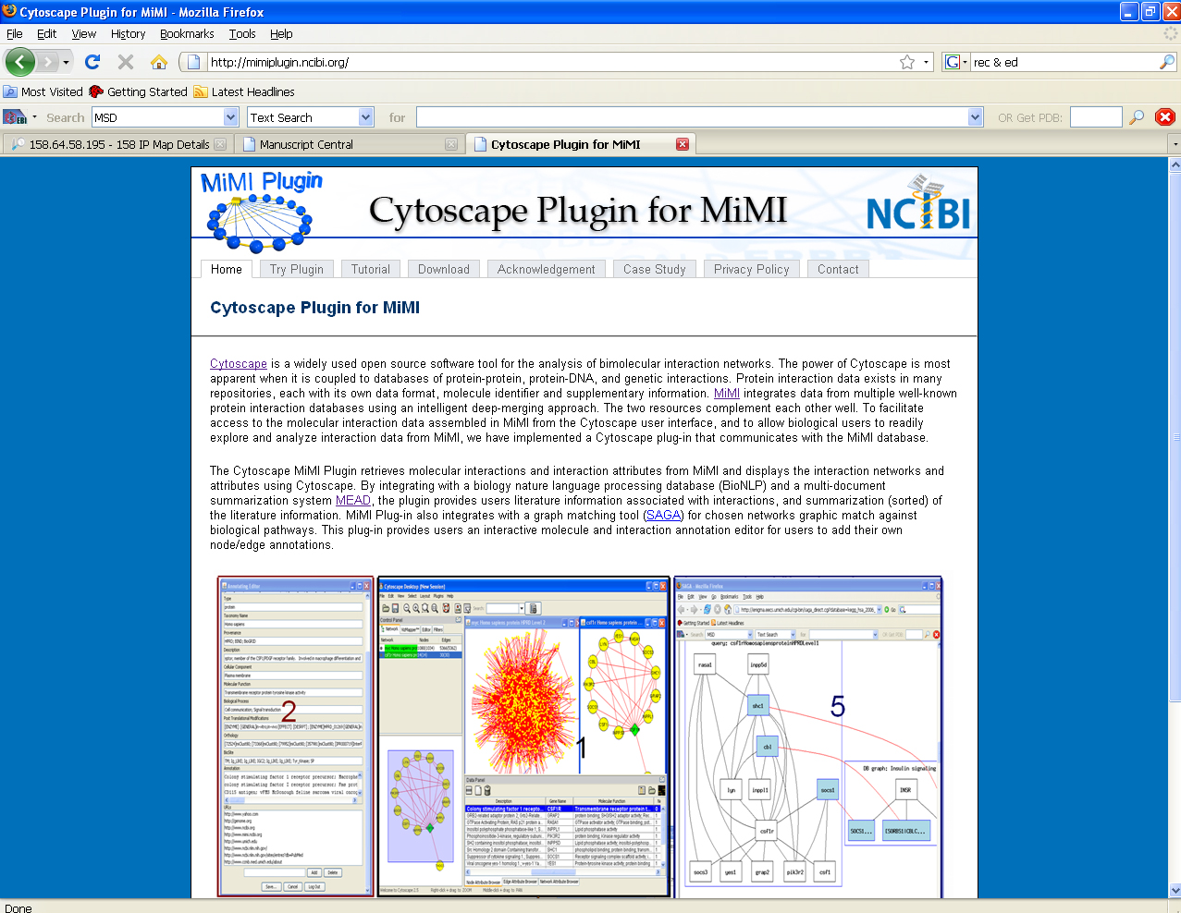
http://mimiplugin.ncibi.org

Slide 5
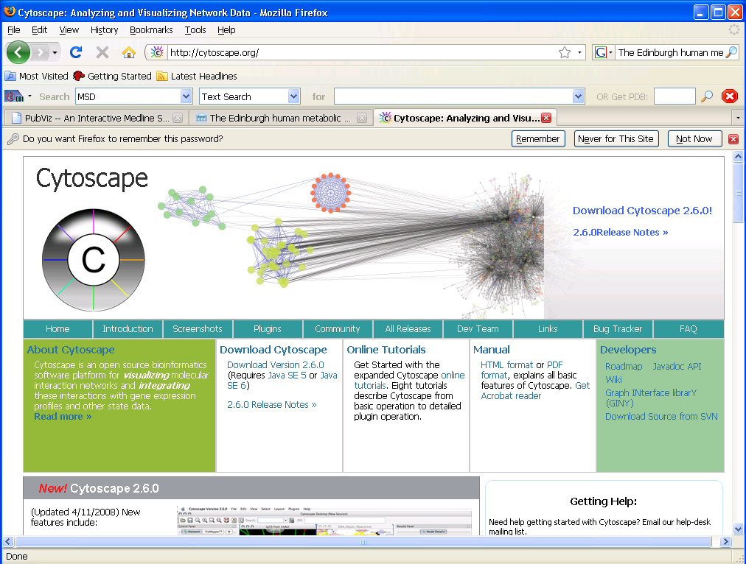
http://cytoscape.org/

