Slide 1
Cytoscape Plugin for MiMI
Jing Gao
Oct 27 2009
(jinggao@umich.edu)

Slide 2


Overview
DIP
BIND
MDC
MCODE Plugin
Cytoscape
HPRD
MiMI
Cerebral Plugin
Plugin
GRID
BiNGOPlugin
IntAct
StructureViz
MINT
CCSB

Slide 3

Cytoscape
Java-based open source software platform
  User community stats from cytoscape
    >20,000 downloads this year
    ~2,000/month
  developed by ISB, UCSD, MSKCC, Pasteur and etc.
Visualize molecular interaction networks
Integrate interactions with
  gene expression profiles
  Annotation (GO term and annotation)
Bundle ~90 Plugins
  Analysis
  Network and Attribute I/O
  Functional Enrichment
  Communication/Scripting
http://www.cytoscape.org/

Slide 4

MiMI
Michigan Molecular Interactions Index
  Repository for molecular interactions
  Integrates data from multiple well-known protein interaction databases like BIND, HPRD, IntAct, cPath etc using an intelligent deep-merging approach
  Developed by National Center for Integrative Biomedical Informatics at University of Michigan.
http://mimi.ncibi.org/MiMI/home.jsp

Slide 5
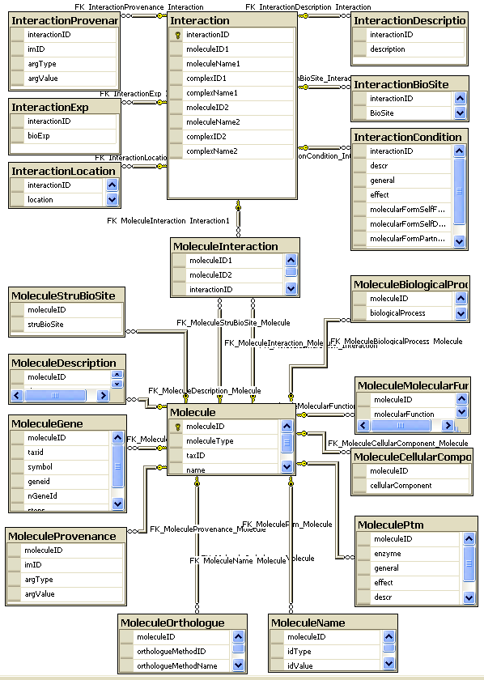
Relational MiMI Schema

Slide 6
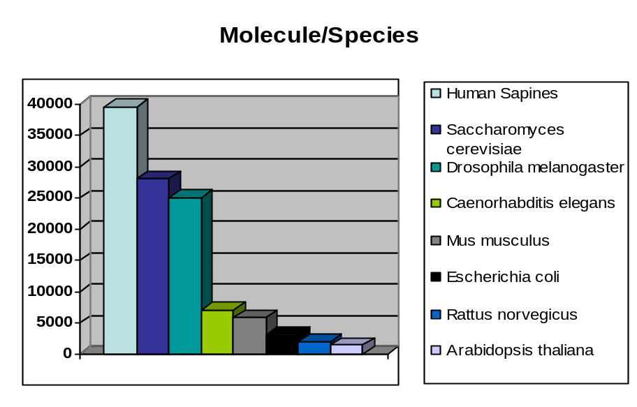
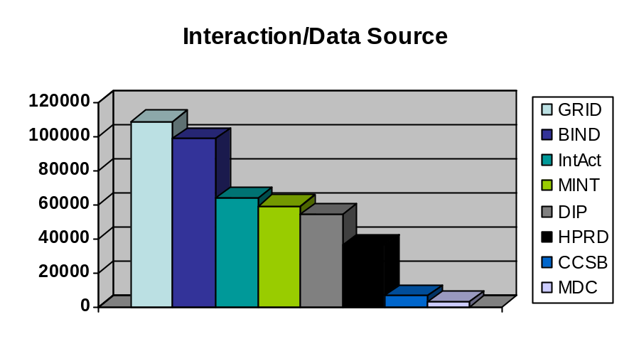
MiMI Data Sources and Stats
Source | From | Updated
BIND | Samuel lunenfeld Research Institute | 07/21/06
CCSB-HI1 | Center for Cancer System Biology, Harvard | 09/28/05
DIP | UCLA | 01/07/07
GO | Gene Ontology Consortium | 01/02/07
BioGRID | Mount Sinai Hospital | 02/01/07
HPRD | John Hopkins University Bioinformatics | 01/01/07
IntAct | EMBL-EBI | 02/02/07
RefSeq | NCBI | 11/06/06
InterPro | EMBL-EBI | 12/08/06
IPI | EMBL-EBI | 02/09/07
MDC PPI | Max-Delbrueck Center for Molecular Medicine | 11/02/05
Reactome | CSHL, EBI, GO | 11/16/06
Pfam | Sanger Institute | 11/06/06
SwissProt | Swiss Institute of Bioinformatics | 02/06/07
Shannon | University of Michigan
Total 121865 Molecule IDs 350843 Interaction IDs

Slide 7
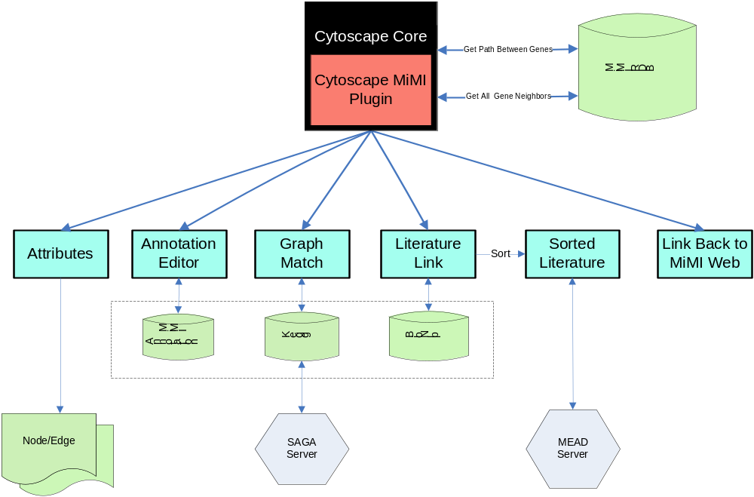
MiMI Plugin Overview

Slide 8
Acknowledgement
David States and Alex Ade
H.V. Jagadish Group (MiMI)
  Glenn Tarcea
Jignesh M. Patel Group (SAGA)
  Yuanyuan Tian
Dragomir Radev Group (MEAD)
  Thuy Vu
Aaron Bookvich & Paul Trombley
(Web page)
Barbara Mirel (User Feedback)
LihShwu Ke (Database Admin)
James Cavalcoli
Terry Weymouth
Zach Wright
Jeffrey de Wet
Ben Keller
Cytoscape Core Developers

