Slide 1
Integration of VisANT and NCIBI tools for multi-scale visualization, analysis and modeling of biological networks/pathways
(Integration Plan)
Zhenjun Hu
Bioinformatics Program
Boston University

Slide 2



















Integration Overview
One platform for different network type, including interaction network (un/weighted, in/directed), pathways (metabolic, signaling or mixed) etc.
One platform to integrate networks of different scales, using hierarchical knowledge, such as GO, MeSH, ATC etc.
Metabolic Network
Integration of Hierarchical Knowledge
ATC Drug
Hierarchy
visANT
Interaction Network
Network Alignment/Matching
Pathway Integration
Integrated workbench for related NCIBI tools.
Open architecture for additional tools
Notes:
Integration overview

Slide 3
Interaction Network (MiMI & VisANT)
Goals
  Make MiMI available to VisANT users (easy)
  Make all VisANT’s functions available to MiMI users, including embedding VisANT in MiMI web
Current status (Jing Gao)
Open questions
  How to best integrate VisANT in MiMI web?
  Support method-based (PSI-MI method) categorization of the interaction data set?
  Share the cost of data synchronization to make sure our data are up-to-date?
  How to cache java applet? (Use hidden frame to cache VisANT?)
  Other interaction type
    On agenda
      Drug --- target
      Metabolite--- enzyme/reaction
    Virus/Pathogen gene interaction?

Slide 4
Current Status of MiMI and VisANT Integration
MiMI and VisANT integration
  Set up “MiMI Data in VisANT” web site with VisANT embedded
  Implement web services to query MiMI database
  Implement plugin to register MiMI database to VisANT
VisANT functions worked for MiMI network
  Exploratory navigation and visualization of MiMI interaction network.
  Expression enrichment analysis to detect phenotypic differences between disease versus normal (treated versus control) samples, in a systems biology context
  Multi-scale visualization of KEGG pathways. Display pathway with only pathway nodes or with gene (enzyme), compound and pathway nodes
  Topological analysis and filtering of the network, including finding shortest path, drawing topology plot for degree distribution, cluster-coefficient distribution, motif detection and filter nodes based on degrees

Slide 5
Known bugs
  FLN (Functional Linkage Network) does not work. (error: access denied)
  Can not query protein against Predictome
  Go term loading does not work
  Can not set default database
Future work
  Finish “MiMI Data in VisANT” web site content
  Add gene type, chromosome, map locus, locus tag, pathway etc attributes to node
  Add PubMed ID, provenance to edge
  Fix bugs and make all VisANT functions (MetaGraph, Filters etc) work for networks from MiMI

Slide 6
Network alignment / module matching
Network alignment
  Cross the species (under development)
  Weighting schema is under the investigation
  Visual transformation is also proposed so that C in the above figure which be transformed into three metanode nodes with each metanode representing corresponding organism
  What is the best orthology database to be integrated?
KOG A
KOG B
KOG A
Protein of Fly
Protein of Mouse
A
B
A
Protein of Homo sapiens
A
A
B
Meta-Node of
Orthologous Proteins
C
C
C
C
KOG C
A
KOG C
B
KOG A
KOG B
KOG A
KOG B
A
B
A
B
C
C
KOG C
D
KOG C
C

Slide 7
Network Alignment / Module Matching (continued)
Modules (or any sub-network to be compared) are usually represented as metanode nodes
VisANT currently integrates GO and KEGG pathway modules (more in the session of the integration of multi-scale knowledge)
VisANT current support two type of enrichment analysis at the run time
How to integrate ConceptGen?
  Proposal
    Develop VisANT plugin to allow submission to ConceptGen with a list of genes,
    the result will be shown in a browser
    Options will be available in the result page to allow user to select corresponding Concepts to be shown in VisANT as metanodesIntegration of data from both MiMI and Predictome databases
  The above proposal shall work well for VisANT applet, in the case of VisANT running as a local application, how to communicate between VisANT and ConceptGen result page?
  Other options are available
    Annotate genes using ConceptGens directly? (Similar to GO annotation)
    Directly load ConceptGens as the metanodes? (similar to KEGG pathway)
How to integrate SAGA
  Similar proposal as for ConceptGen, with opens questions below
    What will be the data format for the matched subgraph for VisANT to load?
    Can we directly implement SAGA algorithm in VisANT so that it can be used to match other module databases with simple user configuration (Many company will love this, we however need to specify the detail of the corresponding module database and corresponding URL API)?

Slide 8
Metabolic Network
Current functions
  KEGG metabolic pathways
  Concentration visualization
Functions on agenda
  Support of bipartite graph graph where metanode will be used to represent the reactions, with enzyme nodes being embedded in the reaction node so that we can transform bipartite graph to the KEGG style network.
  Flux balancing analysis and flux visualization using edge thickness
  Query the of reactions and enzymatic relations using either metabolites and enzymes
NCIBI integration
  Metscape
    Visualizing concentration using node size
    Anything else?
  Annotate metabolic network using MeSH terms
    Similar to GO integration, see next session for detail
Any other suggestion?
  SBML support and extension?
  Standard visual style?

Slide 9
Integration of Hierarchical Knowledge
Gene Ontology
MeSH (e.g. disease hierarchy)
  Hierarchical Explorer to browse the MeSH hierarchy
    Term searching using key word
    Term searching using gene will available indirectly (annotate gene using MeSH term, then click the gene to highlight the term in the hierarchy tree)
    Annotate network by drag & drop the MeSH term over the network, which will group genes in the network using metanode
  Annotate genes using MeSH term
  Interactive visualization between MeSH hierarchy and the network
  Using enrichment analysis to predict the function of given network modules
  Data source of term---gene/metabolite relations
    Gene2MeSH, Meta2MeSH, GAD (Gene Association Database), OMIM, KEGG disease
  Anything else or potential applications?
Anatomical Therapeutic Chemical (ATC) classification (drug hierarchy)
  Hierarchical Explorer to browse the ATC hierarchy
    Term searching using key word, searching using drug name will be indirect
    Annotate network (containing drugs) by drag & drop the ATC term over the network, which will group drugs in the network using metanode
  Annotate drugs using ATC terms (associate the drugs with corresponding therapy)
  Interactive visualization between ATC hierarchy and the network
  Using enrichment analysis to predict the overall therapy of given drug lists?
  Data source of term---drug relations
    DrugBank, KEGG Drug etc.
  Drug—target relations will be available to be queried by drug/gene name
Pathway Hierarchy (next session for detail)
Any other suggestion?

Slide 10
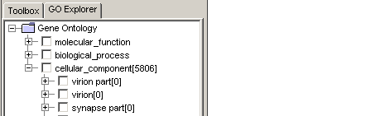
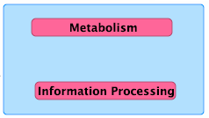



Pathway Integration
KEGG pathway hierarchy
  Hierarchical Explorer to browse the pathway hierarchy
    Pathway searching using key word or pathway id
    Pathway searching using gene is available indirectly
    Drag & drop to load the individual pathway or pathway family
  Add links between genes in the pathway as part of interactions in the database
  Integration pathways in the same database with functions to detect the cross-talk between pathways
  Integration of pathways from different pathway databases through network comparison
Any other suggestions?
KEGG IGSN
F
E
BioCyc pathway
D
D
Reactome pathway
B
K
B
C
C
A
E
D
B
C
G
KEGG pathway

Slide 11
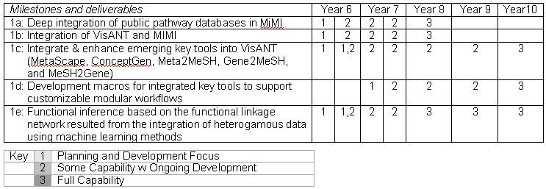
Other Open Questions
What is the priority and schedule of the integrations we proposed?
How deep the integration shall go?
How do we set up the integration collaboration environment?
  Google group for general integration discussion?
  Google doc for shared document
  Wiki or Google site?
  Monthly meeting?
Any recommendation, or request of features for the integration and network analysis?

