Slide 1
NCIBI Tools
Jing Gao
jinggao@umich.edu
National Center for Integrative Biomedical Informatics
University of Michigan, Ann Arbor, MI
http://portal.ncibi.org/gateway/

Slide 2
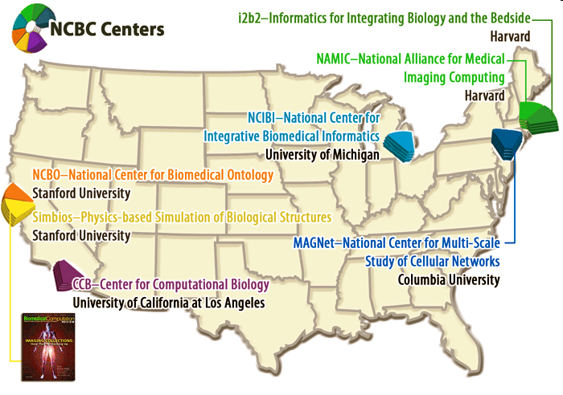
National Centers for Biomedical Computing

Slide 3
Tools Developed by NCIBI
There are total ~20 tools / database developed by NCIBI since 2005.
Protein-protein interactions
  MiMI
  MiMI Plugin
Concepts
  ConceptGen
  Gene2Mesh
Metabolomics
  Metscape
  Metab2Mesh
  humdb
Gene co-occurrence in literature
  pubmed
http://portal.ncibi.org/gateway/tryourtools.html

Slide 4
MiMI Plugin for Cytoscape
Gao J et al., Integrating and annotating the interactome using the MiMI plugin for cytoscape. Bioinformatics, 2009, Vol. 25 no. 1
http://mimiplugin.ncibi.org

Slide 5


Overview
DIP
BIND
MDC
MCODE Plugin
Cytoscape
HPRD
MiMI
Cerebral Plugin
Plugin
GRID
BiNGOPlugin
IntAct
StructureViz
MINT
CCSB

Slide 6
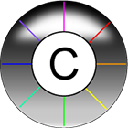
Cytoscape
Well-known and widely used java-based open source platform
  developed by UCSD, University of Toronto, Agilent, MSKCC etc since 2002
  User community stats from cytoscape
    >20,000 downloads this year (2008)
    ~2,000/month
Visualize biological networks
Integrate interactions with
  gene expression profiles
  Annotation (GO term and annotation)
Bundle ~100 Plugins
  Analysis
  Network and Attribute I/O
  Functional Enrichment
  Communication/Scripting
http://www.cytoscape.org/

Slide 7

MiMI
Michigan Molecular Interactions
  Repository for molecular interactions
  Integrates data from multiple well-known protein-protein interaction databases using an intelligent deep-merging approach
  Developed by National Center for Integrative Biomedical Informatics (NCIBI) at University of Michigan.
http://mimi.ncibi.org/

Slide 8
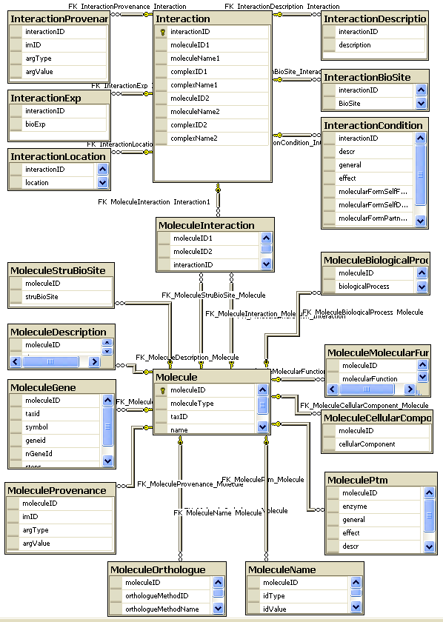
Relational MiMI Schema

Slide 9
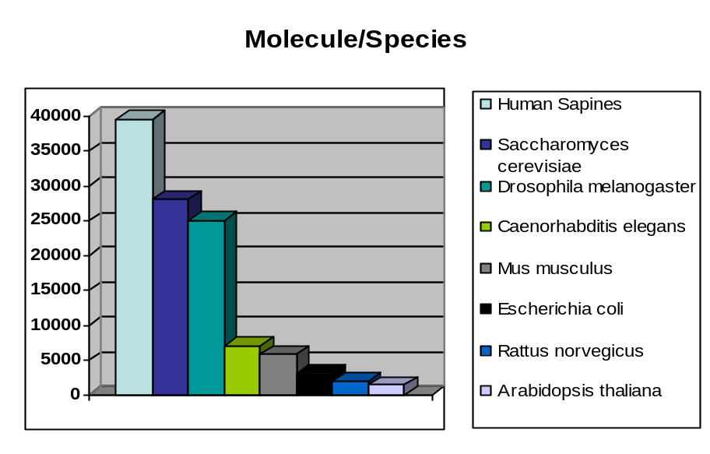
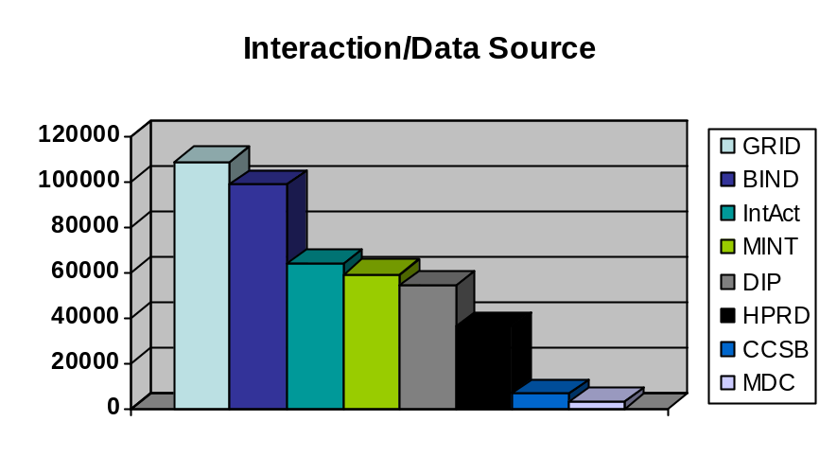
MiMI Data Sources and Stats
Source | From | Updates
BIND | Samuel lunenfeld Research Institute
CCSB-HI1 | Center for Cancer System Biology, Harvard
DIP | UCLA
GO | Gene Ontology Consortium
BioGRID | Mount Sinai Hospital
HPRD | John Hopkins University Bioinformatics
IntAct | EMBL-EBI
RefSeq | NCBI
InterPro | EMBL-EBI
IPI | EMBL-EBI
MDC PPI | Max-Delbrueck Center for Molecular Medicine
Reactome | CSHL, EBI, GO
Pfam | Sanger Institute
SwissProt | Swiss Institute of Bioinformatics
Shannon | University of Michigan
Total 121865 Molecule IDs 350843 Interaction IDs

Slide 10
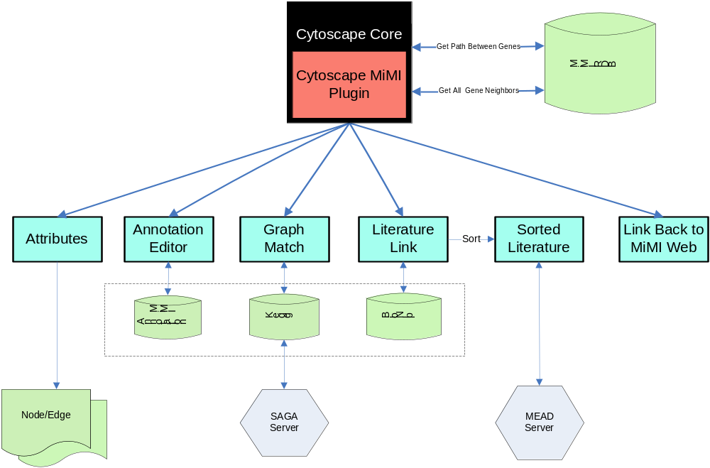
MiMI Plugin Overview
Youtube: http://www.youtube.com/watch?v=R5yFOiRb18I
Chinese version: http://www.youtube.com/watch?v=1wLumLBCn4Q

Slide 11
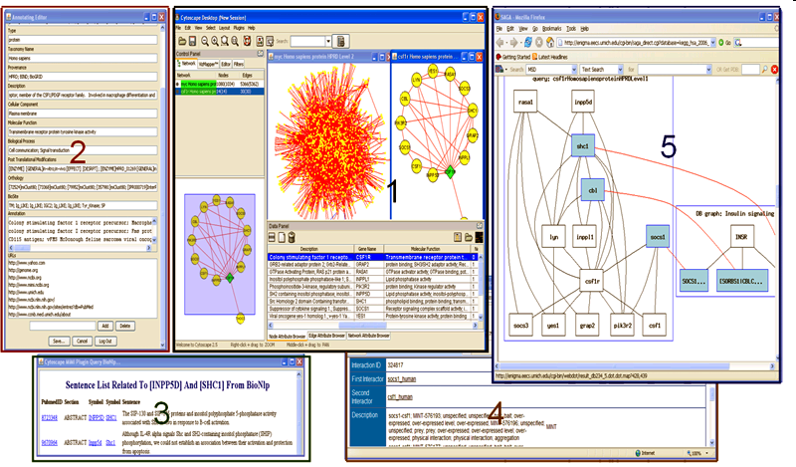

Slide 12
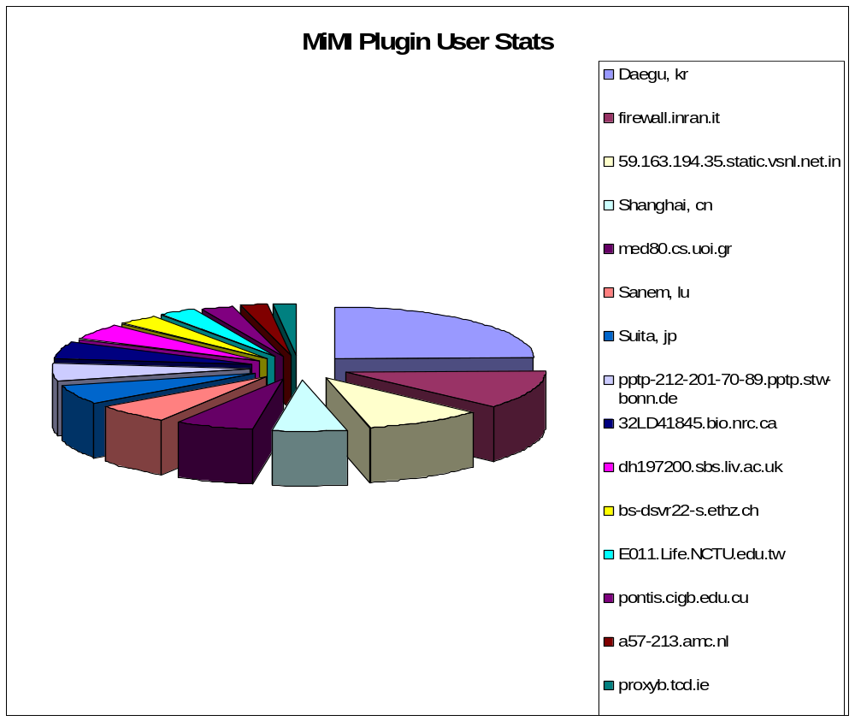
There has been 1920 unique IPs ( users) with 273578 queries, and ~5000 downloads since May 2008
Ch: Switzerland, cu: Cuba, nl: Netherlands, ie: Ireland

Slide 13
Metscape
Gao J et al., Metscape: a Cytoscape plug-in for visualizing and interpreting metabolomic data in the context of human metabolic networks. Bioinformatics, 2010, Vol. 26 no. 7
http://metscape.ncibi.org

Slide 14
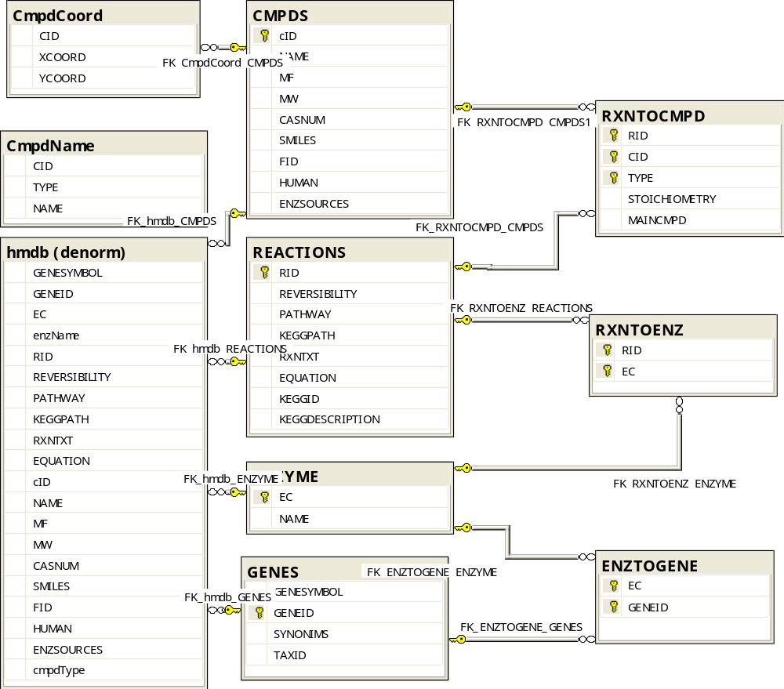
MetDB
Compounds: 2686
Reactions: 2844
Enzymes: 869
Genes: 2231
Pathways: 70 (From EHMN)

Slide 15
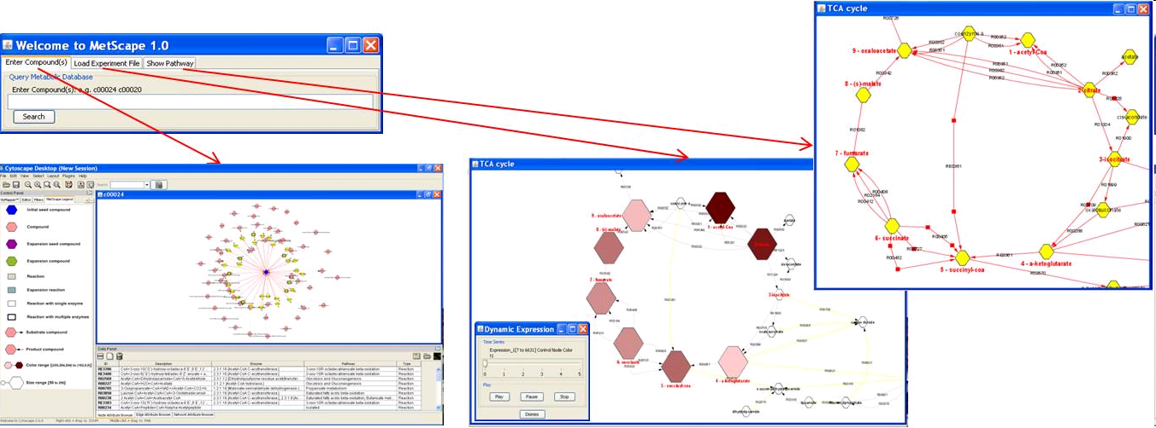
Main Features

Slide 16
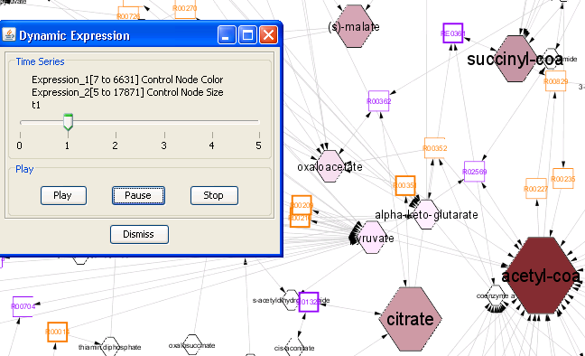
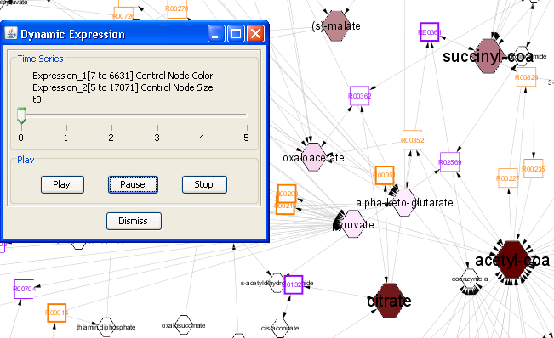
Animation

Slide 17
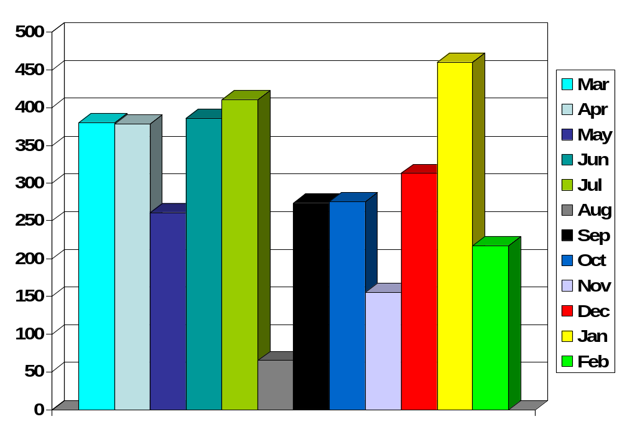
Monthly Queries
There are ~5500 queries since Mar 2009

Slide 18
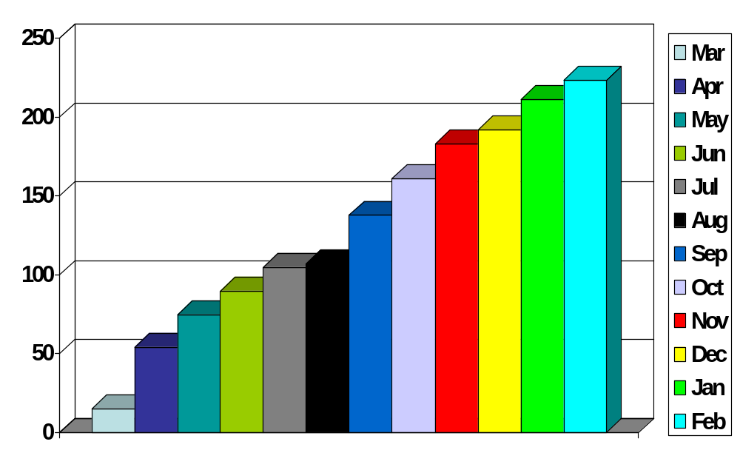
Monthly IP Increase
There are >350 IPs (User Groups/Users) since Mar 2009

Slide 19
Metab2Mesh and Gene2Mesh

Slide 20
Metab2Mesh: http://metab2mesh.ncibi.org
  Metab2MeSH uses a statistical approach to annotate biological substances with the concepts defined in MeSH. The significance of association between substances and MeSH terms are calculated by evaluated using Fisher’s exact test using the R statistics package.
Gene2Mesh: http://gene2mesh.ncibi.org
  Gene2Mesh uses a statistical approach to annotate genes with the concepts defined in MeSH. The significance of association between genes and MeSH terms are calculated by evaluated using Fisher’s exact test using the R statistics package.
MeSh Term
  Medical Subject Heading term

Slide 21
ConceptGen

Slide 22
What Can You Do with ConceptGen
Gene Set Enrichment Testing
• Upload a list of genes (larger lists tend to yield better results) to find other pre-defined concepts that are significantly enriched with genes in your uploaded set
• Find relationships among those concepts
Gene Set Relation Mapping
• Enter a term/topic to retrieve and display predefined concepts that are semantically close to your entry
• Find other concepts from the retrieved results that contain an over represented number of genes contained in the chosen Concept
• Explore the network of relationships
Gene – Gene Enrichment Analysis
• Query a gene symbol to find related genes that share a significant number of annotations with the query gene (can be used to predict the pathway of action of genes with unknown function)
• Query a gene symbol to identify all concepts to which that gene is assigned in ConceptGen

Slide 23
Try MiMI plugin and Metscape
MiMI Plugin webstart:
http://mimi.ncibi.org/cytoscape/launcher
Metscape webstart:
  http://mimi.ncibi.org/metscape/launcher?cmpdID=C00213

Slide 24
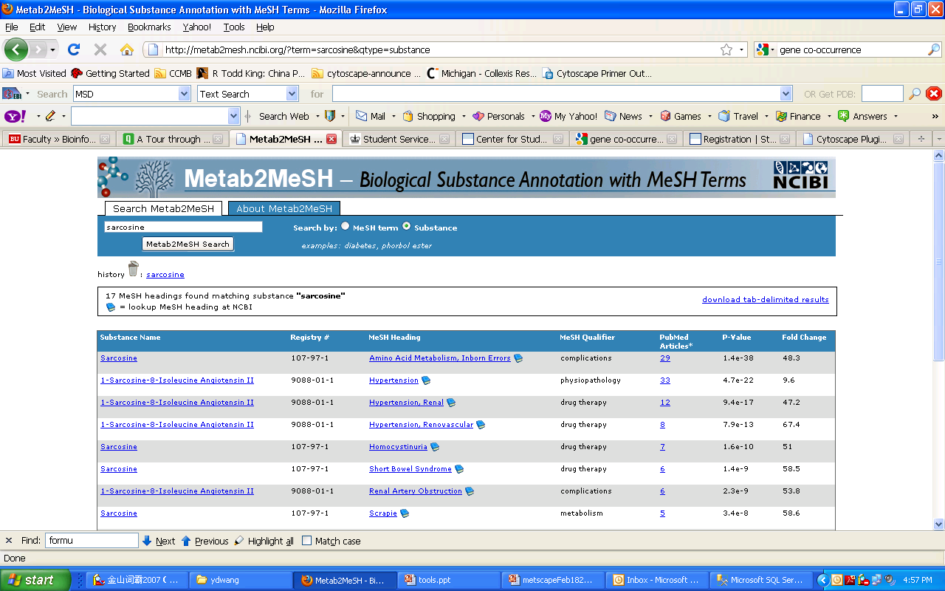

Slide 25
Links
SAGA
  http://saga.ncibi.org/
MEAD
  http://www.summarization.com/mead/

