Slide 1
RxNorm
September 17-21, 2007
Alameda, CA

Slide 2
Outline
Introduction and location of scripts and files
rxn.pl – inversion script
rxnorm.cfg – config. file
input files
inversion snippet
QA

Slide 3
Introduction and location of scripts and files
rxn.pl : an inversion script which is located in the /bin.
rxnorm.cfg : a config. file which is located in the /etc.
/umls_dev/src_root/RXNORM_07AB_070831F
  /orig
    /fromprovider : source files (RxNorm_full_09042007.zip/.txt)
      /scripts : files extracted from the zip (*.bat, *.ctl, *.sql)
    /rrf : files extracted as the input files (RXNCONSO, RXNSAB, RXNREL, RXNSAT, RXNSTY, RXNDOC, etc.)
  /bin : this is where rxn.pl is located.
  /etc : rxnorm.cfg is located, also other intermediate files (rxaui2sctSaid, rxaui2Aui) and the si_proposal.
    /qa : QA files are all located here, ex., QaReport.RXNORM_07AB_070831f
  /tmp : additional intermediate files are located here (atomsWithAuis, ssaids, scuis, usaids, ucuis, rsaids, rcuis, ncuis, nauis, RXNORM_07AB_070831FSaids, IdMap.out, IdMap.out_rel)

Slide 4
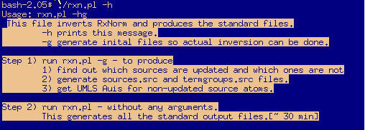
Inversion scripts
rxn.pl -h

Slide 5
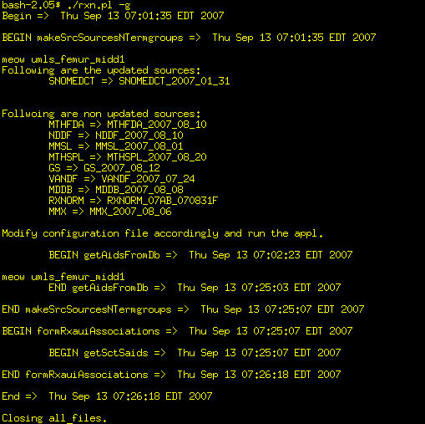
Inversion scripts
rxn.pl -g
sources.src, termgroups.src
updated/non-updated sources
/tmp/atomsWithAuis
/etc/rxaui2Aui
/etc/rxaui2sctSaid

Slide 6
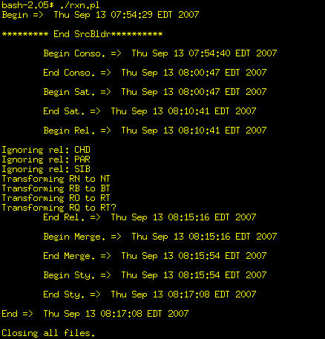
Inversion scripts – cont.
rxn.pl
Why need transmformation?

Slide 7
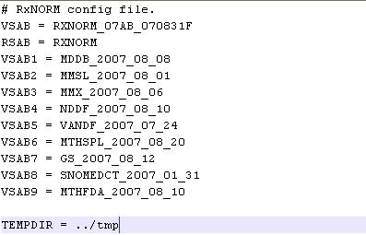
Config. file
rxnorm.cfg
These VSABs information are used within the config file.
It avoids hardcoding the VSABs everywhere.
It is easier to manage, centralized.

Slide 8
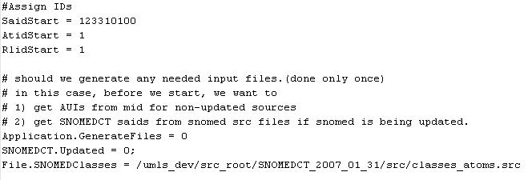
Config. file – cont.
IDs obtain from Sharon.
What is this ?????
SCT updated flag
SCT file path

Slide 9
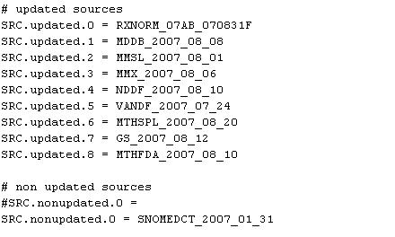
Config. file – cont.
These information are obtained by running rxn.pl –g.
rxn.pl -g
prepareSourceStatus

Slide 10
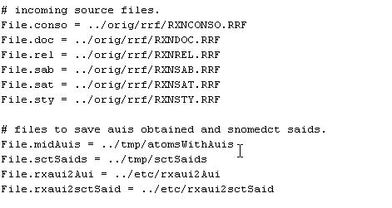
Config. file – cont.
Incoming source files paths
Intermediate files paths
  CheckNeededConfigInfo

Slide 11
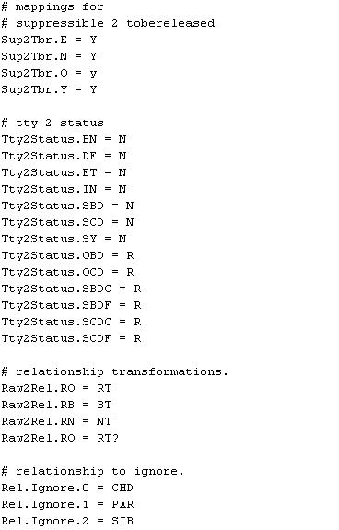
Config. file – cont.
used in init
used in processRel
processRel
  init

Slide 12
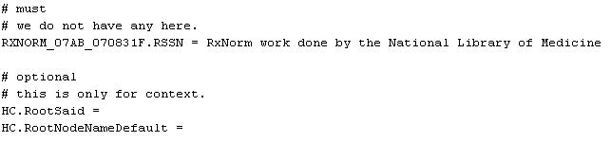
Config. file – cont.
Optional parameters for generating new source and context information.

Slide 13
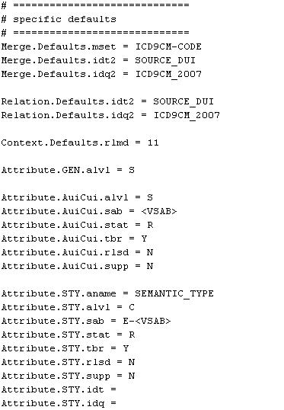
Config. file – cont.
The specific defaults parameters overwrite parameters in /umls_dev/NLM/inv/etc/inv_defaults.cfg.
In addition, it provides additional defined parameters.
  init

Slide 14
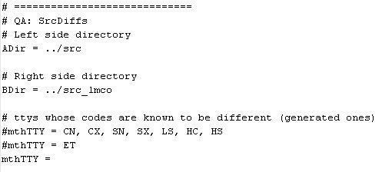
Config. file – cont.
You can provide file paths for running SrcDiffs (QA) instead of providing them from the command line.

Slide 15
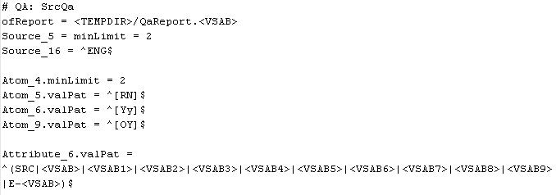
Config. file – cont.
These specified defined values will overwrite the default values in the inv_defaults.cfg. They can be made to become source_specific.

Slide 16
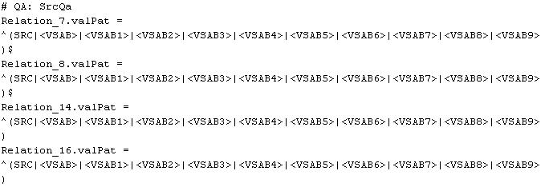
Config. file – cont.
Since there are 10 sources total for RxNorm, the valPat (valid patterns) are limited to only the defined VSABs supplied in the config. file, else it will mark as an error in the QaReport file.

Slide 17
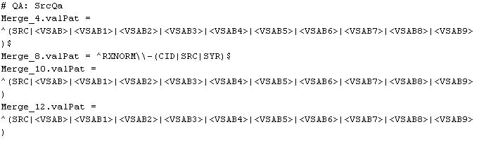
Config. file – cont.

Slide 18
Source Provided Input Files
RXN RRF Files | Records # | Descriptions
RXNCONSO.RRF | 742222 | Concept and Source Information
RXNDOC.RRF | 2296 | Abbreviated Values
RXNREL.RRF | 1644282 | Relationships
RXNSAB.RRF | 10 | Source Information
RXNSAT.RRF | 3874506 | Simple Concept and Atom Attributes
RXNSTY.RRF | 290396 | Semantic Type
RXNATOMARCHIVE.RRF | 100350 | Archive Data
RXNCUICHANGES.RRF | 1478 | CUI Changes
The RRF files are located in the RxNorm directory /orig/rrf folder.

Slide 19
Source Provided Input Files – cont.
RxNorm provides eight RRF files but we only invert four of them.
RXNCONSO.RRF:
  RXCUI|LAT|TS|LUI|STT|SUI|ISPREF|RXAUI|SAUI|SCUI|SDUI|SAB|TTY|CODE|STR|SRL|SUPRESS|CVF
RXNSAT.RRF:
  RXCUI|LUI|SUI|RXAUI|STYPE|CODE|ATUI|SATUI|ATN|SAB|ATV|SUPRESS|CVF
RXNSTY.RRF:
  RXCUI|TUI|STN|STY|ATUI|CVF
RXNREL.RRF:
  RXCUI1|RXAUI1|STYPE1|REL|RXCUI2|RXAUI2|STYPE2|RELA|RUI|SRUI|SAB|SL|DIR|MG|SUPRESS|CVF

Slide 20
Inversion Snippet
When rxn.pl –g is called:
  if (defined $options{g}) {
  &prepareSourceStatus;
  &makeSrcSourcesNTermgroups;
  &formRxauiAssociations;
  }
sub main{}

Slide 21
Inversion Snippet – cont.
sub prepareSourceStatus {
foreach $ele ($glInv->getList('SRC.updated')) {
#getList will get all the VSABs from SRC.updated fields in the config. file
…
#Remember the elements of each updated source into a hash, if the VSAB is SCT, it will have special processing whether it is belonged to an updated or non-updated source.
}
foreach ($glInv->getList('SRC.nonupdated')) {
#remember its elements in a hash.
}
}
&prepareSourceStatus
config. file

Slide 22
Inversion Snippet – cont.
# prepares src/sources.src and src/termgroups.src
sub makeSrcSourcesNTermgroups {
# prepare src/sources.src file.
open(IN, "<:utf8", $glInv->getEle('File.sab')) or die "Could not open File.sab\n";
open (OUT, ">:utf8", $glInv->getEle('File.Sources')) or die "Could not open File.sources.\n";
while(<IN>) {
# write out to sources.src
}
#print out all the updated sources which are stored in the updatedSabs hash.
#print out all the non-updated sources which are stored in the nonupdatedSabs hash.
## prepare src/termgroups.src file by first reading
## from the DOC file and get all the obsolete ttys.
## After that read through the CONSO file and write to the termgroups file.
while(<CONSO>) {
print OUT "$vsab/$tty|$prevVsab/$tty|$supp|N|N|$tty|\n";
}
# for each non-updated sabs, it will get auis from db.
&getAidsFromDb(@strpSrcs);
}
&makeSrcSourcesNTermgroups

Slide 23
Inversion Snippet – cont.
# do this for only non-updated sources.
sub formRxauiAssociations {
open (IN, "<:utf8", $glInv->getEle('File.conso'))
or die "Could not open File.conso\n";
while (<IN>) {
#remember the elements into a hash
}
# record them into files.
# save rxaui2Aui and rxaui2sctSaid are stored in /etc folder
open (OUT, ">:utf8", $glInv->getEle('File.rxaui2Aui', '../etc/rxaui2Aui'))
or die "Could not open file File.rxaui2Aui\n";
foreach $ele (sort keys (%rxaui2Aui)) {
print OUT "$ele|$rxaui2Aui{$ele}\n"; }
}
one parameter
two parameters
&formRxauiAssociations

Slide 24
Inversion Snippet –rxn.pl
#!/share_nfs/perl/5.8.6/bin/perl
use lib "/umls_dev/NLM/inv/bin";
use NLMInv;
use Atom;
use Attribute;
use Relation;
use Merge;
use Context;
use IdGen;
# declare variables, hashes and paths
our ($gAtom, $gAttr, $acAttr, $cxtAttr, $styAttr, $gMerge);
our ($gRel, $gUpRel, $gCxt);
our $sctUpdated = 0;
our %mthAuis = (); # mthAuis - Auis for non-updated srcs (from database)
our %rxaui2Aui = (); # rxaui2Aui -
our %sctSaid = (); # sctSaid
our %rxaui2sctSaid = (); # rxaui2sctSaid
our $cfgFile = "../etc/rxnorm.cfg";
our $ofErrors = "errors.rxnorm";
#subroutines
sub init{}
sub process{}
sub main{}
&main;
Declare the use of different libraries and packages.
Declare variables.
Declare hashes.
Declare path and output filename.
subroutines

Slide 25
Inversion Snippet - subroutines
#These are the main subroutines in rxn.pl.
sub init{}
sub process{}
sub main{}
&main;

Slide 26
Inversion Snippet – sub init{}
sub init {
#get all the updated and nonupdated sources from
#the config. file and store them in hash
&prepareSourceStatus;
# create a main generator with proper seeds.
$mainGenId = new IdGen();
# fill suppressible2tobereleased and tty2status from config file.
%sup2tbr = $glInv->getHash('Sup2Tbr');
%tty2status = $glInv->getHash('Tty2Status');
# create templates for atom, attributes, merge, relationships.
# ATOM templates.
$gAtom = new Atom;
# ATTRIBUTE templates.
$gAttr = new Attribute('Attribute.GEN');
$acAttr = new Attribute('Attribute.AuiCui');
$cxtAttr = new Attribute('Attribute.CXT');
$styAttr = new Attribute('Attribute.STY');
}
sub init{}
&init

Slide 27
Inversion Snippet – sub process{}
sub process {
# dump source meta data.
$glInv->processSrc('RXNORM');
# process conso file.
&processConso;
&processSat;
&processRel;
&processSty;
&processMerge;
}
generate RPT, RAB, VPT, VAB
One of the subroutines in NLMinv.pm
subroutines that process source provided RRF files to generate SRCs
sub process{}
&process

Slide 28
Inversion Snippet – processConso
sub processConso {
$glInv->prTime("\tBegin Conso.");
#declare variables
# process conso file.
open (CONSO, "<:utf8", $glInv->getReqEle('File.conso'))
or die "Could not open input File.conso file.\n";
# we ignore snomedct atoms here.(whether updated or not)
while(<CONSO>) {
#store each element to their declared variable.
if ($sab eq 'RXNORM') {
# dump all rxnorm atoms
$gAtom->dumpAtom({sab => $Vsab, tty => $tty, code => $code,status => $tty2status{"$tty"}, tbr => $sup2tbr{"$supp"}, rlsd => 'N',name => &trim($name), supp => $supp, saui => $saui, scui => $scui, sdui => $sdui});
$thisId = $gAtom->getLastId();
#store elements to different hashes for later retrieval
$rxaui2said_Rx{"$rxaui"} = $thisId;
push(@{$rxCuis{"$cui"}}, $rxaui);
RxNorm
&processConso

Slide 29
Inversion Snippet - processConso
# A1: create RXAUI and RXCUI attributes - RxNorm
$acAttr->dumpAttr({id => $rxaui, aname => 'RXAUI', aval => $rxaui, idt => 'SOURCE_AUI', idq => $Vsab});
$acAttr->dumpAttr({id => $rxaui, aname => 'RXCUI', aval => $cui, idt => 'SOURCE_AUI', idq => $Vsab});
# M1: merge between rxaui to rxcui of RxNorm
$gMerge->dumpMerge({id1 => $rxaui, id2 => $cui, mset => 'RXNORM-CID', idt1 => 'SOURCE_AUI', idq1 => $Vsab, idt2 => 'SOURCE_CUI', idq2 => $Vsab});
&processConso

Slide 30
Inversion Snippet - processConso
} elsif (defined($upSsab2Vsab{"$sab"})) {
# $gAtom->dumpAtom(); (for updated sources, except snomedct)
#store elements to different hashes for later retrieval
# A2: create RXAUI and RXCUI attributes - updated sources
} elsif ($sab eq 'SNOMEDCT' && $sctUpdated == 1) {
# else if it is an updated scnomedct case. It will be handled like the non-updated sources case, except that we use saids as opposed to AUIs in non-updated case.
# store needed elements in hash
# A3: create RXAUI and RXCUI attributes - SNOMEDCT
# other non updated sources (may include sct if it is not updated)
# check that an Aui is available.
if AUIs are not available, skip
} else {
#store the AUIs in a hash.
# A4: create RXAUI and RXCUI attributes - non updated sources
$acAttr->dumpAttr();
}
}
}
close(CONSO);
$glInv->prTime("\tEnd Conso.");
}
Updated Sources
SNOMEDCT
Non-updated Sources
&processConso

Slide 31
Inversion Snippet - processSat
sub processSat {
$glInv->prTime("\tBegin Sat.");
# process attr file.
open (SAT, "<:utf8", $glInv->getReqEle('File.sat'))
while (<SAT>) {
#remember variables.
if ($sab eq 'RXNORM') {
# RxNorm attributes.
# A5: dump rxnorm attribute.
} elsif it is an updated source{
# A6: dump other updated sources attributes.
} elsif it is SNOMEDCT and is updated {
# updated snomed attributes. ignore
next;
} else {
# attributes for non updated sources. These (must) have Auis.
# ignore these.
next;
}
}
close(SAT);
$glInv->prTime("\tEnd Sat.");
}
processSat

Slide 32
Inversion Snippet - processRel
sub processRel {
$glInv->prTime("\tBegin Rel.");
# open RXNREL.RRF (iREL).
# declare variables.
# find from config file what rels to ignore and which ones to transform.
while(<iREL>) {
# store variables
# R1: Do the RXNORM RXCUI1 <-> RXNORM CUI2 rels, dumpRel().
# R2: Do RXNORM RXAUI1<-> RXNORM-or-other-updated_source AUI2 rels, dumpRel().
# R3: 2nd atom is updated SNOMEDCT and non-updated sources, dumpRel();
# create RXNORM-SYR merges here:
# M8: merge between rxaui1 to rxaui2 as AUI, dumpMerge().
# M9: aui2 belongs to rxnorm's, merge between rxnorm aui1 and aui2, dumpMerge().
# M10: rel between rxnorm aui and updated said, dumpMerge();
# M11: take care of snomed first. rest is non-updated, dumpMerge().
# M12: non-updated case, dumpMerge().
# R5: Do rels between two other-updated-source AUIs
# do not include SNOMEDCT. do only if aui1 < aui2
}
close(iREL);
$glInv->prTime("\tEnd Rel.");
}
sub Process

Slide 33
Inversion Snippet - ProcessSty
sub processSty {
$glInv->prTime("\tBegin Sty.");
# process semantic types.
# open RXNSTY.RRF
# declare variables.
while(<STY>) {
# A8: sty attribute for each RXNORM cui, dumpAttr().
}
# A9: dump sty attribute for each updated atom, dumpAttr().
## for non-updated atoms. SNOMED is always in this case.
# A10: snomed case, dumpAttr().
# A11: other non-updated sources, dumpAttr().
}
close(STY);
$glInv->prTime("\tEnd Sty.");
}
sub Process

Slide 34
Inversion Snippet - processMerge
sub processMerge {
$glInv->prTime("\tBegin Merge.");
## M2: merge between updated said to rxnorm's cui
# for each updated CUI, if it is defined in
# the rxCuis hash, dumpMerge().
## M3: merge between non updated Aui to rxnorm's cui
# for each CUI in non-updated CUIs hash, dumpMerge().
## M4: merge between snomed (if updated) said
# to rxnorm's cui, dumpMerge().
## M5: for each cui, merge with in updated sources,
# merge atoms, dumpMerge().
## M6: for non-updated Auis to updated said
# with the same cui. This is one to many –
#each updated said to nonupdated auis, dumpMerge().
## M7: merge between snomed (if updated) said to one of the saids
# for each updated cuis. sct said to updated src atom's said, dumpMerge().
$glInv->prTime("\tEnd Merge.");
}
sub Process

Slide 35
Inversion Snippet – sub main{}
sub main {
open (ERRS, ">:utf8", $ofErrors) or die "Couldn't open $ofErrors file.\n";
$glInv = new NLMInv($cfgFile, *ERRS);
$glInv->prTime("Begin");
&checkNeededConfigInfo (\$glInv);
$sctUpdated = $glInv->getEle('SNOMEDCT.Updated', 0);
if (defined $options{g}) {
&doOnce;
} else {
## read rxaui2Aui and rxaui2sctSaid associations from files.
if ($sctUpdated == 1) {
# read rxaui2sctSaid
}
## initialize inv object to open files etc..
$glInv->invBegin;
## initalize
&init;
## process inversion
&process;
}
$glInv->prTime("End");
$glInv->invEnd;
close(ERRS);
}

