Slide 1
Inversion Framework
&
Utilities

Slide 2
Inversion S/W
Inversion Framework
Inversion Utilities

Slide 3
Problems
Software maintenance
  Cost:
    Development ~ 40%
    Maintenance is ~ 60%
    Response time (Ease of modification)
Single point of failure
  Hard to follow for any one other than the original developer
Accuracy of data

Slide 4
Causes
Lack of standard practices
Lack of understanding
  Lack of documentation
Complexity

Slide 5
Drivers
Simple
  Easy to understand
  Easy to maintain
  Uniformity
Standard practices
Standard tools/utilities
Efficient
Modular
Extensible
Data driven (via configuration file)

Slide 6
A Simple Sample
sub main {
open (ERRS, ">:utf8", "Errors.out") or die "...";
my $inv = new NLMInv("cfgfile", *ERRS);
$inv->invBegin;
$inv->processSrc;
my $atom = new Atom(‘PT’);
my $attr = new Attribute();
my $mrg = new Merge();
my $rel = new Relation();
my $a1 = $atom->dumpAtom({name => "test Atom1", code => '1'});
my $a2 = $atom->dumpAtom({name => "another test Atom1", code => '2'});
$attr->dumpAttr({id => $a1, aname => 'color', aval => 'blue'});
$mrg->dumpMerge({id1 => $a1, id2 => $id2});
$rel->dumpRel({id1 => $a1, id2 => $id2, rname => 'BT', rela => 'has..'});
$inv->invEnd;
close(ERRS);
}
Standard
Init
Standard

Slide 7
Inv Framework
Root Class: NLMInv
Supporting classes:
Atom
IdGen
Hierarchy
Config
Attribute
SrcBldr
NLMInv
Relationship
…….
…….
Logger
…….
Merge
UserAppl
Context

Slide 8
Config
A simple java like config module
Reads a (text) file containing the forms
  rsab = lnc
  ver = 221
  vsab = <rsab><ver>
  A.B1 = xyz
  A.B2 = pqr
Can have comments starting with #

Slide 9
IdGen
Maintains unique numbers for
  aid, atid, rid, mthids
Takes starting numbers and gives next unique numbers
Uniform and across the application
Config:
  SaidStart =
  AtidStart =
  RlidStart =

Slide 10
SrcBldr
Creates sources related information
  Atoms, attributes, rels, merges
Takes the relevant information from config file and sources.src
  MakeRoot =
  MakeTrans =
  vsab.RSSN =
  vsab.RHT =
  vsab.VSY.0 =; vsab.RSY.0 =

Slide 11
SrcBldr 2
Get ids of vpt, vab, rpt, rab
  getVptSaid, getRptSaid, getVabSaid,getRabSaid
Can supply the merge set name. Defaults to stripped source

Slide 12
Atom
Capability to write an atom
  Returns said
Instantiate Atom with different defaults, taken from
  Given in the call
  Cfg file
  Defaults file
Atom ordering:
  ‘natural’ (default, can be set in cfg file)
  other

Slide 13
Atom, Attribute, Merges, Rels
Provide the capability to instantiate with different defaults
Able to write the information to appropriate files while supplying minimal data
  My $atom = new Atom(‘PT’);
  My $id = $atom->dumpAtom({str => “blasdf”})
  $semAttr->dumpAttribute({id => $id1, aval => “..”})

Slide 14
NLMInv
A façade to all other internal classes
Instantiate
  Takes a config file and an error port
InvBegin – initialize all, open files, ..
InvAppend – restart (to add additional info to src files)
InvEnd – close all

Slide 15
NLMInv
ProcessSrc
Get vpt, vab, .. Information
Get config, error port ..
Start and Stop clock (to find elapsed time)
CharCount
ConvertRaw2Utf
PrepareAtomOrdering of the tree
Inherit default STYs

Slide 16
Hierarchy
Capability to build trees, and parent paths
addParChld, PrepareCxts
getParents, getChildren, getDescendants
hasChildren, hasParents
getParentPaths
GetSiblings, getSiblingPairs
GetRoots, setBogusRoot

Slide 17
Config Defaults
# defaults for Atoms
Atom.Defaults.sab = <VSAB>
Atom.Defaults.tty = NONE
Atom.Defaults.code =
Atom.Defaults.status = N
Atom.Defaults.tbr = Y
Atom.Defaults.rlsd = N
Atom.Defaults.name = NONAME
Atom.Defaults.supp = N
Atom.Defaults.saui =
Atom.Defaults.scui =
Atom.Defaults.sdui =
Atom.Defaults.lang = ENG
Atom.Defaults.ordid =
Atom.Defaults.lrc =
# Defaults for Attributes
Attribute.Defaults.id =
Attribute.Defaults.alvl = S
Attribute.Defaults.aname =
Attribute.Defaults.aval =
Attribute.Defaults.sab = <VSAB>
Attribute.Defaults.stat = R
Attribute.Defaults.tbr = Y
Attribute.Defaults.rlsd = N
Attribute.Defaults.supp = N
Attribute.Defaults.idt = SRC_ATOM_ID
Attribute.Defaults.idq =
Attribute.Defaults.satui =
Default file: /umls_dev/NLM/inv/etc/inv_defaults.cfg

Slide 18
Config Defaults
MakeRoot = 0
MakeTrans = 0
VSAB = NONE
RSAB = NONE
TEMPDIR = ../tmp
AtomOrder.Type = Natural
AtomOrder.Begin = 100
AtomOrder.Increment = 10
# standard files
File.Atoms = ../src/classes_atoms.src
File.Attributes = ../src/attributes.src
File.Merges = ../src/mergefacts.src
File.Relations = ../src/relationships.src
File.Sources = ../src/sources.src
File.Termgroups = ../src/termgroups.src
File.Contexts = ../src/contexts.src

Slide 19
Standard File Structure (during release)
Orig
  fromProvider
    Received files
  Pre-processed files
Bin
  Executables
Etc
  Source specific info (config, MG_default_stys..)
Src
  Output .src files
Tmp
  QA
    Reports and logs
  Temp files

Slide 20
Archive
Src_root
  SABS
    RSAB (SNOMED)
      VSAB (SNOMED_2008_01_31)
Yearly
  2007
    ReleaseAB
      SNOMED_2008_07_31

Slide 21
SrcQa
A module to do QA on .src files
Supporting classes:
  QaAtom, QaAttr, QaRel, QaMerge ..
  FldMon, LineMon
Common known checks are implemented in Qa* classes
Configuration driven to specialize for a given source

Slide 22
SrcQa
QaAtom
FldMon
QaAttr
SrcQa
QaRel
QaMerge
LineMon
UserAppl
QaCxt

Slide 23
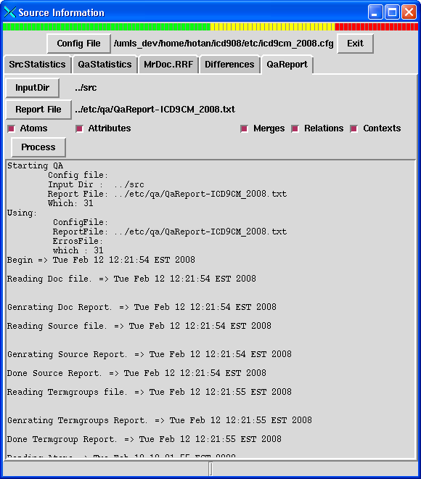

Slide 24
Config Defaults
Source_3.name = RestrictionLvl
Source_3.minLimit = 1
Source_3.maxLimit = 1
Source_3.nullable = 1
Source_3.unique = 0
Source_3.valPat = ^[01234]$
Source_3.invPat =
Source_3.collect = 0
Source_3.collectFile =
Source_3.tally = 1
Atom_1.name = SrcAtomId
Atom_1.minLimit = 9
Atom_1.maxLimit = 12
Atom_1.nullable = 0
Atom_1.unique = 1
Atom_1.valPat = ^[\\d]*$
Atom_1.invPat =
Atom_1.collect = 1
Atom_1.collectFile = <TEMPDIR>/<VSAB>Saids
Atom_1.tally = 0

Slide 25
Config Defaults
Relation_4.name = RelName
Relation_4.minLimit = 2
Relation_4.maxLimit = 7
Relation_4.nullable = 0
Relation_4.unique = 0
Relation_4.valPat = ^(SFO\/LFO|SY|RT|NT|XR|BT|RT\?)$
Relation_4.invPat =
Relation_4.collect = 0
Relation_4.collectFile =
Relation_4.tally = 1
Merge_8.name = MergeSet
Merge_8.minLimit = 1
Merge_8.maxLimit = 30
Merge_8.nullable = 0
Merge_8.unique = 0
Merge_8.valPat = ^<RSAB>\\-(SRC|SY|SCUI|AB|AE|EX|LAT|CODE|CUI|CID|SAMEAS|SRCRPT|SRCVPT|SB)$
Merge_8.invPat =
Merge_8.collect = 0
Merge_8.collectFile =
Merge_8.tally = 1

Slide 26
FldMon
Field specific checks
Collect statistics
Checks valid/invalid patterns
Checks whitespace, uniqueness, min, max and null fields

Slide 27
LineMon
Line specific checks
Can check the validity of the line using the specified field values
  Ex: if attribute name is context, then tbr must be ‘n’
Future: capability to check a file via a hook class

Slide 28
QaAtoms
should be 1 and only 1 each of SRC|SRC/VPT and SRC|SRC/VAB
foreach field: min, max, 0ln,
duplicate saids
term: ascii chars out of range 40-176
term: more than 1 space
term: occurrences of <number> in terms.
term: Odd punctuation chars in terms??
term: mis-matched parens.
Fields: valids
tty/code/saui/scui/sdui should not have blanks in them.
codes should not begin with 'U'
saids should be unique
atoms should be unique (can't have the same sab/tty/sadcui/code/string)
multiple langs
missing order id, duplicate order ids
incorrect number of fields

Slide 29
QaAttrs
mi, max, 0ln
Bad Field Lengths
Duplicate Record IDs
Bad format for IDs - F 2/11
Bad values in fields
Incorrect no. of fields
TBR for CONTEXT or LEXICAL TAG not 'n'
Semantic Type not Status 'N'
Semantic Type w/ level not 'C'
Source not E-<SAB> for Semantic Type (warning)
Invalid ID Type (Field 11)
Unknown Values in Semantic Types
Source Level not Status 'R'
ATN too long
Spacing errors in ATV
No ATV
Duplicate Attributes
Duplicate ATUIs
SOS Attributes Found
Bad LXT TBR settings Found
SAIDs NOT found in classes
Mismatched Parentheses

Slide 30
QaRels
Bad Field Lengths
Duplicates in ID field
Bad field count
Bad values in fields
Bad types in ID_TYPE
Bad ID values in Field 3 or 6
Source level Rels w/ Stat='N' (Fields 2 & 9)
Duplicate NTs for same IDs Found (warning)
Duplicate BTs for same IDs Found (warning)
Conflicting BT & NT for same IDs
Same Rel expressed as both NT and BT (warning)
IDs Missing Qualifiers
Bad RELAs Found
REL/RELA Conflicts
SFO/LFO Rel where TBR != 'Y'
SFO/LFO Rel w/o a RELA
NT Rel w/ ATV eq 'mapped_from'
Invalid REL/RELA combos
Duplicate Code1/Code2 - id_qualifier1 - id_qualifier2 Combos
RUI duplicates
SAIDs NOT found in classes

Slide 31
QaMerges
Bad field count
Bad values in fields
Invalid type (Field 9)
Invalid ID (Field 9)
Invalid ID (Field 11)
Missing Qualifier (Field 10/12)
Bad Field Lengths
Bad Merge Set Values
SAIDs NOT found in classes
Merges between the same atoms

Slide 32
QaOthers
Context:
  Invalid saids
  Missing fields
Sources:
  Bad Field Lengths
  Bad Field Count
  Bad Field Values
  Bad Termgroups
  Missing Termgroups
  Bad Termtype
Termgroups
  Bad Field Lengths
  Bad Field Count
  Bad Field Values
  Bad Termgroups
  Missing Termgroups
  Bad Termtype

Slide 33
Utilities
SrcStats
QaStats
SrcDiffs
MRDOC
SrcQa
ViewTree/STYs
Brit2Amer
CharCount
LVG

Slide 34
SrcStats
Run on a directory with .src files
Produces detailed statistics –tty based
Has a detailed mode which produces more elaborate statistics with other fields.
A|ET|19050
A|HT|3678
A|PT|17282
A|VAB|2
A|VPT|2
M|ICD9CM-CODE_ET_SDUI|4821
M|ICD9CM-SRC_VPT_VAB|1
M|MTHICD9-SRC_VPT_VAB|1
AT|HT_S_CONTEXT|3675
AT|PT_S_CONTEXT|17282
AT|SDUI_C_SEMANTIC_TYPE|21657
AT|SDUI_S_ICA|304
AT|SDUI_S_ICC|190
AT|SDUI_S_ICE|5073
AT|SDUI_S_ICF|58
AT|SDUI_S_ICN|290
AT|SDUI_S_ICS|17282
AT|SDUI_S_SOS|3165
AT|VPT_C_SEMANTIC_TYPE|2
AT|_S_CONTEXT|1
R|BT_VPT_RPT_has_version|2
R|RT?_ET_SDUI_|14229

Slide 35
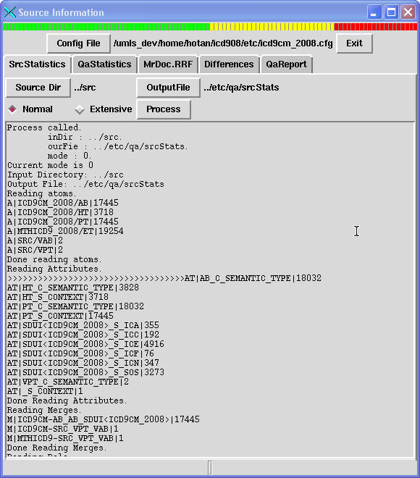

Slide 36
qaStats.src
ATOM1|sab_lat_tty_atom_tally|MEDCIN3_2008_01_23|ENG|FN|265227
ATOM1|sab_lat_tty_atom_tally|MEDCIN3_2008_01_23|ENG|PT|265178
ATOM1|sab_lat_tty_atom_tally|MEDCIN3_2008_01_23|ENG|SY|133559
ATOM3|inv_sab_tty_status_tbr_suppress_atom_tally|MEDCIN3_2008_01_23|PT|N|Y|E|15
ATOM3|inv_sab_tty_status_tbr_suppress_atom_tally|MEDCIN3_2008_01_23|PT|N|Y|N|265
163
ATOM3|inv_sab_tty_status_tbr_suppress_atom_tally|MEDCIN3_2008_01_23|SY|N|Y|N|133
559
ATOM5|inv_scui_atom_notnull_cnt|scui|663964
CXT1|sab_rela_cxt_par_tally|MEDCIN3_2008_01_23|isa|264757
MSET1|inv_mset_stype1_stype2_squal1_squal2_merge_tally|SY|SRC_ATOM_ID||ROOT_SOUR
CE_CUI|MEDCIN|663964
MSET1|inv_mset_stype1_stype2_squal1_squal2_merge_tally|SY|SRC_ATOM_ID||SRC_ATOM_
ID||4
REL1|sab_rel_rela_stype1_stype2_rel_tally|MEDCIN3_2008_01_23|NT|isa|ROOT_SOURCE_
CUI|ROOT_SOURCE_CUI|82854
REL1|sab_rel_rela_stype1_stype2_rel_tally|MEDCIN3_2008_01_23|PAR|isa|SRC_ATOM_ID
|SRC_ATOM_ID|264757

Slide 37
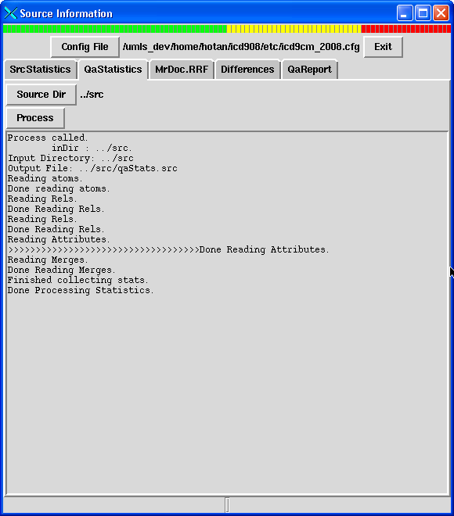

Slide 38
SrcDiffs
A way to compare two sets of .src files
Resolves the references and compares the content
Produces A-B and B-A sets of differences
A valuable tool to check that the results are the same and to identify and fix any descripencies

Slide 39
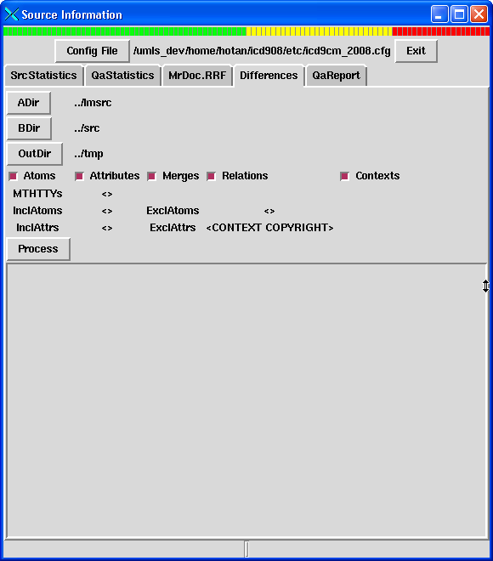

Slide 40
DIFF - 120714042<LN|5352-0|||>/120714045<LN|5352-0|||> - <DEFINITION> =>
<SN for CN: Ro AB>
<SN for CN: Ro AB;>
DIFF - 120725315<LN|8093-7|||>/120725318<LN|8093-7|||> - <DEFINITION> =>
<SN for CN: Ro AB>
<SN for CN: Ro AB;>
DIFF - 120714038<LN|5351-2|||>/120714041<LN|5351-2|||> - <DEFINITION> =>
<SN for CN: Ro AB>
<SN for CN: Ro AB;>
DIFF - 120714050<LN|5354-6|||>/120714053<LN|5354-6|||> - <DEFINITION> =>
<SN for CN: La AB;Ha AB>
<SN for CN: La AB;Ha AB;>
DIFF - 120714045<LN|5353-8|||>/120714048<LN|5353-8|||> - <DEFINITION> =>
<SN for CN: La AB;Ha AB>
<SN for CN: La AB;Ha AB;>
DIFF - MTHU025988<>/MTHU025988<> - <MAPSETVERSION> =>
<June 2007>
<Sept 2006>
DIFF - 120725321<LN|8094-5|||>/120725324<LN|8094-5|||> - <DEFINITION> =>
<SN for CN: La AB;Ha AB>
<SN for CN: La AB;Ha AB;>
DIFF - MTHU025988<>/MTHU025988<> - <FROMVSAB> =>
<LNC215>
<LNC221>
NEW - 120748957<XM|MTHU025988|||>/120567608<XM|MTHU025988|||> - <SEMANTIC_TYPE> =>
<Intellectual Product>

Slide 41
ViewTree
Gui app to visualize hierarchies (with stys)
Takes input from atoms.src and contexts.src
Works for MeSH trees also
Has search capabilities
  By said
  By code
  By string
Written in tcl/tk

Slide 42
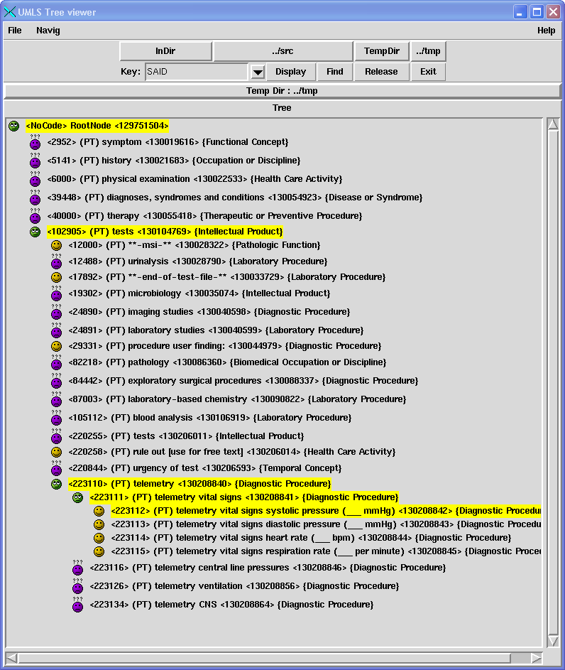

Slide 43
Other
Brit2Amer
  Given a British string, converts to American
CharCount
  Counts the occurrences of chars in a file
LVG
  Takes a file and passes it through lvg with the resulting string appended in the output file

Slide 44
iutil
Other common functionality
  StripBlanks
  CheckId (if a given id is valid – format)
  ValidSty…

Slide 45
Doc
Every program must have the following switches
-h help
-g generate all intermediary input files
Usage: sct.pl -hgs
This file inverts SNOMEDCT and produces the standard files.
-h prints this message.
-l specify the language. SPA is for spanish. otherwise English.
-g generate inital files so actual inversion can be done.
-s generate semantic type attributes after the inversion and a
a test insertion. This process uses a file sty_term_ids that
is produced as a result of test insertion.
1) First prepare the input files. For a list of these and
and their descriptions, see OCCS_SNOMED.readme file.
2) Edit the .cfg file
3) run sct.pl -g to generate the necessary files.
4) Update the generated etc/..files. [MG_URcid2did]
5) run sct.pl.
This generates all the standard output files.[~ 90 min]

Slide 46
Doc
Source document must have
4 tables – atoms, attrs, rels, mrgs
Explain for each tty, all other properties
A good diagram

Slide 47
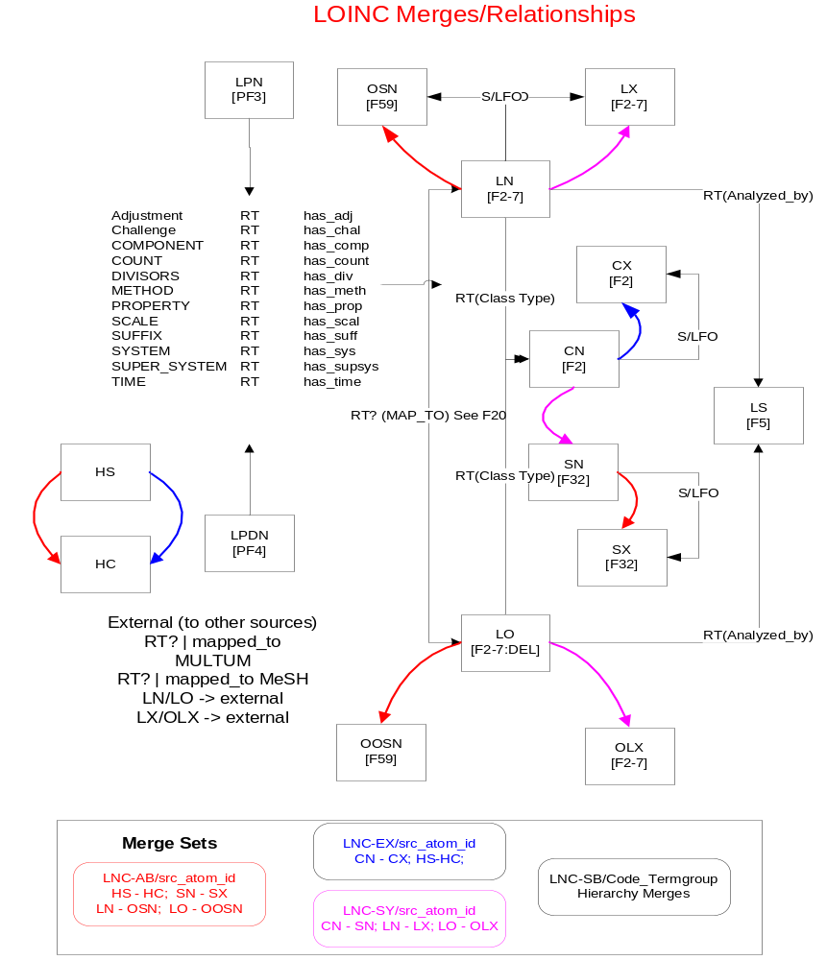

Slide 48
Sample atoms table
LN | Official Fully Specified Name: From file: LOINCDB Condition: If F19 is != “DEL” (meaning current) String: F2:F3:F4:F5:f6:F7 Code: F1 Attrs: context and F2 – F61 except F10, F23, F25, F27, F32, F48, F49, F59. NOTE: F45 and F30 have multiple values separated by “,” and “;” respectively. Separate them and create multiple attributes. STY: ‘Clinical Attribute’
LO | From File: LOINCDB Condition: if F19 = “DEL” (meaning obsolete) String: F2:F3:F4:F5:f6:F7 Code: F1

Slide 49
SNOMED 5hrs vs. > 1day
Comprehensive QA
  SNOMED QA could not even run
Visualization of hierarchies and STYs
Standardization

Slide 50
Sample QaRules
# FileMon.Atom.6.name = Mismatched SUPPRESS (Y)
# SELECT a.Termgroup, a.SUPPRESS, b.SUPPRESS
# FROM termgroups a, classes_atoms b
# WHERE a.Termgroup = b.Termgroup
# AND ((a.SUPPRESS = 'Y' && b.SUPPRESS NOT IN ('Y','O'))
# OR
# (a.SUPPRESS = 'N' && b.SUPPRESS = 'Y')
# OR
# (a.SUPPRESS = 'O' && b.SUPPRESS != 'O'))
#
#
IlFileMon.Atom.6.enable = 1
IlFileMon.Atom.6.type = error

Slide 51
Sample QaRules
# SELECT VSAB, SrcAttrId FROM attributes
# WHERE attribute_name='XMAP'
# AND SUBSTR(ATV,
# instr(ATV, '~', 1, 3) + 1,
# (INSTR(ATV, '~', 1, 4) - INSTR(ATV, '~', 1, 3)) -1 )
# IS NULL;
#[12]
#LineMon.Attribute.10.name = XMAP Attribute with Null REL
#LineMon.Attribute.10.tally = "@_[6]|@_[1]"
#LineMon.Attribute.10.query = @j = split(@_[5],/\~/,5); \
# @_[4] eq 'XMAP' && $j[2] eq 'RN' && $j[3] eq ''
IlLineMon.Attribute.10.type = error
IlLineMon.Attribute.10.enable = 1

Slide 52
Sample QaRules
# SELECT SrcRelId, VSAB FROM relationships
# WHERE SgId1 = SgId2
# AND SgType1 = SgType2
# AND NVL(SgQual1,'null') = NVL(SgQual2,'null');
#
#LineMon.Relation.2.name = Self-referential Relationships
#LineMon.Relation.2.tally = "@_[1]|@_[7]"
#LineMon.Relation.2.query = @_[3] eq @_[6] && @_[13] eq @_[15] \
# && @_[14] eq @_[16]
IlLineMon.Relation.2.type = error
IlLineMon.Relation.2.enable = 1

Slide 53
Sample QaRules
# SELECT SrcRelId, VSAB, REL, RELA FROM relationships
# WHERE (RELA in ('associated_with','consists_of','constitutes',
# 'contains','contained_in','ingredient_of','has_ingredient')
# AND
# REL != 'RT')
# OR (RELA in ('conceptual_part_of','form_of','isa','part_of',
# 'tradname_of')
# AND REL != 'NT')
# OR (RELA in ('has_conceptual_part','has_form','inverse_isa',
# 'has_part','has_tradname')
# AND REL != 'BT');
#
#LineMon.Relation.3.name = Conflicting REL,RELA
#LineMon.Relation.3.tally = "@_[1]|@_[7]|@_[4]|@_[5]"
#LineMon.Relation.3.query = (@_[4] eq 'RT' && @_[5] !~ /<RTRELAS>/) \
# || (@_[4] eq 'NT' && @_[5] !~ /<NTRELAS>/) \
# || (@_[4] eq 'BT' && @_[5] !~ /<BTRELAS>/)
IlLineMon.Relation.3.type = error
IlLineMon.Relation.3.enable = 1

Slide 54
Sample QaRules
# SELECT VSAB,SgType1,SgType2 FROM relationships
# WHERE REL = 'SFO/LFO'
# AND (SgType1 NOT IN ('ROOT_SOURCE_AUI','SOURCE_AUI','SRC_ATOM_ID')
# OR
# SgType2 NOT IN ('ROOT_SOURCE_AUI','SOURCE_AUI','SRC_ATOM_ID'));
#
#LineMon.Relation.5.name = SFO/LFO Not Connected to Atom
#LineMon.Relation.5.tally = "@_[7]|@_[13]|@_[15]"
#LineMon.Relation.5.query = @_[4] eq 'SFO/LFO' && (@_[13] !~ /<SLFOSGS>/ \
# || @_[15] !~ /<SLFOSGS>/)
IlLineMon.Relation.5.type = error
IlLineMon.Relation.5.enable = 1

Slide 55
Sample QaRules
# SELECT * FROM relationships
# WHERE (SgId1,SgId2,SgType1,SgType2,SgQual1,SgQual2)
# IN (SELECT SgId2,SgId1,SgType2,SgType1,SgQual2,SgQual1
# FROM relationships);
#
# FileMon.Relation.6.name = Duplicate Relationships
#IlFileMon.Relation.6.type = error
IlFileMon.Relation.6.enable = 1

Slide 56
Sample QaRules
# SELECT * FROM mergefacts
# WHERE SgId1 = SgId2
# AND SgType1 = SgType2
# AND NVL(SgQual1,'null') = NVL(SgQual2,'null');
#
#LineMon.Merge.1.name = Self-referential Mergefacts
#LineMon.Merge.1.query = @_[1] eq @_[3] @_[9] eq @_[11] @_[10] eq @_[12]
IlLineMon.Merge.1.type = error
IlLineMon.Merge.1.enable = 1

