Slide 1
Boot Camp II:
Inversion and
Insertion
Welcome and Overview
Tuesday - Thursday, February 21 - 23, 2006
David Sherertz

Slide 2
Agenda
Welcome and Introductions
Housekeeping Details
Overview – UMLS and Transition Context of Inversion and Insertion

Slide 3
Introductions - 1
NLM - OCCS
  Simon Liu
  Karen Casey
  Wei Ma
  Naveen Hota
  Ronnie Chan
  Soma Lanka
Apelon (presenters in Gold)
  Brian Carlsen
  Stephanie Lipow
  Keith Lindsay
  David Sherertz
  Stu Mayhugh
  Tim Kao
  Luda Druskin
  Tony Weida
  Adam Weinrich
  Eric Mays
  Stephen Coady

Slide 4
Introductions - 2
NLM – LO
BSD
  Carolyn Tilley (Day 1)
MMS
  David Gillikin (Day 1)
  Jan Willis
  Valerie Akers
  Heather Hopkins
  Rachel Kleinsorge (Day 1)
NICHSR
  Vivian Auld (Day 1)
MeSH
  Stuart Nelson (Day 1?)
  John Kilbourne
  Tammy Powell
  Natalie Arluk (Day 2 only)
NLM – LO
RxNorm / DailyMed
  Robin Moore
  Vikraman Ganesan
  Chandra Kola
  Ratnakar Korem
  Subbarao Polavarapu
  Xiaohang Wang
NLM – LHC
  William Hole (Day 1?)
  Kin Wah Fung (Days 1 / 2)
NCI / MSD
  Carol Creech
  Amy Jacobs (Day 1+?)
  Laura Roth

Slide 5
Housekeeping Details
Coffee, Tea and Pastries in ‘foyer’ outside
Bathrooms on other side of elevators
Lunch today of sandwiches, chips, drinks
General Question and Answer session at end of each day and each session (if time)
Quiz ( and Certificates if you pass ☺ ) at end of Day 3
No ‘official’ wireless internet access here (we want your full attention anyway!)

Slide 6
Session Logistics
No session is longer than 75 minutes
Most sessions are 45 – 60 minutes
Breaks are 15 minutes
Lunch is available here today only
Lunch break is 90 minutes Days 1 and 2
Lunch only 60 minutes on Day 3
But we end by 3 PM on Day 3
We will try to stay on schedule
All course materials available on MEOW
http://meow.nlm.nih.gov/MEME/Training/InversionBootCamp/boot_camp_schedule.html

Slide 7
Overview and Context
This is a detailed-oriented training, especially Days 2 and 3
Represents over 16 years of experience
Processes have evolved over the years, but some ‘legacy’ approaches remain
As you will see, Inversion and Insertion are very content-oriented, source specific, and QA intensive
We believe we are making progress!

Slide 8
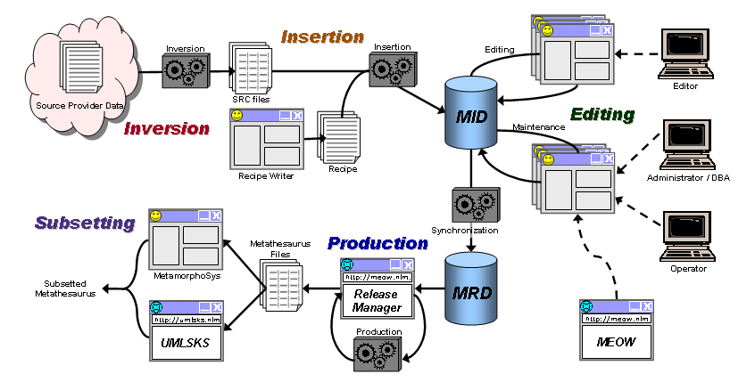
Metathesaurus Life Cycle
http://meow.nlm.nih.gov/MIDS

Slide 9
Transition Phases - 1
Phase I – Media production and distribution of approved release files
Phase II – Independent QA verification, validation, and approval of release files
Phase III – Production database building, database validation and release file generation
Phase IVa– Editing sources in the MID, validation and approval of data with Jekyll interface
Phase IVb– EMS, WMS administration and source insertion into the MID
Phase V – Inversion and test insertion of source files into the MID

Slide 10
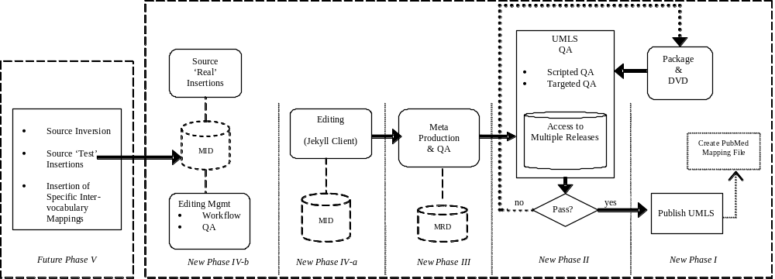
Transition Phases - 2
http://meow.nlm.nih.gov/Transition/index.html

Slide 11
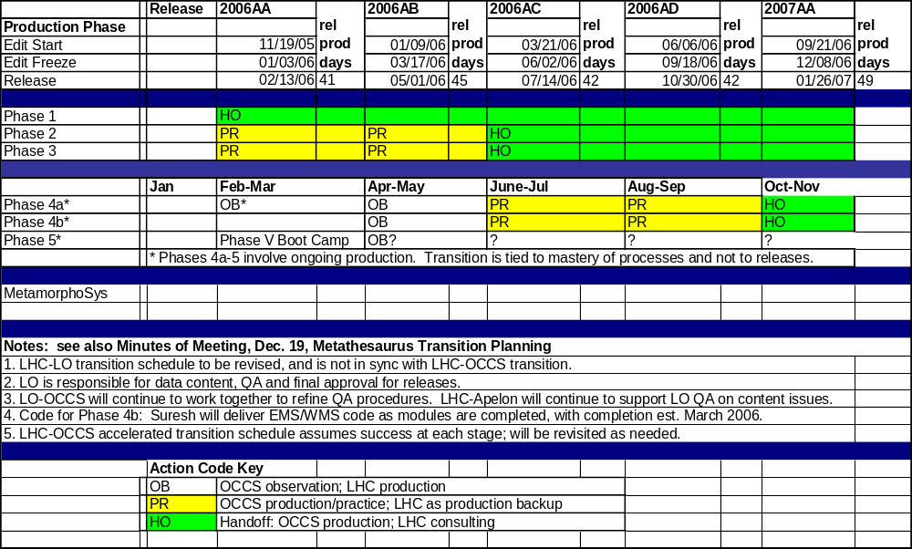
Transition Schedule

Slide 12
Questions?

Slide 13
Let’s Get Started!

