Slide 1
A “simple” update
Stephanie Lipow
Inversion/Insertion Boot Camp
February, 2006

Slide 2
Why isn’t inversion straightforward?
The challenge is rarely technical
The “answers” aren’t always clear
Data is rarely “perfect” or as expected
Documentation is often lacking
Input data formats change
Formal spec changes
Our thinking evolves
“Finishing touches,” (metadata, documentation) often take longer than expected

Slide 3
Changing the spec
Recent examples:
Change in the way we handle Metathesaurus-added data, e.g. Americanizations (affected SNOMEDCT, MedDRA, ICPC2Plus, etc.)
Change in suppressibility values for obsoletes (affected NCBI, LOINC, ICPC2Plus, etc.)

Slide 4
Changing the spec
General
Discuss & decide on spec
Update documentation
Change .src QA
Source-specific
Change inversion script
Update conservation of mass
Update metadata files
Update documentation

Slide 5
Evolution
Goal of source transparency (usually)
Less effort to “fix” sources

Slide 6
ICPC2Plus source files
2001
1,"Disease;Hansens (Leprosy)","A78016"
2,"Problem;growth;infant","T10005"
3,"Lesion;brachial plexus","N94001"
5,"Pain;left lower quadrant","D06005"
6,"Lesion;internal","A99003"
7,"Lethargy","A04014"
8,"Lesion;penile","Y04003"
9,"Leukaemia ","B73001"
11,"Lesion;vulval","X16004"
12,"Lesion;intracranial","N99009"
14,"Leucorrhoea","X14002"
15,"Problem;feeding;infant","T04004"
16,"Loss (of);relative","Z23001"
19,"Lichen simplex chronicus","S99013"
20,"Lesion;hives;skin","S98002"
21,"Leukopenia","B84005"
22,"Lesion;vaginal","X15003"
23,"Loss (of);child","Z19001"
2005
1,"Disease;Hansens (Leprosy)","Hansens (leprosy) disease","A78","016","A",
2,"Problem;growth;infant","problem with growth of an infant","T10","005","A",
3,"Lesion;brachial plexus","lesion of brachial plexus","N94","001","A",
4,"Lazy eye","n/a","F15","002","I","F14006"
5,"Pain;left lower quadrant","left lower quadrant pain","D06","005","A",
6,"Lesion;internal","internal lesion","A99","003","A",
7,"Lethargy","lethargy","A04","014","A",
8,"Lesion;penile","penile lesion","Y04","003","A",
9,"Leukaemia ","leukaemia","B73","001","A",
10,"Lesion;skin;generalised","n/a","S05","002","I","S29019"
11,"Lesion;vulval","vulval lesion","X16","004","A",
12,"Lesion;intracranial","intracranial lesion","N99","009","A",
13,"Lesion;skin;multiple","n/a","S05","003","I","S29019"
14,"Leucorrhoea","leucorrhoea","X14","002","A",
15,"Problem;feeding;infant","infant with feeding problem","T04","004","A",
16,"Loss (of);relative","loss of relative","Z23","001","A",
17,"Locking (of); joint(s)","n/a","L29","003","I","L20026"
18,"Lesion;skin;localised","n/a","S04","002","I","S29018"
19,"Lichen simplex chronicus","lichen simplex chronicus","S99","013","A",
20,"Lesion;hives;skin","skin hive lesion","S98","002","A",
21,"Leukopenia","leukopenia","B84","005","A",
22,"Lesion;vaginal","vaginal lesion","X15","003","A",
23,"Loss (of);child","loss of child","Z19","001","A",

Slide 7
Differences
File name
  2001: icpc2plus.csv and rubric.csv (ICPC2E hierarchy)
  2005: ATT355079.txt (received rubric but it did not sync with UMLS version of ICPC2E, so we have no hierarchy)
File format
  2001: 3 fields, including ICPC2P code
  2005: 7 fields – 5 new fields: “natural language,” ICPC2E code, termcode, status, replacement; no code field (need to concatenate); inclusion of inactive concepts

Slide 8
Characteristics to take note of
British spellings; American equivalent not provided by source
  Incise;haematoma;skin
Use of abbreviations in Description
  Premature;rupt of memb;stillbi”
Unusual punctuation, grammar conventions, use of (s)
  Locking (of); joint(s)
Use of “n/a” in natural language field for most inactive
Natural language term sometimes same as Description
Same string different code cases exist
Need to combine 2 fields to make the “code”
Inclusion of inactive concepts, replacement info
Extra blanks found in some term fields

Slide 9
Changes in inversion
Consider how to populate new UMLS fields: SAUI, SCUI, SDUI, order_id
Handle Metathesaurus-created data (Americanizations) in new way
Default semantic types in new way due to no hierarchy
No pretty versions of atoms for aesthetic reasons – lvg now handles “(s)”
No abbreviation expansions
Add code to deal with inactives (tty, suppressibility)
Accomodate new source fields (ATNs, rels, etc.)
Concatenate fields to create code
Understand and handle replacements (merge? create rel?)
Create atoms from “natural language terms,” understand their effect on insertion
Use SRCbuilder to create SRC concept; RHT no longer needed
MRDOC.RRF required
(contexts.src, mapping data not required for this source)

Slide 10
Quiz
How many termtypes will there be for ICPC2Plus?
What are options for representing “replacement” information in ICPC2Plus?
Why insert “natural language terms” status=‘R’?
Should same string different code be allowed to merge?
In the input data, there are 7410 lines where status=A; 909 lines where status=I. Predict the number of PT, PTN, OP, OPN termtypes

Slide 11
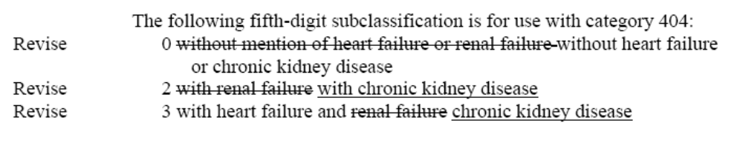
More examples
results in changes to 9 codes (404.00, 404.02, 404.03, 404.10, 404.12,
404.13, 404.90, 404.92, 404.93)

Slide 12
More examples ...
MedDRA (the “perfect” source), SNOMEDCT: Inversions updated to comply with new format for Metathesaurus-created data (Americanizations, abbreviation expansions); creation of mapping data in progress for MedDRA; new MedDRA data not yet processed
CPT, HCPCS: Hierarchy not available electronically; we create it from the book
ICD-9-CM: updates in .pdf format must be manually processed; no official preferred term
NCBI: exclude certain parts of the hierarchy; suppress terms with certain patterns
AlternativeLink: New format requires parsing on commas ... but there are a few extra commas
CRISP: Originally combined “see” and “use” relationships, but recently decided this did not represent the source transparently (after attempted “reversion” project).
HL7: character set issues, data model mismatches, etc.

