Slide 1
NCIEditTab – A Protégé TabWidget Plug-in
Kim Ong, Iris Guo
Present to NCICB
2/20/2007

Slide 2
Outline
Objective
Background
NCIEditTab plug-in
  Use Cases
  Design Overview
  Class Hierarchy
  Key Classes
  Sample code
Summary
Discussion

Slide 3
Objective
Support NCICB effort in migrating EVS to open terminology development and open terminology server environment
  LexBIG
  Protégé/OWL ontology editor
  MEME/Jekyll Metathesaurus editor
Replace Apelon’s proprietary Ontylog editor by Stanford Medical Informatics (SMI’s) open source Protégé OWL ontology editor

Slide 4
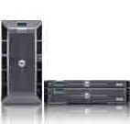


Protégé-OWL Editor Architecture
Server
jdbc
Database
Internet
RMI
Client

Slide 5
Protégé-OWL Editor
Load and save OWL and RDF ontologies
Edit and visualize classes, properties, and SWRL rules
Define logical class characteristics and OWL expressions
Execute reasoners such as description logic classifiers
Edit OWL individuals for Semantic Web markup
  Source: http://protege.stanford.edu/overview/protege-owl.html
  SWRL: Semantic Web Rule Language (combine OWL and RuleML)

Slide 6
Protégé/OWL Editor Advantages
Open Source
Concurrent Users
Sharing of a single knowledge base by multiple users
Maintainability
Extendibility (e.g., Advanced Search Plug-in (AQP) by SMI and University of Victoria)

Slide 7
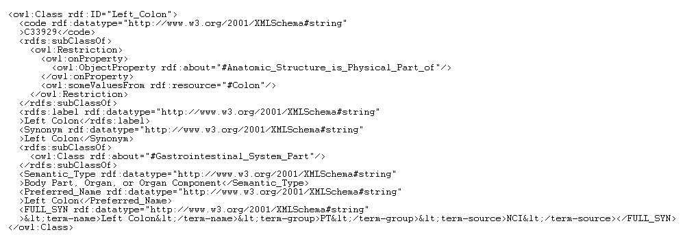
OWL – An Example
rdf:ID, rdfs:label, rdfs:comment, etc
simple data type annotation property
anonymous super-class
(restriction, role)
named super-class
complex data type annotation property (with qualifiers)
object-valued annotation property (association)
Source: NCI Thesaurus

Slide 8
Semantic Conversion
Ontylog
  Roles
  Properties
  Associations
  Role Groups
  Defined and Primative Concepts
  Qualifiers
OWL
  Restrictions
  Data type annotation properties
  Object-valued annotation properties
  Expressions
  Necessary and Sufficient and Necessary conditions
  No easy way to represent qualifiers – use micro-syntax
Source: “Status of EVS migration to open terminology development tools
and open terminology server software” by Sherri de Coronado and Gilberto Fragoso

Slide 9
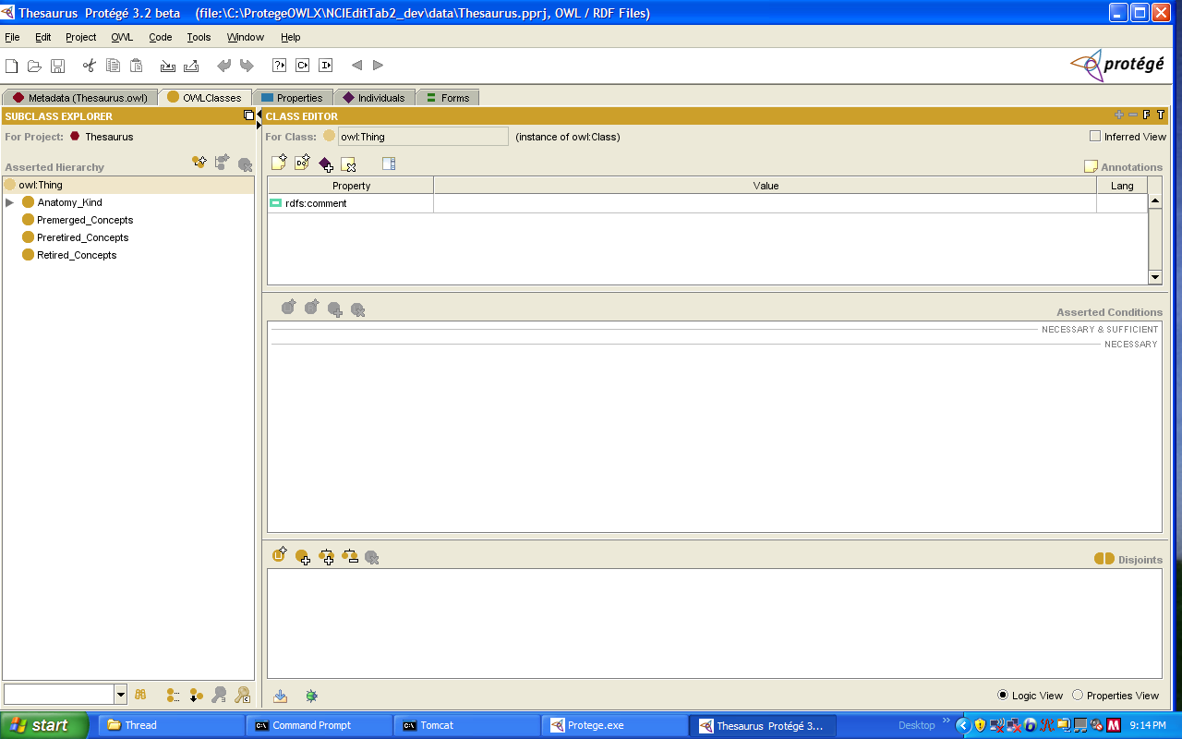
Protégé/OWL Editor Main User Interface
Create subclass
Create sibling class
Delete selected class
Taxonomy Tree
drag and drop
double clicking brings
up an OWL class editor on
a pop-up window
OWL Class Editor (for editing a single class)
Search

Slide 10
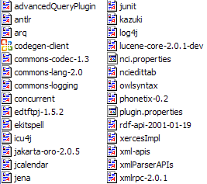
NCIEditTab - a Tab Widget Plug-in
(\plugins\gov.nih.nci.protegex.nciedittab)
code generator server
Server
code generator
ip and port
jdbc
Database
internet
Built on top of Protégé OWL plug-in

Slide 11
Dependencies and Interfaces
Depend on Core Protégé and OWL Plug-in
Interface with
  Advanced Query Plug-in (AQP)
  History Plug-ins
  Prompt – workflow management

Slide 12
NCIEditTab Use Cases
Create named class (i.e., concept)
Edit class
  FULL SYNs (i.e., terms, or synonyms with term group, source, and source code data)
  DEFINITIONs and qualifiers
  Restrictions (roles and role groups)
  Named super-classes
  Associations (object-valued annotation properties)
  Simple properties
  Other complex properties with qualifiers
Delete class (by authorized users)

Slide 13
NCIEditTab Use Cases
Split
Pre-merge
Merge
Pre-retire
Retire
Generate reports
Load concepts in batch
Edit concepts in batch
Generate partonomy tree
Copy data elements between concepts
Perform advanced queries
Edit by-name and by-code OWL data formats

Slide 14
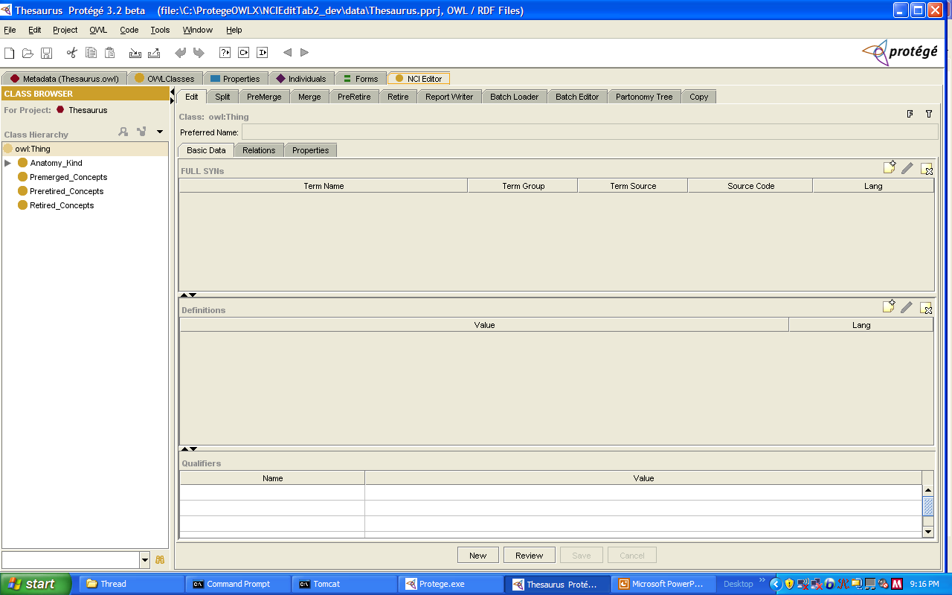
NCIEditTab Main User Interface
Tabs mapped to use cases
Edit Panel (customized class editor)
Basic data
Relations
Properties
Taxonomy Tree
No drag and drop
No “hard” delete
Double clicking brings up a read-only Edit Panel
Save all changes at the same time
Advanced Search

Slide 15
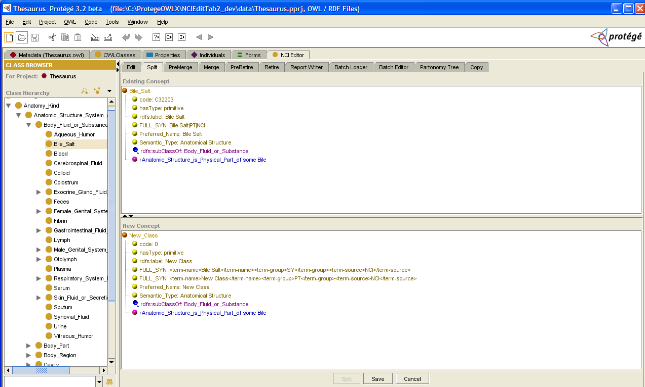
Tree-Based UI Components
Nodes are editable through pop-up menu and dialog boxes
T1
T2
Split

Slide 16
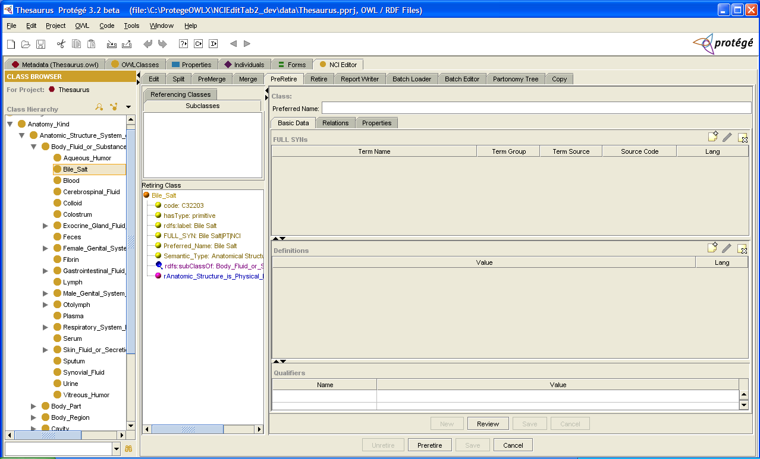
Reuse Components
Resolve subclasses and
referencing classes
Edit Panel as shown earlier
language
drop-down
T1
Pre-retire

Slide 17
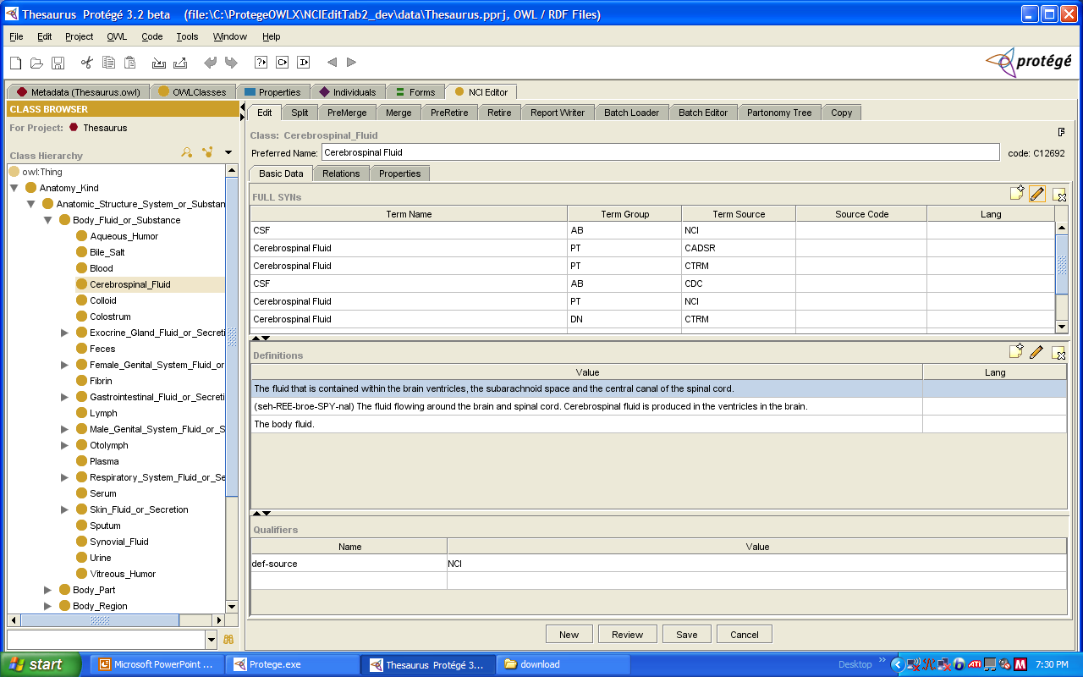
Changes are Saved in Batch
Require changes to OWL plug-in table models
Buffering of data
(Save Button)

Slide 18
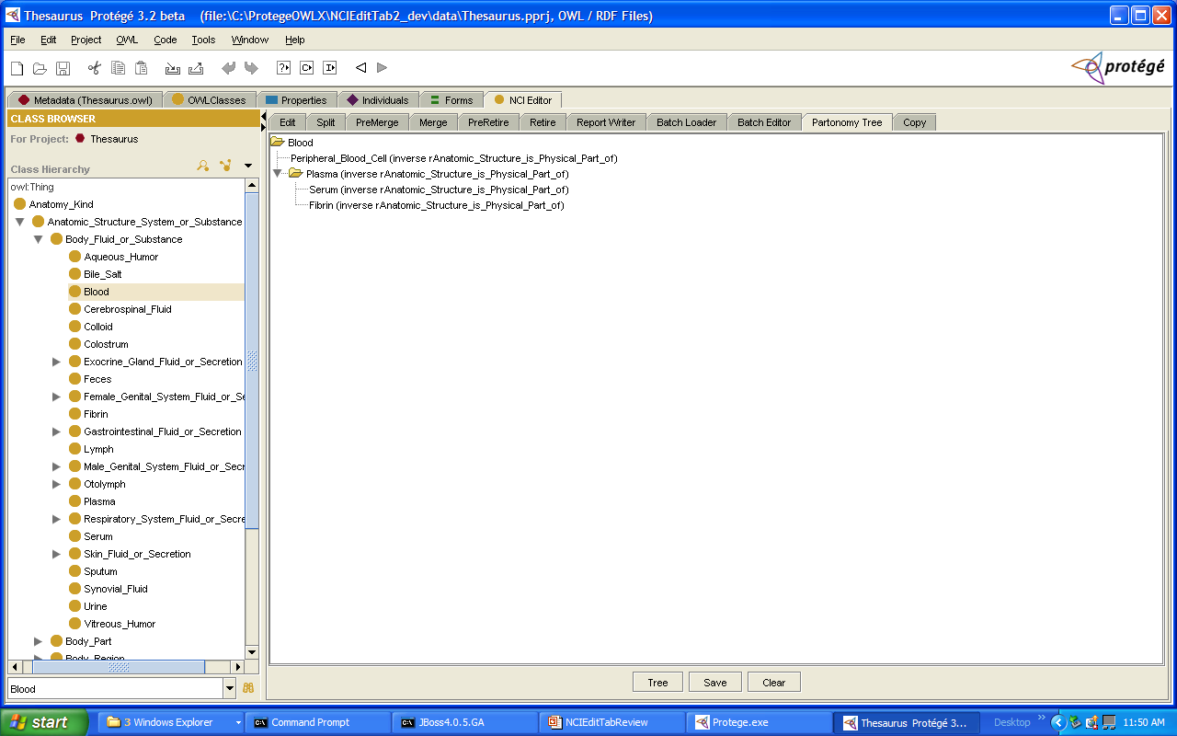

Partonomy Tree Display

Slide 19
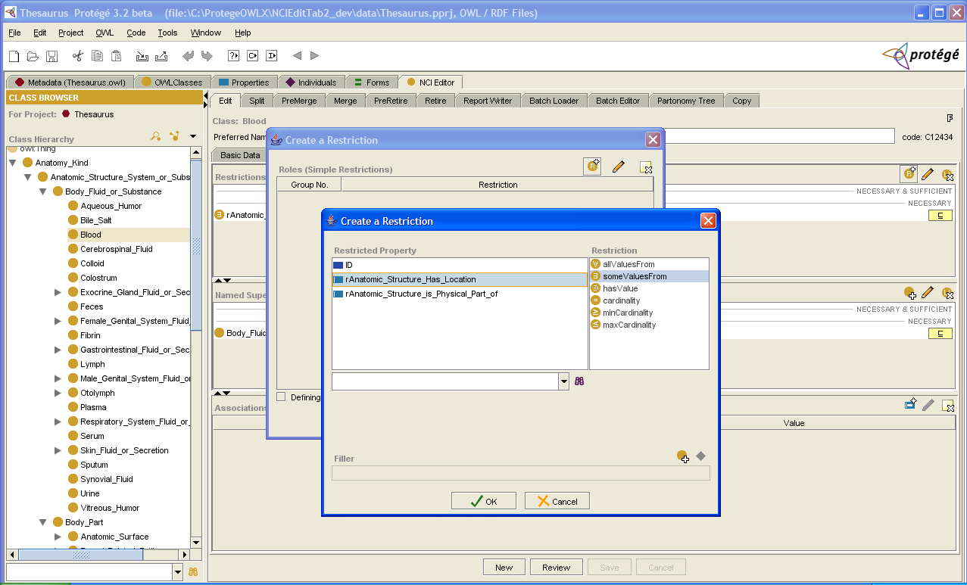
Edit Action Requires Specific Dialog Boxes
Role Group Editing

Slide 20
Example: Role Group
Role group expression: UG_{i}
General expression: (∩g_{i}) ∩ (UG_{i})
  where g_{i} and g_{ik} represent simple restrictions,
  G_{i} = g_{i1} ∩ g_{i2} … ∩ g_{ik} denote role groups,
  and ∩ and U represent the intersection and union operators, respectively.

Slide 21
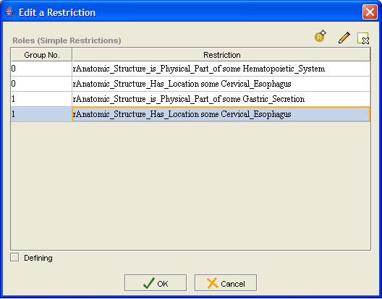
Role Group Editing
Add
Modify
Delete
Group
number
assigned
by the user
Each row corresponds to a simple restriction/role
(Note: content are for illustration only)

Slide 22
Role Group Editing
Saved in KB as:
  OWLIntersectionClass: (∩g_{i}) ∩ (UG_{i})
  OWLUnionClass: UG_{i}
  OWLRestriction: g_{i} (degenerate case)

Slide 23
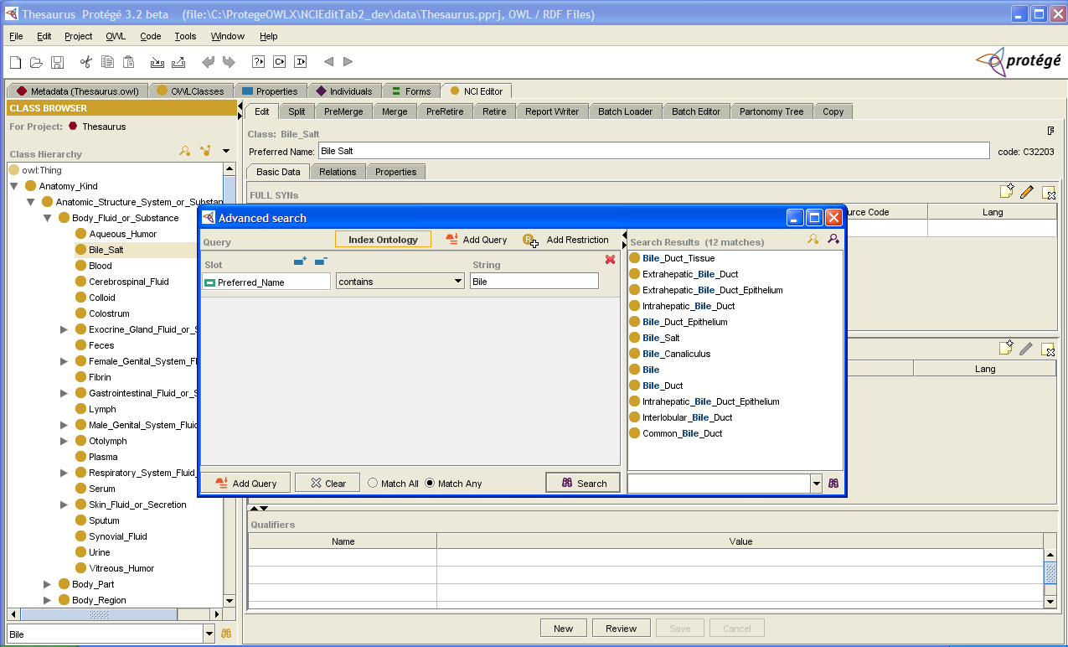
Integration with AQP
AQP

Slide 24
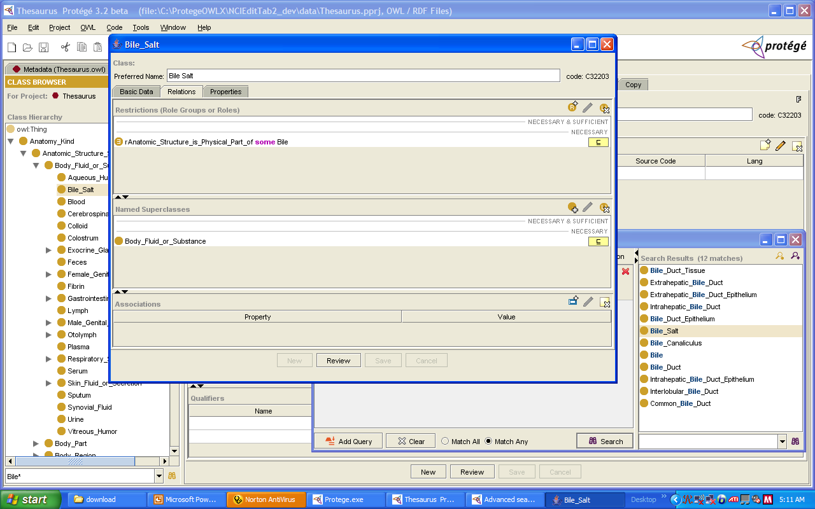
Integration with AQP
(two-way communications)
read-only
Invoke NCIEditTab
AQP
Invoke AQP
Also used in class selection

Slide 25
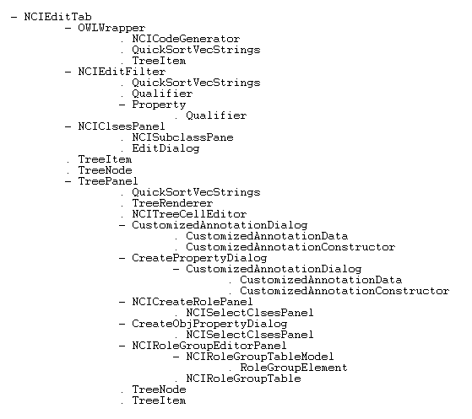
Class Hierarchy

Slide 26
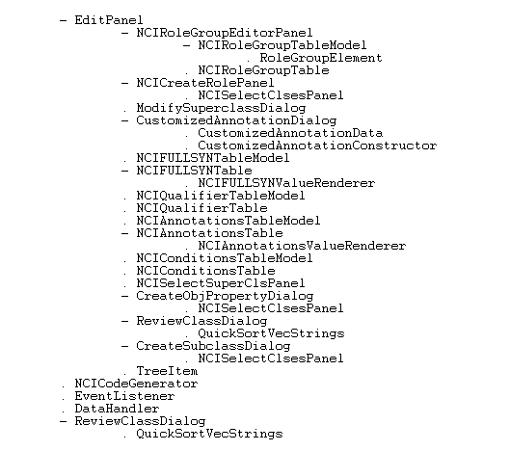
Class Hierarchy

Slide 27
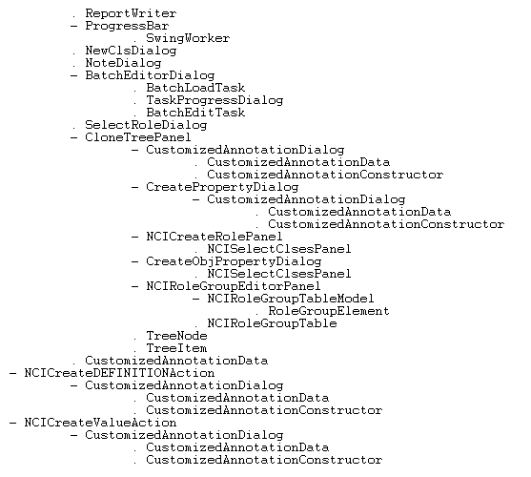
Class Hierarchy

Slide 28
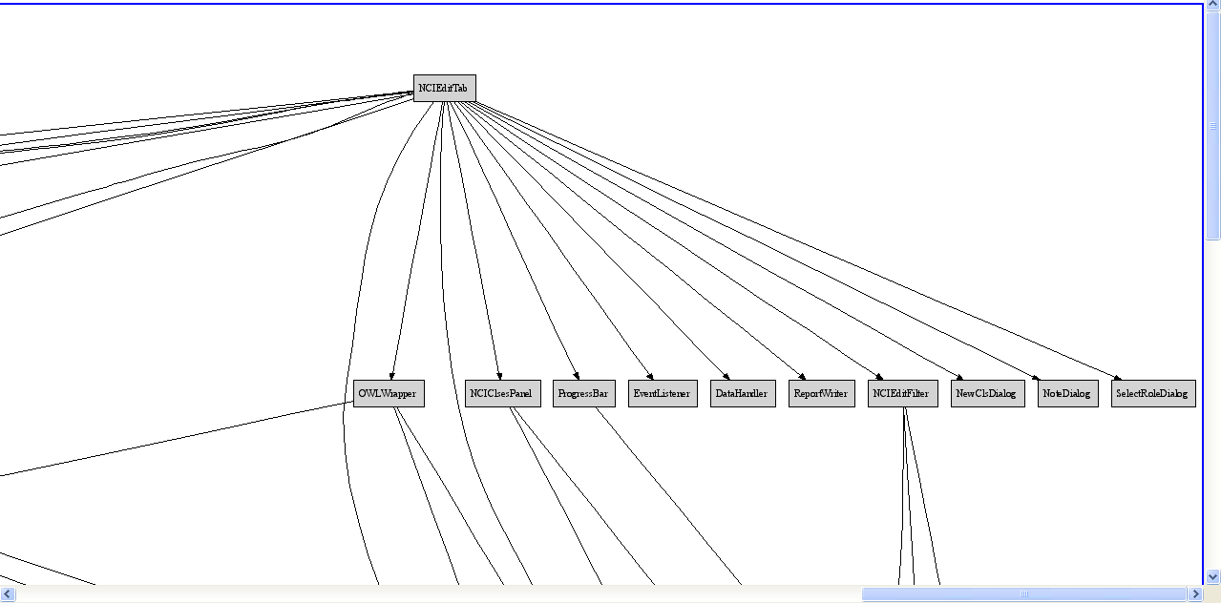
NCIEditTab Class Hierarchy
(Graphviz plot)

Slide 29
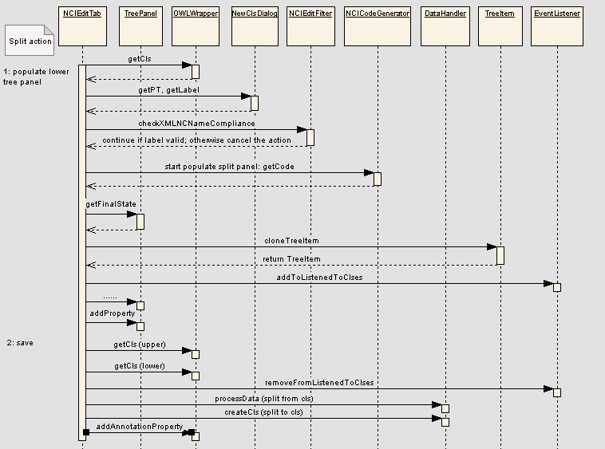
Sample Sequence Diagram
Split

Slide 30
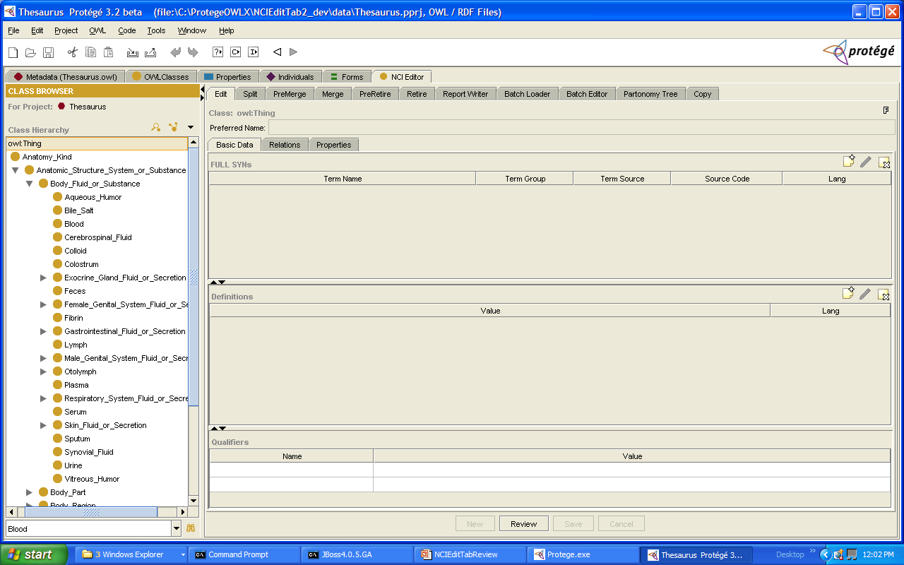
Class NCIEditTab
Provide main user interface
Check user privilege through remote meta-project
Instantiate
  NCICodeGenerator
  OWLWrapper
  DataHandler
  NCIEditFilter
  EventListener
Instantiate/initialize panel for each tab
Implement actionPerformed method to respond to each user command (i.e., button-press)

Slide 31
Class EditPanel
Provide user-interface for editing a single class:
  Create new class
  Edit FULL_SYN properties
  Edit DEFINITION properties (and qualifiers)
  Edit relations
    Restrictions (i.e., role and role groups)
    Named super-classes
    Object-valued annotation properties (i.e., associations)
  Edit simple annotation properties
  Edit complex annotation properties and qualifiers (for example, GO Annotation)
  Delete a class

Slide 32
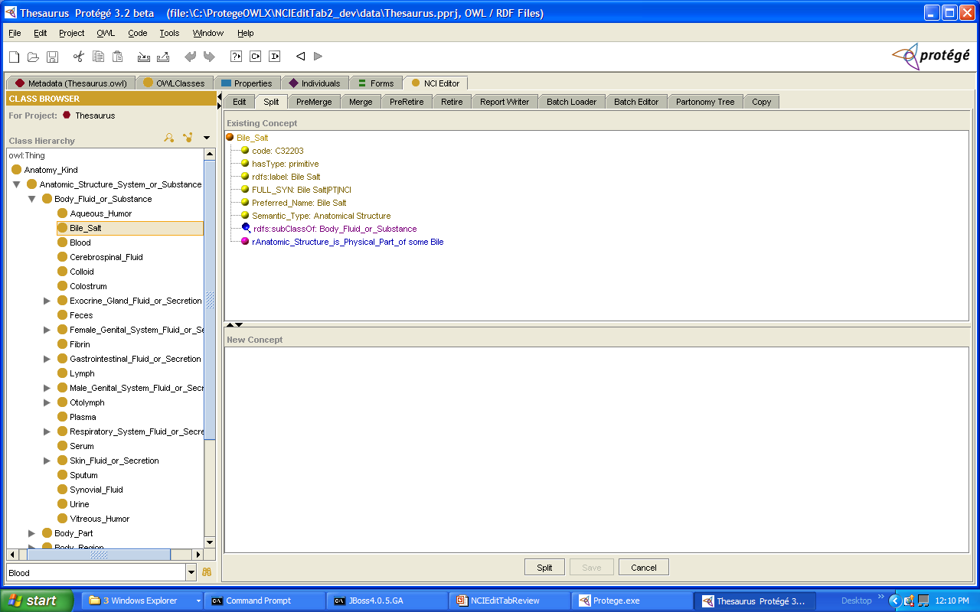
Class TreePanel
Show content of a concept in a tree structure
Support drag and drop
Provide edit functions through pop-up menu
Used in Split, Pre-Merge, Merge, Pre-Retire, Retire, and Copy tabs

Slide 33
Class EventListener
Prevent conflicts by alerting the user when the content of a concept the user is editing has been modified by another user
Disabled on Save

Slide 34
Class NCICodeGenerator
Locate code generator server through configuration
Generate the value of rdf:ID or code annotation property for each new class depending on the underlying format of the OWL knowledge base (i.e., by code or by name)

Slide 35
Class OWLWrapper
A thin wrapper for Protégé/OWL API
Contains a collection of convenience methods
Called by DataHandler on Save

Slide 36
Class DataHandler
Invoked by NCIEditTab saveConcept methods
Enforce business rules using NCIEditFilter
Compare states of a concept (old versus new) to identify new and deleted data elements
Invoke OWLWrapper to update the underlying OWL knowledge base

Slide 37
Class NCIEditFilter
Triggered by DataHandler on Save
Enforce business rules such as:
  Prevent any retired concept from being selected by the user as a super-class of any concept, or as a filler for a restriction
  Synchronization between Preferred Name, FULL_SYN, and rdfs:label properties
  Disallow leading or trailing spaces in property values
  Disallow spaces between tokens (i.e., words)
  Check existence and uniqueness of some property qualifiers

Slide 38
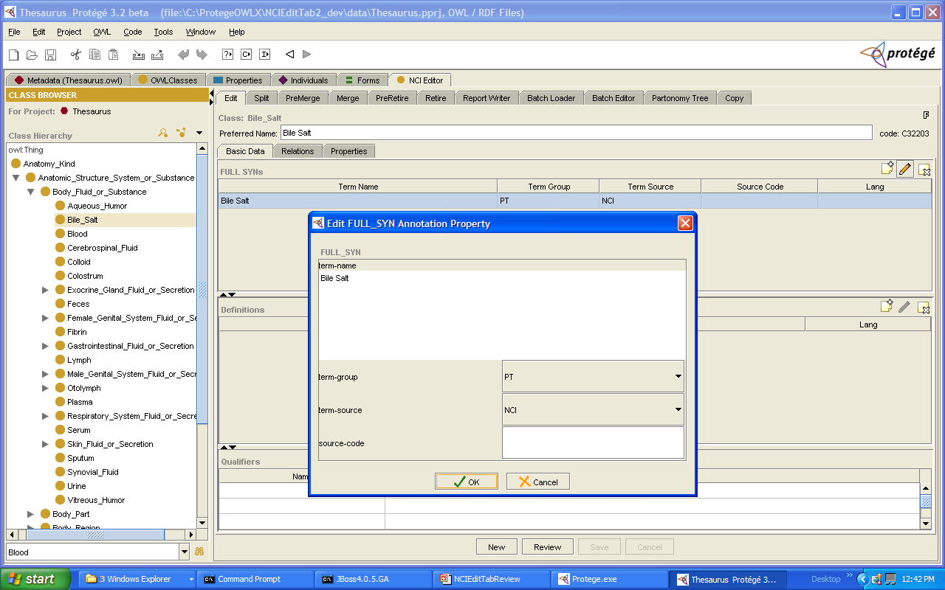
Other Classes -- Example
(Edit a FULL_SYN Annotation Property)

Slide 39
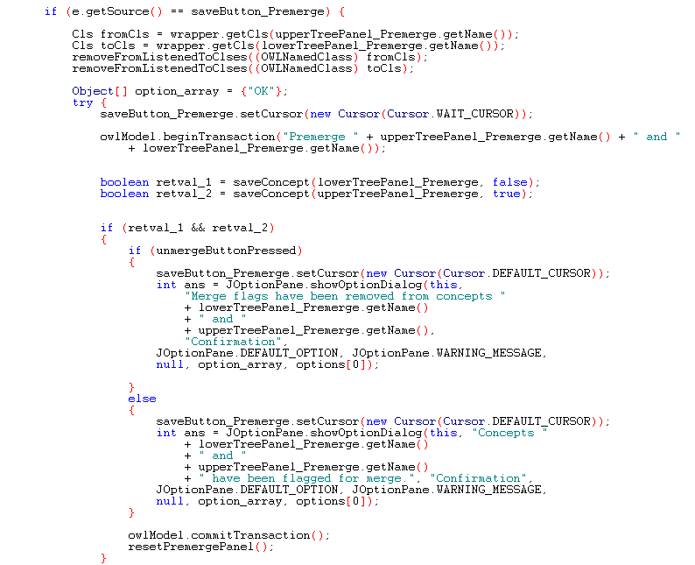
Transaction Block
(Code segment taken from NCIEditTab)
disable listener
beginTransaction
saveConcept
commitTransaction

Slide 40
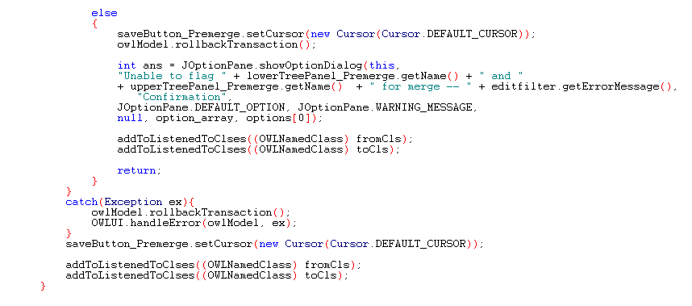
Transaction Block
rolebackTransaction
enable listener
handleError

Slide 41
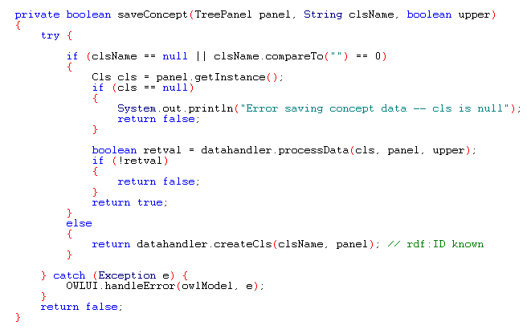
saveConcept

Slide 42
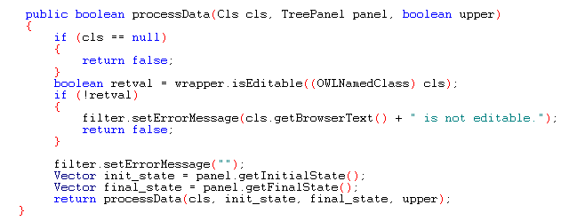
processData

Slide 43
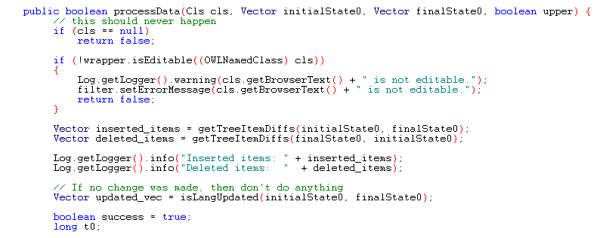
processData

Slide 44
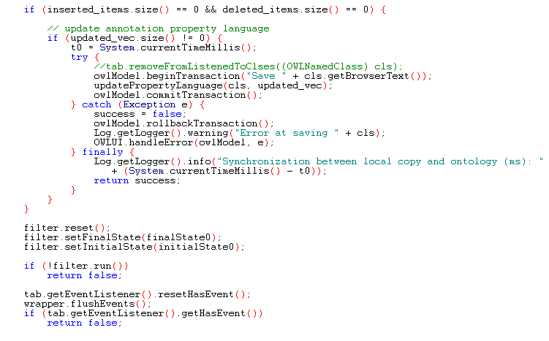
processData

Slide 45
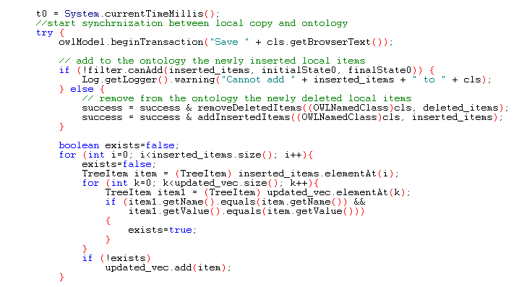
processData

Slide 46
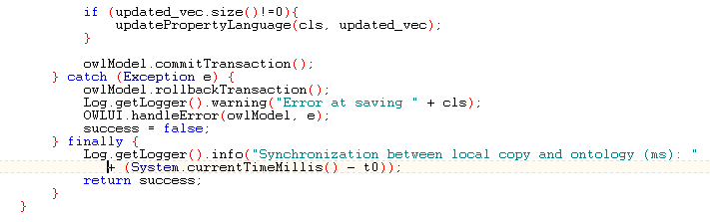
processData

Slide 47
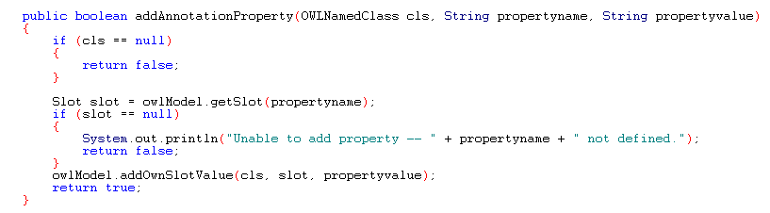
Convenience Methods – OWL Wrapper

Slide 48
Summary
73 classes, ~40,000 LOC
Cover most Ontylog editor functionalities
Will collaborate with Stanford Medical Informatics to optimize the performance
A multi-user simulator is available

Slide 49
Discussion

