Slide 1
CTCAE V4.0
User Reference Publication
Presentation to VCDE Working Group
April 30, 2009
Notes:
Focus on production of end-user documents.
Terminology is going to be developed using tools that typically work in terms of machine-readable formats.
Need human-readable counterpart for general distribution.

Slide 2
CTCAE V4.0 End User Publications
Goals
  Preserve usability of Version 3.0 Quick Reference (Hard Copy)
  Provide electronic distribution to a wide variety of platforms/audiences
  Automate generation from terminological source using caBIG® technologies (e.g. LexBIG/EVS).
Additional Interests
  Generate view-only (PDF) and edit-capable (Word) versions
  Provide additional formats/layouts for new distribution mechanisms (e.g. HTML for publication as standard web page)
Challenges
  Moving target – V4 Review in process
  Desire to provide strategic process for publication, while still needing to utilize short-term source formats (e.g. Excel files)
Notes:
Version 3 quick reference had wide-spread adoption and use; capitalize on that familiarity.
Desire for soft copy in addition to hard copy distribution.
Generate view-only, edit-capable, and web-capable versions to meet different use cases.
PDF for general distribution – compact, secure, cross-platform support, meets legal tests (cannot be changed or altered and still be passed off as an NCI work without leaving footprints).

Slide 3
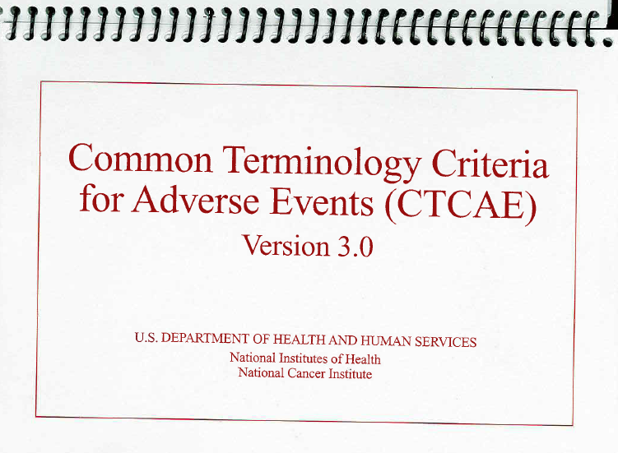
CTCAE V3.0 Quick Reference
Prior CTCAE Release - Front Cover
Notes:
The target…

Slide 4
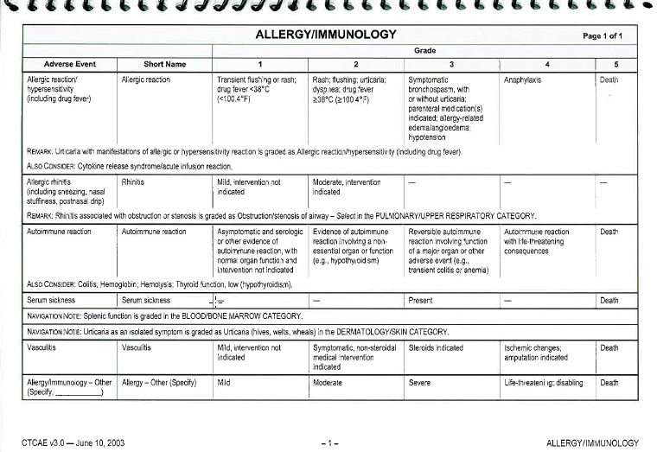
CTCAE V3.0 Quick Reference
Prior CTCAE Release – Sample Page

Slide 5
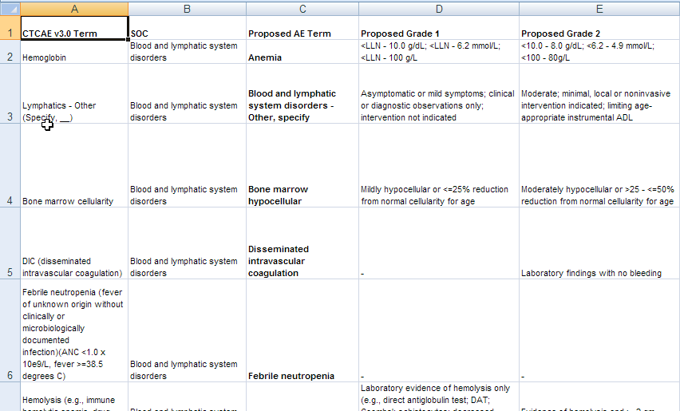
CTCAE V4.0 Source
Short term – Excel Spreadsheet
Notes:
Starting point

Slide 6







V4.0 Publish Process – Short Term
LexWIKI Collaborative Review
Excel
Transform to LexGrid XML
Access
DB
Load from
Source
Supplemental
Sources
LexEVS XML Loader
LexEVS
Repository
Store and
Access
Introduction Page (manual edit once per release), logos, bar code
Query
HTML
Publish
RTF
CTCAE Publishing
Program
PDF
Read
Publish

Slide 7
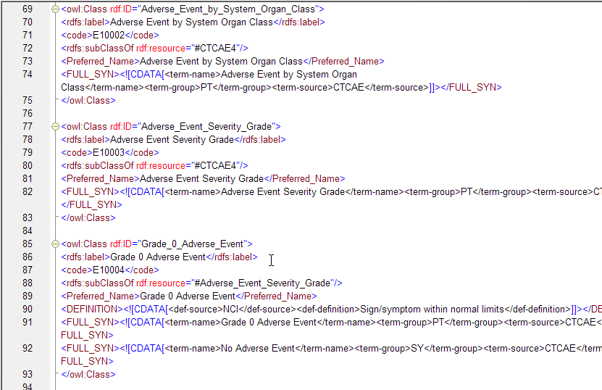
CTCAE V4.0 Source
Strategic Terminological Format - OWL
Notes:
Long-term source

Slide 8



V4.0 Publish Process - Strategic
CTCAE OWL Source
LexEVS OWL Loader
Load from
Source
LexEVS
Repository
Store and
Access
Introduction Page (manual edit once per release), logos, bar code
Query
HTML
Publish
RTF
CTCAE Publishing
Program
PDF
Read
Publish
Notes:
Different import path, but publish process largely unchanged.

Slide 9
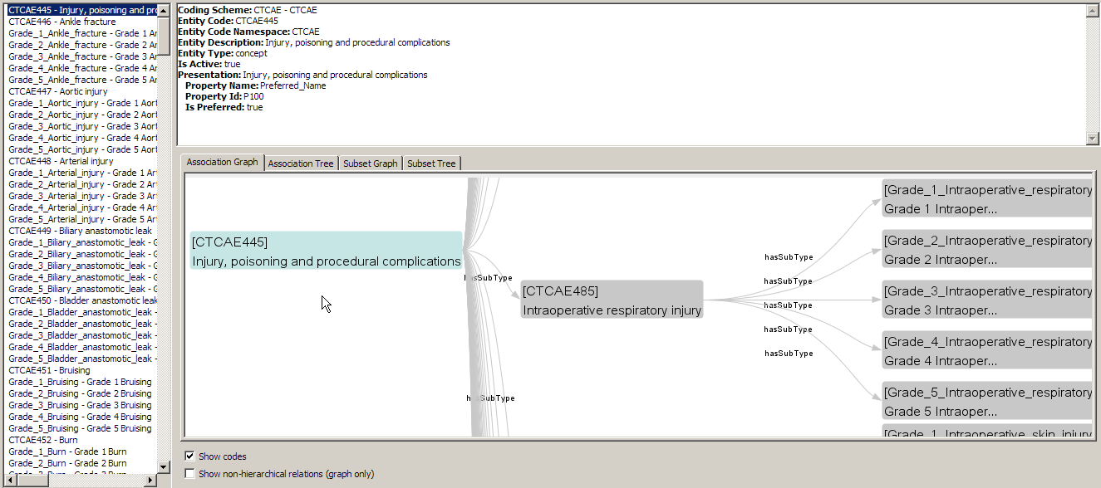
CTCAE V4.0 LexEVS Representation
LexEVS GUI - Example Graph
Notes:
Once imported, we can leverage any of the LexBIG/EVS tools.

Slide 10
Publish Program Basics
Machinable Information
  Input - Utilizes LexBIG/EVS APIs to access terms, attributes, and traverse relationships (from Category to Adverse Event to Grades)
  Output - Utilizes IText open source library for PDF/RTF/HTML document formatting and generation (http://www.lowagie.com/iText/). Freely available under Mozilla/MPL or GPL license.
Artistic Information
  Pull introduction text, logos, and barcode from external files.

Slide 11
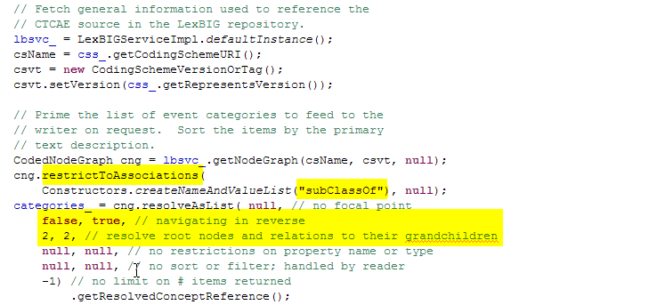
CTCAE V4.0 LexEVS Representation
LexEVS Example – Graph Query
Notes:
Example of how we query for root terms (categories), with navigation to children (adverse events), and grandchildren (grades)

Slide 12
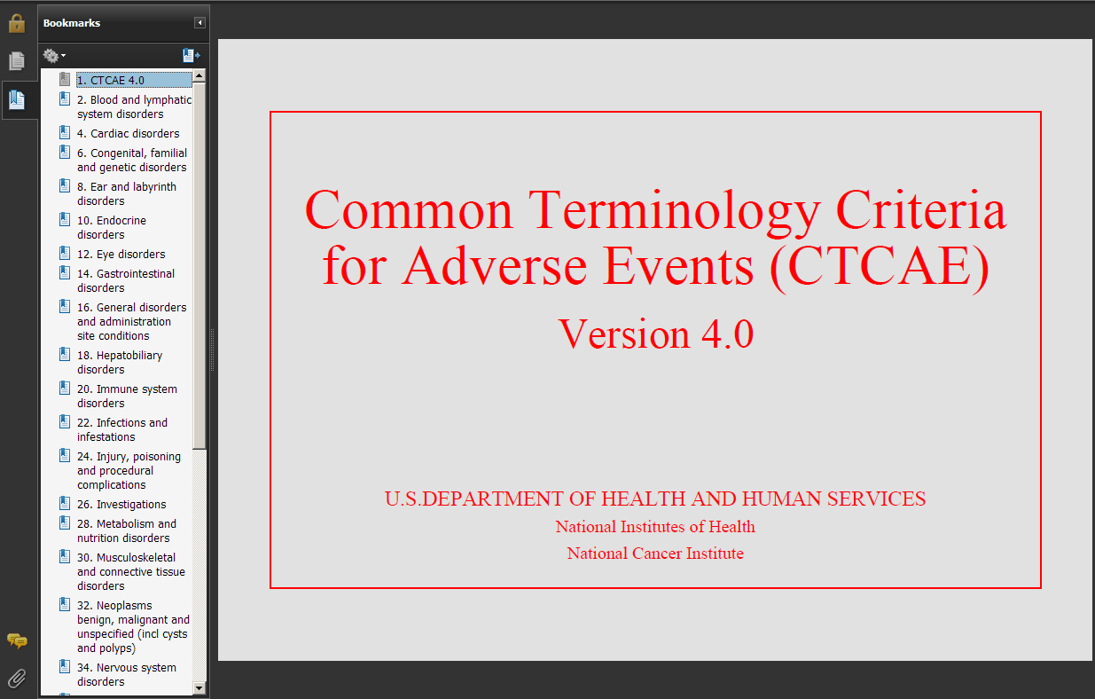
CTCAE V4.0 Publish
Quick Reference Front Cover - PDF

Slide 13
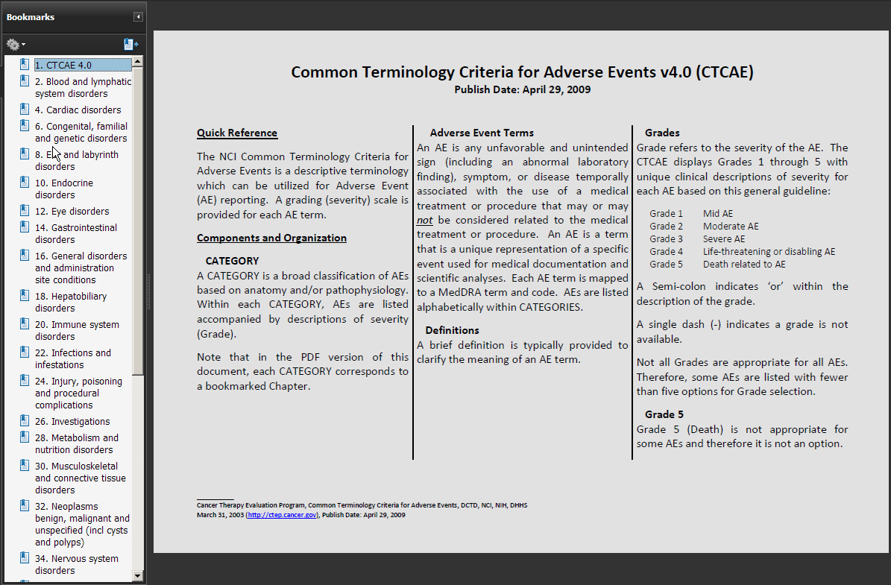
CTCAE V4.0 Publish
Quick Reference Intro Page - PDF
Notes:
Not automatically generated… imported from file that is edited once per release.

Slide 14
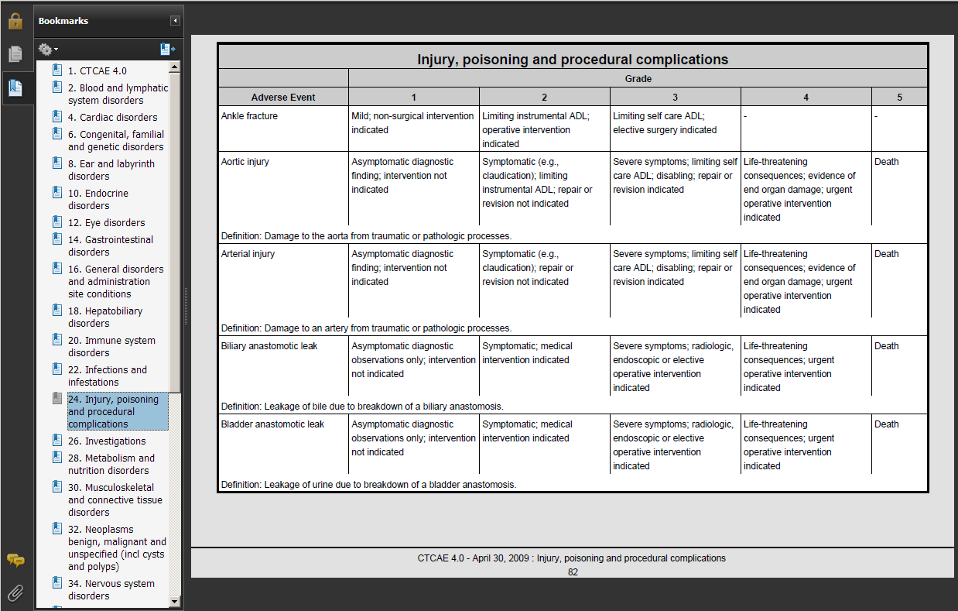
CTCAE V4.0 Publish
Quick Reference Page - PDF

Slide 15
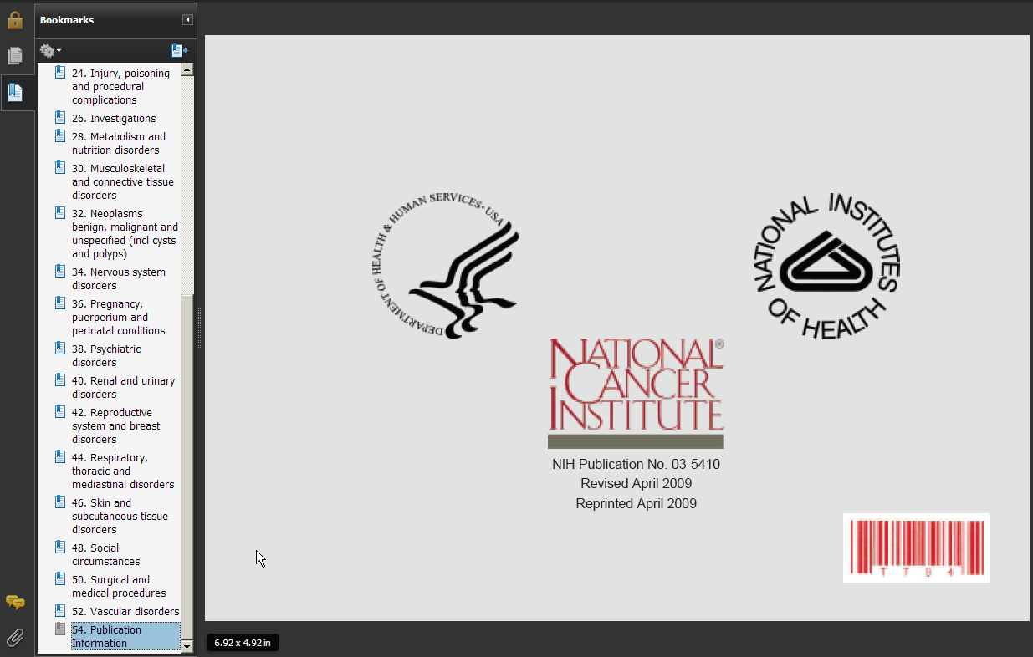
CTCAE V4.0 Publish
Quick Reference Back Cover - PDF

Slide 16
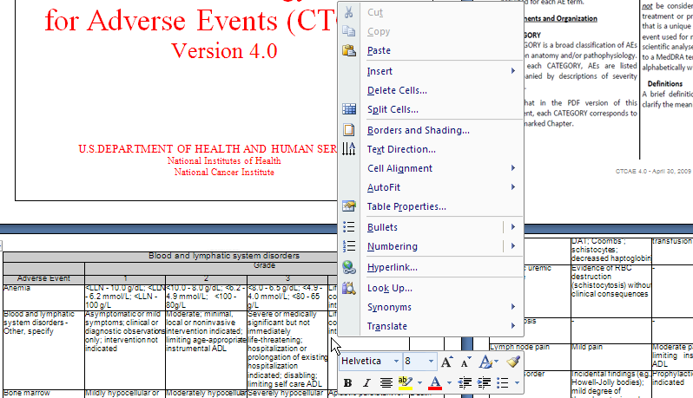
CTCAE V4.0 Publish
Edit-ready Output: RTF

Slide 17
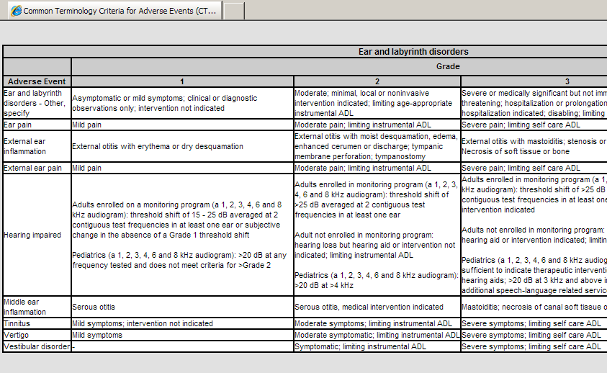
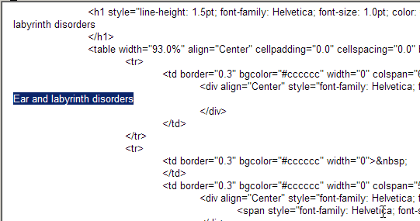
CTCAE V4.0 Publish
Web-ready Output: HTML

Slide 18
Future Considerations
Automatic generation of additional document sections for related information (e.g. synonyms) that is too awkward to insert in-line.
Generating additional hyper links between associated concepts (e.g. See Also), or from concepts to related information (e.g. Synonyms).

