Slide 1
AIM Version 3.0
Pat Mongkolwat PhD • Vlad Kleper
Northwestern University Feinberg School of Medicine Department of Radiology
Daniel Rubin MD MS
Stanford University Medical School Department of Radiology
David S. Channin MD
Guthrie, Sayre, PA
This work funded by a contract from the National Cancer Institute through Booz Allen Hamilton
to Northwestern University’s Robert H. Lurie Comprehensive Cancer Center

Slide 2
The problem
An annotation is typically captured as free text in a radiology report.
A graphical drawing (markup) is stored in a proprietary format, DICOM Presentation State, or SR (structured reports) separated from text annotation.

Slide 3
The problem (cont.)
No agreed upon syntax for annotation and markup.
AIM Information Model
No agreed upon semantics to describe annotations.
RadLex, DICOM, SNOMED CT, etc.
No standard format for annotation and markup
DICOM SR, XML, HL7 CDA

Slide 4
A Solution - AIM
Annotations are explanatory or descriptive information related to referenced image or images.
Image annotations capture information about the meaning of pixel information in images.
Image markups are graphical symbols associated with an image.
Image Annotations + Image Markups = AIM Annotation

Slide 5
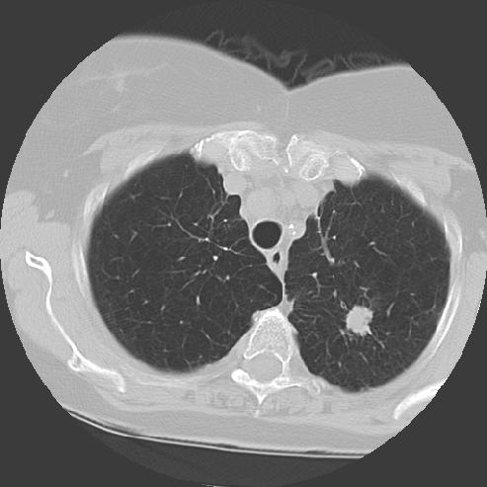
An Image

Slide 6
An Image and A Markup

Slide 7
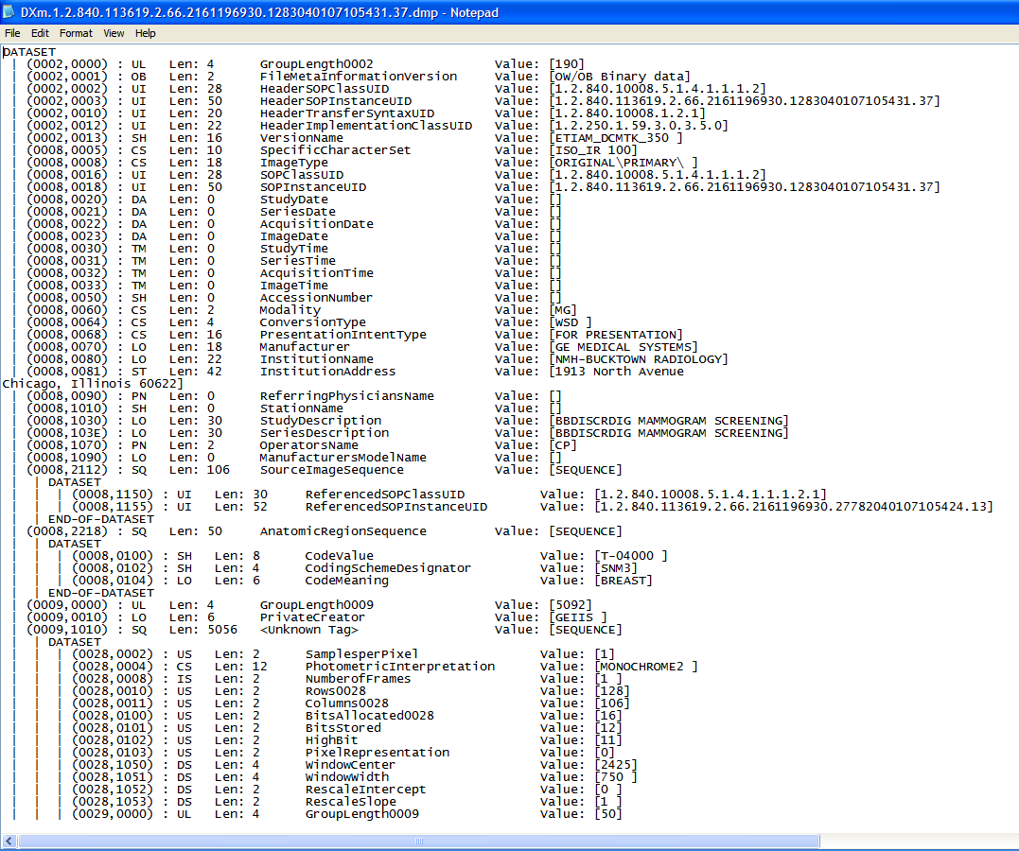
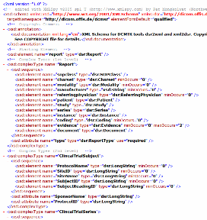
An Image, A Markup, An Annotation
Anatomic Entity: Upper lobe of left lung (RID1327)
Observation: Mass (RID:3874)
Characteristic: Microlobulated margin (RID5712)
Geometric Shape: Polyline
2D coordinates: {(x,y), (x,y)….}
Calculation: Largest diameter result: 2.8 cm
XML
DICOM SR
HL7 CDA

Slide 8
AIM captures…
ImageAnnotation
  Describe a single object
  Annotation and markup information on one or multiple images
AnnotationOfAnnotation
  Annotation information on one or multiple AIM annotations
  Grouping
  Comparing

Slide 9
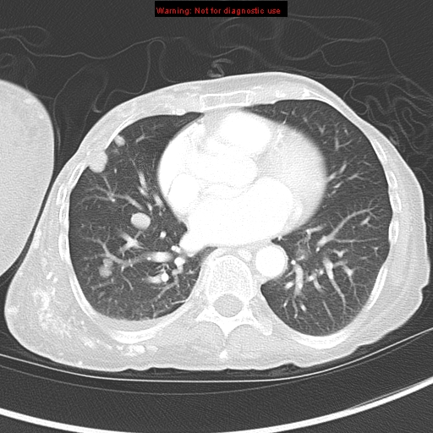
An ImageAnnotation

Slide 10
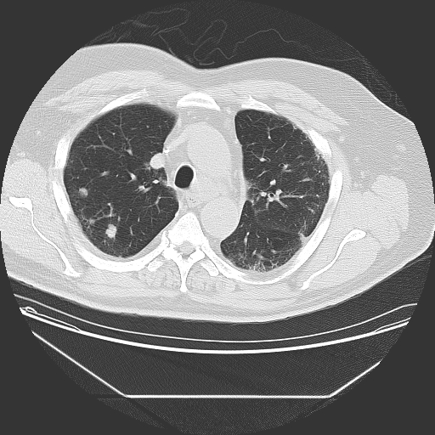
ImageAnnotations
1
2
2001

Slide 11
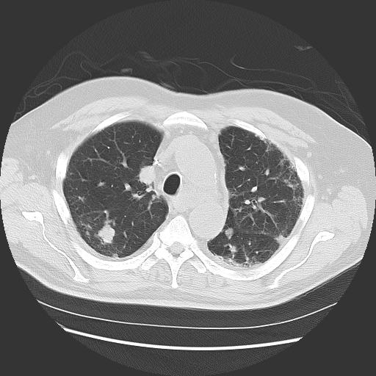
ImageAnnotations
3
4
2003

Slide 12
AnnotationOfAnnotations
3
1
2
4

Slide 13
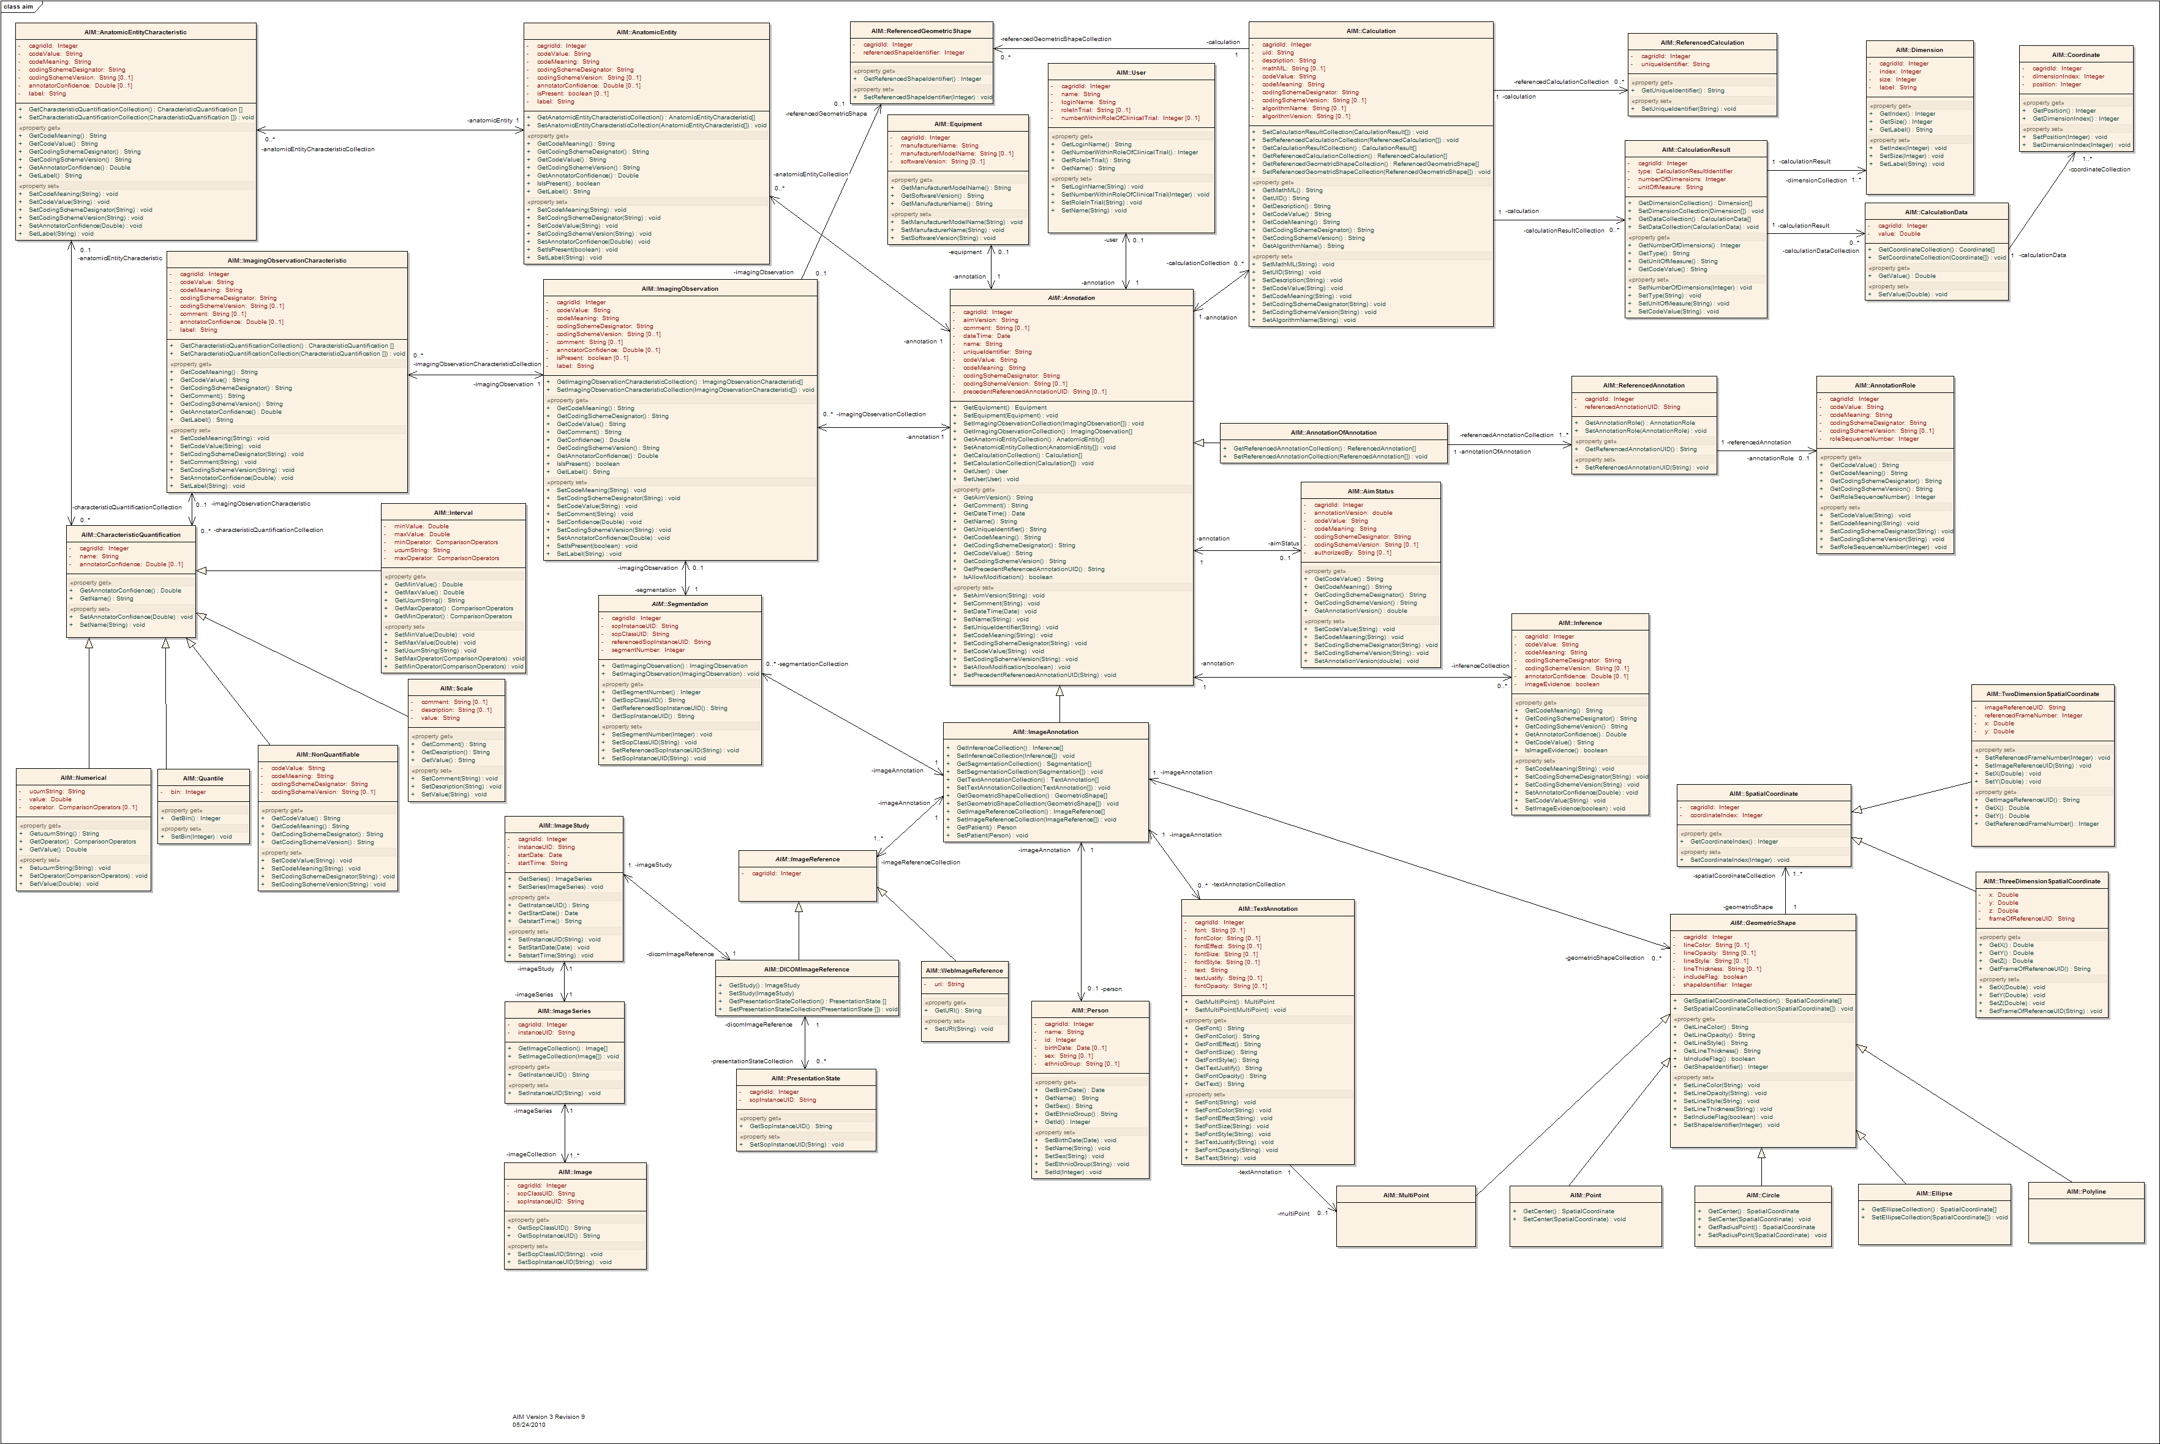
AIM 3.0 Model
Finding
Calculation
Results
User
Equipment
Annotation
Of
Annotation
Annotation Role &
References
Inferences
Image
Annotation
Text
Geometric Shapes
(2D and 3D)
DICOM
“web” Image
References
Person

Slide 14
AIM 3.0 Model
Anatomic Entity
Characteristic
Anatomic Entity
Calculations
User
Calculation
Results
Equipment
Image Observation
Characteristic
Annotation
Of
Annotation
Image Observation
Annotation
References
Annotation
Role
(for analysis)
Quantification
Characteristic
AIM
Status
DICOM Segmentations
Inferences
Image
Annotation
DICOM Image
References
Text
Geometric Shapes
(2D and 3D)
Person
“web” Image
References
DICOM Presentation State

Slide 15
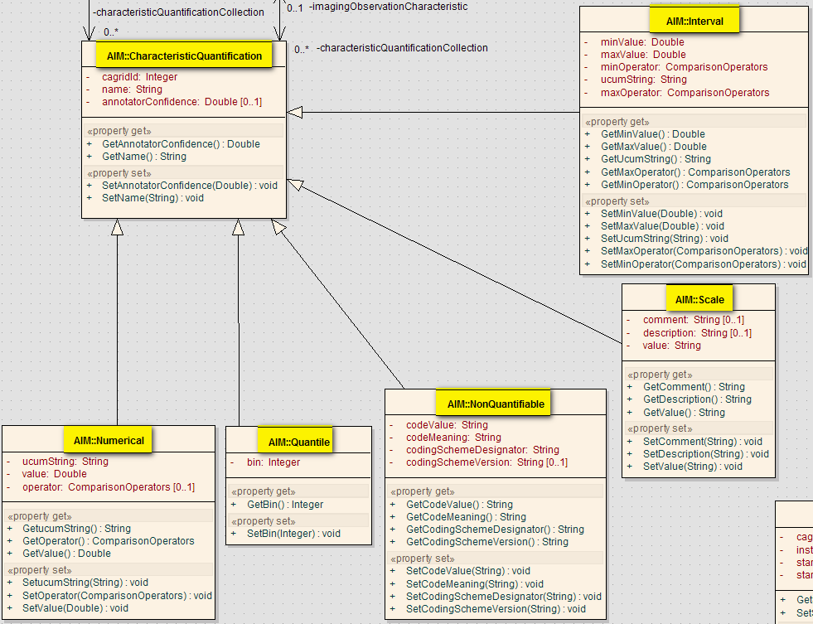
Characteristic Quantification

Slide 16
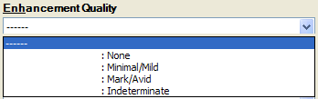
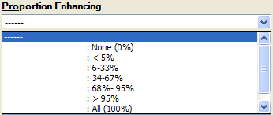
Samples Characteristic Quantification
Non-quantifiable
Numerical
Interval
Scale
Quantile

Slide 17
Pixel Semantic Meaning
Capture many types of image semantic content
AnatomicEntity
  RID1327, Upper lobe of left lung, RadLex
AnatomicEntityCharacteristic
  RID5784, Collapsed, RadLex
ImagingObservation
  RID3874, Mass, RadLex
ImagingObservationCharacteristic
  RID5712, Microlobulated margin, RadLex

Slide 18
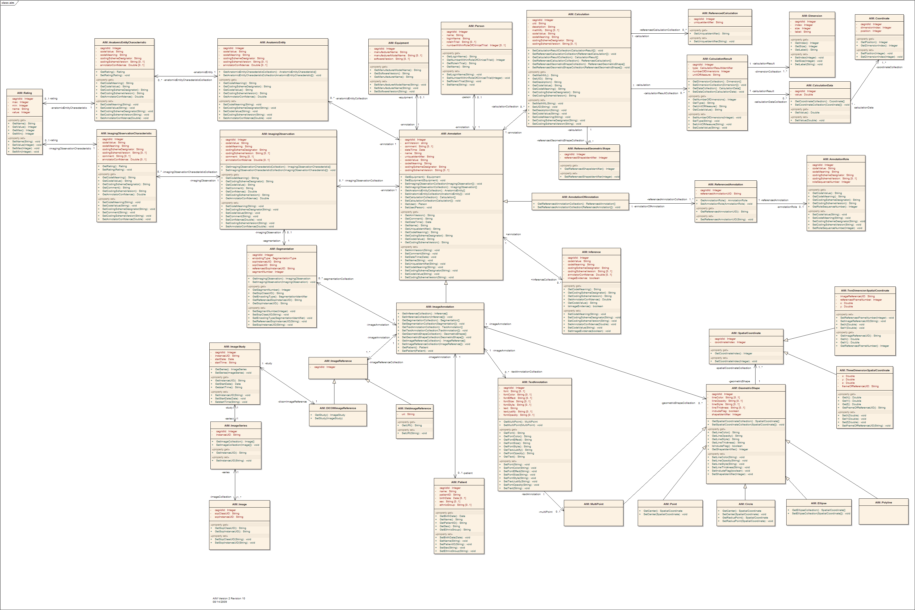
Use of Controlled Terminologies
codeValue: “RID3875”
codeMeaning: “nodule”
codingSchemeDesignator: “RadLex”
codingSchemeVersion: “2.0”

Slide 19
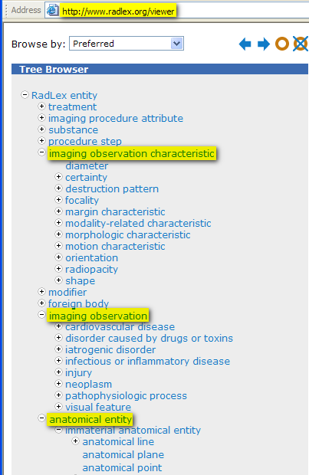
RadLex Vocabulary
DICOM,
LOINC,
SNOMED CT,
NCI, etc…

Slide 20
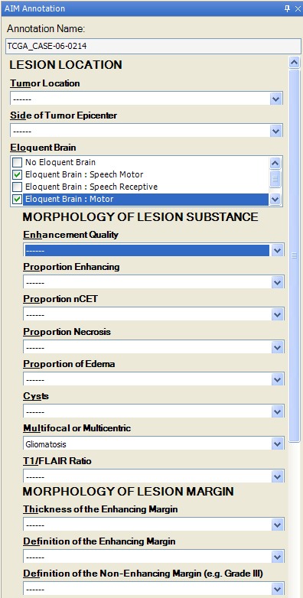
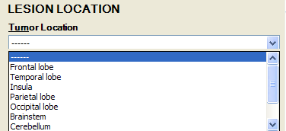

Controlled Terms
Simple & Constraint Annotations

Slide 21
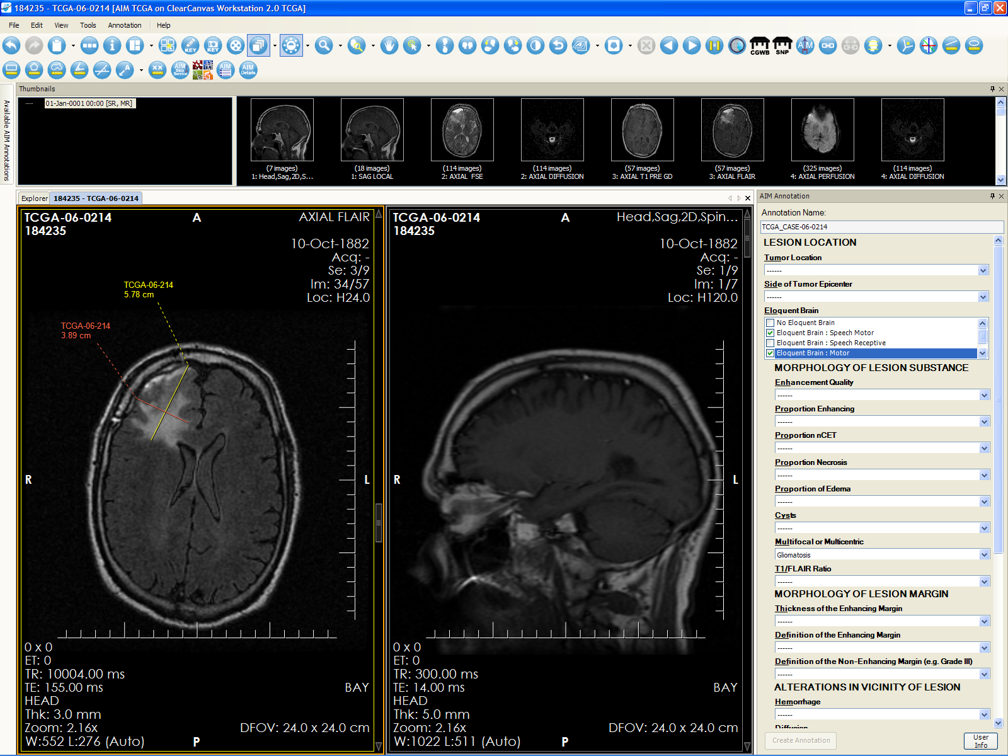
AIM & Controlled Terms in Action
AIM 2.0 Plugin available on www.ClearCanvas.ca

Slide 22
AIM Template
XML schema to capture the creation of constrained terminology for AIM annotations
AIM template XML document to be consumed by AIM enabled workstations
Terms can be selected from standard vocabularies (RadLex, DICOM, SNOMED, etc.)
Private terms created by annotator
Not involved in GUI design

Slide 23
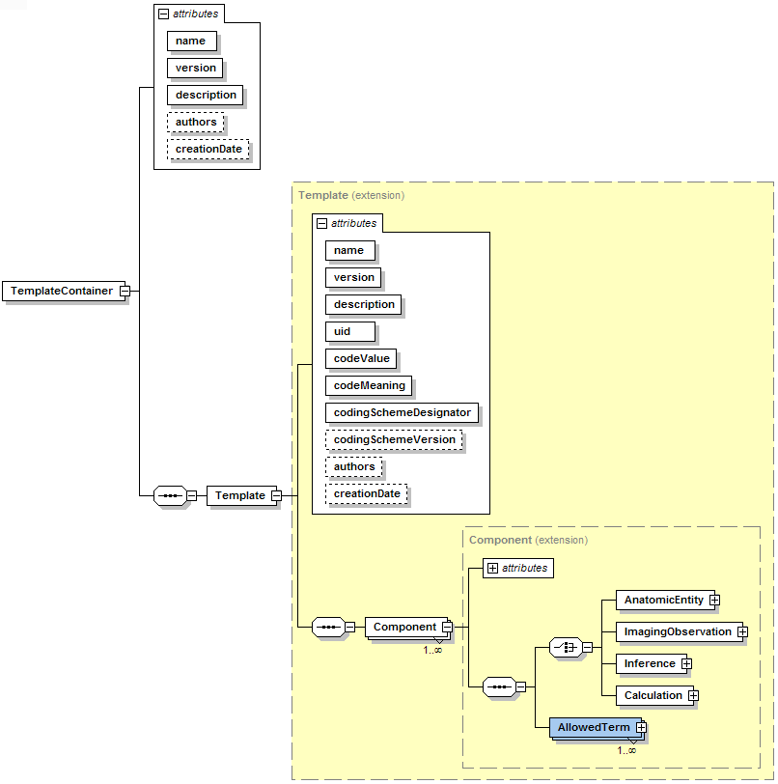
AIM Template Schema

Slide 24
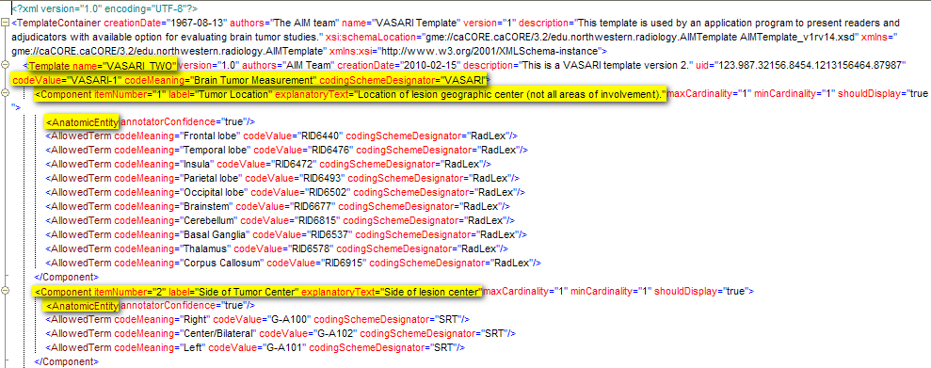
AIM Template (partial example)

Slide 25
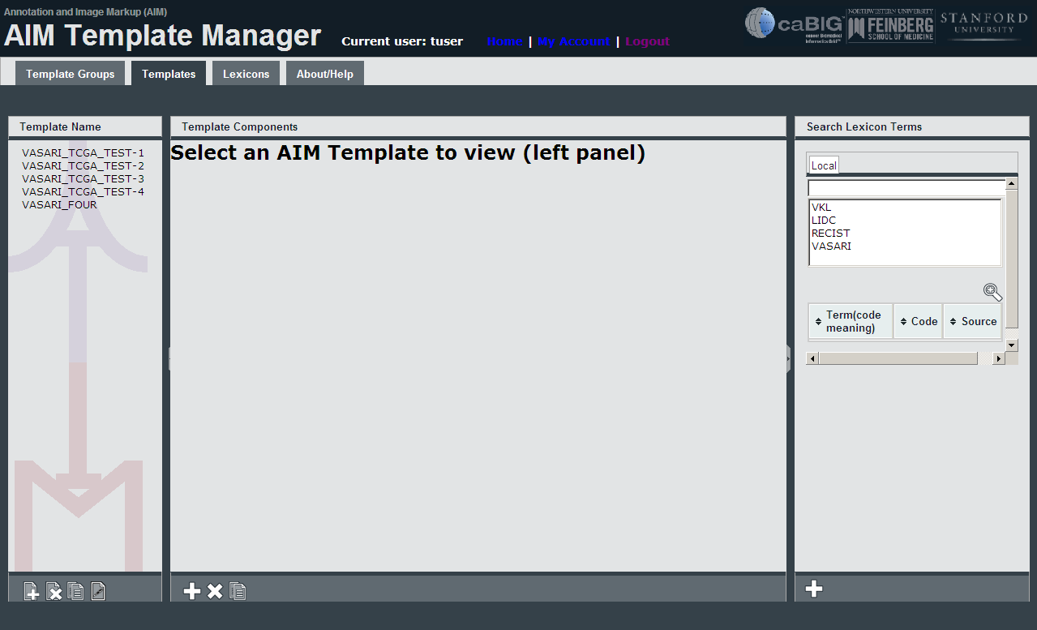
AIM Template

Slide 26
AIM History
AIM 1.0 (March 5th, 2009)
AIM 1.5 (AIM TCGA, September 2009, April 2010)
AIM 2.0 (March 15th, 2010)
AIM 3.0 (September 2010)
AIM 4.0 (Expected 2011)

Slide 27
AIM Resources
https://gforge.nci.nih.gov/frs/?group_id=230
CDE Browser
  http://cdebrowser.nci.nih.gov/CDEBrowser/
UML Model Browser
  http://umlmodelbrowser.nci.nih.gov/umlmodelbrowser/
AIM 3.0 standard C++ library
ANIVATR
AIM 3.0 referenced implementation
  Convert between AIM XML and AIM DICOM SR
  AIM 3.0 official XML schemas
Documentation

Slide 28
What can you do?
Get your imaging vendor to support AIM annotation in their products
Build AIM annotation into your favorite open source research imaging software
Take the AIM UML Model and build Grid Services that store and retrieve AIM annotations (this is under way)
  Build Web 2.0 services that serve up AIM
  Build DICOM services that query and retrieve AIM
Start annotating images!

Slide 29
Summary
AIM is critical to “tagging” content in medical images
  Effective search & retrieve
  Such that images containing similar content can be identified
The AIM project provides information model and encoding standards for the structure and content of image annotations
AIM annotations is critical components of future image based research.
AIM for Pathology and Oncology

Slide 30
Assistance Needed?
Contact : AIMTeam@northwestern.edu

