Slide 1
CSM/UPT
Build and Deployment Automation
May/June 2008

Slide 2
Why Automate?
Consistent builds
Repeatable processes
Reduced cost of delivering software
Providing development teams with more time for creating good software

Slide 3
Build and Deployment Process
DEV Writes Code
QA Tests Code
Systems Promotes Tested Code
Systems/QA/Dev Verify STAGE/PROD
All
  Build every time from source
  Ability to build from a Subversion tag

Slide 4
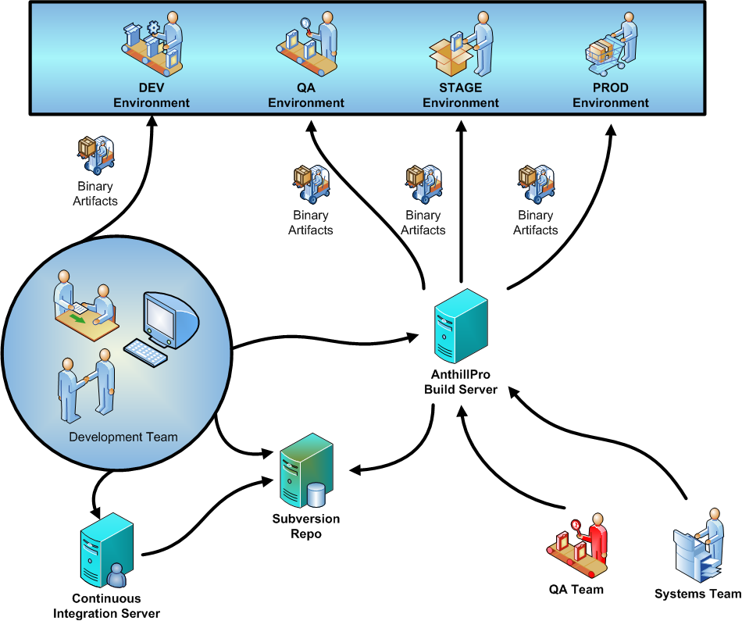

Slide 5
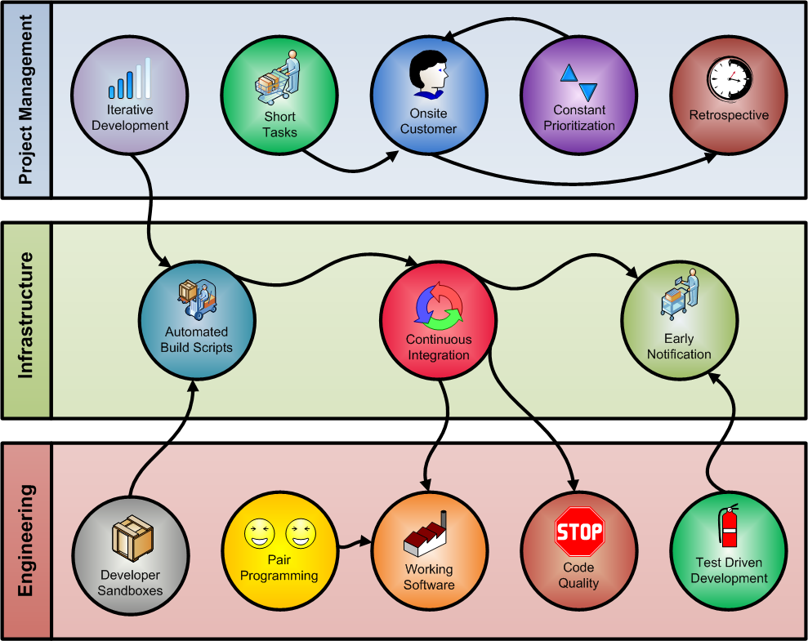

Slide 6
Project
5/12/2008 – Kickoff
6/13/2008 – Final delivery
One-week iterations
In collaboration with the development team
Deliverables (partial list):
  Automated build scripts (ABS)
  AnthillPro build and promotion environment
  CI environment

Slide 7
Questions & Answers

