Slide 1
BDA Features
December 2008

Slide 2











Mission
Ensure ALL CBIIT active development teams are able to generate working software from DEV to QA to STAGE in one-click in FY 2009

Slide 3
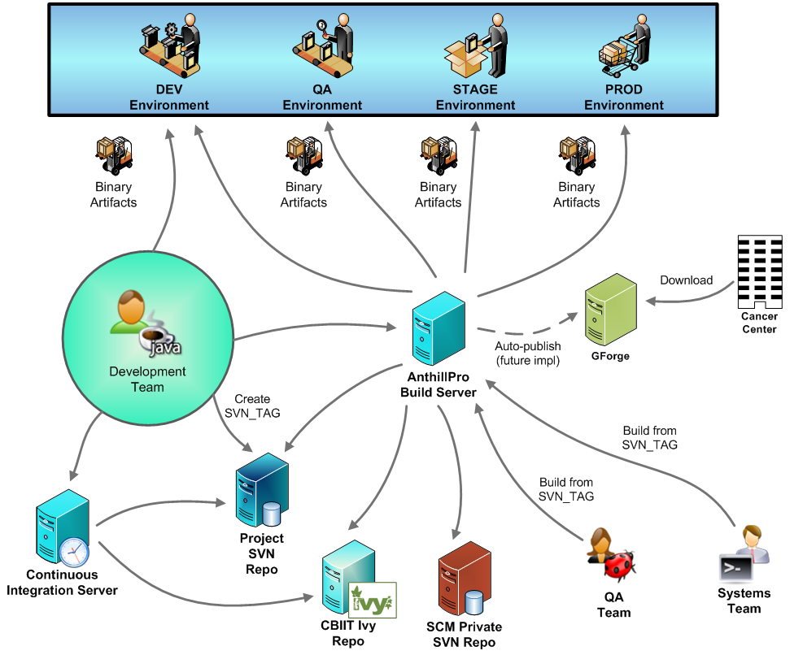
All CBIIT Projects

Slide 4
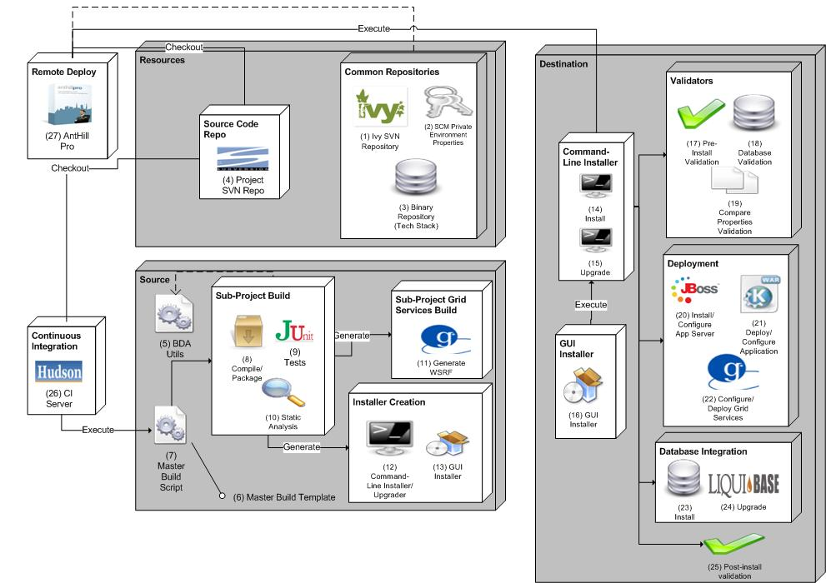
BDA Architecture

Slide 5
Database Integration and Upgrades
Recreate database schema via scripted deployment in each target environment
  Based on DDL and DML (SQL) scripts checked into Subversion
Insert seed and test data into each target environment
Custom macros and targets that use Liquibase database upgrade tool
  Running SQL scripts that apply incremental changes
  Database rollback
  Database diff
  Database doc

Slide 6
Remote Deployment
Security (login-config.xml, etc.)
JNDI
Web configuration
Datasource
SMTP
Configuring binary artifacts
Restarting servers
Grid configuration
Port configuration
Securing web container and grid services

Slide 7
Command-Line Installation
Remote deployment executed via command-line installation in target environment
Requires Ant in target environment

Slide 8
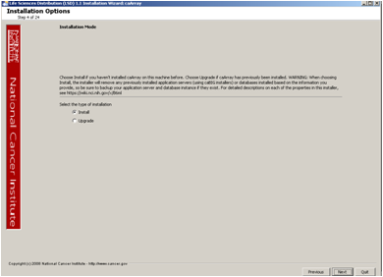
GUI Installation
Runs command-line installation along with many user validation checks

Slide 9
Automated Test Harnesses
JUnit Ant templates
Selenium support

Slide 10
Static Analysis
Standards
  PMD, CheckStyle, FindBugs
Coverage
  Cobertura
Cyclomatic Complexity
  JavaNCSS
Duplication
  Simian
Dependencies
  JDepend
Aggregate
  FuseMetrics

Slide 11
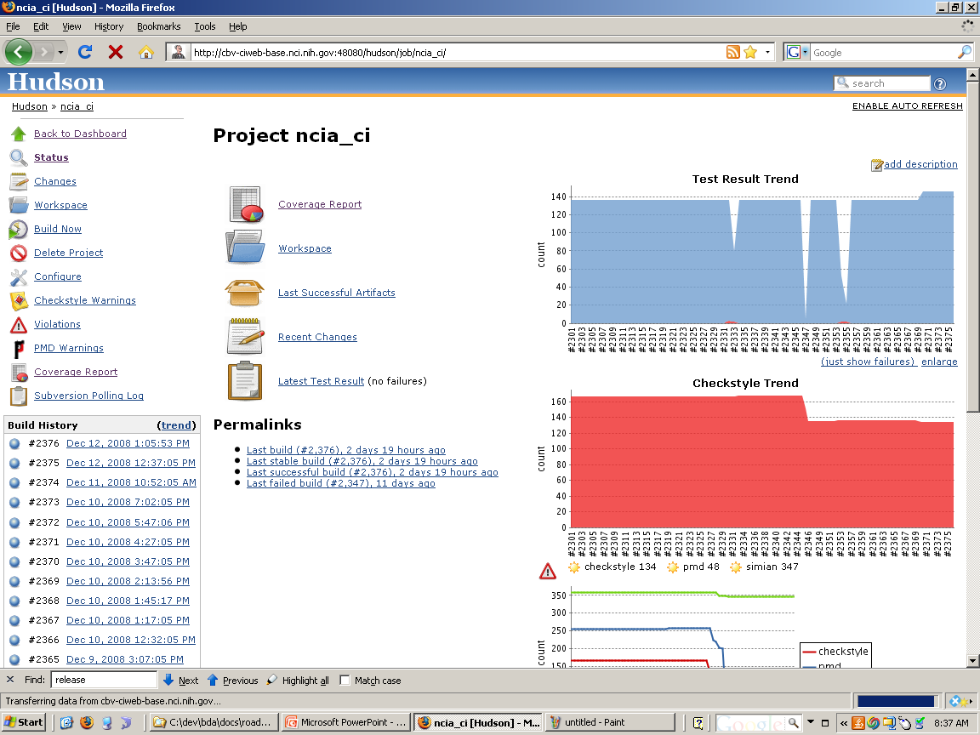
Continuous Integration Environment
Build and deploy with every change
Reports

Slide 12
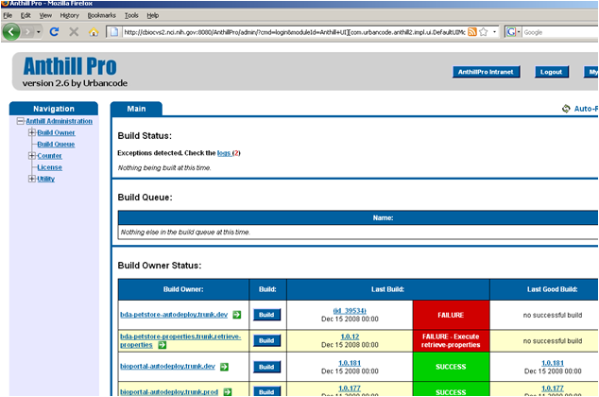
Build Management Configuration
Deploy (via command-line install) into DEV, QA, STAGE, PROD, etc. target environments

Slide 13
Binary Repository
Binary repository for tools in the CBIIT tech stack
  JBoss
  Java SDK
  Ant
  SVN
  MySQL
  Others

Slide 14
Enterprise Dependency Management
Centralize Ivy repository
Determine if JAR is available
Templates for configuring Ivy
Processes and standards for managing files/directories
Optional
Ant macros
  Adding to Ivy repo

Slide 15
Other
Developer Documentation Generation
  ERD
  UML
  Build
Parallel development utilities
Diagnostics
Log4j

