Slide 1
Automated Build and Deployment
Team Priorities
October 2008

Slide 2
Mission
DEV to QA to STAGE in less than two hours
Extend BDA to all development projects at CBIIT
  Providing support for BDA-enabled development teams
  BDA monitoring and certification (Governance)
Maintaining and Improving BDA toolset
  Reducing risks that could prevent two-hour mission
Special Projects
  DRT
  SVN migration (Knowledge Centers)

Slide 3
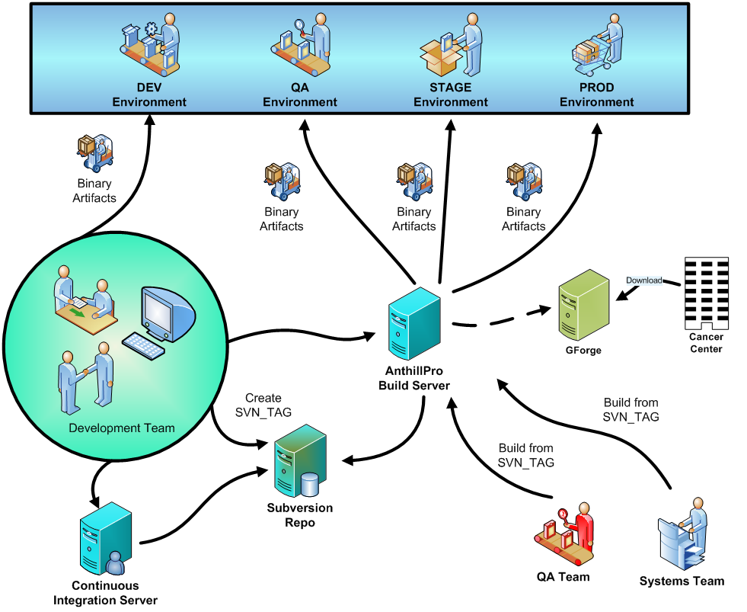
Mission

Slide 4
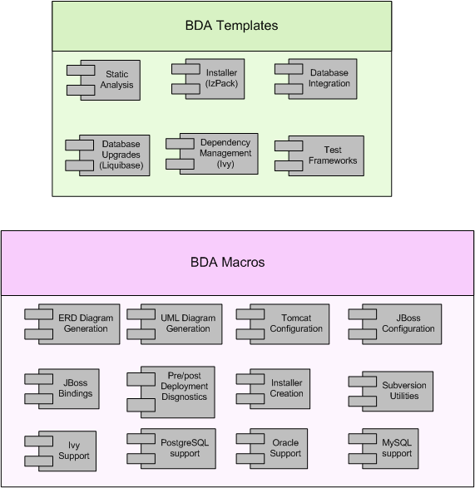
BDA Tools

Slide 5
Build and Deployment Automation
Support
  [Add examples]. See matrix https://wiki.nci.nih.gov/x/dZ18
See my todo list (online) for other projects
  Security
  Code inspection
Roadmap and Implementation Plan
  All projects to incorporate BDA “rules and tools”
  June 2009
XML build improvements
  File handling operations (open files)
Disposable Application Containers
  Unpack and configure same JBoss container in every tier (DEV, QA…)
Securing JBoss containers
  Analyzing JBoss security vulnerabilities
  Securing the JBoss containers delivered with installers
Automating GForge release process
  Automate uploading files to GForge files tab
Ivy repository changes and administration
  Cleanup and standardize process of managing over 200 .jar files for all BDA projects
  Assign an administrator
‘Heartbeat’ pages
  Provide tools for all teams to determine “health” of application: obtaining data from database, authenticating w/ LDAP, data from grid service, etc.

Slide 6
Roadmap and Implementation Plan
‘Franchising’
  Screencasts
  Training
  Updating BDA wiki with how-to, usage instructions, etc.
PM support
Generalizing automated behavior
  Compilation and Packaging
  Database Integration/Upgrades
  Running Tests
  Static Analysis
  Dependency Management
  Continuous Integration
  Build Promotion
  Installers (Command Line and GUI)
  Local/Remote Deployment
  Documentation
From new project to production
  BDA’fication
  Dependency Management (Ivy’fication)
  Continuous Integration (Hudson)
  Build Management (AntHill Pro)
  DRT
BDA Governance
  Certification
BDA Support

Slide 7
Installers
Master Installer
Genericize (IzPack) behavior for development teams
Training for development leads to go over installer maintenance and extension
Move documentation to projects' SVN
Automate creation of branches, tags, etc. when making a change

Slide 8
Stats
Number of BDA projects
Number of CI servers
Number of CI jobs
AntHill Pro tracks

Slide 9
Knowledge Center SVN migration
Using CTODS to perform SVN migration
  ESN SVN Admin: Coordinate user accounts (i.e. create new accounts in new repository for existing accounts in old repository). See https://gforge.nci.nih.gov/projects/cactus/ for a list of the possible users
  CBIIT and ESN SVN Admins: Ensure both machines have the necessary storage space to hold resultant dump files
  CBIIT SVN Admin: Create SVN dump file of CTODS (https://gforge.nci.nih.gov/svnroot/cactus/ctods)
  CBIIT SVN Admin: Filter dump file so as to capture desired CBIIT project. Work with Andy Glover and ESN SVN Admin to determine the allocated size on the ESN SVN server
Documenting process for other teams to use
  See https://gforge.nci.nih.gov/svnroot/automation/trunk/docs/knowledge-center/svn-migration-howto.pdf
[DIAGRAM DIFFERENT TEAMS]

Slide 10
Deployment Request Tracker Pilot
Documenting repeatable deployment process using JIRA
Will begin adding new features this week

Slide 11
Resource Allocation
Knowledge Center SVN Migration – One FTE
Deployment Request Tracker – 0.5 FTE
New BDA Features – One FTE
BDA Support – One FTE
BDA Franchising Rollout
  Training – One FTE
  Auditing, Certification/Governance – One FTE
  Support – One FTE
  Implementation – One FTE

