Slide 1
Continuous Delivery
Paul Duvall
February 2010

Slide 2

Continuous Delivery Concept
Software can be delivered on-demand to any target environment at any time based only on source files checked into version-control repository
Includes provisioning virtual hardware instances

Slide 3
Intro Stuff
Tools We Provide
  BDA Framework (Automate)
  Certification Dashboard (Verify)
  Application Provisioner (Deliver)
CERF
  BDA Mission: https://wiki.nci.nih.gov/x/IJx8
Tools We Use
  BDA Tech Stack: https://wiki.nci.nih.gov/x/Tpx8

Slide 4



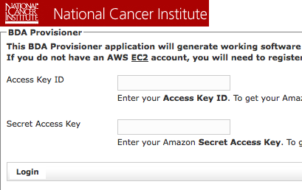
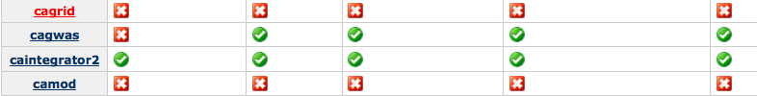
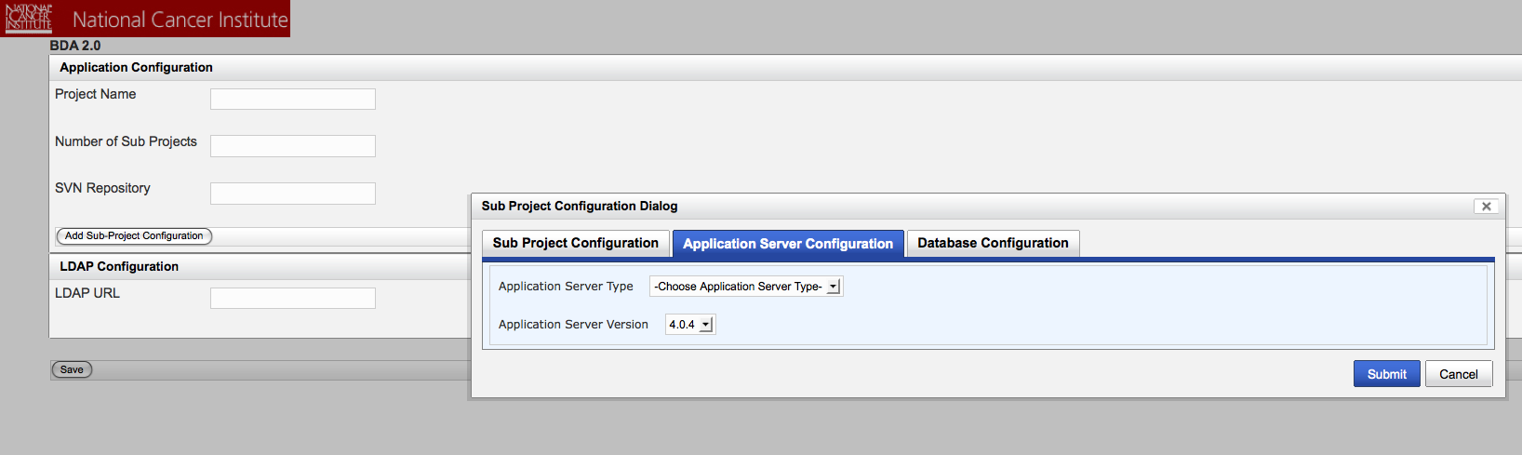
What we Provide
Support
BDA
Framework
Provisioner
Dashboard
Framework for creating single-command/one-click working software
Will provide web application
Uses BDA 2.0 Engine and Plugin framework
Database, Application, SSL, etc.
Provisions hardware
  Cloud
  Virtual Instance (Private)
  Physical machines
Real-time dashboard that analyzes whether working software is created across products in a portfolio

Slide 5
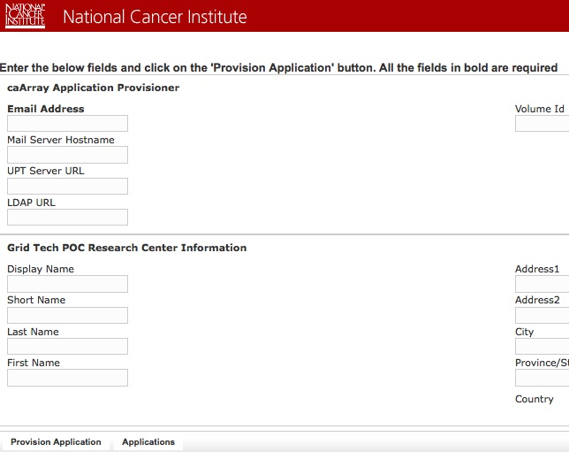
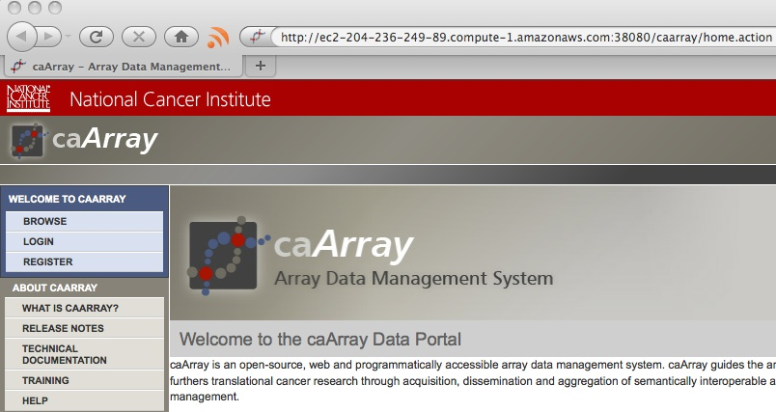

Application Provisioner
Install working software to new virtual hardware instance, from SVN source, with one click
Click
Connect
Use

Slide 6
Continuous Delivery – The What
All processes are automated and on demand
Provision virtual hardware instances
Compilation and Packaging
Database assembly and upgrade (DDL and DML execution)
Unit, Component, Functional, Load and Performance Tests
Local and Remote Deployment
Continuous Integration (including various feedback mechanisms)
Static Analysis (Standards, Duplication, Complexity, Dependencies, etc.)
Perform Build Management and Promotion
Use Dependency Management
Documentation (UML, ERD, Developer Documentation, etc.)
Creation of Installation distribution (if necessary)
Automated dashboard monitoring of build, deployment and installation processes
Parallel development (branching, tagging, codeline policies, etc.)

Slide 7
Continuous Delivery – Provisioning
Procures, installs and configures a virtual Linux hardware instance
Installs and configures Java, Ant and Subversion on the procured Linux instance
Installs and configures MySQL database server for application. This includes creating database users and granting access to the newly created (empty) application database.
Performs a checkout of application source code from CBIIT SVN tag
Creates a data storage volume on the virtual instance, attaches it and configures MySQL to store the data files on the drive
Assembles application database and inserts lookup data
Installs and configures the JBoss web container including things like connecting the container to the MySQL database
Builds and deploys the archive (e.g. WAR) and configures it for the JBoss web container
Uses a dependency manager to download and configure class path for dependent tools required by application (e.g. Hibernate, Logging, etc.)
Makes application grid service available on the training grid portal

Slide 8
Continuous Delivery – Build
Compilation and Packaging

Slide 9
Continuous Delivery – Database
Database assembly and upgrade (DDL and DML execution)

Slide 10
Continuous Delivery – Code Analysis
Static Analysis (Standards, Duplication, Complexity, Dependencies, etc.)

Slide 11
Continuous Delivery – Dependency Management
Dependency Management

Slide 12
Continuous Delivery – Testing
Unit, Component, Functional, Load and Performance Tests

Slide 13
Continuous Delivery – Documentation
Documentation (UML, ERD, Developer Documentation, etc.)

Slide 14
Continuous Delivery – Integration
Continuous Integration (including various feedback mechanisms)

Slide 15
Continuous Delivery – Build Promotion
Build Management and Promotion

Slide 16
Continuous Delivery – Deployment
Local and Remote Deployment – including hardware and server provisioning

Slide 17
Continuous Delivery – Installation
Creation of Installation distribution (if necessary)

Slide 18
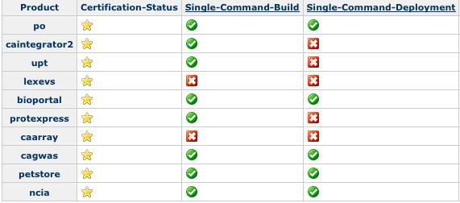
Continuous Delivery – Monitoring
Automated dashboard monitoring of build, deployment and installation processes

Slide 19
Continuous Delivery – SCM
Parallel development (branching, tagging, codeline policies, etc.)

