Slide 1
Systems Team
Build and Deployment Automation Workshop
Aug 2008

Slide 2
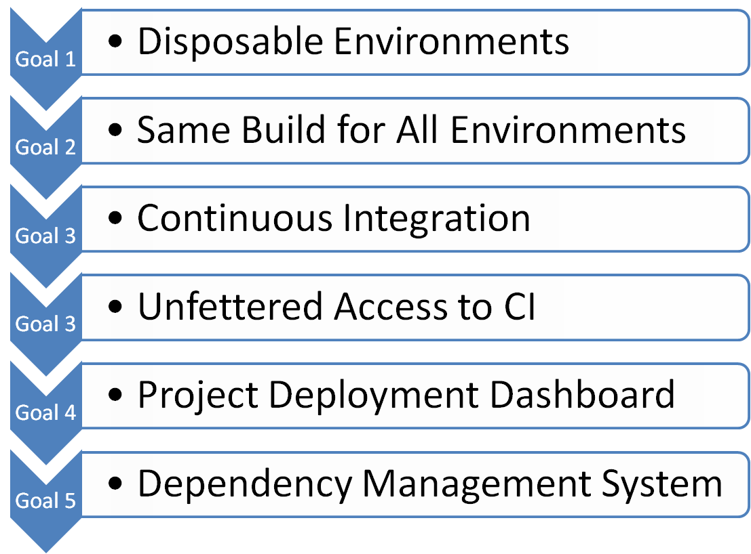
BDA Goals

Slide 3
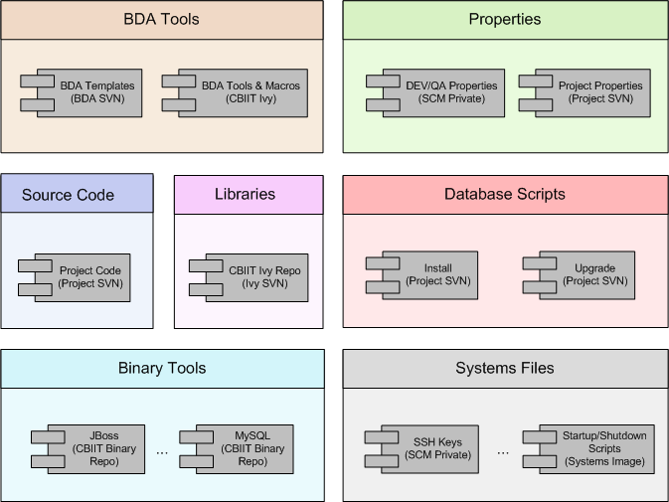
Build and Deployment Automation Components

Slide 4
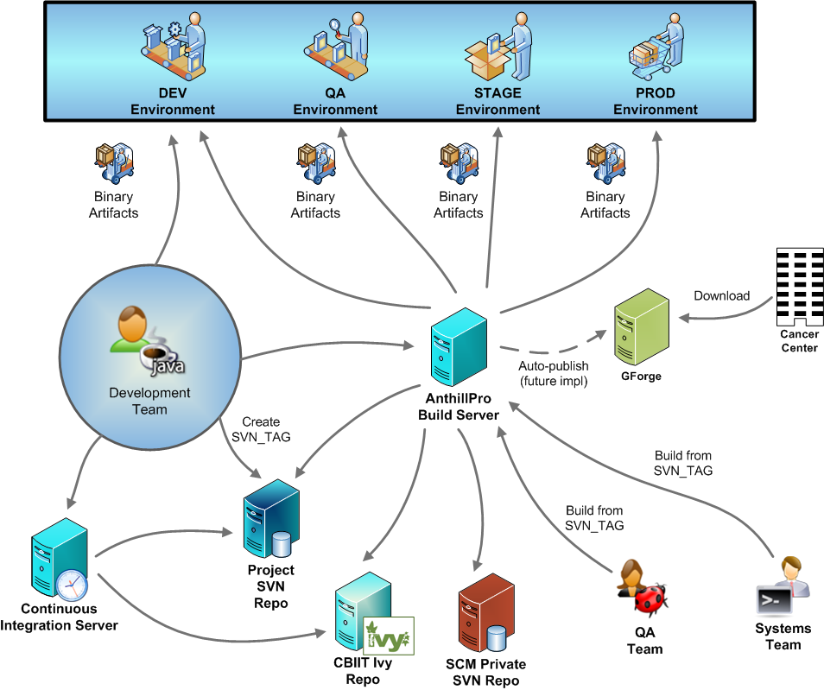

Slide 5
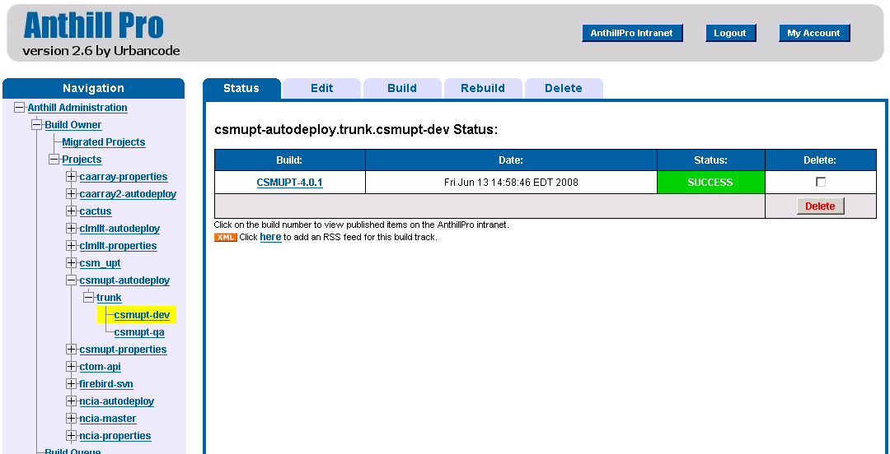
AnthillPro Builds

Slide 6
More Info
BDA WIKI - https://wiki.nci.nih.gov/x/fJd8
BDA FAQ - https://wiki.nci.nih.gov/x/UZx8
Paul Duvall – duvallp@mail.nih.gov
Steve Saksa – saksas@mail.nih.gov
Levent Gurses – gursesl@mail.nih.gov
Mahidhar Narra – narram@mail.nih.gov
Questions & Answers

