Slide 1
BDA Enterprise Rollout
November 2008

Slide 2











Mission
Ensure ALL CBIIT development teams are able to promote working software from DEV to QA to STAGE in less than two hours in FY 2009

Slide 3
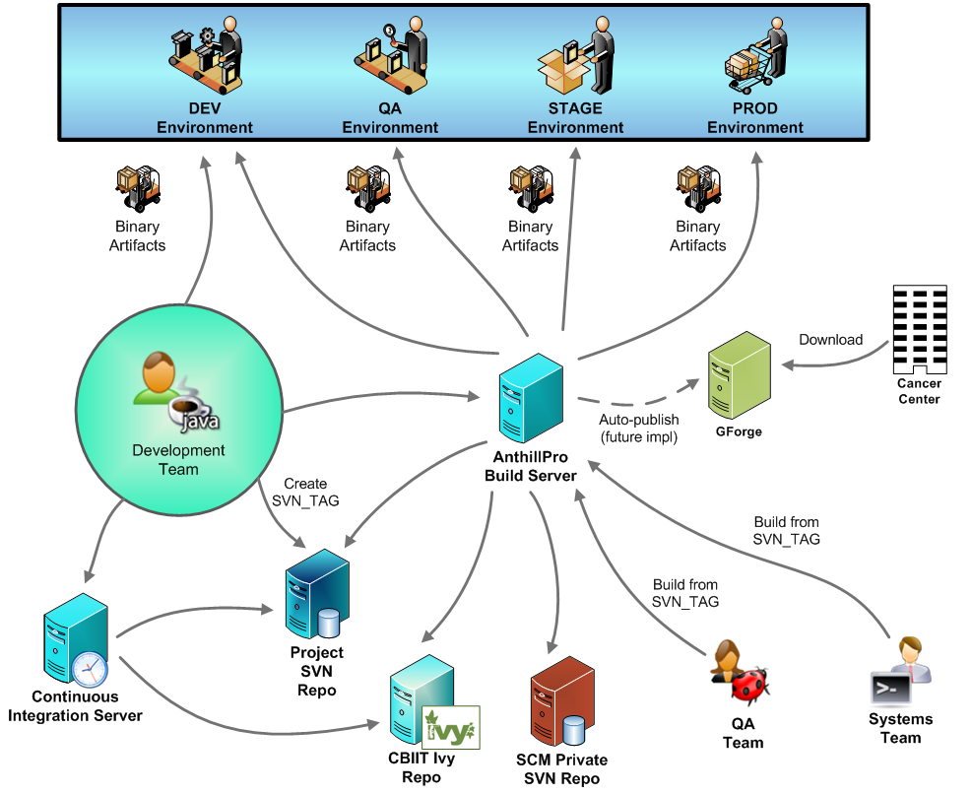
All CBIIT Projects

Slide 4
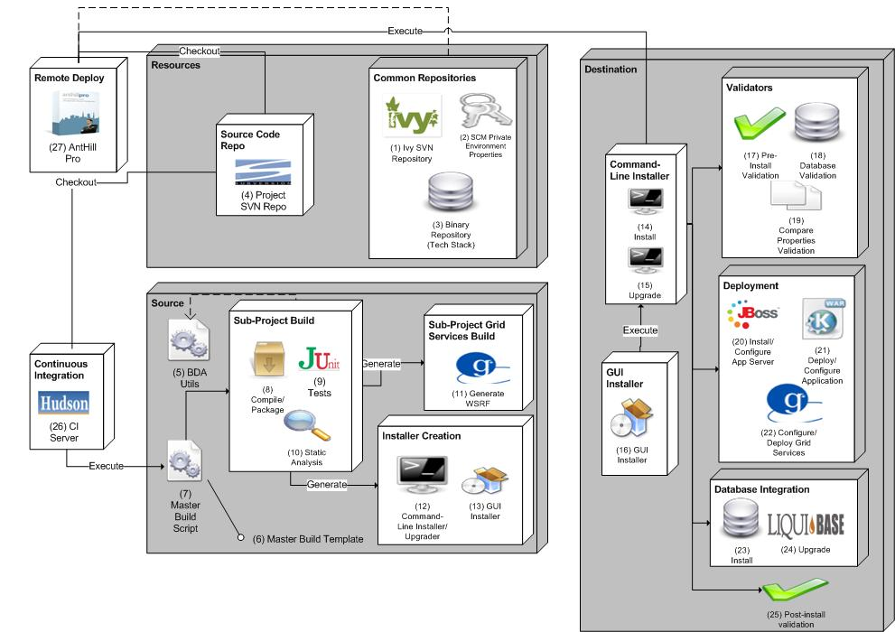
BDA Architecture

Slide 5
Automated Test Harnesses
JUnit Ant templates
Selenium support

Slide 6
Static Analysis
Standards
  PMD, CheckStyle, FindBugs
Coverage
  Cobertura
Cyclomatic Complexity
  JavaNCSS
Duplication
  Simian
Dependencies
  JDepend
Aggregate
  FuseMetrics

Slide 7
Database Integration
TBD

Slide 8
Database Upgrades
Custom macros and targets that use Liquibase database upgrade tool

Slide 9
Command-Line Installation
Remote deployment execute via command-line installation in target environment

Slide 10
Remote Deployment
Security (login-config.xml, etc.)
JNDI
Web configuration
Datasource
SMTP
Configuring binary artifacts
Restarting servers
Grid configuration
Port configuration
Securing web container and grid services

Slide 11
GUI Installation
GUI installation runs a command-line install

Slide 12
Continuous Integration Environment
Reports

Slide 13
Build Management Configuration
Also, defining the processes around build management and promotion

Slide 14
Binary Repository
Tech Stack

Slide 15
Enterprise Dependency Management
TBD

Slide 16
Other
Developer Documentation Generation
  ERD
  UML
  Build
Parallel development utilities
Diagnostics
Log4j

