Slide 1
COPPA
Build and Deployment Automation Kickoff
July 2008

Slide 2
Overview
Project
  Timeline: 7/21/08 -> 8/8/08
  Approach: Three, one-week iterations
  Deliverables: Automated build and deployment system
Team
  Levent Gurses – gursesl@mail.nih.gov
  Steven Saksa – saksas@mail.nih.gov

Slide 3
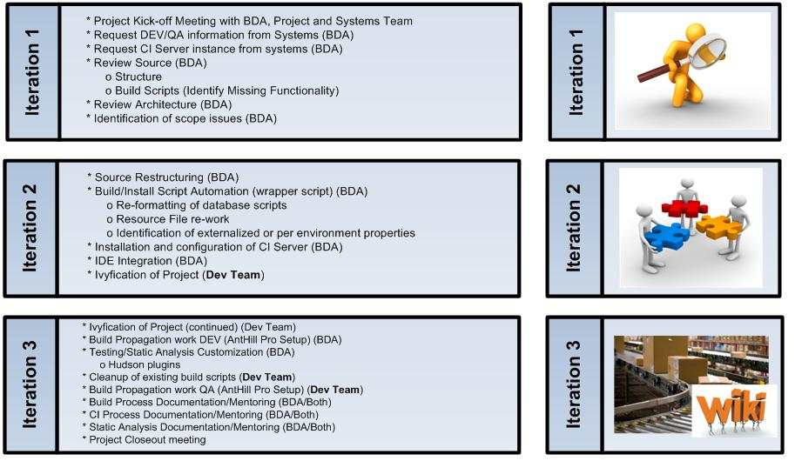
Iteration Plan

Slide 4
Build and Deployment Process
DEV Writes Code
QA Tests Code
Systems Promotes Tested Code
Systems/QA/Dev Verify STAGE/PROD
All Teams Build Code
  Build every time from source
  Ability to build from a SVN tag

Slide 5
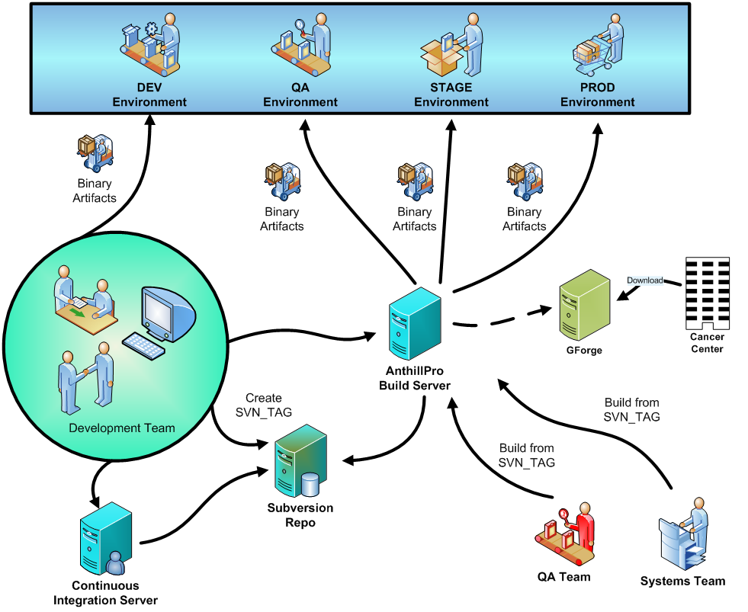

Slide 6
Build and Deployment Contexts
Local Install (Developer Workstation/CI)
Local Upgrade (Developer Workstation/CI)
Remote Install (NCI/AnthillPro)
Remote Upgrade (NCI/AnthillPro)
External Install (Cancer Centers)
External Upgrade (Cancer Centers)

Slide 7
Special Considerations
Three subprojects
  PO – Maven build
  PA – Ant build
  Common JAR – Maven build
Maven Repository -> CBIIT Ivy Repo

Slide 8
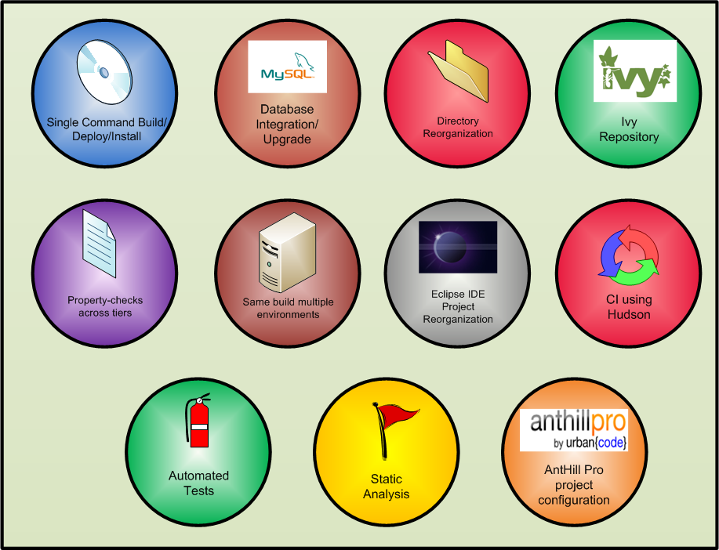
Features

Slide 9
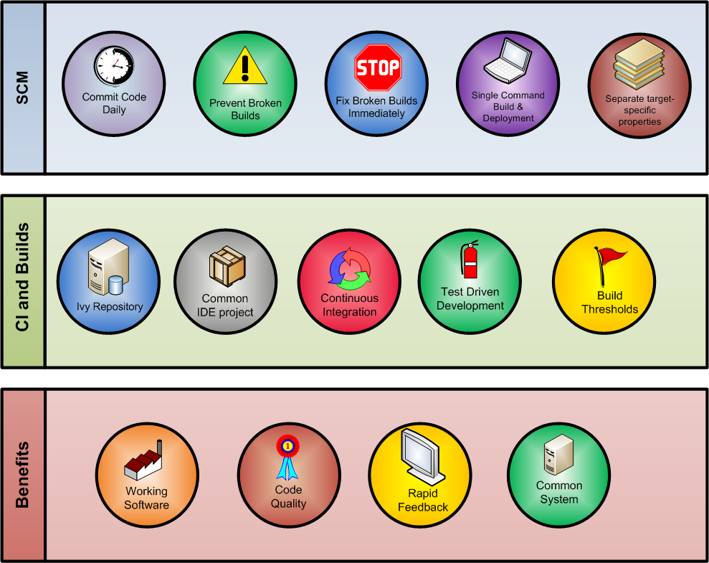
Practices and Benefits

Slide 10
More Info
BDA WIKI - https://wiki.nci.nih.gov/x/fJd8
PROJECT BDA WIKI - https://xxxxx.xxx.xxx
BDA FAQ - https://wiki.nci.nih.gov/x/UZx8
BDA Team:
  Paul Duvall – duvallp@mail.nih.gov
  Steve Saksa – saksas@mail.nih.gov
  Levent Gurses – gursesl@mail.nih.gov
  Mahidhar Narra – narram@mail.nih.gov

