Slide 1
Build and Deployment Automation Team
Life Sciences Distribution Installers
November 2008

Slide 2
LSD Installers
Deployment using installers
Minimize time and resources using installer
Minimize the issues
One time effort
Confidence

Slide 3
LSD Installers
Command-line Installer
GUI Installer

Slide 4
Command Line Installers
Non GUI installer
Edit the properties files
Validators during install
Used across tiers at NCI

Slide 5
GUI-Installer
IZpack
Wrapper for the Command Line installer
Prompts for the Configuration
Updates the property files with the configuration
Executes the command line installer
downloads http://gforge.nci.nih.gov/frs/?group_id=450
Types of Install
  Typical
  Custom
Modes of Install
  Install
  Update

Slide 6
GUI Installer
Validators
  PortValidator
  URLCheckValidator
  DBConnectionValidator
  NonEmptyValidator
  HostNameValidator

Slide 7
GUI-Installer
UPT
caArray
caGWAS
CTODS
NCIA
LSDB

Slide 8
Future LSD Releases
Master Installer
Validators
Enhancements

Slide 9
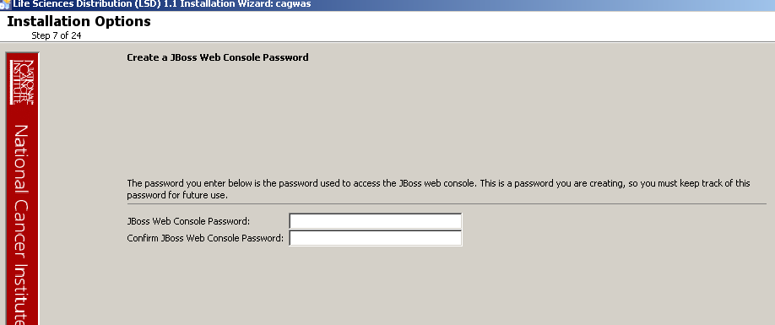
DEMO

