Slide 1
Moving toward Continuous Delivery
Tools, BDA and Future
March 2010

Slide 2
BDA Mission and Agenda
Former: “Once an environment has been minimally provisioned, an authorized user only needs to click a button or type a single command to create working, testable software for users. In other words, other than the click or command, one is able to create working software without any human intervention.”
Move toward “Continuous Delivery” and more and more self-service teams.
Software Production processes should be CERF:
C - Cheap - Make deployments/releases inexpensive to reproduce so that (inevitable) failures aren't costly and can be run as often as necessary
E - Easy - Once the infrastructure has been established, deployments should be a single command or the click of a button
R - Repeatable - Ability to the run the same processes in any target environment (developer workstation, QA, cancer center, production)
F - Fast - Eliminate human bottlenecks in production/delivery process
The environment provisioning must be minimal and typically consists of installing/configuring JADS and JADSON.
Continuous Delivery|Tools|Governance

Slide 3
Cloud Computing Definition
“…a model for enabling convenient, on-demand network access to a shared pool of configurable computing resources (e.g., networks, servers, storage, applications, and services) that can be rapidly provisioned and released with minimal management effort or service provider interaction” (NIST)

Slide 4

Executive Summary(1)
1
Similar performance metrics between cloud provider and virtual metal
2
Cost $408/month(2) to run NBIA in the cloud
Successfully installed caArray into cloud in one click with “Application Provisioner” (requires BDA certification)
3
(1) See CBIIT cloud feasibility report at https://gforge.nci.nih.gov/svnroot/cloud/trunk/docs/cbiit-cloud-computing-feasibility-report.pdf
(2) Costs can be considerably less when using AWS reserved instances

Slide 5
Findings - Costs
Using NBIA for one month with AWS EC2
Two core CPU
7.5GB memory
Feature | Usage | Cost
Instance | 720 hours (one month) | @ $ 0.34/hour =$244.80
Storage | 500 GB | $0.10/GB/Month=$50.00
Bandwidth | 750 GB | 0.15/GB out, in free=$112.50
Disk I/O | 1.5 million | 0.10/1 million I/O requests=$0.15
Totals |  | $407.15

Slide 6
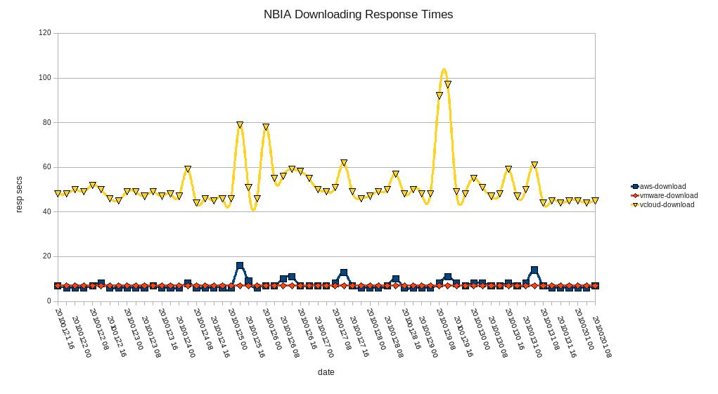
Findings - Performance
NBIA Performance Times

Slide 7
Findings - Performance
NBIA Performance Times
Provider | Average Time
AWS | Checkout: 1m45s Build: 13m38s Data Load: 151m41s
VMWare | Checkout: 2m2s Build: 13m18s Data Load: 136m16s
Terremark | Checkout: 7m5s Build: 72m55s Data Load: 326m25s

Slide 8
Launch Application Provisioner – Step 1
1
Center Deployment Lead Enters Credentials

Slide 9
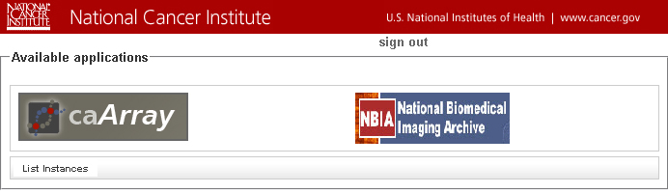
Application Provisioner – Step 2
2
Deployment Lead Selects Application to Install

Slide 10
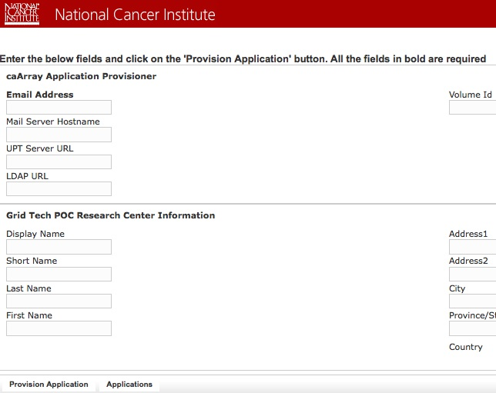
Application Provisioner – Step 3
3
Deployment Lead Enters Required Information and Clicks Provision Application

Slide 11

Application Provisioner – Step 4
4
Deployment Lead Receives Email Notification

Slide 12
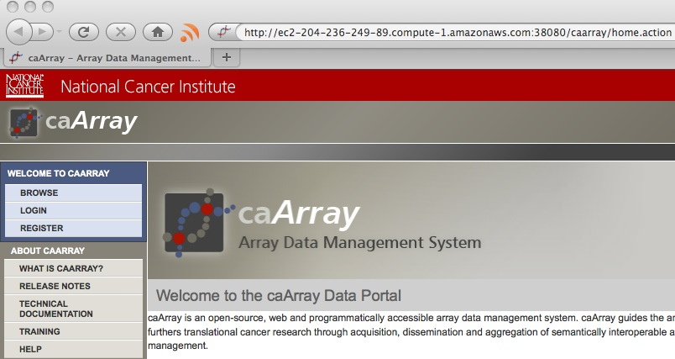
Application Provisioner – Step 5
5
Working caArray Application

Slide 13
Application Provisioner - Summary
1
Center Deployment Lead Enters Credentials
2
Deployment Lead Selects Application to Install
3
Deployment Lead Enters Required Information and
Clicks Provision Application
4
Deployment Lead Receives Email Notification
5
Working caArray Application
❑
Timeline
0
45 min

Slide 14

What’s Happening Behind the Scenes?
The following step-by-step example demonstrates a specific example of using the Application Provisioner to install caArray into an EC2 environment
In the future, any of the components of the Provisioner can be modified for other applications to include the:
Cloud Provider
Compiler
Build Tool
Database
Application
These changes would require additional work, but the purpose of these slides is to demonstrate a specific one-click installation example using cloud computing

Slide 15

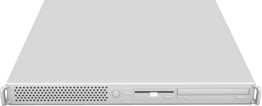

Installs Hardware
Amazon EC2 Cloud
Reserved Cloud
❑
Timeline
0
45 min

Slide 16

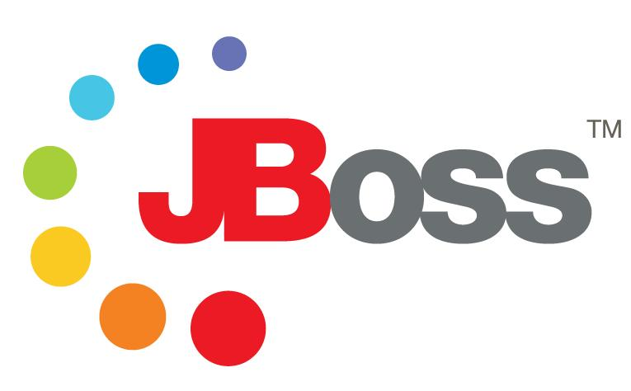
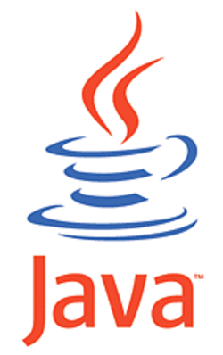
Configures Hardware – Installs Tools
NCI Repository
Reserved Cloud
Configured Instance
❑
Timeline
0
45 min

Slide 17
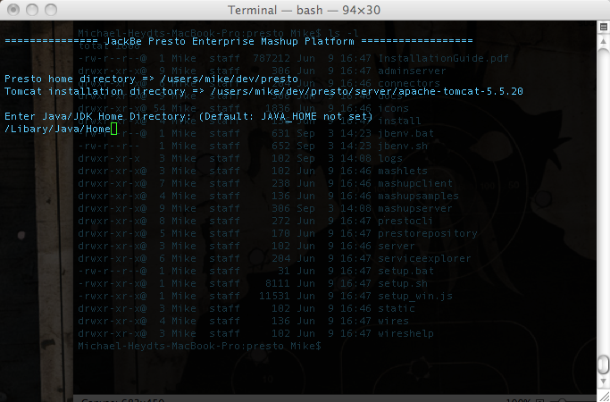


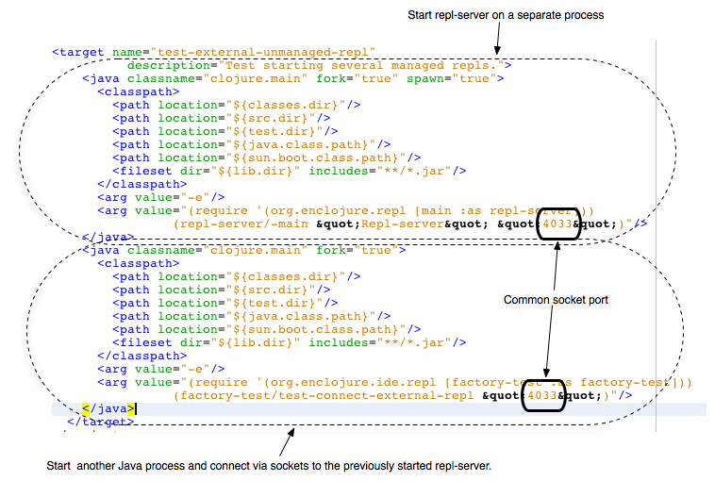
Configures Hardware – Environment Setup
Run Configuration Scripts
Configure Java
Configure Environment
Configure Apache Ant
Fully-Configured Instance
❑
Timeline
0
45 min

Slide 18

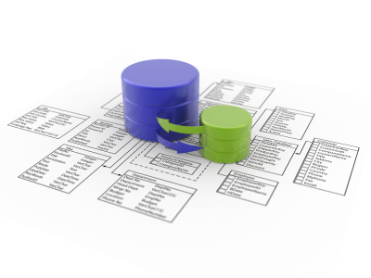
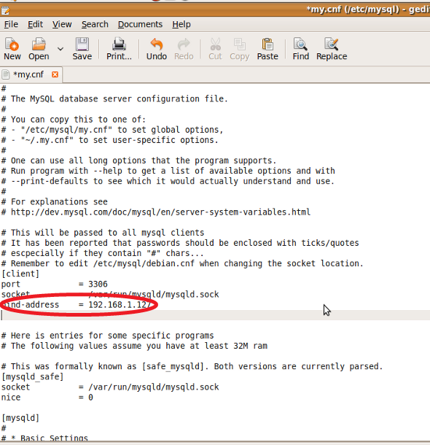
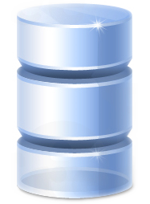
Installs and Configures Database Server
Database Server
Create User Accounts
Create Empty Database
Configure MySQL (my.cnf)
Configured Instance
❑
Timeline
0
45 min

Slide 19


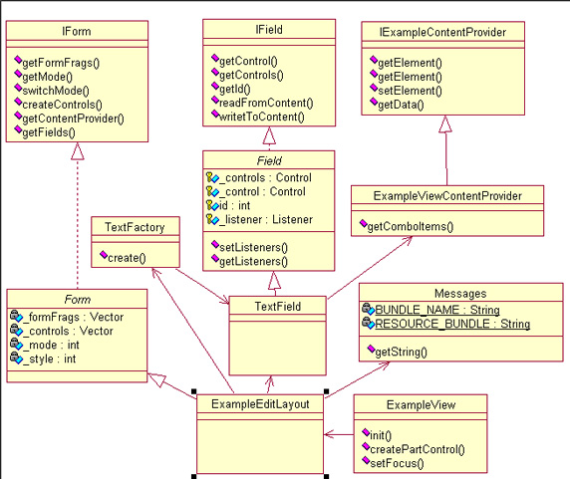
Checks out source code from tag
CBIIT SVN Repo
caArray Source
Configured Instance
❑
Timeline
0
45 min

Slide 20


Assembles Database
Database Server
Insert Lookup Data
Create Application Database
Configured Instance
Timeline
❑
0
45 min

Slide 21
Configures Data Storage
Amazon EC2 Cloud
Reserved Cloud
Data Storage Volume
Attach Storage to New MySQL Instance
Timeline
❑
0
45 min

Slide 22
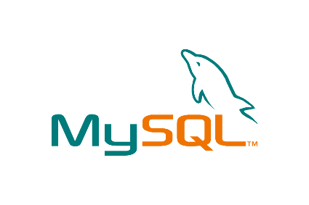
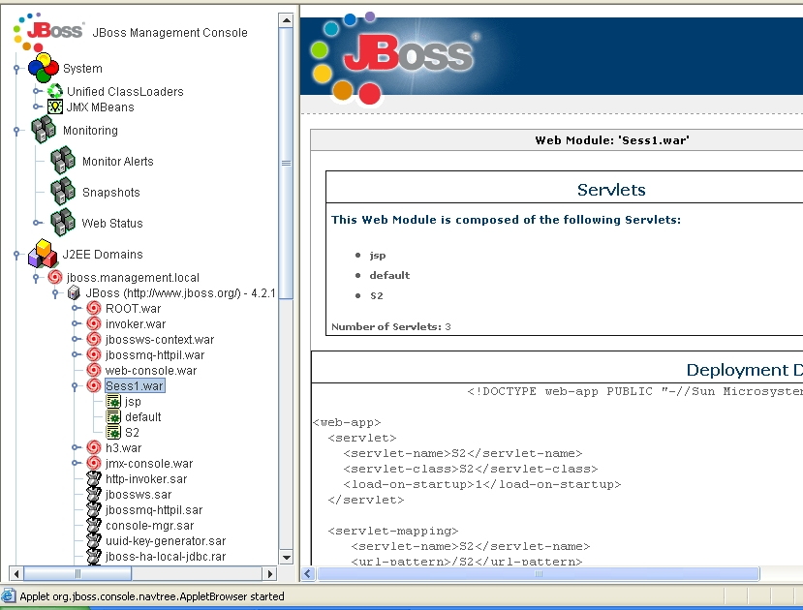

Configures Web Container
Web Container
Link w/ MySQL
Configure JBoss Server
Configured Instance
Timeline
❑
0
45 min

Slide 23

Deploys Application
Amazon EC2 Cloud
Web Container
caArray Web Archive
Configured Instance
Timeline
❑
0
45 min

Slide 24
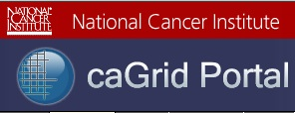
Publish Grid Service
Web Container
Grid
Service
Configured Instance
Timeline
❑
0
45 min

Slide 25
The End Result: Working Software

Slide 26

Continuous Delivery
With Continuous Delivery, releasing software becomes a “non event”
Using Continuous Delivery, teams can setup target environments on demand and in a matter of minutes
Teams can deliver software to users quickly and often
Teams are not encumbered submitting tickets to teams who might takes days or weeks to fulfill their request(s) (self-service)

Slide 27

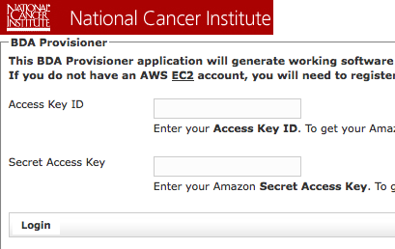
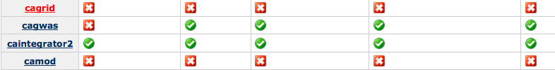
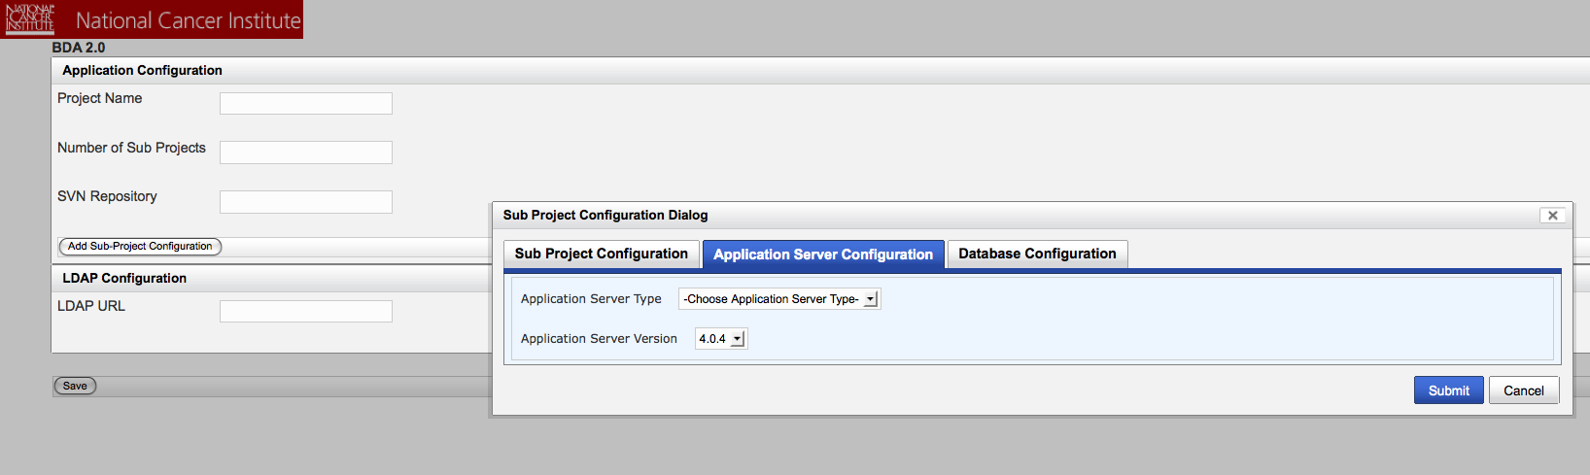
Tools and Support
Support
Web
Configurator
Provisioner
Dashboard
Provisions hardware
Cloud
Virtual Instance (Private)
Physical machines
Application for creating single-command/one-click working software
Uses BDA 2.0 Engine and Plugin framework
Database, Application, SSL, etc.
Real-time dashboard that analyzes whether working software is created across products in a portfolio

Slide 28
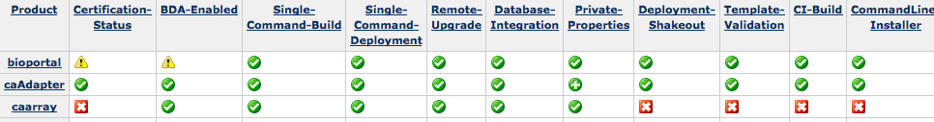
Automated BDA Certification
Repository | Task-Level Commit | Minimal Dependencies | Private Build
Continuous Feedback | Expeditious Fixes | Independent Build | Single Command
Externalize Configuration | Scripted Database | Automated Tests | Continuous Inspection
Scripted Deployment | Disposable Container | Decouple Installation | Single-Command Provisioning
Dedicated Machine | Tokenize Configuration | Developer Documentation | Protected Configuration
Build Threshold | Deployment Test | Unified Deployment | Database Sandbox

Slide 29
Certification Governance
Project teams are responsible for ensuring project is continually BDA certified
New automated verification will check against certification during build promotion (e.g. DEV prior to promotion to QA)
Systems team will reject non-certified projects

Slide 30
2010 Projects
Installer
BDA 1.x Maintenance
BDA 2.0
Certification Dashboard (Development)
Individual Projects (BDA'fication/Certification)
Communication/Outreach Plan
Governance Plan: https://wiki.nci.nih.gov/x/QwHb
On Demand CI

Slide 31
Summary
Mission
Creating on-demand target environments gets software to users faster and cheaper
BDA provides project teams certification dashboard (and automated weekly emails) to continually verify whether project can create working software (a picture of project reality)
Summary of ongoing and new projects

