Slide 1
BDA Overview for LSD PM’s
January 2009
Notes:
CI Server: http://cbv-ciweb-base.nci.nih.gov:48080/hudson/job/ncia_ci/
AHP: http://cbiocvs2.nci.nih.gov:8080/AnthillPro/admin/
BDA Systems: https://wiki.nci.nih.gov/x/KgSM
BDA Project Features: https://wiki.nci.nih.gov/x/KZx8
BDA Project Plan Template: https://wiki.nci.nih.gov/x/Ghmy
BDA Enterprise rollout: https://wiki.nci.nih.gov/x/Mg6y

Slide 2











Mission
Ensure ALL active CBIIT development teams are able to promote working software from DEV to QA to STAGE to PROD without human intervention in 2009
Release software to users more often. Reduce time, errors and costs between Development and Production. Increase user adoption through simple-to-build/deploy/install software.
Notes:
NCIA GUI INSTALLER – java –jar ncia***.jar
NCIA COMMAND-LINE INSTALLATION - https://wiki.nci.nih.gov/x/lqql
NCIA DEVELOPER BUILD
NCIA CI SERVER
NCIA AHP

Slide 3
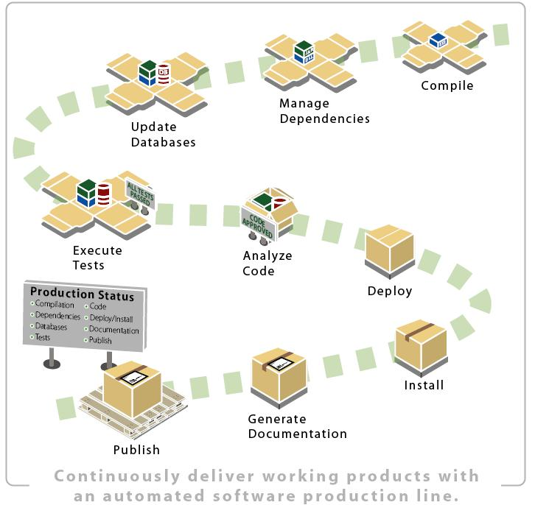
Each CBIIT Target Environment (DEV, QA…)

Slide 4

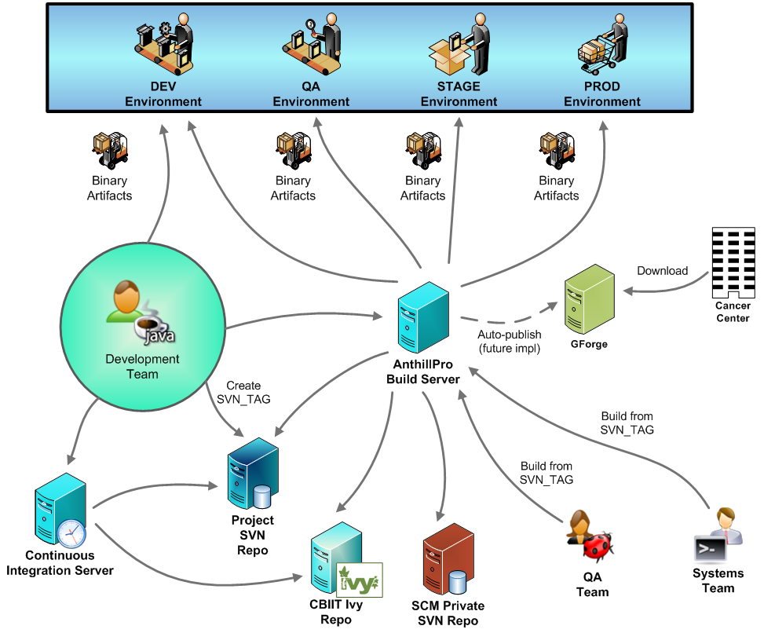
A Day in the Life…

Slide 5
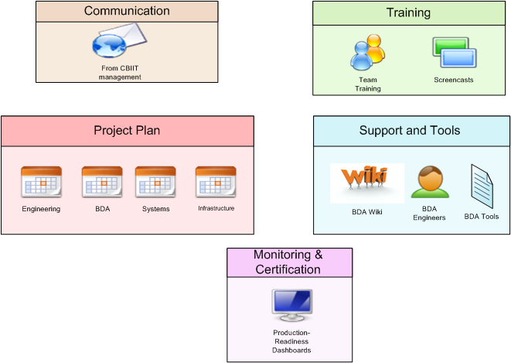
Enterprise rollout
Notes:
https://wiki.nci.nih.gov/x/Mg6y

Slide 6

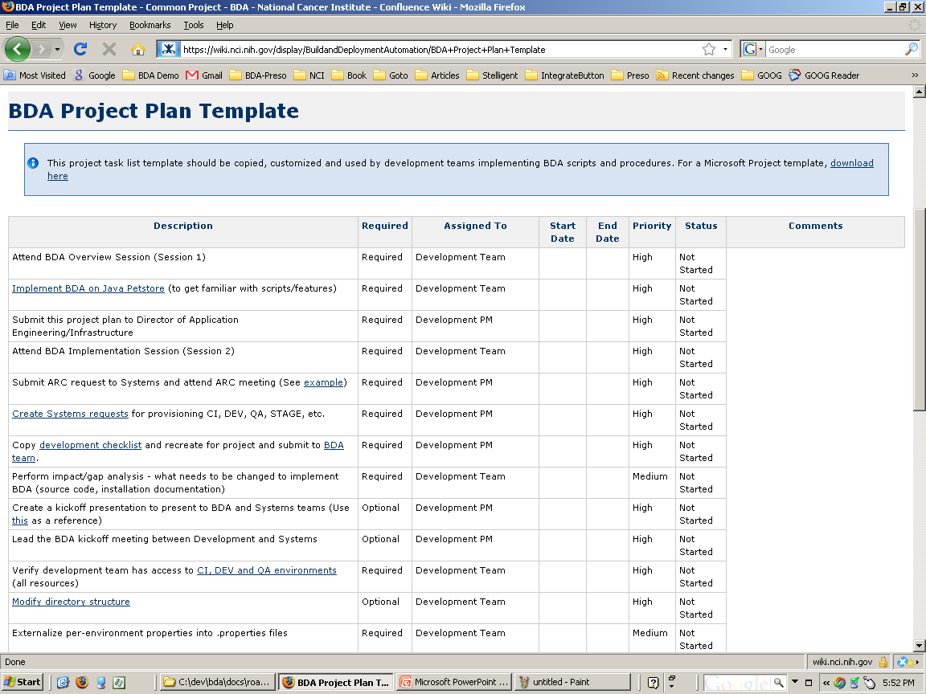
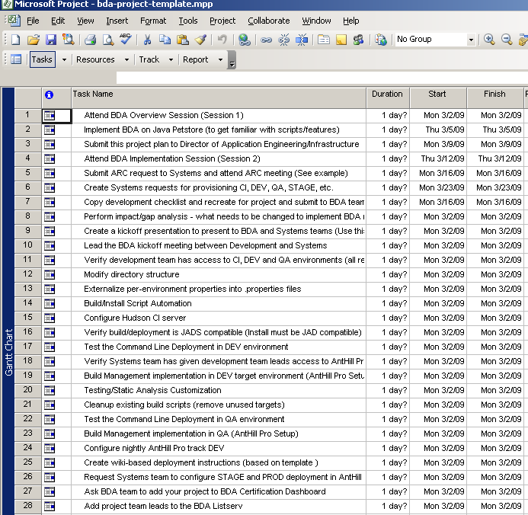
Project Plan Example
Notes:
https://wiki.nci.nih.gov/x/Ghmy

Slide 7



BDA Training
BDA Wiki - https://wiki.nci.nih.gov/x/fJd8
Development Team Training
  Two Sessions
    Overview
    Implementation
Screencasts
  New project setup
  BDA’fication
    Compilation/Packaging, Database Integration/Upgrades, Deployment (Web, Grid, LDAP, SMTP, Datasource, etc.), Installation, Testing, Static Analysis
  CI server
    Installation, configuration, reporting, etc.
  Build Management
    Tracks, dependent projects, SSH keys, properties, etc.

Slide 8
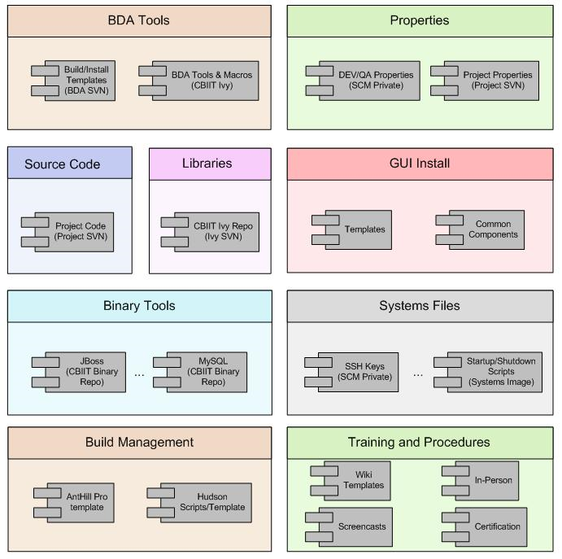
BDA Tools and Framework

Slide 9
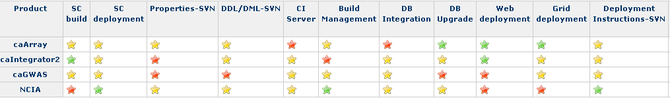
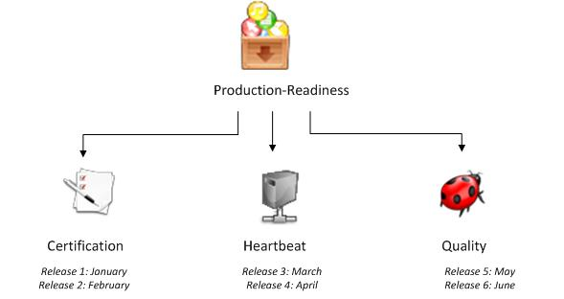
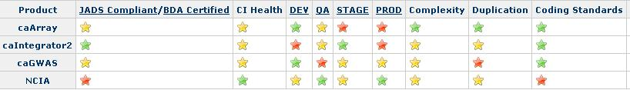
BDA Certification (and more…)
JADS – Java, Ant, Database, Subersion
JADSON– Java, Ant, Database, Subersion, OS, Network
Automated scripts to continually analyze and present via dashboard (above)
BDA and Systems team expert analysis
  All projects at least once a month
Production readiness dashboard (prototype is below)

Slide 10
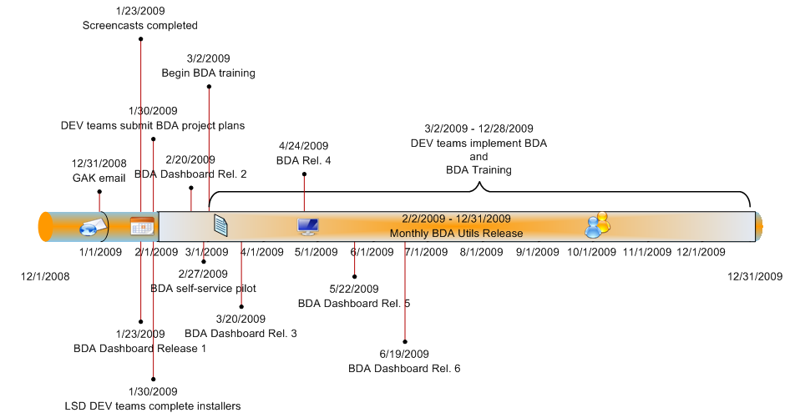
BDA Rollout Timeline

Slide 11
Command Line and GUI Installers
Consistent and easy to install LSD software at cancer center
Separate installers for each product
  Consistency is provided by implementing BDA toolset
  An output of implementing the BDA toolset is a command-line installer
BDA provides an installation framework, based on IzPack, to create GUI installers
  GUI installers call the command-line installer
  Requirements: https://wiki.nci.nih.gov/x/MRGy
Development teams will be responsible for implementing BDA rules and tools
  BDA team can be consulted at any time
  BDA team will provide oversight on consistency for LSD products
  See https://wiki.nci.nih.gov/x/_Q6Z for BDA implementation (contains installer steps)
Notes:
NCIA GUI INSTALLER – java –jar ncia***.jar
NCIA COMMAND-LINE INSTALLATION - https://wiki.nci.nih.gov/x/lqql
NCIA DEVELOPER BUILD
NCIA CI SERVER
NCIA AHP

Slide 12
BDA Contact Information
BDA Email
  ncicbiitbda@mail.nih.gov
BDA Listserv
  https://list.nih.gov/archives/cbiit-bda.html
BDA Wiki
  https://wiki.nci.nih.gov/x/fJd8

