Slide 1
BDA Enterprise Rollout
November 2008

Slide 2











Mission
Ensure ALL CBIIT development teams are able to promote working software from DEV to QA to STAGE in less than two hours in FY 2009

Slide 3
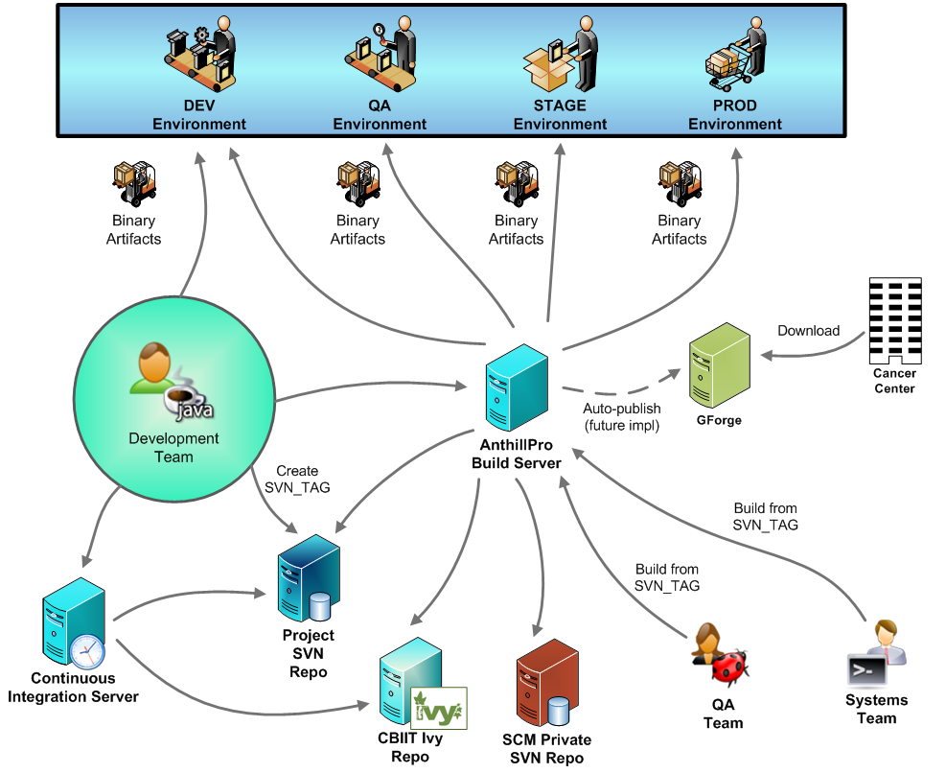
All CBIIT Projects

Slide 4
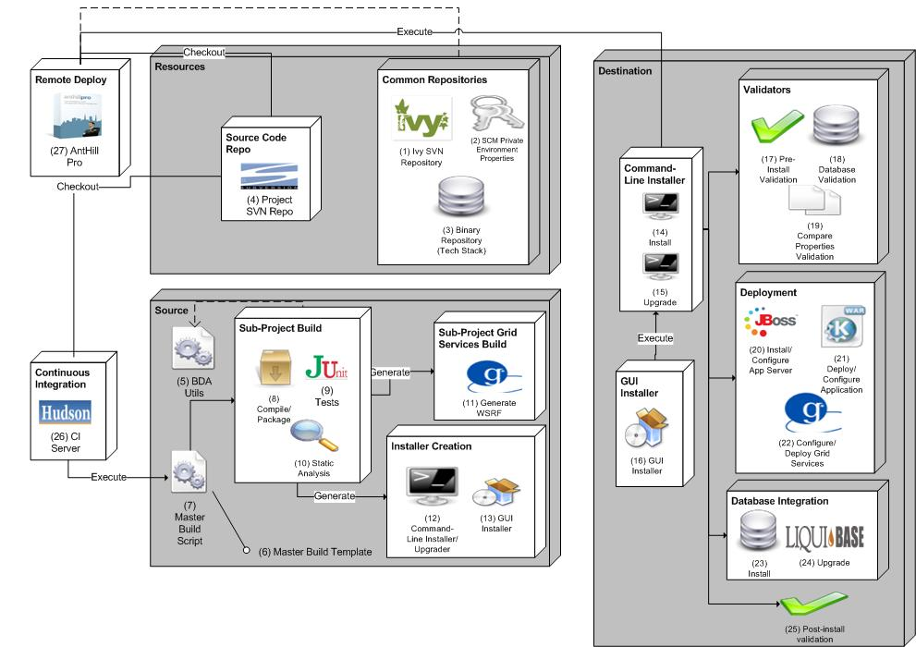
BDA Architecture

Slide 5
Scenario
Development team receives email from Application Engineering, Systems and Deputy Director of CBIIT
BDA schedules training with development team
BDA conducts two, two-hour training sessions with development team
Development team submits project plan to Application Engineering Director, Systems and BDA identifying date the project will be BDA certified
Development team consults BDA resources (BDA wiki, consultants, screencasts, etc.) to implement BDA
BDA continually audits projects for certification

Slide 6



Communication
December 2008
  Directors send email on BDA mandate and rollout to all development teams, QA, product managers and Systems teams at CBIIT
    Mandate (Two-hours to STAGE, JADS-compliant – ALL projects)
    Timeline
    Project Plans
    Responsibilities
  BDA team delivers “brownbag” training to CBIIT, after BDA mandate email
  BDA team develops automated analysis, utilities, training program, screencasts, documentation, etc.
January – June 2009
  Enterprise rollout
  Date dependent on number of projects

Slide 7



BDA Training
BDA Wiki - https://wiki.nci.nih.gov/x/fJd8
Development Team Training (Twice)
Open Sessions: bi-weekly
Screencasts
  New project setup
  BDA’fication
    Compilation/Packaging, Database Integration/Upgrades, Deployment (Web, Grid, LDAP, SMTP, Datasource, etc.), Installation, Testing, Static Analysis
  Ivy’fication
    Dependent JARs
  CI server
    installation, configuration, reporting, etc.
  Build Management
    Tracks, dependent projects, SSH keys, properties, etc.

Slide 8
Schedule
Project | Training | BDA Certification Date
Firebird | January 5, 2009 | April 30, 2009
caNanoLab | January 8, 2009 | April 30, 2009
Firebird | January 12, 2009 | April 30, 2009
caNanoLab | January 15, 2009 | April 30, 2009
Rembrandt | January 20, 2009 | April 30, 2009
I-SPY | January 22, 2009 | April 30, 2009
Rembrandt | January 26, 2009 | April 30, 2009
I-SPY | January 29, 2009 | April 30, 2009
caDSR | February 2, 2009 | May 31, 2009
caCore and SDK | February 5, 2009 | May 31, 2009
caDSR | February 9, 2009 | May 31, 2009
caCore and SDK | February 12, 2009 | May 31, 2009
caB2B | February 16, 2009 | May 31, 2009
trWorkbench | February 19, 2009 | May 31, 2009
caB2B | February 23, 2009 | May 31, 2009
trWorkbench | February 26, 2009 | May 31, 2009
caMOD | March 2, 2009 | June 30, 2009
caBIO | March 5, 2009 | June 30, 2009
caMOD | March 9, 2009 | June 30, 2009
caBIO | March 12, 2009 | June 30, 2009
CPAS | March 16, 2009 | June 30, 2009
CDS | March 19, 2009 | June 30, 2009
CPAS | March 23, 2009 | June 30, 2009
CDS | March 26, 2009 | June 30, 2009
This is only an example. Schedule is dependent upon Systems and Application Engineering input

Slide 9
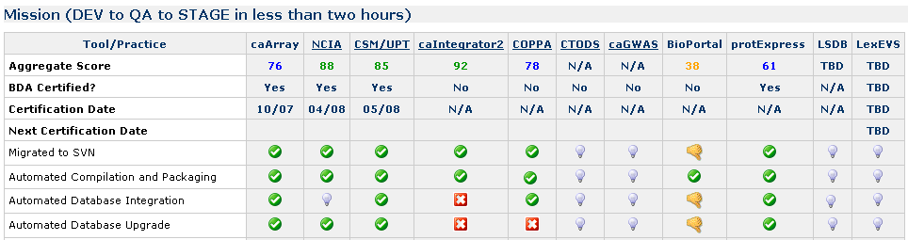
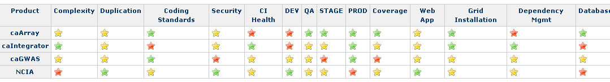
BDA Certification
Automated scripts to continually analyze and present via dashboard (right)
BDA expert analysis
  All projects at least once a month
Release readiness dashboard (prototype)

Slide 10
Special Projects
In FY 09, the BDA team will consist of 2+ engineers. Assignments on special projects will be based on prioritization (and supply). Here are some of BDA’s current projects.
Build/Deployment related
  Disposable Application Containers
  LSD installation support
  Securing JBoss
  HTTPS servers
  Build script enhancements
  AntHillPro 3 migration
Other
  Deployment Request Tracker (DRT)
  GForge to JIRA migration
  Security checklist (roll into release-readiness)
  Coding standards checklist (roll into release-readiness)
  SVN migration
  SVN support (hooks, etc.)

Slide 11
GForge to JIRA migration
Full Project Migration (30 projects)
  One project at a time
  Develop automated scripts to perform migration
  Approximately 500 hours
  Does not include JIRA training

