Slide 1
Continuous Delivery
Paul Duvall
February 2010

Slide 2

Continuous Delivery
Software can be delivered on-demand to any target environment at any time from only the source files checked into version-control repository
Includes provisioning virtual hardware instances
Once setup, requesting infrastructure resources becomes entirely self service (e.g. Developers can get a shared DEV environment up and running with click of a button – in minutes)

Slide 3

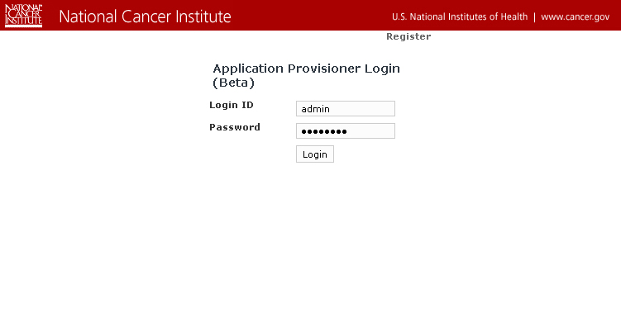
Application Provisioner – Step 1
1
Center Deployment Lead Enters Credentials

Slide 4
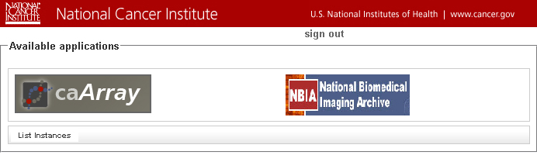
Application Provisioner – Step 2
2
Deployment Lead Selects Application to Install

Slide 5
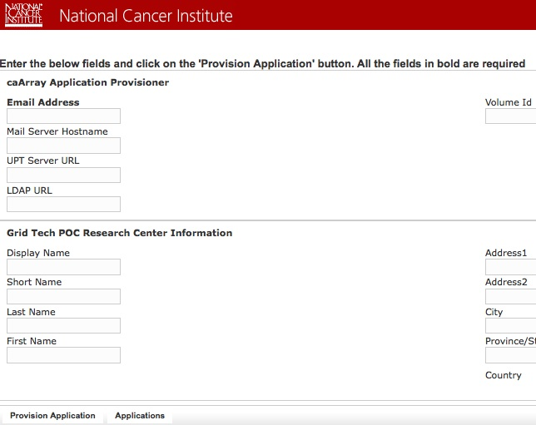
Application Provisioner – Step 3
3
Deployment Lead Enters Required Information and Clicks Provision Application

Slide 6

Application Provisioner – Step 4
4
Deployment Lead Receives Email Notification

Slide 7
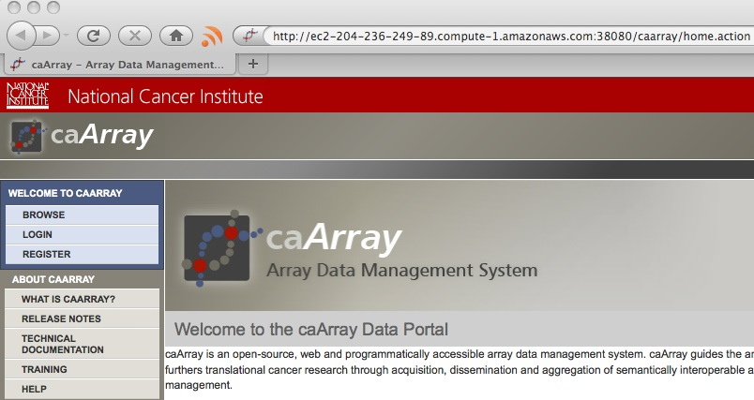
Application Provisioner – Step 5
5
Working Application

Slide 8
Application Provisioner - Summary
1
Center Deployment Lead Enters Credentials
2
Deployment Lead Selects Application to Install
3
Deployment Lead Enters Required Information and
Clicks Provision Application
4
Deployment Lead Receives Email Notification
5
Working Application (from SVN source files)
❑
Timeline
0
45 min

Slide 9
Continuous Delivery – Provisioning
Procures, installs and configures a virtual Linux hardware instance
Installs and configures Java, Ant and Subversion on the procured Linux instance
Installs and configures MySQL database server for application. This includes creating database users and granting access to the newly created (empty) application database.
Creates a data storage volume on the virtual instance, attaches it and configures MySQL to store the data files on the drive
Performs a checkout of application source code from CBIIT SVN tag
Assembles application database and inserts lookup data
Installs and configures the JBoss web container including things like connecting the container to the MySQL database
Builds and deploys the archive (e.g. WAR) and configures it for the JBoss web container
Uses a dependency manager to download and configure class path for dependent tools required by application (e.g. Hibernate, Logging, etc.)
Makes application grid service available on the training grid portal

Slide 10
Continuous Delivery – System Requests
Does Not
Scale Well
Developers
Queue
Engineers
Traditional
Synchronous
Scalable
Continuous
Delivery
Developers
Service
Engineers
Asynchronous

Slide 11

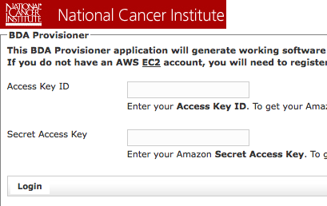
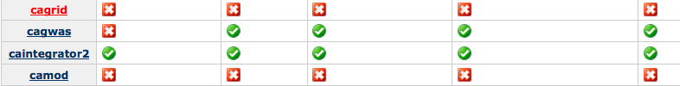
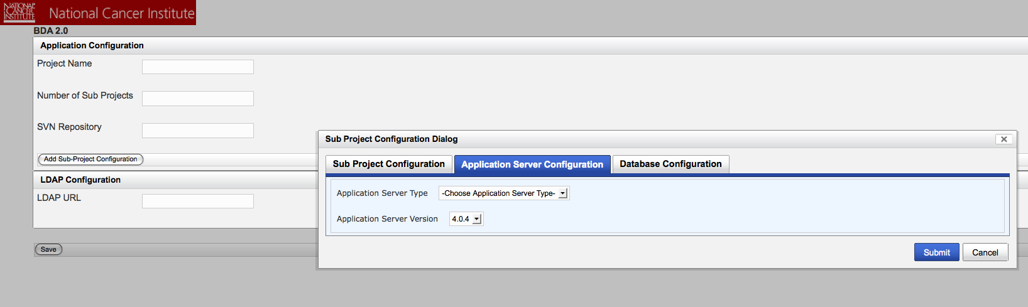
BDA Tools and Support
Note: Items in bold have not been fully developed yet
Support
BDA
Framework
Provisioner
Dashboard
Framework for creating single-command/one-click working software
Will provide web application
Uses BDA 2.0 Engine and Plugin framework
Database, Application, SSL, etc.
Provisions hardware
Cloud
Virtual Instance (Private)
Physical machines
Real-time dashboard that analyzes whether working software is created across products in a portfolio

Slide 12
Continuous Delivery – The What
All processes are automated and on demand
Provision virtual hardware instances
Compilation and Packaging
Database assembly and upgrade (DDL and DML execution)
Unit, Component, Functional, Load and Performance Tests
Local and Remote Deployment
Continuous Integration (including various feedback mechanisms)
Static Analysis (Standards, Duplication, Complexity, Dependencies, etc.)
Perform Build Management and Promotion
Use Dependency Management
Documentation (UML, ERD, Developer Documentation, etc.)
Creation of Installation distribution (if necessary)
Automated dashboard monitoring of build, deployment and installation processes
Parallel development (branching, tagging, codeline policies, etc.)

Slide 13


Continuous Delivery – Build
Compilation and Packaging

Slide 14
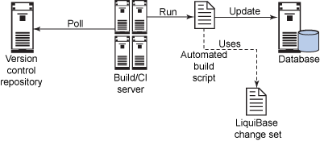
Continuous Delivery – Database
Database assembly and upgrade (DDL and DML execution)
<?xml version="1.0" encoding="UTF-8"?>
<databaseChangeLog xmlns="http://www.liquibase.org/xml/ns/dbchangelog/1.7"
xmlns:xsi="http://www.w3.org/2001/XMLSchema-instance"
xsi:schemaLocation="http://www.liquibase.org/xml/ns/dbchangelog/1.7
http://www.liquibase.org/xml/ns/dbchangelog/dbchangelog-1.7.xsd">
<changeSet id="2" author="paul">
<createTable tableName="brewer">
<column name="id" type="int">
<constraints primaryKey="true" nullable="false"/>
</column>
<column name="name" type="varchar(255)">
<constraints nullable="false"/>
</column>
<column name="active" type="boolean" defaultValue="1"/>
</createTable>
</changeSet>
</databaseChangeLog>

Slide 15
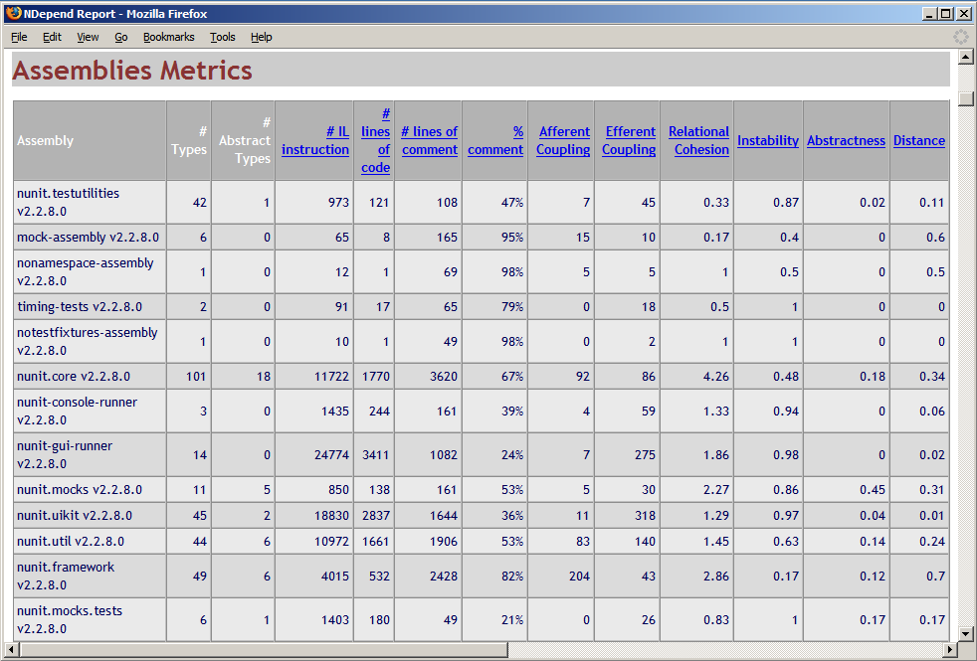
Continuous Delivery – Code Analysis
Static Analysis (Standards, Duplication, Complexity, Dependencies, etc.)

Slide 16
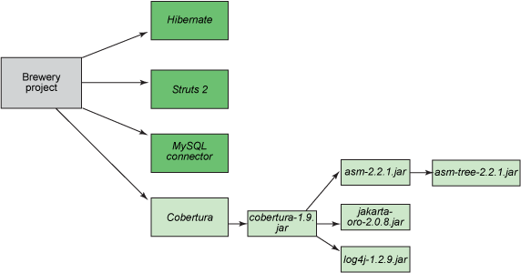
Continuous Delivery – Dependency Management
Dependency Management
<?xml version="1.0" encoding="ISO-8859-1"?>
<?xml-stylesheet type="text/xsl" href="./config/ivy/ivy-doc.xsl"?>
<ivy-module version="1.0">
<info organisation="com" module="integratebutton" />
<dependencies>
<dependency name="hsqldb" rev="1.8.0.7" />
<dependency name="pmd" rev="2.0" />
<dependency name="cobertura" rev="1.9"/>
<dependency name="checkstyle" rev="4.1" />
<dependency name="junitperf" rev="1.9.1" />
<dependency name="junit" rev="3.8.1" />
</dependencies>
</ivy-module>

Slide 17
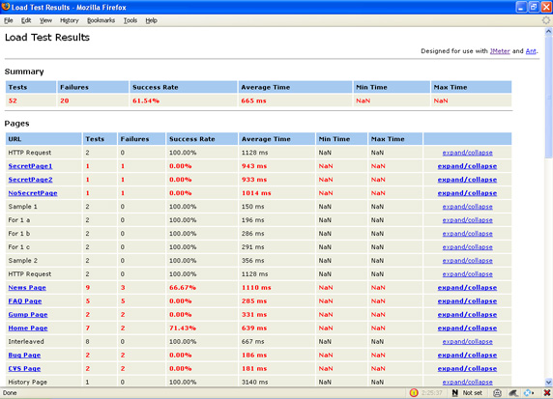
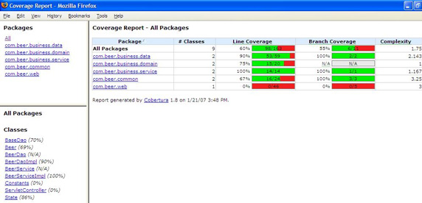
Continuous Delivery – Testing
Unit, Component, Functional, Load and Performance Tests

Slide 18
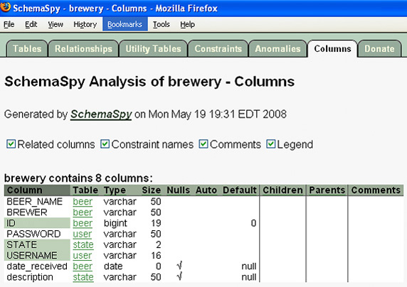
Continuous Delivery – Documentation
Documentation (UML, ERD, Developer Documentation, etc.)

Slide 19
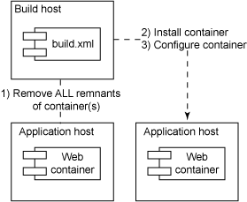
Continuous Delivery – Deployment
Local and Remote Deployment – including hardware and server provisioning
<!-- Check to see if Tomcat is running prior to this -->
...
<exec executable="sh" osfamily="unix" dir="${tomcat.home}/bin" spawn="true">
<env key="NOPAUSE" value="true" />
<arg line="shutdown.sh" />
</exec>
<delete dir="${tomcat.home}" />
<get src="${tomcat.binary.uri}/${tomcat.binary.file}"
dest="${download.dir}/${tomcat.binary.file}" usetimestamp="true"/>
<unzip dest="${target.dir}" src="${download.dir}/${tomcat.binary.file}" />
<exec osfamily="unix" executable="chmod" spawn="true">
<arg value="+x" />
<arg file="${tomcat.home}/bin/startup.sh" />
<arg file="${tomcat.home}/bin/shutdown.sh" />
</exec>
<xmltask source="${appserver.server-xml.file}"
dest="${appserver.server-xml.file}">
<attr path="/Server/Service[@name='${s.name}']/Connector[${port='${c.port}']"
attr="proxyPort"
value="${appserver.external.port}"/>
<attr path="/Server/Service[${name='${s.name}']/Connector[${port='${c.port}']"
attr="proxyName"
value="${appserver.external.host}"/>
</xmltask>
<!-- Perform other container configuration -->
...
<echo message="Starting tomcat instance at ${tomcat.home} with startup.sh" />
<exec executable="sh" osfamily="unix" dir="${tomcat.home}/bin" spawn="true">
<env key="NOPAUSE" value="true" />
<arg line="startup.sh" />
</exec>

Slide 20
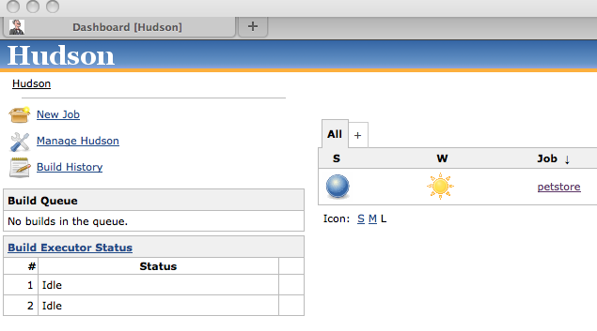
Continuous Delivery – Integration
Continuous Integration (including various feedback mechanisms)

Slide 21
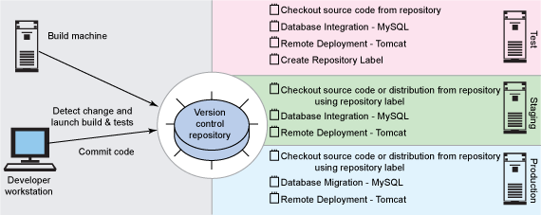
Continuous Delivery – Build Promotion
Build Management and Promotion

Slide 22
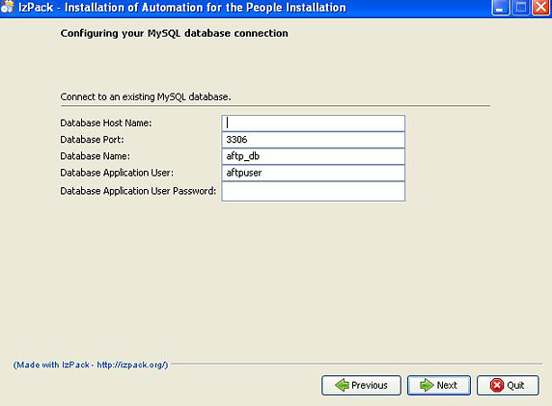
Continuous Delivery – Installation
Creation of Installation distribution (if necessary)

Slide 23
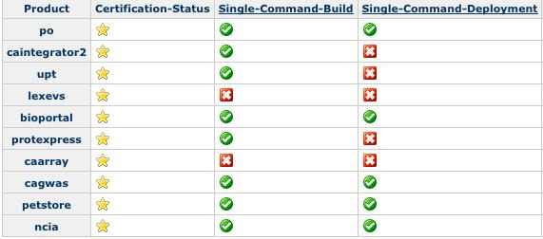
Continuous Delivery – Certification
Automated dashboard monitoring of build, deployment and installation processes

Slide 24
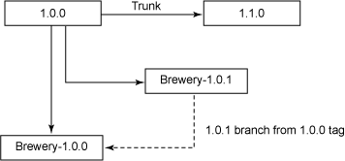
Continuous Delivery – SCM
Parallel development (branching, tagging, codeline policies, etc.)

Slide 25
Continuous Delivery – Patterns
Repository | Task-Level Commit | Minimal Dependencies | Private Build
Continuous Feedback | Expeditious Fixes | Independent Build | Single Command
Externalize Configuration | Scripted Database | Automated Tests | Continuous Inspection
Scripted Deployment | Disposable Container | Decouple Installation | Single-Command Provisioning
Dedicated Machine | Tokenize Configuration | Developer Documentation | Protected Configuration
Build Threshold | Deployment Test | Unified Deployment | Database Sandbox
http://bit.ly/aWz3qp
http://refcardz.dzone.com/refcardz/continuous-integration

Slide 26
Continuous Delivery - Summary
With Continuous Delivery, releasing software becomes a “non event”
Using Continuous Delivery, teams can setup target environments on demand and in a matter of minutes
Teams can deliver software to users quickly and often
Teams are not encumbered submitting tickets to teams who might takes days or weeks to fulfill their request(s) (self-service)
CERF
BDA Mission: https://wiki.nci.nih.gov/x/IJx8
Tools We Use
BDA Tech Stack: https://wiki.nci.nih.gov/x/Tpx8

