Slide 1
Build and Deployment Automation Team
Life Sciences Distribution Installers
November 2008

Slide 2
Problems before Installers
Easy to enter incorrect values causing application failures
Numerous error-prone manual steps
50+ page manuals
Repeated calls to application support!!
Frustrated users
Frustrated application support
Lack of user adoption

Slide 3
Benefits of using Installers
Ease of installation
Broaden user base (less technical)
Lessen time user spend on installation
Reduce calls to application support
Generates activity logs useful to application support
Installer logs its activities to:
  ${user.home}/.installer-<productname>.antlog_installer.txt

Slide 4
Installer Suite
Recommended Order
  UPT
  caArray
  caGWAS
  CTODS
  NCIA
  LSDB
Other LSD products
  geWorkbench (client installation only)
  caTissue (not installer supported)

Slide 5
General Requirements
Must be “JAD” compliant
  Java SDK 1.5.0 (Patch 10)
  Ant 1.7.0
  Database - User must install MySQL database server
    Create (empty) database and user (w/ proper permissions)
    Minor configuration to database (e.g. lower case, etc.)
See LSD installation guide at https://gforge.nci.nih.gov/frs/?group_id=450

Slide 6
LSD Installers
Two kinds of installers (user option)
  Command-line Installer
  GUI Installer
Recommend users choose GUI installers

Slide 7
Command-line Installers
Performs the install and configures the application
Non-GUI installer
Edit the .properties files
  install.properties
  upgrade.properties
Installer performs numerous validations pre and post install
Same installers used across tiers at NCI

Slide 8
GUI Installer
Use an open-source tool called IzPack to create the installers
Wrapper for the Command Line installer
  Prompts for the Configuration
  Updates the property files with the configuration
  Executes the command line installer
LSD installer artifacts can be downloaded from : http://gforge.nci.nih.gov/frs/?group_id=450
Types of Install
  Typical
  Custom
Modes of Install
  Install
  Upgrade

Slide 9
GUI Installer Pre-Install Checks
Validators
  PortValidator
  URLCheckValidator
  DBConnectionValidator
  NonEmptyValidator
  HostNameValidator

Slide 10
Future LSD Releases (Installer related changes)
Master Installer
Validators
Enhancements

Slide 11
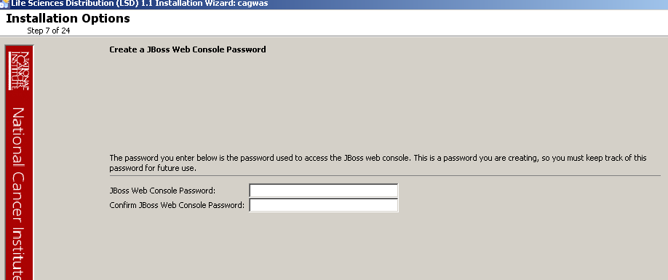
Installer Demonstration

Slide 12
Frequently Asked Questions (FAQ)
LSD FAQ
  https://wiki.nci.nih.gov/x/MK6l
BDA Contact Information
  https://wiki.nci.nih.gov/x/vQOZ

