Slide 1
[DEV TEAM NAME]
Build and Deployment Automation Training
[MONTH YEAR]

Slide 2
Build and Deployment Story
Jane Developer starts the day by getting the latest changes from Subversion (SVN). Jane uses Eclipse to build as she makes changes to the code. After finishing her work and before checking in the code, Jane runs the build and deployment Ant scripts in her private workspace and targeting her local environment. After smoke-testing the local build and deployment Jane checks in all task-related changes into SVN.
A Continuous Integration (CI) server such as Hudson monitors SVN and detects Jane’s changes. It kicks a build. The build fails and Hudson notifies Jane of the failure. Jane gets the latest from SVN, fixes the broken code and checks in the changes to SVN. Hudson detects the latest changes; runs the build and notifies Jane that the build is now fixed.
Satisfied with the results from Hudson, Jane kicks a remote build through a command line or the AnthillPro build server to build and deploy to the DEV environment.

Slide 3
Build and Deployment Story
As the project milestone approaches and the development team is happy with the DEV build, John Teamlead tags the SVN (e.g. MYTAG_2008_06_19_BUILD_2078) and passes it to Mark Q. A.
Mark uses AnthillPro to build from a tag and deploys the application to the QA environment. After completing the build, Mark and his team test the latest changes in the QA environment. Satisfied with the results, Mark passes the SVN tag to Frank Systems.
Frank Systems builds from a tag using AnthillPro and deploys to STAGE. After finishing the last smoke tests and ensuring the software is ready for production, Frank uses AnthillPro to build from the same SVN tag to deploy to PRODUCTION.
Everybody celebrates.

Slide 4
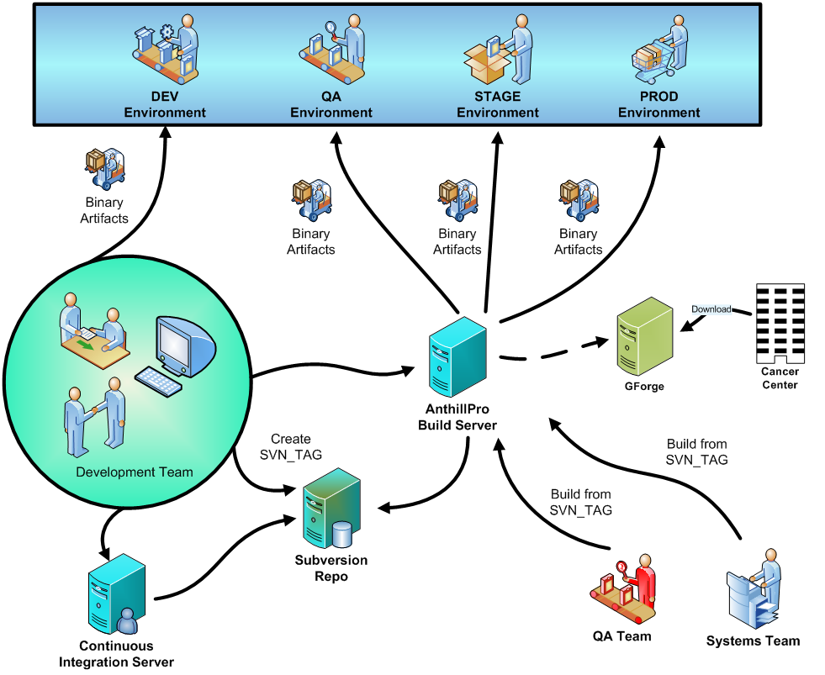

Slide 5
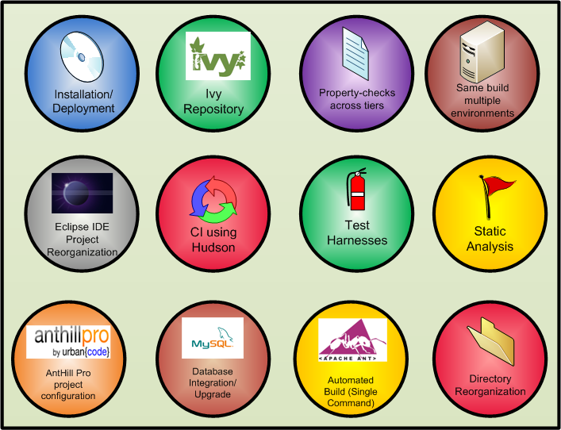
Features

Slide 6
Ivy
Benefits
  Dependency Management
  Centralized Storage
Approach
  Chained resolvers- local file-system resolver first followed by NCICB Ivy Enterprise Repository.
  SVN repository as ivy repository - The ivy repository is currently in the commonlibrary NCICB project.
  No external/public repositories
Constraints
  Limited write access to repository project
  Add only
  Updates need approval
  No deletes
  Not versioned with the rest of the code

Slide 7
Build and Deployment Contexts
Local Install (Developer Workstation/CI)
Local Upgrade (Developer Workstation/CI)
Remote Install (NCI/AnthillPro)
Remote Upgrade (NCI/AnthillPro)
External Install (Cancer Centers)
External Upgrade (Cancer Centers)

Slide 8
Command-line Builds
ant build:all deploy:local:install
ant build:all deploy:local:upgrade
ant deploy:remote:upgrade –Dproperties.file=C:\dev\properties\dev-upgrade.properties
ant deploy:remote:upgrade –Dproperties.file=C:\dev\properties\qa-upgrade.properties

Slide 9
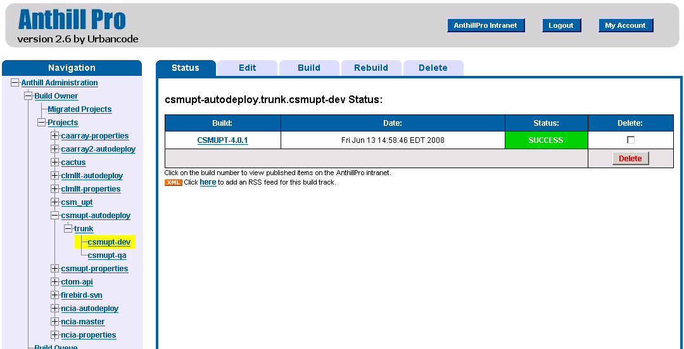
AnthillPro Builds
http://cbiocvs2.nci.nih.gov:8080/AnthillPro/admin

Slide 10
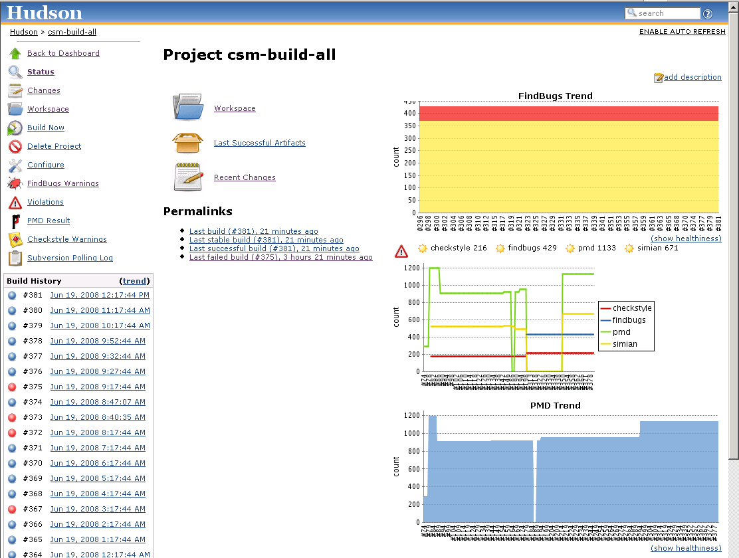
Hudson CI Server
http://cbvapp-c1005.nci.nih.gov:48080/hudson/

Slide 11
Maintenance & Support
[PROJECT NAME] owns all build artifacts
BDA will help with troubleshooting (schedule permitting)
BDA releases once every month
BDA will assist with upgrades
[PROJECT NAME] currently on BDA X.X.X
BDA currently on X.X.X

Slide 12
More Info
BDA WIKI - https://wiki.nci.nih.gov/x/fJd8
[DEV TEAM BDA] WIKI - https://wiki.nci.nih.gov/x/[FILL IN HERE]
BDA FAQ - https://wiki.nci.nih.gov/x/UZx8
Steve Saksa – saksas@mail.nih.gov
Levent Gurses – gursesl@mail.nih.gov
Mahidhar Narra – narram@mail.nih.gov
Questions & Answers

