Slide 1
BDA Enterprise Rollout
BDA-Internal
November 2008

Slide 2











Mission
Ensure ALL CBIIT development teams are able to promote working software from DEV to QA to STAGE in less than two hours in FY 2009
All projects will be capable of creating working software from a clean machine
assuming JADS compliance

Slide 3
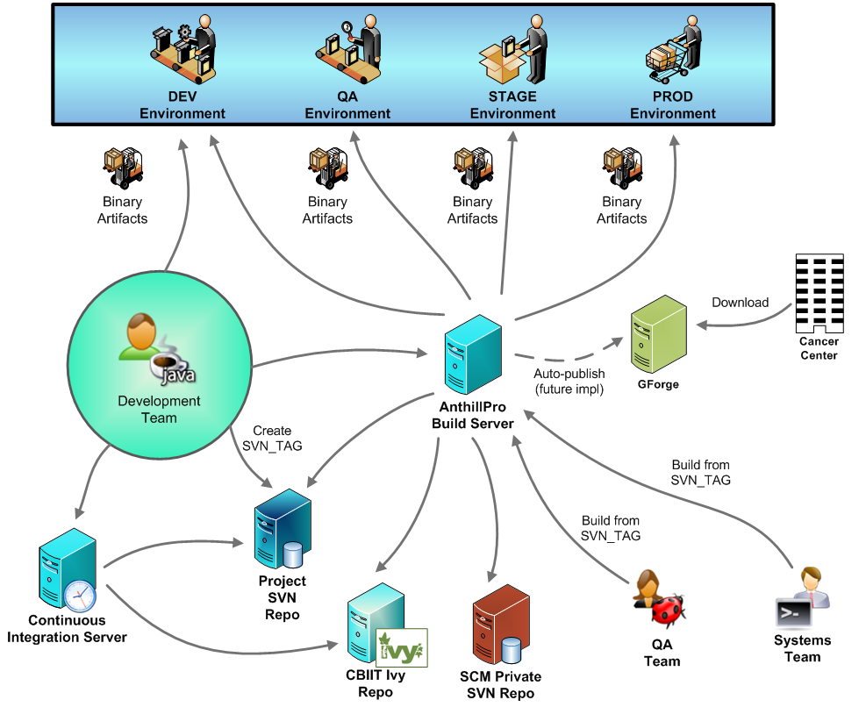
All CBIIT Projects

Slide 4
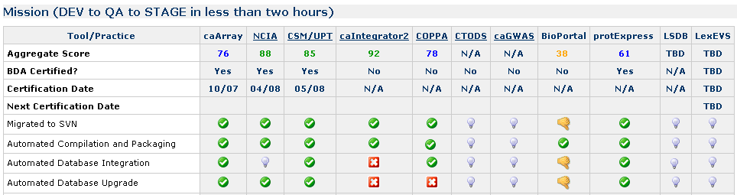
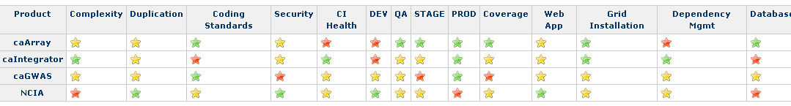
BDA: FY 2009
ALL active CBIIT projects will be BDA certified
BDA team will write automated scripts to update this dashboard in real time
A release-readiness dashboard will be updated for all CBIIT BDA projects in real time

Slide 5
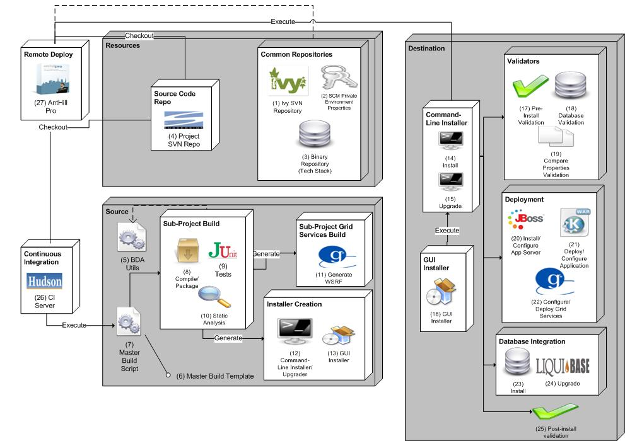
BDA Architecture

Slide 6
Scenario
Development team receives email from Director
BDA schedules training with development team
BDA conducts two, two-hour training sessions with development team
Development team submits project plan to Director and BDA identifying date the project will be BDA certified
Development team will consult BDA resources (BDA wiki, consultants, screencasts, etc.) to implement BDA
BDA continually audits projects for certification

Slide 7



Communication
December 2008
  Director of Application Engineering sends email on BDA mandate and rollout to all development teams, QA, product managers and Systems teams at CBIIT
    Mandate (Two-hours to STAGE – all projects)
    Timeline
    Project Plans
    Responsibilities
  BDA team develops automated analysis, utilities, training program, screencasts, documentation, etc.
January – June 2009
  Enterprise rollout

Slide 8



Training
BDA Wiki
Development Team Training (Twice)
Open Sessions: bi-weekly
Screencasts
  New project setup
  BDA’fication
    Compilation/Packaging, Database Integration/Upgrades, Deployment (Web, Grid, LDAP, SMTP, Datasource, etc.), Installation, Testing, Static Analysis
  Ivy’fication
    Dependent JARs
  CI server
    installation, configuration, reporting, etc.
  Build Management
    Tracks, dependent projects, SSH keys, properties, etc.

Slide 9
Special Projects
Build/Deployment related
  Disposable Application Containers
  LSD installation support
  Securing JBoss
  HTTPS servers
  Build script enhancements
  AntHillPro 3 migration
Other
  Deployment Request Tracker (DRT)
  GForge to JIRA migration
  Security checklist (roll into release-readiness)
  Coding standards checklist (roll into release-readiness)
  SVN migration
  SVN support (hooks, etc.)

Slide 10
Enterprise BDA projects
Verification and Validation
  BDA Certification Automation dashboard
    Automated version of “The Matrix”
  Release-readiness Dashboard
Support and Training
  BDA support
  BDA training
  Screencasts
BDA Enhancements
  Generalizing behavior (macros)
  Load/Performance Testing
  Automated release process
  Automated BOM
  BDA Archetype
  Disposable Application Containers

Slide 11
BDA Certification Automation
Is product JADS compliant?
  Clean the BDA machine
  Ensure JADS is installed
  Run a BDA install for project
  Ensure working software is deployed (Selenium- use release-readiness)
  BDA writes a static analysis tool to search for errors after running a build/install on a clean VM (that’s JADS compliant)
Database (Verified by JADS check above)
Grid service (Run release-readiness check)
Verify dependency management is in place (Ivy/Maven)
Deployment
  TBD
Verify template-property check is implemented
Verify Build Management server has been implemented and running (AntHillPro)
  DEV|QA|STAGE|PROD tracks
Verify automated tests have been written
  Use static analysis (regex pattern matching) to ensure “test” is found
Verify database upgrade (Liquibase) is implemented
Verify CI server has been implemented and running
Lower priority
  Verify coding standard, dependencies, complexity, coverage and duplication checks

Slide 12
Release-Readiness Automation
Create automated scripts that generate the following:
  State of working software in any environment (CI, DEV, QA, STAGE, PROD)
  Complexity
  Coding Standards
  Security
  Code Duplication
  Developer Documentation
    Grand
    SchemaSpy
    UMLGraph
    JavaDoc
  Code Coverage
  Dependency Graph
  Is database returning product-specific data?
  Is grid service returning product-specific data?
Is product able to authenticate via LDAP?
Did AppScan run on DEV, QA, STAGE, PROD?
Are there any duplicate binary files?
Is grid server up and running (if separate)?
Is command-line installation operating correctly?
Is GUI installation operating correctly?
Is there a property mismatch?
Is web application up and running?
Is product able to send SMTP messages?
Which projects are having too many build failures?
Think “Development NOC” or, perhaps, a “DOC”

Slide 13
Projects
ICONS

Slide 14
BDA rollout - projects
Projects | Assigned To
Publish BDA certification to Wiki | Mahi
Publish release-readiness content to Wiki | Mahi
Create New project screencast | Paul
Create BDA basics screencast | Paul
Create BDA database screencast | Paul
Create BDA deployment screencast | Paul
Create BDA Ivyfication screencast | Paul
Create BDA CI screencast | Paul
Create BDA build management screencast | Paul
Create BDA DRT screencast | Paul
Create BDA build promotion screencast | Paul
Disposable application containers (JBoss) | Paul
More effective XML manipulation in BDA build scripts (XMLConfig) | Mahi
Remodel Wiki | Steve
Disposable Application Containers | Steve
Heartbeat pages (to go into “release-readiness” pages) | Steve
Develop BDA project plan template for development teams | Paul
DEV team training | Paul/Steve
BDA archetype? | Mahi

