Slide 1
BDA Enterprise Rollout Introduction
December 2008

Slide 2











Mission
Ensure ALL CBIIT development teams are able to promote working software from DEV to QA to STAGE to PROD without human intervention in 2009
Release software to users more often. Reduce time, errors and costs between Development and Production. Increase user adoption through simple-to-install software.

Slide 3
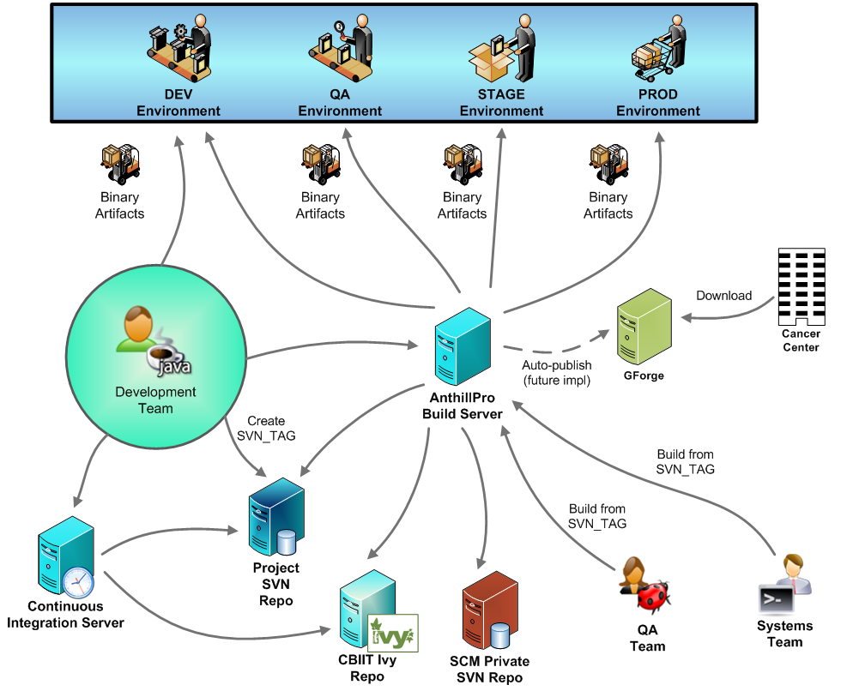
All CBIIT Projects

Slide 4
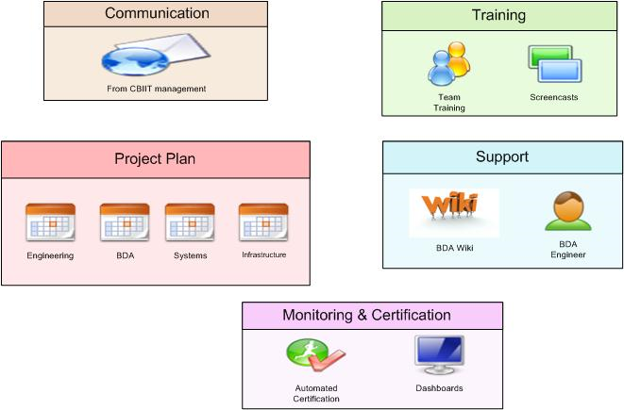
Enterprise rollout

Slide 5
Rollout Plan
Development team receives email from Application Engineering, Systems and Deputy Director of CBIIT
BDA schedules training with development team
BDA conducts two, two-hour training sessions with development team
Development team submits project plan to Application Engineering Director, Systems and BDA identifying date the project will be BDA certified
Development team consults BDA resources (BDA wiki, consultants, screencasts, etc.) to implement BDA
BDA and Systems continually audits projects for certification

Slide 6
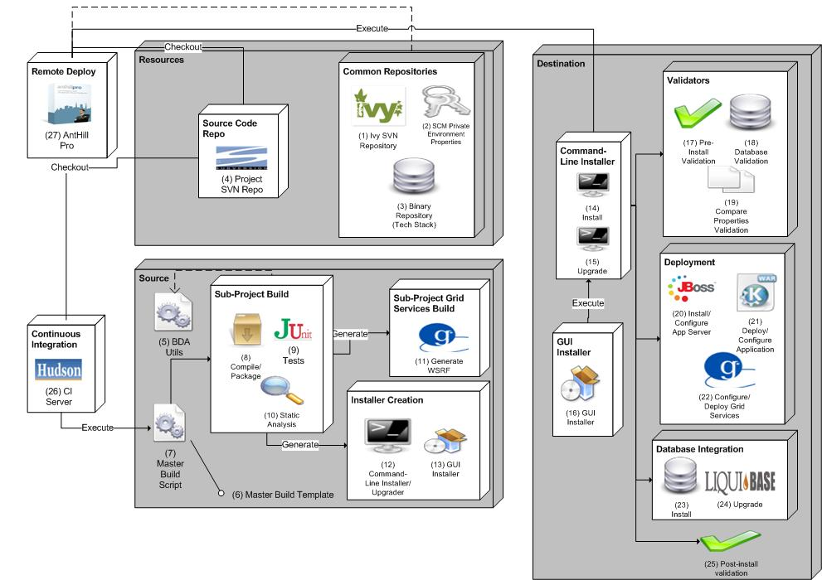
BDA Components

Slide 7
Tools/Components
Show pic from Tools on BDA wiki

Slide 8



Communication
December 2008
  Directors send email on BDA mandate and rollout to all development teams, QA, product managers and Systems teams at CBIIT
    Mandate (Two-hours to STAGE, JADS-compliant-ALL projects)
    Timeline
    Project Plans
    Responsibilities
  BDA team delivers “brownbag” training to CBIIT, after BDA mandate email
  BDA team develops automated analysis, utilities, training program, screencasts, documentation, etc.
2009
  Enterprise rollout – January or February dependent on external teams
  Date dependent on number of projects
  Priority identified by Systems team

Slide 9



Training
BDA Wiki - https://wiki.nci.nih.gov/x/fJd8
Development Team Training (Twice)
Open Sessions: bi-weekly
Screencasts
  New project setup
  BDA’fication
    Compilation/Packaging, Database Integration/Upgrades, Deployment (Web, Grid, LDAP, SMTP, Datasource, etc.), Installation, Testing, Static Analysis
  CI server
    Installation, configuration, reporting, etc.
  Build Management
    Tracks, dependent projects, SSH keys, properties, etc.

Slide 10
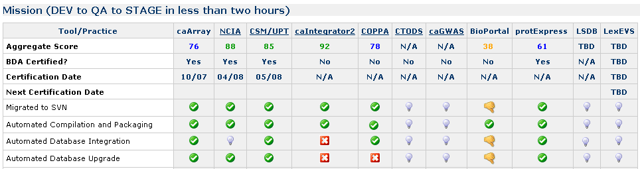
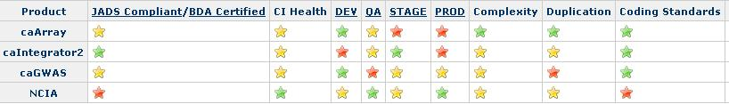
BDA Certification
JADS
JADSON
Automated scripts to continually analyze and present via dashboard (right)
BDA expert analysis
  All projects at least once a month
Release readiness dashboard (prototype is below)

Slide 11
BDA Contact Information
BDA Email
  ncicbiitbda@mail.nih.gov
BDA Listserv
  https://list.nih.gov/archives/cbiit-bda.html
BDA Wiki
  https://wiki.nci.nih.gov/x/fJd8

