Slide 1
Bioconductor / caBIG EY2
ARCH / VCDE Mentor Overview
Martin Morgan
(mtmorgan@fhcrc.org)
Fred Hutchinson Cancer Research Center

Slide 2
Bioconductor / caBIGTM
Bioconductor
  Large, established open source software for microarray and other high throughput analysis
Bioconductor / caBIGTM analytic services
  Subset of Bioconductor functionality as caBIGTM caGrid services
  Previous: 3 packages; this round: 5 packages
Bioconductor / caGrid client

Slide 3
Architectural Background
Bioconductor
  Written in R, a high level language for statistical computing
  R implemented in C
RWebServices
  A Bioconductor package to expose other packages as Java web services
  Includes infrastructure for ‘service’ front end and ‘worker’ back-end

Slide 4
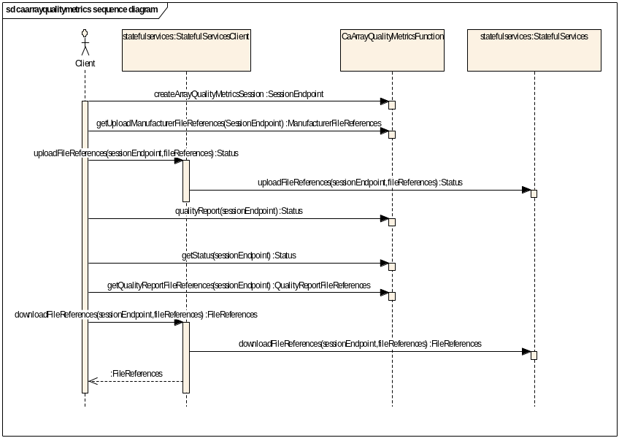
Architectural approaches
Stateless caGrid services
  A thin wrapper around RWebServices packages
  Using caGrid introduce tooling
Stateful services
  File up- and down-load; extended computation
  Standardized implied order of operations
  Implementation exposes SessionEndpionts (identifiers) and client-side helper classes

Slide 5
New Bioconductor / caBIGTM analytic services
caArrayQualityMetrics: quality report on a collection of raw data files
caGeneFilter: filtering and recoding raw data files or derived data structures
caLinearModel: linear models (differential expression) of designed experiments
caGeneSet: gene set enrichment analysis
caMachineLearning: supervised and unsupervised machine learning algorithms

Slide 6
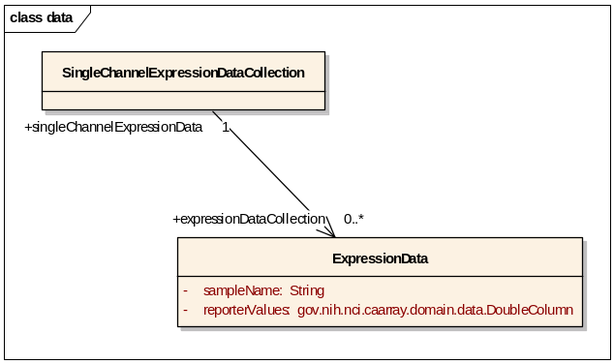
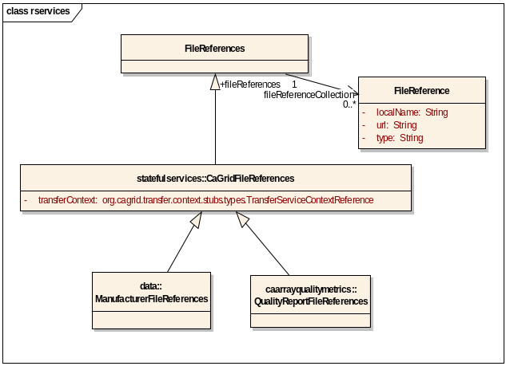
Bioconductor / caBIGTM key data model components
Simple representation of expression data: collection of microarrays, each represented by a sampleName and reporterValues
File references for collection of manufacturer and output files
Parameters influencing algorithm execution, but with no ‘outside’ semenatic meaning

Slide 7
Bioconductor / caBIGTM caGrid client
Functionality
  Service discover via index service
  Data service CQL query
  Analytic service invocation
  Management of user-provided security credentials
Target audience is a Bioconductor user
  Command line-style interface
  Bioinformatician

