Slide 1
Adopting Bioconductor caGrid services
Successful use with existing infrastructure
Martin Morgan (mtmorgan@fhcrc.org)
Fred Hutchinson Cancer Research Center
September 16, 2009

Slide 2
Introduction: successful development / adoption of caBIG caGrid analytic services
Players
Genome Services, Fred Hutchinson Cancer Research Center
Bioconductor
caBIG / caGrid
Objectives
Develop new caGrid analytic services
Integrate into existing infrastructure
Do so in a timely fashion
Recipe / secret ingredients
Close collaboration between developer / adopter
Identify appropriate roles and common meeting ground
Iterative development
Local deployment

Slide 3
Context: genome services
Genome Services Shared Resource at the Hutch
  High-throughput data generation
  Microarrays, re-sequencing, other assays
  Major point of contact for wet-lab investigators
Data management
  HutchBASE: off-the-shelf application, modified for Hutch use
  Original need: present results (manufacturer files) to users
  Ad hoc tools for preliminary exploration
Evolution
  Approaches to more complete analyses
  Modules linking to third-party solutions

Slide 4
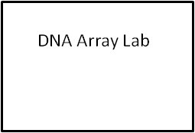
Context: Genome services
Genetic Analysis Lab
Sequencing
Genotyping
RNA Interference Lab
shRNA
siRNA
Array Platforms
- Affymetrix
Agilent
Custom ‘Spotted’
- NimbleGen
- Illumina
Array Assays
- mRNA/miRNA Expression
- ChIP-chip
- array-CGH
Methylation Profiling (e.g., MeDIP)
Replication Timing
Deployment
Method 1
Deployment
Method 2
MultiExperiment Viewer (MeV) Feature
caGeneFilter
other caBIG modules (i.e. caLinearModel, caGeneSetAnalysis, caMachineLearning)
HutchBASE Plugin
- caArrayQualityMetrics
HutchBASE
(BASE v2.6)

Slide 5
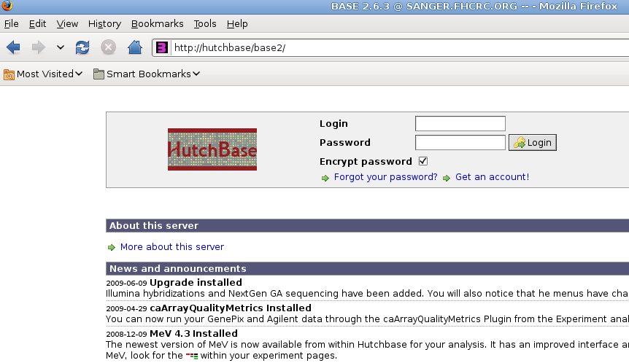
Context: HutchBASE interface

Slide 6
Context: Bioconductor and caGrid
Bioconductor
  Successful open-development software for high-throughput analysis
  Based on the R programming language
  Advanced analysis ‘packages’
User community
  Bioinformatics experts
  Comfortable with programming language paradigms
  Especially used for custom, rather than turn-key, solutions
caBIG caGrid analytic services
  Encourages granularity between interactive programming environment and fully integrated application

Slide 7
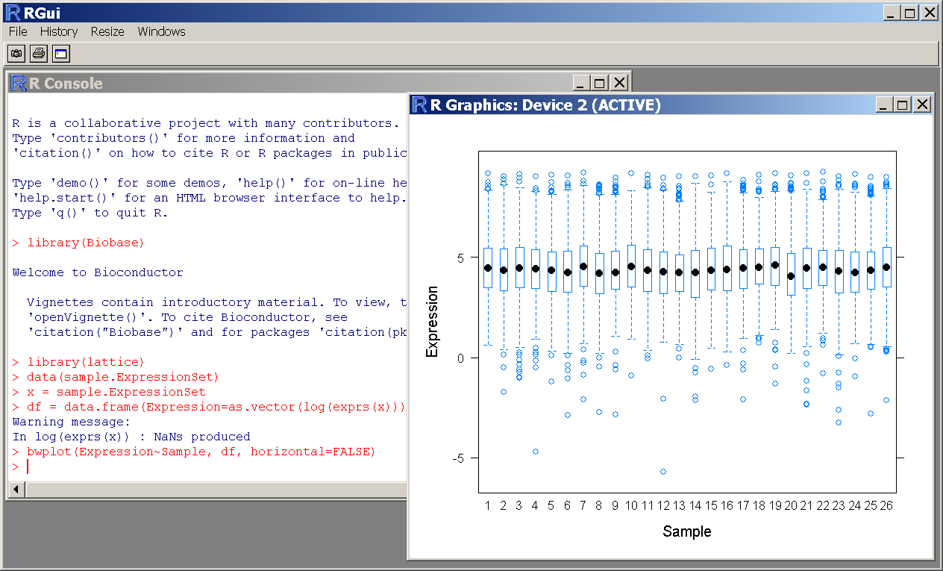
Context: Bioconductor and caGrid

Slide 8
Challenges: HutchBASE users accessing Bioconductor services
Divergent user expectations
  HutchBASE: graphical user interface, well-defined choices
  Bioconductor: programmatic interface, open-ended environment
Broad technology coverage
  HutchBASE: specific requirements for integrating external resources
  caGrid: SOAP-based web services
  Bioconductor: specialized programming language

Slide 9
Solutions
Key: genome services bioinformaticians
  Know end user requirements; familiar with HutchBASE architecture
  Comfortable with Java programming
Close interaction during development
  Requirements and specifications, initial delivery, service revision
Roles and common ground
  Adopter: end-user requirements, HutchBASE front end, software acceptance
  Developer: caGrid implementation, Bioconductor back end
  caGrid service interface is common ground
Iterative service creation
  5 service modules, varying technical challenges
Local deployment
  Integration with HutchBASE: clickable elements exposed to user
  Service discovery of minor importance

Slide 10
Example: assess array quality
HutchBASE user requirements
  Recall: users are scientifically sophisticated
  Requiring assessment of array quality
Bioconductor offering
  arrayQualityMetrics provides HTML-based report, integrating graphical presentation with appropriate technical explanation
Technical challenges
  Large file transfer
Solution
  caArrayQualityMetrics grid service
    Inputs: manufacturer files, e.g., .cel, .gpr, …
    Output: collection of files representing an HTML report
  HutchBASE
    Experiment retrieval associated with links to assess array quality

Slide 11
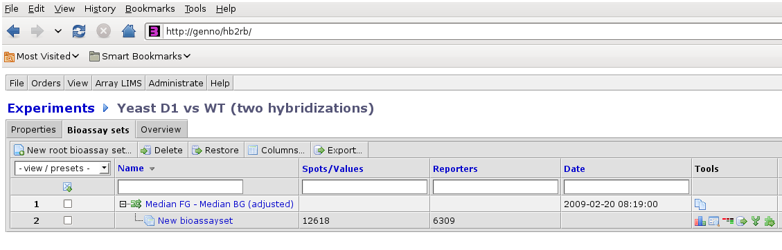
Example: assess array quality
Plug-in icon

Slide 12
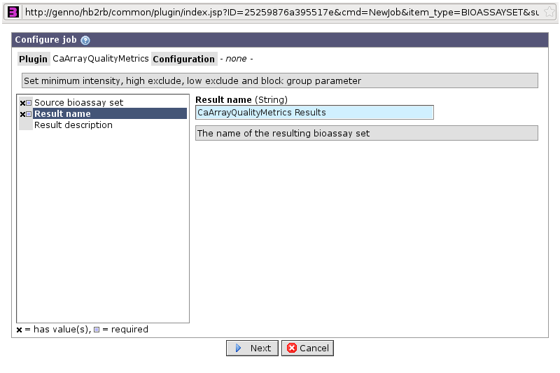
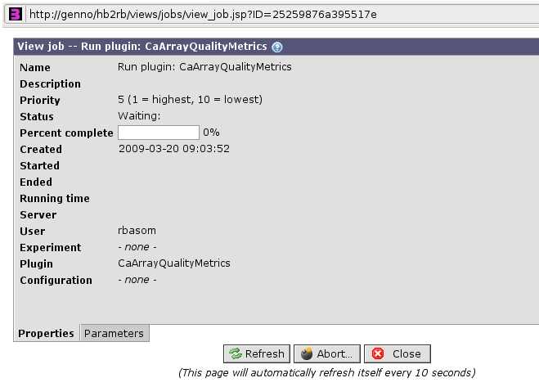
Example: assess array quality

Slide 13
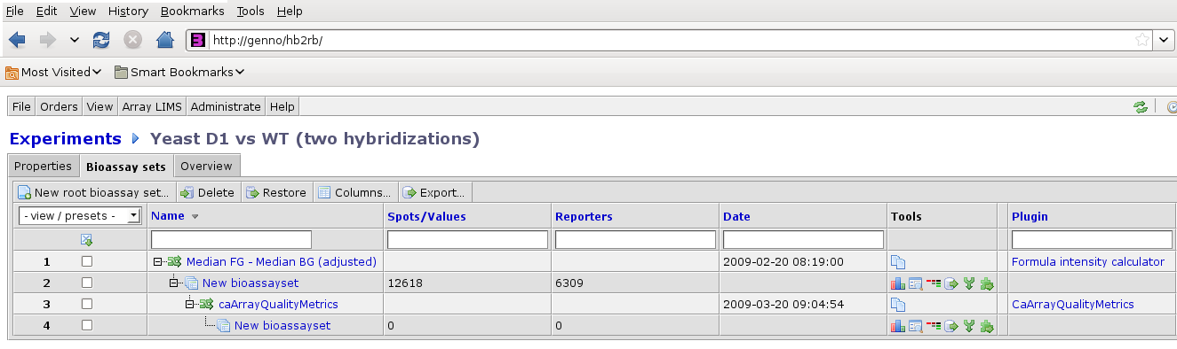
Example: assess array quality
Access results

Slide 14
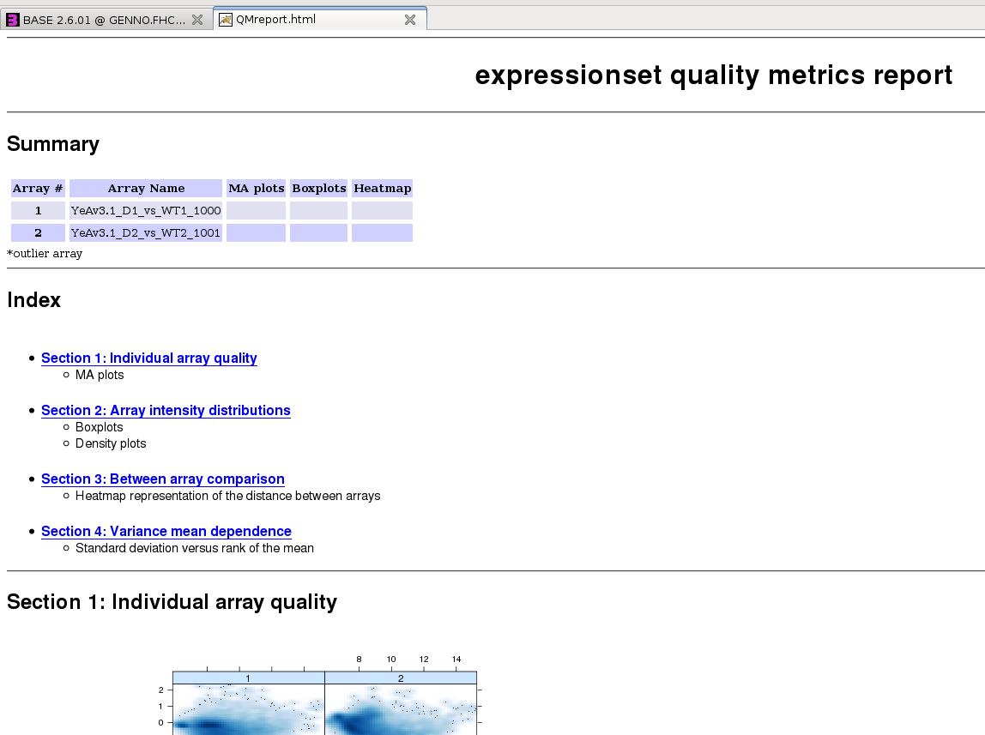
Example: assess array quality

Slide 15
Lessons learned
As service developer
  Recognize the end user as bioinformatics programmer, not bench scientist
  Locally available deployment often appropriate and feasible during early development stages
As adopter
  Integrate services into existing infrastructure
Together
  Collaborate on refining requirements and specifications
Iterative development
  Prompt feedback
  Service refinement, e.g., content of quality report
  Improve design, e.g., useful return types
  Sequentially address technological challenges, e.g., large file transfer

Slide 16
Challenges
Iterative development
  Early modules implemented differently (less technical sophistication)
caBIG
  Semantic requirements under-used during adoption, e.g., no sense in which useful services are ‘discovered’ based on data types
  Interoperability not a primary concern, e.g., transformations are necessarily between HutchBASE / caGrid data types

Slide 17
Acknowledgements
Project management
  Juli Klemm (NCI / CBIT)
  Kevin Groch (SAIC-Frederick)
Adopters
  Jeff Delrow, Director, Genome Services
  Ryan Bassom (HutchBASE implementation)
Developers
  Robert Gentleman
  Tom Milac (R / Bioconductor package development)
  MinhNhat Tran (caGrid interface and management)

