Slide 1
Bioconductor / caBIGTM
ICR Presentation
Martin Morgan
(mtmorgan@fhcrc.org)
Fred Hutchinson Cancer Research Center

Slide 2
Bioconductor / caBIGTM
Bioconductor
  Large, established open source software for microarray and other high throughput analysis
Bioconductor / caBIGTM analytic services
  Subset of Bioconductor functionality as caBIGTM caGrid services
  Previous: 3 packages; this round: 5 packages
Bioconductor / caGrid client

Slide 3
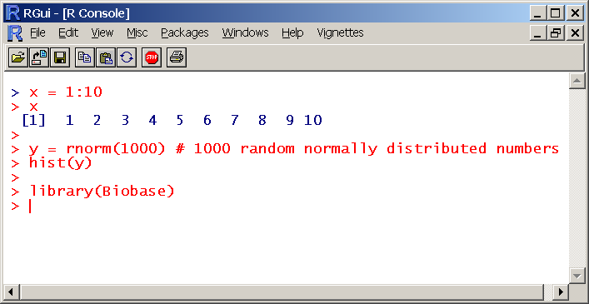
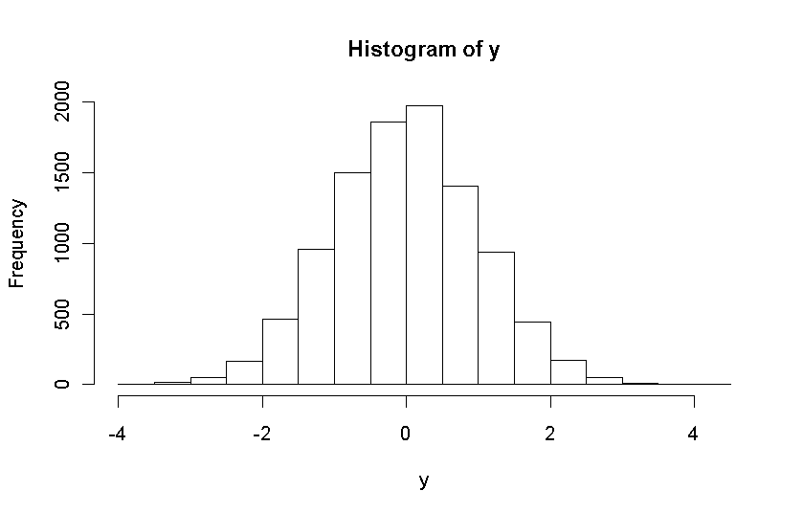
Bioconductor
Written in R, a high level language for statistical computing
  R implemented in C
  Open source / open development
>300 packages
  Microarray
  Short read
  Flow cytometry, …

Slide 4
Bioconductor in caBIGTM
caGrid services
Goals
  Expose select packages representing a coherent analysis workflow
  Directly relevant to end users
  Exploit caArray as data source
  Performant for realistic data
caBIGTM compatible

Slide 5
New Bioconductor / caBIGTM analytic services
caArrayQualityMetrics: quality report on a collection of raw data files
caGeneFilter: filtering and recoding raw data files or derived data structures
caLinearModel: linear models (differential expression) of designed experiments
caGeneSet: gene set enrichment analysis
caMachineLearning: supervised and unsupervised machine learning algorithms

Slide 6
Example: caArrayQualityMetrics
Inputs
  ‘Manufacturer’ files, or matrix-like expression values
Output
  HTML-based report
  Multiple text and image files, as .zip
Highlights
  caGridTransfer to up / download files
  Stateful service implementation

Slide 7
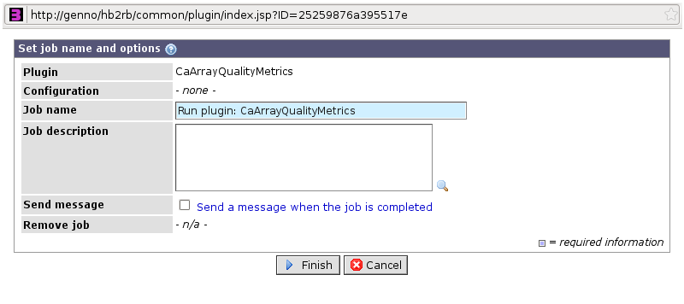
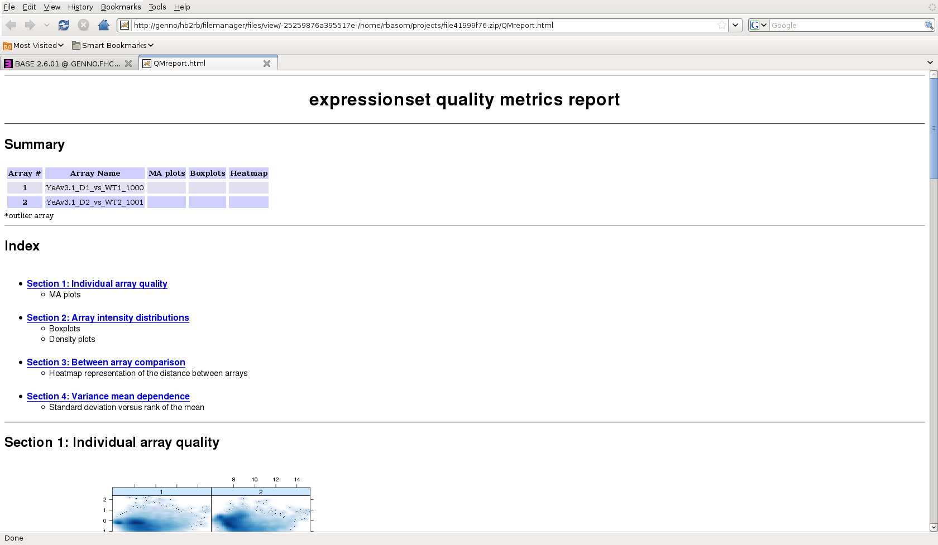
HutchBASE integration
In-house data base
  Manage microarray experimental data
  Pluggable architecture
caArrayQualityMetrics
  Select
  Configure
  Submit
  Check status
  View

Slide 8
Adopter innovation
Integration with in-house array data base
Also: web page (jsp) front end
  Standard internal URL, file selection, etc
  In-browser presentation of results
Highlights: caBIGTM infrastructure…
  Enables adoption by non-developers
  Provides added value, viz., integration of R / Bioconductor as web service

Slide 9
Bioconductor / caBIGTM services
Coherent work flows
  caArrayQualityMetrics → caGeneFilter → caLinearModel → caGeneSet
  caArrayQualityMetrics → caGeneFilter → caMachineLearning
Relevant
  Common file and data formats; interoperable
  Accessible to non-developers

Slide 10
Bioconductor / caBIGTM caGrid client
Functionality
  Service discovery via index service
  Data service CQL query
  Analytic service invocation
  Management of user-provided security credentials
Target audience is a Bioconductor user
  Command line-style interface
  Bioinformatician

Slide 11
Service discovery
> library(CaClient)
> d <- discover()
> services(d)
...
Anova(1) Aracne(1) AuthenticationService(1) BRPMeasures(1) CaaersDataService(2) CaAffy(1) CaArraySvc(24) CaBIO32GridSvc(1)
...
> d["CaAffy"]
...
caExpresso(DerivedBioAssay, string, ExpressoParameter):
DerivedBioAssay
> pointsOfContact(d["CaAffy"])
FirstName LastName PhoneNumber Email Role
1 Martin Morgan (XXX) XXX-XXXX mtmorgan@fhcrc.org Project Manager
2 Minhnhat Tran (XXX) XXX-XXXX mtra2@fhcrc.org Developer
...

Slide 12
Data exploration: caArray
> nci <- d["CaArraySvc"][idx] # CaArraySvc at NCI
> dm <- domain(nci) # domain model
> head(names(dm)) # (short) named components
[1] "ArrayReporter" "TermSource" ...
> exp <- dm[["Experiment"]] # a component
> names(exp) # queryable attributes
[1] "replicateDescription" "qualityControlDescription" ...
> detail(exp) # attribute details
class: UMLClass; uml class: Experiment
uml package: gov.nih.nci.caarray.domain.project
attributes:
replicateDescription
description: Describes how biological or technical replicates were employed in this experiment.
data type name: java.lang.String
value domain
name: java.lang.String

Slide 13
Query: titles of caArray experiments that used SNP chip
> exp <- dm[["Experiment"]] # model components
> snps <- attribute("assayType", "SNP", "LIKE") # SNP chips
> query(nci, exp, snps, countOnly=TRUE) # how many?
class: QueryResult
length: 13
> res <- query(nci, exp, snps) # get them
> names(res) # available fields
> res[["title"]]
[1] "SNP Profiling of Cancer Cell Line Panel"
[2] "empty"
[3] "TCGA Analysis of SNPs and Copy Number…"
[4] "TCGA Analysis of Allele Specific Copy…"
...

Slide 14
Query: organism, common name like “rat” or scientific name like “Mus”
> org <- dm[["Organism"]]
> rat <- attribute("commonName", "%Rat%", "LIKE")
> mouse <- attribute("scientificName", "Mus%", "LIKE")
> rodent <- rat | mouse # compose query
> as(query(nci, org, rodent), "data.frame")
scientificName ncbiTaxonomyId commonName taxonomyRank id
1 Mus musculus 10090 house mouse species 2
2 Rattus norvegicus 10116 norway rat species 3
3 Rattus rattus 10117 black rat species 4
4 Mus musculus <NA> <NA> <NA> 45

Slide 15
Bioconductor / caBIGTM caGrid client
Implemented functionality
  Index service discovery
  Service exploration – methods, types, metadata
  Data service domain exploration and CQL query
Coming soon…
  Analytic service invocation
  Security credential management
Highlights
  Direct integration with R / Bioconductor data types
  Natural for Bioconductor scripts and work flows

Slide 16
Bioconductor / caBIGTM team
Development
  MinhNhat Tran
  Tom Milac
  Nianhua Li (RWebServices)
  Robert Gentleman (R / Bioconductor)
Adoption
  Jeff Delrow
  Ryan Basom
Project management
  Kevin Groch
  Juli Klemm
Mentors
  Baris Suzek
  Grace Spofford
  Pankaj Agrawal
ICR
  Elaine Freund

