Slide 1
Engaging Bioconductor end users caBIG™ Annual Meeting “Engaging End-Users Session”
Martin Morgan, Bioconductor
Fred Hutchinson Cancer Research Center, Seattle, WA
mtmorgan@fhcrc.org
http://bioconductor.org

Slide 2
Bioconductor
Open source statistical software
  >200 user-contributed packages
  R programming language
High-throughput gene expression analysis
  Expression array pre-processing, linear models, clustering and machine learning, expression pathways, …
  Sophisticated visualize tools
  Flexible ad hoc analyses

Slide 3
Our current user community
Drawn from biology, statistics, bioinformatics
Two types of user
  Analysts: research scientists, genome centers
  Package developers: bringing novel methods to a wider community
Established community
  Web presence, active list-serve, regular workshops, annual conference
  International

Slide 4
caBIG™ participation: engaging a wider community
From research to routine
  Transition from exploratory research methods to established analytic protocols
From desktop to grid
  Access: web service
  Ability: computing resources
  Exchange: data sharing

Slide 5
End-user challenges I: Accessing Bioconductor
Almost unlimited possibility for analysis
  Overwhelms many potential users
  Requires unusual combination of abilities
Solution: workflow and granularity
  Identify & consolidate sequences of analytic steps
  Select key parameters to influence workflow
  Informatively summarize complex results

Slide 6
Accessing Bioconductor
Example: quality control of Affymetrix expression data
Adopters at Northwestern
  Identify need for routine assessment of quality
Bioconductor package developers
  Significant analytic expertise & well-developed understanding of quality control issues
Result: assemble existing and new methods to create comprehensive quality assessment documents

Slide 7
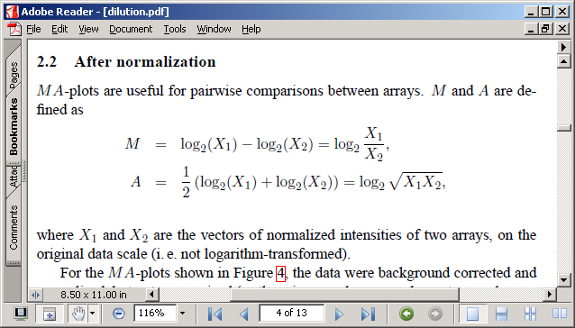
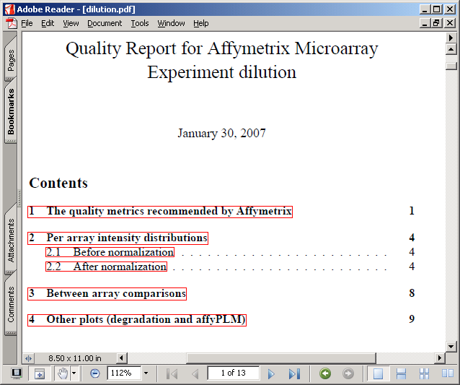
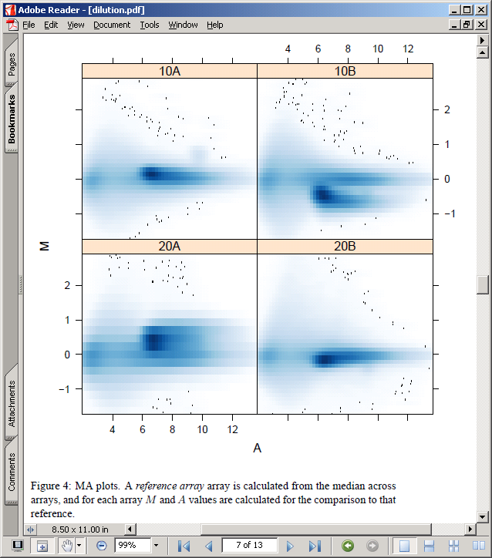
Accessing Bioconductor

Slide 8
End-user challenges II: Enabling Bioconductor
Creating grid-enabled packages
  Benefits of grid-enabling packages
    Accessible, standardized workflow
    Centralized, specialized resources
  Available to all package developers
Solution: RWebServices
  Conveniently represent R data and methods in Java
  Readily integrates into caGrid introduce
  Provides access to Java messaging and other technologies

Slide 9
Opportunities and challenges
Local grid service deployment
  Benefits of grid-enabled packages
  Control of internal resources, sensitive data
Exploiting caGrid tools
  ‘Big data’ transfer
  Security
Imprimatur of scientific credibility
  Implied by ready access to services

