Slide 1
Bringing Bioconductor to caGrid
Martin Morgan, Nianhua Li, Seth Falcon, Robert Gentleman. Fred Hutchinson Cancer Research Center, Seattle, WA
mtmorgan@fhcrc.org
http://bioconductor.org

Slide 2
Overview
Using caGrid-enabled Bioconductor services
Deploying caGrid-enabled Bioconductor packages
Creating caGrid services from Bioconductor packages
Implementation insights

Slide 3
I. Using enabled services
Benefits to users
  Powerful analysis methods
  Specialized computing resources
  Easy maintenance
Services
  Array CGH copy number variation – caDNAcopy
  Mass spec. peak identification – caPROcess
  Gene expression array preprocessing – caAffy
Project status: beta

Slide 4
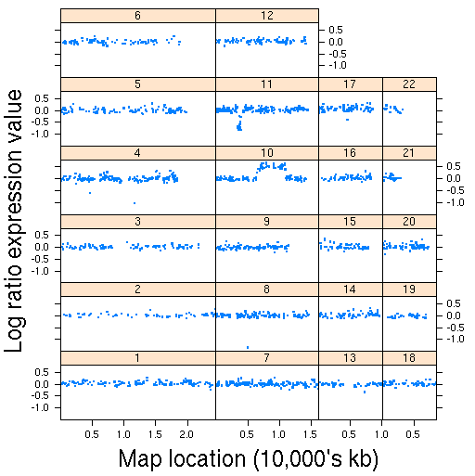
caDNAcopy
Copy number variation from gene expression data
Inputs
  Expression values and chromosomal locations
  Parameters influencing change point criteria
Results
  Segment start and end map positions
  Marker and average copy number per segment
Snijders et al, 2001. Assembly of microarrays for genome-wide measurement of DNA copy number. Nature Genetics 29: 263-264. http://dx.doi. org/10.1038/ng754

Slide 5
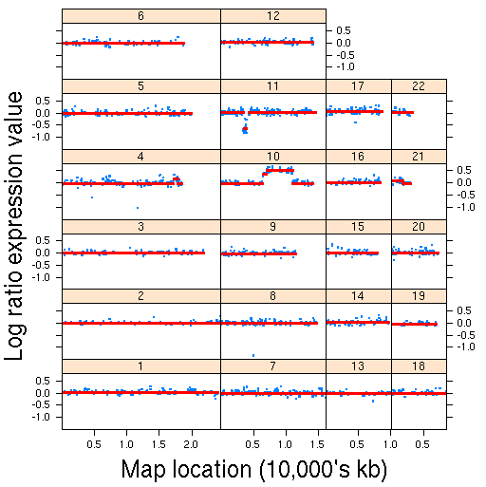
caDNAcopy
Copy number variation from gene expression data
Inputs
  Expression values and chromosomal locations
  Parameters influencing change point criteria
Results
  Segment start and end map positions
  Marker and average copy number per segment
Snijders et al, 2001. Assembly of microarrays for genome-wide measurement of DNA copy number. Nature Genetics 29: 263-264. http://dx.doi. org/10.1038/ng754

Slide 6
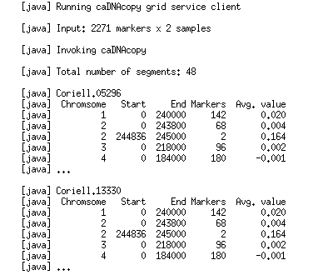
caDNAcopy
Copy number variation from gene expression data
Inputs
  Expression values and chromosomal locations
  Parameters influencing change point criteria
Results
  Segment start and end map positions
  Marker and average copy number per segment

Slide 7
caDNAcopy
Copy number variation from gene expression data
Inputs
  Expression values and chromosomal locations
  Parameters influencing change point criteria
Results
  Segment start and end map positions
  Marker and average copy number per segment

Slide 8
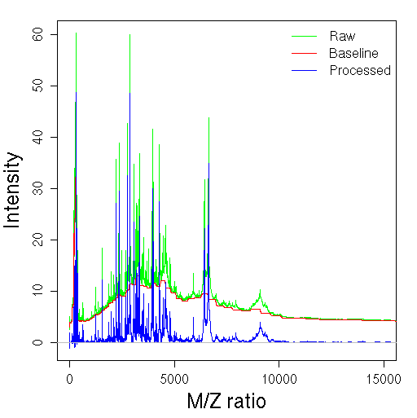
caPROcess
SELDI-TOF mass spec. peak detection
  Including baseline removal and renormalization
Inputs
  Spectra: M / Z ratios and corresponding intensities
  Normalization and peak detection parameters
Results
  Peaks for each spectrum, including M/Z ratio and mass

Slide 9
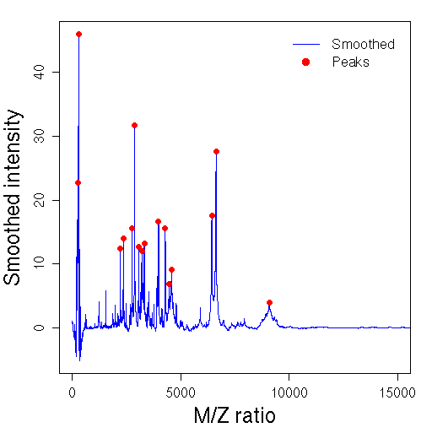
caPROcess
SELDI-TOF mass spec. peak detection
  Including baseline removal and renormalization
Inputs
  Spectra: M / Z ratios and corresponding intensities
  Normalization and peak detection parameters
Results
  Peaks for each spectrum, including M/Z ratio and mass

Slide 10
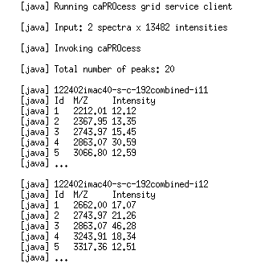
caPROcess
SELDI-TOF mass spec. peak detection
  Including baseline removal and renormalization
Inputs
  Spectra: M / Z ratios and corresponding intensities
  Normalization and peak detection parameters
Results
  Peaks for each spectrum, including M/Z ratio and mass

Slide 11
caPROcess
SELDI-TOF mass spec. peak detection
  Including baseline removal and renormalization
Inputs
  Spectra: M / Z ratios and corresponding intensities
  Normalization and peak detection parameters
Results
  Peaks for each spectrum, including M/Z ratio and mass

Slide 12
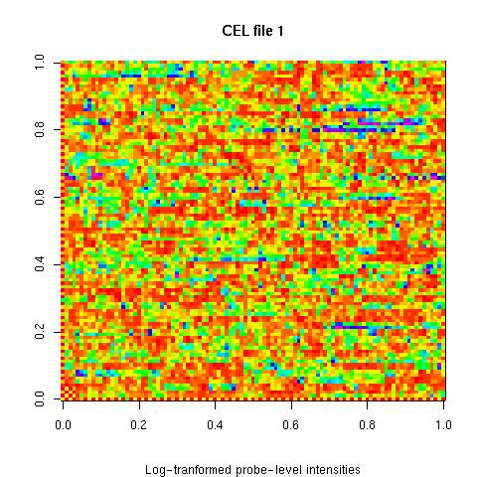
caAffy
Affymetrix expression array preprocessing
Inputs
  MAGE-OM, e.g., from caArray
  Background & PM correction, normalization, & probe summary methods
Results
  MAGE-OM
  QA Report

Slide 13
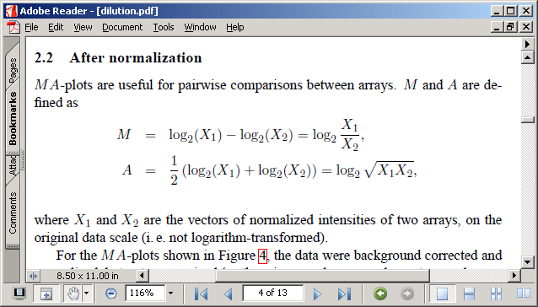
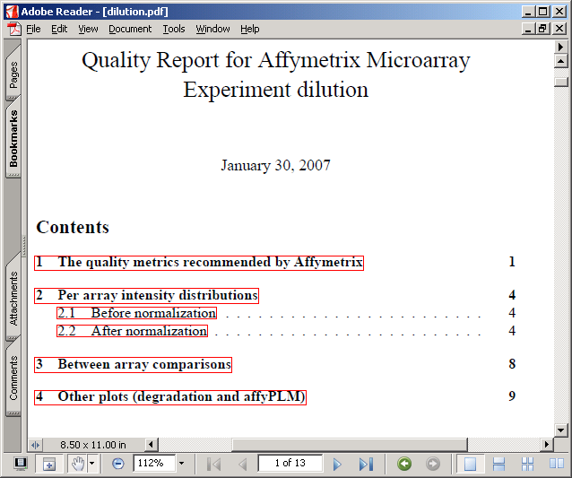
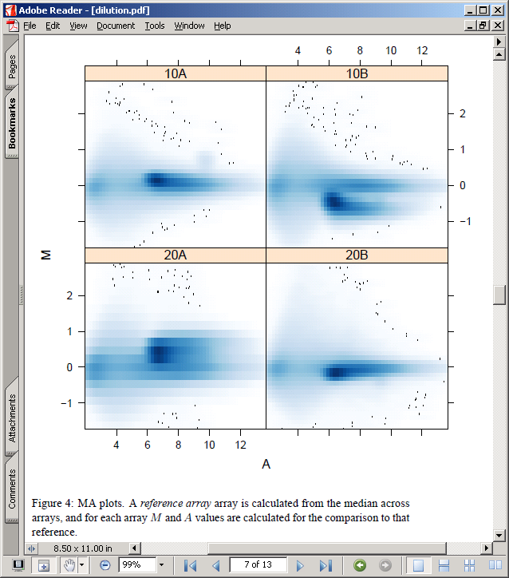
caAffy – QA reports

Slide 14
II. Deploying enabled packages
Benefits to working groups
  Effective resource use
  Centralized system administration
Technical aspects
  System architecture
  Deploying grid-enabled packages
  Package structure

Slide 15

System architecture
Web service, caGrid
RWebServices service
  caGrid to RWebServices data map
  activeMQ task management
    Multiple queues
RWebServices workers
  RWebServices to R data and method map
R / Bioconductor
  Method evaluation

Slide 16
Deploying caGrid-enabled packages
Work-flow diagram

Slide 17
Layout of caGrid-enabled packages
caGrid logic
R code
Business logic

Slide 18
III. Creating caGrid-enabled packages
Benefits to researcher / analysts
  Wide availability of new methods
  Tailored workflows
Steps to caGrid-enable existing packages
  Strong typing – TypeInfo
  R / Java mapping – RWebServices
  caGrid-specific steps – introduce
    Alternative: web service, via RWebServices

Slide 19
Strong typing – TypeInfo
Argument and return types
  R language types
  S4 classes
  Limitations: no S3 classes
Often, small wrappers for existing functions
  Standardize data types
  Consolidate work flow

Slide 20
R / Java mapping – RWebServices
Data and methods
  Ant: map-from-package
  Argument and return value data beans
    Appropriate class hierarchy
  activeMQ server, R service and workers
Additional abilities and tasks
  Sample data
  Tests: framework provided

Slide 21
caGrid enabling

Slide 22
(Web service enabling)

Slide 23
IV. Implementation insights
caGrid user interface
Exposing non-Java applications
  Data transfer and function mapping
  Leveraging Java
Exploiting grid services

Slide 24
caGrid user interface
  Granularity of work flow and user input
  Documentation and help files
    Wrapper to existing package with extensive documentation
    Needs to be exposed at more than programmatic level
  Return values
    Should be computable, but…
      Images
    Complex structures / non-transformable representations
      E.g., affyQCReport produces an informative document with embedded images
  Missing values
    Representation and propagation

Slide 25
Exposing non-Java applications
  From R to Java
    Strong types, type mapping, and data transfer
  Existing but inappropriate solutions
  Multiple workers

Slide 26
Exploiting grid services
  Data sharing
    Big data latency
    Security
    Computational back-end
    Realistic computing models
  Leveraging grid services
    WS-Enumeration and large-data transfer
    Service replication

