Slide 1
Cancer Central Clinical Participant Registry (C3PR) v2
Checkpoint Demo 2008 Base Period
Jamie Cuticchia1, Bob Annechiarico2, Patrick McConnell3
Duke Comprehensive Cancer Center
1jamie.cuticchia@duke.edu
2bob.annechiarico@duke.edu
3SemanticBits, LLC
patrick.mcconnell@semanticbits.com

Slide 2
Agenda
Background (10 min)
Progress report (10 min)
Demonstration (45 min)
Next steps (5 min)
Discussion (20 min)

Slide 3
Who is involved in C3PR?
Duke Bioinformatics
  Jamie Cuticchia (PI)
Duke Information Systems
  Bob Annechiarico (co-PI)
  Pankaj Agarwal (PM)
  William Banks (domain expert)
  Seth Fehrs (developer)
  Mohamad Farid (DBA, tester)
  Jeff Allred (IT manager)
Duke Clinical Trials
  Vijaya Chadaram (domain expert)
CALGB
  Kim Johnson (domain expert)
  Amish Shah (domain expert)
Westat
  Steve Riordan (domain expert)
Georgetown
  Jieping Li (domain expert)
North Carolina State
  Patty Spears (patient advocate)
Wake Forest
  Bob Morrell (domain expert)
  Don Babcock (Technical Expert)
  Lisa Dixon (SME)
  Claire Kimbrough (SME)
Mayo
  Sharon Elcombe (domain expert)
SemanticBits
  Patrick McConnell (architect)
  Ram Chilukuri (architect)
  Kruttik Aggarwal (lead developer)
  Ramakrishna Gundala (developer)
  Vinay Gangoli (developer)
  Vinay Kumar (analyst)
  Shilpa Alluru (QA tester)
  David Coffey (UI designer)
  Elizabeth Nobriga (tech writer)
NCI
  Christo Andonyadis
SAIC
  Nancy Roche
  Peter Yan

Slide 4
Timeline Perspective
C3PR Release 3
  Developed by Duke Comprehensive Cancer Center in collaboration with SemanticBits
  Extends the Release 2 functionality
  Project began in March 2008, slated for 7+5 months
C3PR v1
Released
C3PR v2
Construction
Start
C3PR v3
Start
C3PR v2.1
Release
Mar
Mar
Sep
2004
2005
2006
2007
2008
2009
Nov
Jan
May
Mar
C3PR v1
Testing
Start
C3PR v2
Start
C3PR v2
Transition
Start
C3PR v3
Construction
Start
C3PR v3
Release

Slide 5
What does a participant registry do?
Tracks subject registrations to clinical trials
  Screening, registration, re-randomization, protocol amendments,
  re-consent, etc.
Ensures that all registration criteria are met
  Trial is still open to accrual
  Consent has been obtained
  Eligibility criteria are met
Stratifies the subject into a stratum group
Randomizes the subject to the trial
Enrolls the subject on the trial
Handles reporting
  Meets federal regulatory reporting
  Supports local reporting needs
Integrates with other systems
  Starting point for collecting clinical data

Slide 6





Where does a participant registry fit in?
Cancer Central Clinical
Participant Registry (C3PR v2)
Patient Study Calendar (PSC)
Eligibility is verified
and patient is registered
to a study
Tracks the patient
throughout the study
Clinical Trial Data
Management Systems (C3D)
Cancer Adverse Event
Reporting System (caAERS)
Patient visits the
Physician
Lab Viewer
Clinical data is captured
Identifies adverse events
and any associated
schedule changes
Identifies labs, loads
them into the CDMS
and AE system

Slide 7
C3PR Scope
Release 2 (Nov 2006-Mar 2008)
  Overhaul of release 1 (developed by Nortel)
  Core participant registry functionality
  Subject management, study management, registration management, basic reporting, basic interoperability, CCTS 1.0
Release 3 (Mar 2008-Mar 2009)
  Enhancement of release 2
  More complex registry functionality
  Companion studies (embedded, required, etc.)
  Notifications (rules-based, email/dashboard)
  Multi-site data sharing (study, registration, amendments, etc.)
  Enhanced reporting: Summary 3, 4
  Customization (required fields, additional fields)
  Expansion of integration points (RSS, OPEN, CCTS 1.1/1.5/2.0, legacy)
  Hosted mode and local mode

Slide 8
C3PR CCTS Integration
Create Study message
  Broadcast to caAERS, PSC, LabViewer
Create Registration message
  Broadcast to caAERS, PSC, LabViewer, C3D
  C3D patient position returned and stored in C3PR
Integration with grid security
  Dorian, GTS, WebSSO
Hotlinks to caAERS, PSC, LabViewer, C3D
  Open in same window, new window, named window
Window title enhancements
  Subject name/MRN, Study short title/identifier

Slide 9
New Development
Adopter Engagement
Elaborator feedback
  F2F meeting, weekly all-hands calls, email lists
  Engage technical and clinical SMEs
Multi-site pilot
  Deployment plan at Duke, Wake, Georgetown
  PANVAC study – Duke Coordinating Center
Adoption planning
  Multi-site pilot, CDMS integration
User acceptance testing (slated for early Aug)
Usability testing (slated for early Aug)
Deployment and gap analysis (slated for early Aug)

Slide 10
New Development
CCTS Work
UI Enhancements
  Error messaging, hotlinks, window title
Installation hardening
  Installation testing, documentation
Systems supporting
  Database deployment, caGrid/WebSSO troubleshooting
caGrid 1.2 Upgrade
  Study Consumer, Registration Consumer

Slide 11
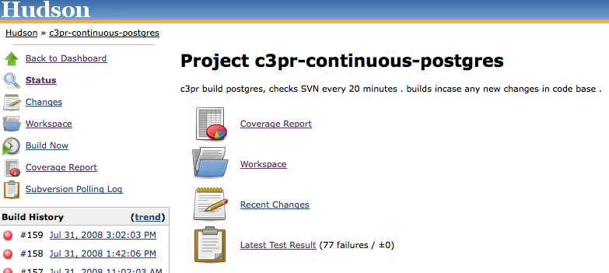
New Development
Codebase Refactor
N-tier refactoring, separation of concerns, harden service layer
Ivy migration
Build dashboard, code coverage report, check-style report

Slide 12
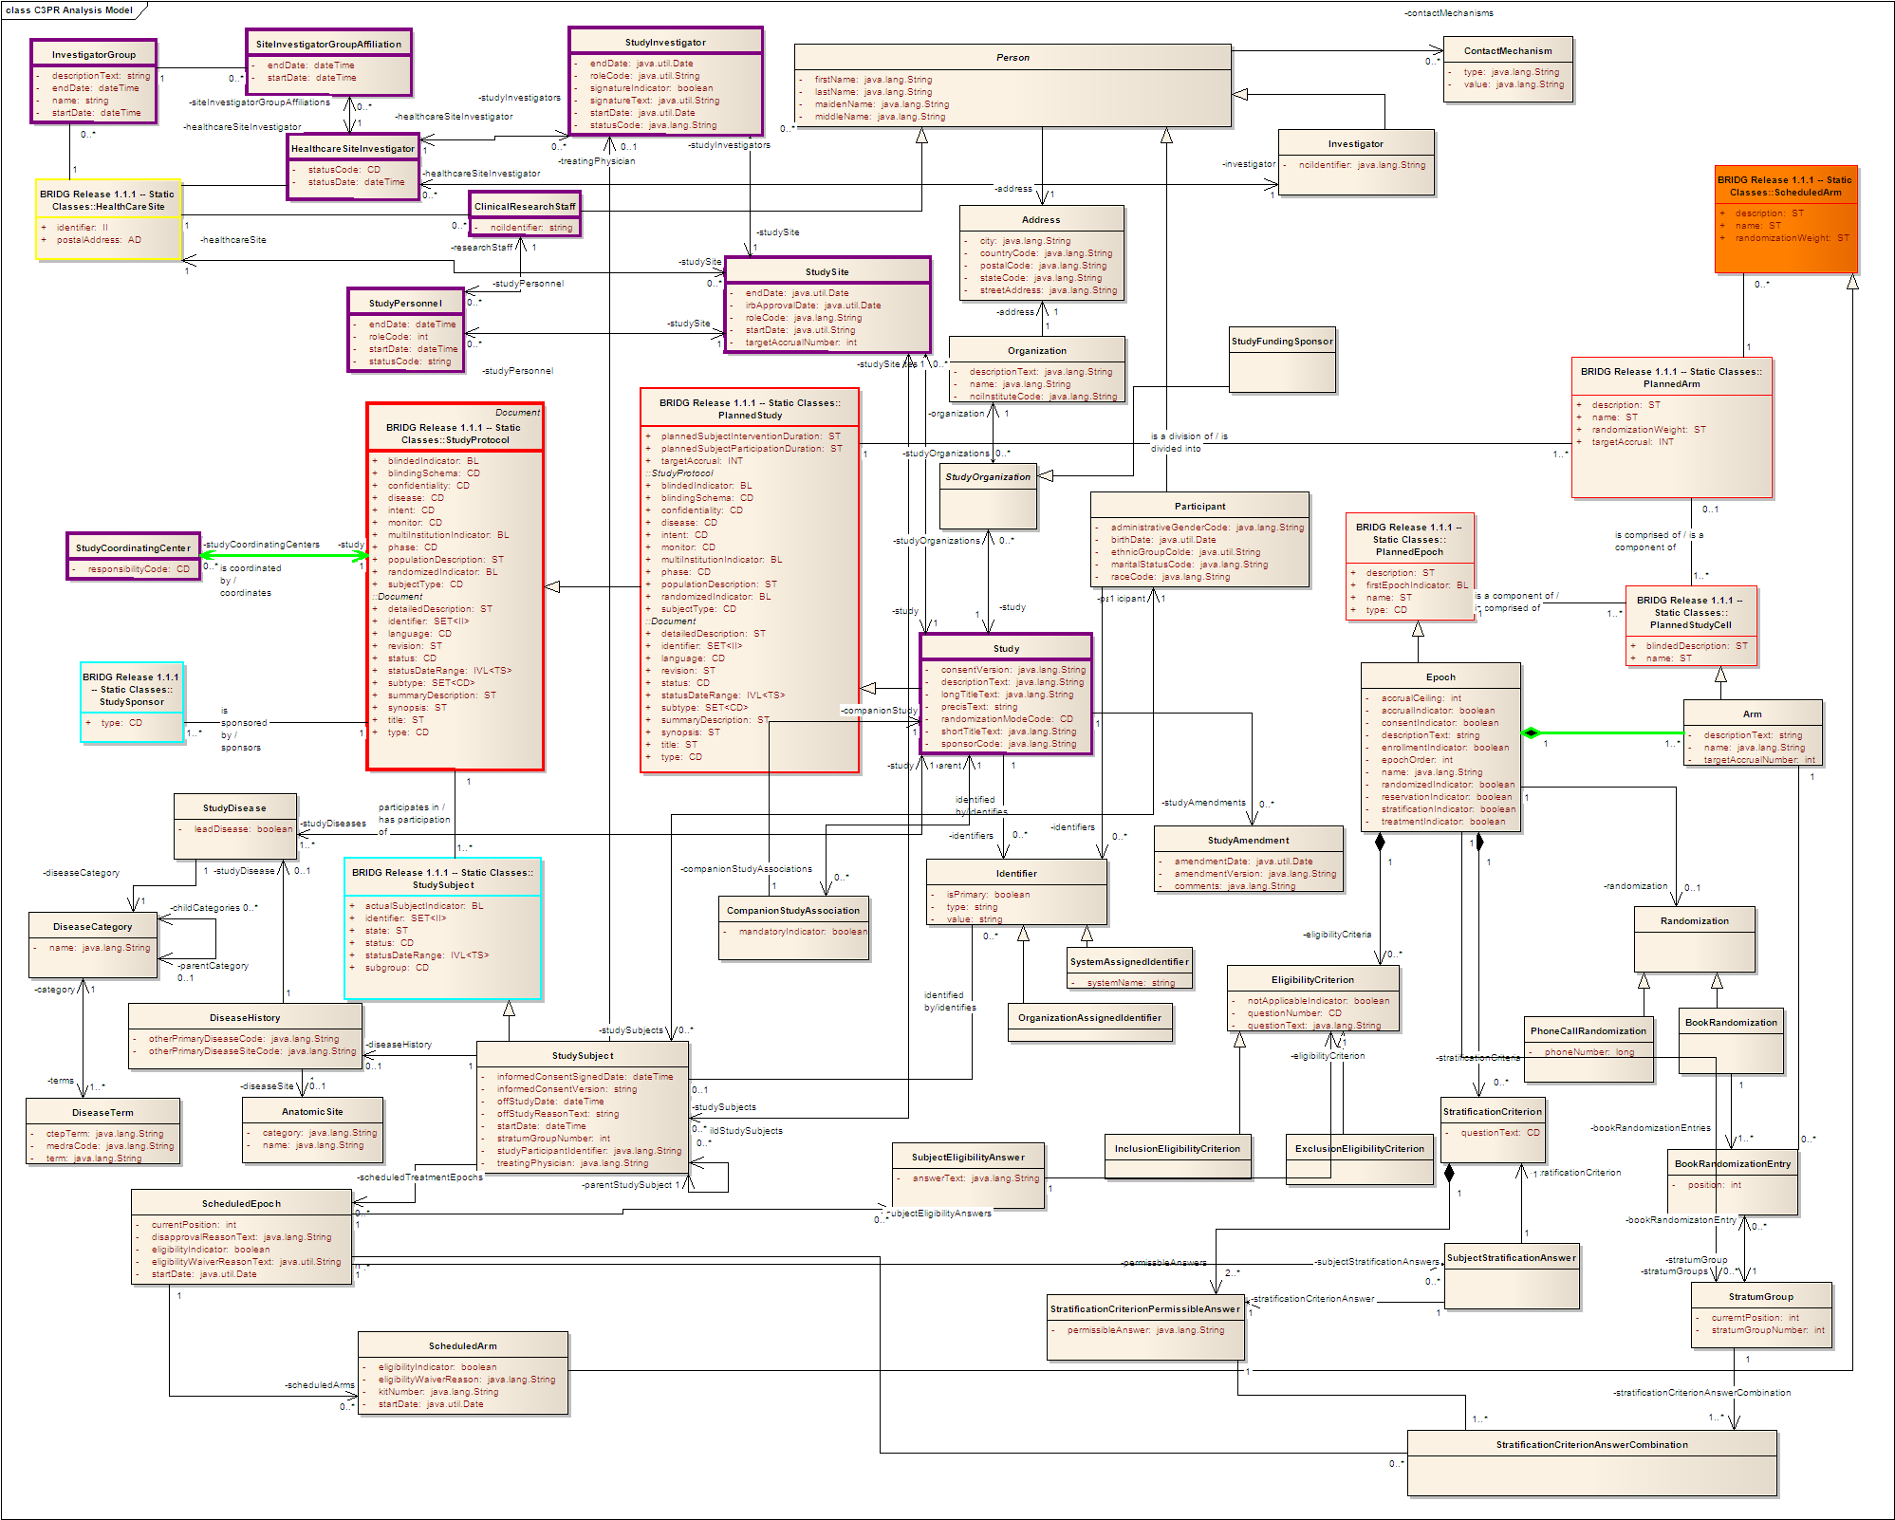
New Development
BRIDG Harmonization

Slide 13
New Development
BRIDG Harmonization

Slide 14
New Development
BRIDG Harmonization

Slide 15
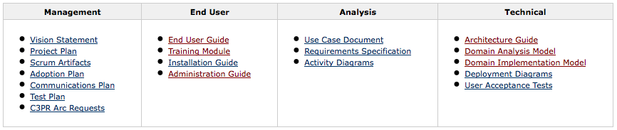
New Development
Documentation
Wiki migration, use cases, SRS, end user guide, etc.

Slide 16
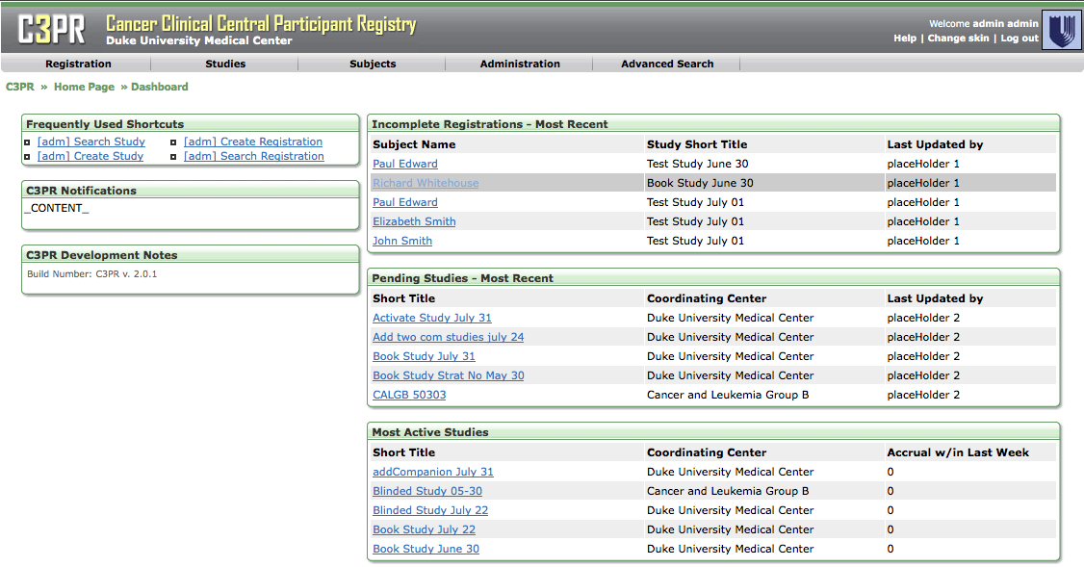
New Development
UI Redesign
Cleaner, skinnable, dashboard

Slide 17
New Development
New Use Cases
Exception handling
  General framework, enhanced error messages
Companion protocols
  Study design, subject registration
Notifications
  Flexible, rules-based, email, dashboard
Password policy
  Password length, complexity, case sensitivity
PMRP integration
  Subject linking, flexible field constraints
Multi-site (slated for late August)
  New study, register subject
Subject Demographics
  Multiple races, MRN default, etc.

Slide 18
Demonstration

Slide 19
Next Steps
Startup multi-site pilot
Continue adoption activities
CCTS 1.5/2.0 service specifications and implementation, security
Enhance notifications (in iterative fashion)
Enhance companion protocols (in iterative fashion)
OPEN/RSS integration
Hosted mode (part of CCTS?)
EMR integration
Legacy integration
Enhance reporting (Summary 3/4, etc.)
Field customization
Data deidentification (for messaging)
Enhance documentation, online help

Slide 20
Discussion/questions
For more information
GForge: http://gforge.nci.nih.gov/projects/c3prv2/
  Documentation
  File releases
  CVS
Wiki: https://wiki.nci.nih.gov/display/CTMS/Cancer+Central+Clinical+Participant+Registry+(C3PR)
  Description
  Documentation
  Use Cases
  Domain Model
  Business Rules
  Project Planning
  Meetings

