Slide 1
C3PR
Potential Enterprise Services
Pankaj Agarwal
Ram Chilukuri
Patrick McConnell
Edmond Mulaire

Slide 2
Agenda
Overview (5 min)
  Services to contribute, summary reports background
High-level view of services (5 min)
  Person, registration, accrual, summary 3/4 reports
Further analysis (2 min)
  Activities, deployment
Proposal (3 min)
  Proposed development model, advantages

Slide 3
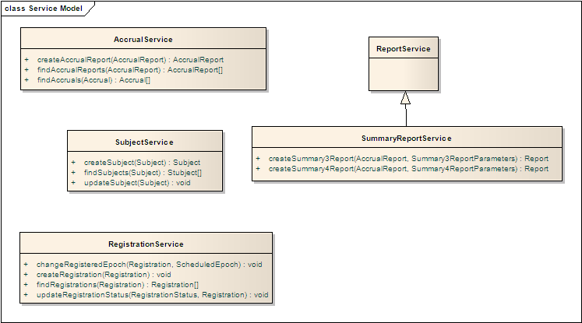
Overview
Potential services to contribute
Subject
Registration
Accrual
Summary 3/4 reports

Slide 4
Overview
Summary reports background
The National Cancer Institute requires funded cancer centers to produce a variety of summary reports that are used for reviewing the activity of centers (for competitive applications) and to produce broader reports on all cancer center programs. There are five primary reports:
  Summary 1: Cancer Center Senior Leaders, Research Programs, Program Members, and Shared Resources as of the Reporting Date Indicated on the Summary
  Summary 2: Active Funded Projects
  Summary 3: Reportable Patients/Participation in Therapeutic Protocols By Anatomic Cancer Site
  Summary 4: Information on Clinical Research Studies
  Summary 5: Comparison of Current and Requested CCSG Budgets
More information can be found at:
  http://cancercenters.cancer.gov/documents/Summaries6_06.pdf

Slide 5
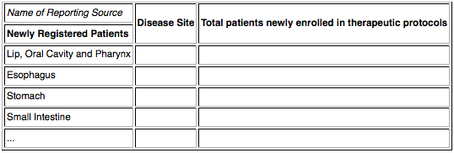
Overview
Summary 3 example
The Summary 3 Report documents which anatomic cancer sites are being treated at the cancer center and whether the center is placing these patients onto therapeutic protocols. Broadly, it summarizes the clinical research activities of the cancer center. The report has the following format:

Slide 6
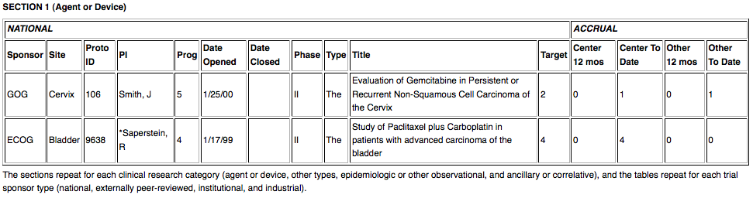
Overview
Summary 4 example
The Summary 4 Report documents the clinical research studies open at any time at a cancer center during a defined reporting period.

Slide 7
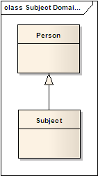
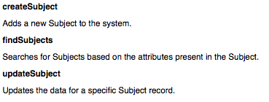
High-level view of services
Subject service
A Subject is a Person who is a patient involved in clinical trials. The Subject is either registered or is a candidate to be registered on a Study.

Slide 8
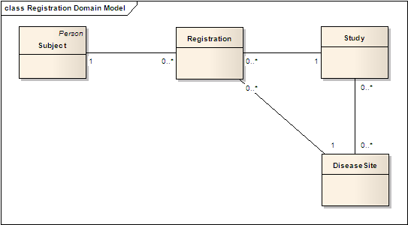
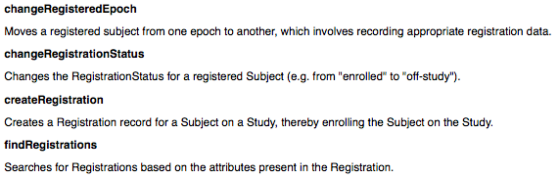
High-level view of services
Registration service
A Registration represents a Subject enrollment on a Study and all of the associated data (e.g. consent, stratification, eligibility, etc.).

Slide 9
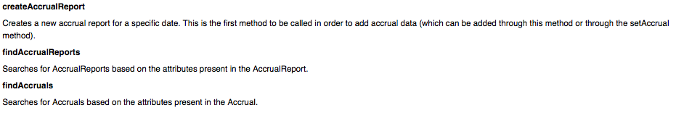
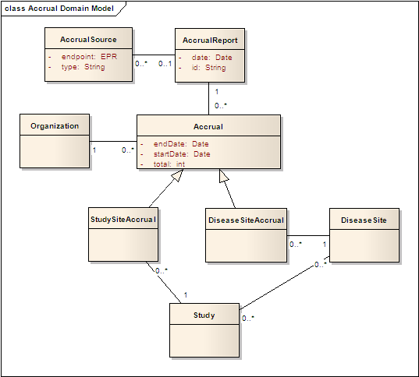
High-level view of services
Accrual service
Accrual captures a total number of registrations for particular categories within a specific timeframe. Broadly, these categories are study site and disease site. The StudySiteAccrual captures the total number of subjects registered by a specific Organization on a specific Study. The DiseaseSiteAccrual captures the total number of subjects registered by a specific Organization related to a specific disease site (anatomical site).

Slide 10
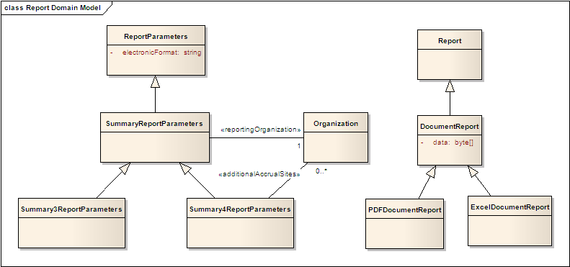

High-level view of services
Summary 3/4 report service
The Report is the actual electronically produced report, whether in bytes or some other form.

Slide 11
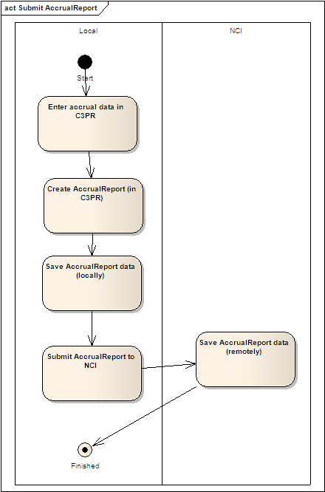
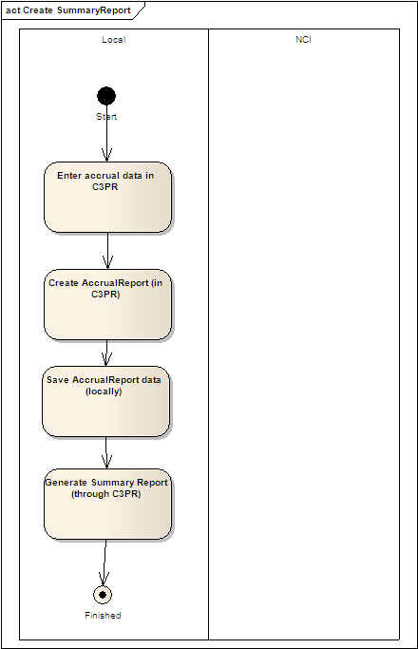
Further analysis
Activities

Slide 12
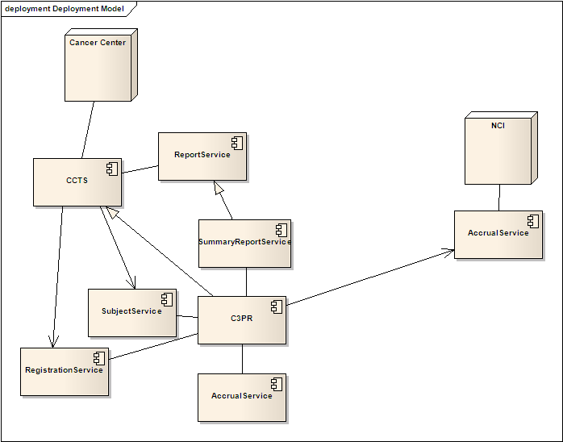
Further analysis
Deployment

Slide 13
Proposal
Proposed development approach
Development
  The C3PR team will build the subject, registration, accrual, and summary 3/4 reporting services
  The C3PR team will be integrated into the CTRP team (along with the COPPA/CTRP developers)
Analysis
  The C3PR will leverage the BAM analysts to further elaborate on the CTRP requirements
Integration
  CTRP will become a client to the accrual and summary 3/4 report services
  C3PR will become a client to the accrual and summary 3/4 report services

Slide 14
Proposal
Advantages
Reuse existing work
  C3PR clearly already captures the majority of this data
  The C3PR team has a head start on designing the solution
  C3PR already has implemented most of the fields necessary for accrual and summary 3/4 reporting
Community requirements
  There is a strong call for summary reporting to be part of C3PR from adopters, elaborators, and postings to the KC forums
  The C3PR team has already documented many of these requirements
Integration with existing work
  C3PR will be one of the primary consumers of the services (feeding accrual information and generating summary reports)
  The C3PR team has a track record of building reusable services (for CCTS)
Timelines
  Resourcing and timeline constraints with CTRP and COPPA teams

