Slide 1
Cancer Central Clinical Participant Registry (C3PR) v2
Silver Compatibility Overview
Patrick McConnell
Duke Comprehensive Cancer Center
patrick.mcconnell@duke.edu

Slide 2
Agenda
Overview (5 min)
Model (10 min)
API (5 min)
Package contents (5 min)

Slide 3
Who is involved in C3PR?
Duke Bioinformatics
  Jamie Cuticchia (PI)
  Patrick McConnell (lead architect)
Duke Information Systems
  Bob Annechiarico (PM)
  William Banks (domain expert)
  Seth Fehrs (developer)
  Mohamad Farid (DBA, tester)
  Jeff Allred (IT manager)
Duke Clinical Trials
  Vijaya Chadaram (domain expert)
Coalition of Cancer Cooperative Groups
  Robin Nickens (domain expert)
CALGB
  Kim Johnson (domain expert)
  Charles Keen (domain expert)
Westat
  Steve Riordan (domain expert)
CCR
  Jeff Shilling (domain expert)
North Carolina State
  Patty Spears (patient advocate)
Wake Forest
  Bob Morrell (domain expert)
  Steven Cheng (tester)
  Lisa Dixon (domain expert, tester)
  Kim Livengood (domain expert, tester)
Mayo
  Sharon Elcombe (domain expert)
SemanticBits
  Ram Chilukuri (lead developer)
  Manav Kher (developer)
  Priyatam Mudivarti (developer)
  Kruttik Aggarwal (developer)
  Ramakrishna Gundala (developer)
NCI
  Christo Andonyadis
BAH
  Julie Holtzople
  Karen Ryan
  Niket Parikh

Slide 4
Overview
Timelines
C3PR Release 2
  Developed by Duke Comprehensive Cancer Center
  Extends the Release 1 functionality
  Project began in November 2006, slated for 14 months
^{C3PR v2}
^{Construction}
^{Start}
^{C3PR v2}
^{Project}
^{Complete}
^{C3PR v1}
^{Released}
^{Mar}
^{Mar}
²⁰⁰⁴
²⁰⁰⁵
²⁰⁰⁶
²⁰⁰⁷
²⁰⁰⁸
^{Nov}
^{Jan}
^{C3PR v1}
^{Testing}
^{Start}
^{C3PR v2}
^{Elaboration}
^{Start}
^{C3PR v2}
^{Transition}
^{Start}

Slide 5


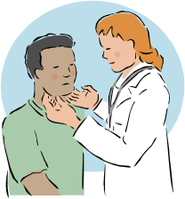


Overview
Where does a participant registry fit in?
Cancer Central Clinical
Participant Registry (C3PR v2)
Patient Study Calendar (PSC)
Eligibility is verified
and patient is registered
to a study
Tracks the patient
throughout the study
Clinical Trial Data
Management Systems (C3D)
Cancer Adverse Event
Reporting System (caAERS)
Patient visits the
Physician
Lab Viewer
Clinical data is captured
Identifies adverse events
and any associated
schedule changes
Identifies labs, loads
them into the CDMS
and AE system

Slide 6
Overview
What does a participant registry do?
Tracks subject registrations to clinical trials
  Screening, registration, re-randomization, protocol amendments,
  re-consent, etc.
Ensures that all registration criteria are met
  Trial is still open to accrual
  Consent has been obtained
  Eligibility criteria are met
Stratifies the subject into a stratum group
Randomizes the subject to the trial
Registers the subject on the trial
Handles reporting
  Meets federal regulatory reporting
  Supports local reporting needs

Slide 7
Overview
Project goals
Integrate with other clinical system
  Cancer Clinical Database (C3D)
  Patient Study Calendar (PSC)
  Cancer Adverse Events Reporting System (caAERS)
  Clinical Trials Object Model (CTOM)
  caXchange
Provide support for multi-site studies
  C3PR-to-C3PR integration
Extend registration, including storing randomization information
  Phone call and internal book lookup
Enhance protocol management, including web-based management
Improve the user interface from the perspective of the registrar
Augment reporting to meet regulatory needs

Slide 8
Overview
Use cases and features
Study Personnel Management
  Principle investigators
  Study research staff
Study Management
  Adding study investigators and personnel
  Blinded studies
  Multi-institutional studies
  Epochs, strata, arms
  Screening
  Custom eligibility or from the caDSR
  Protocol amendments
Subject Management
  Demographics
  Multiple identifiers
Disease Site
  Study disease sites
  Study subject disease sites
  Custom disease lists
Security
  Role-based
  Scoped (study versus system)
  CSM for local security
  Grid-based security
caBIG Principles
  Open access (APIs and DB)
  Open source
  Federated development
Register Subject
  Consent
  Enrolling physician
  Primary disease site
  Eligibility check
  Stratification
  Randomization (phone, book, callout)
Manage Registration
  Move between epochs
  Re-consent
  Recheck eligibility
  Re-randomization
Multi-site Studies
  Share study definition
  Update study status
  Multi-site registration
  Multi-site protocol amendment
User interface
  Intuitive look-and-feel
  Google-like search boxes
  Support for multiple workflows
  Show summary information when possible
  Dynamic interface controls
Integration
  C3D, PSC, caAERS, LabViewer

Slide 9
Overview
Architecture
^{User Interface}
^{Database}
^{IndexService}
^{Java APIs}
^{Business Logic}
^{Grid Services}
^{GME}
^{caGrid Security Components}
^{Enterprise}
^{Service Bus}
^{(ESB)}
^{SSO}
^{Webapp}
^{Authentication}
^{Service}
^{Dorian}
^{GTS}
^{Delegation}
^{Service}
^{CSM}

Slide 10
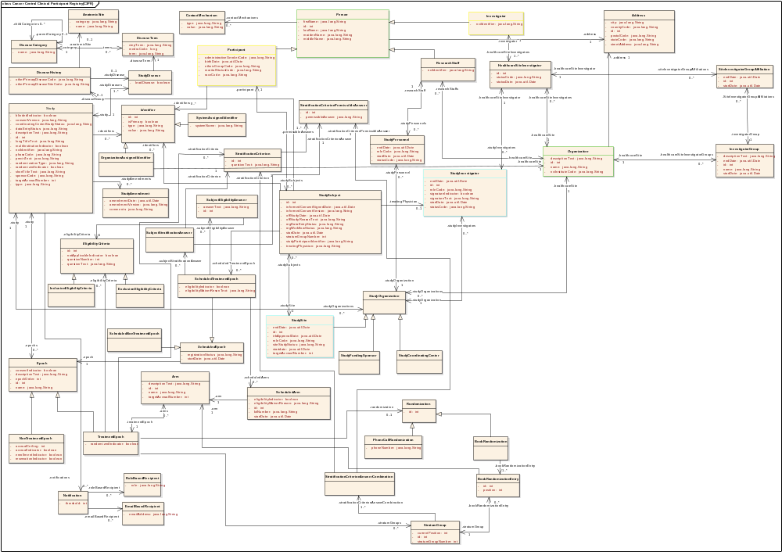
Model
Overview
^{Diseases}
^{Study}
^{Personnel}
^{Site}
^{Subject}
^{Study}
^{Registration}

Slide 11
Model
Subject

Slide 12
Model
Study: details, eligibility, stratification

Slide 13
Model
Study: structure (epochs and arms)

Slide 14
Model
Study: randomization

Slide 15
Model
Study: randomization type

Slide 16
Model
Registration: general approach

Slide 17
Model
Disease

Slide 18
Model
Study Personnel

Slide 19
Model
Organization

Slide 20
Model
Standards, etc.

Slide 21
API
Overview
Hibernate maps Java objects to RDMS
  caTissue CORE, CAE, Tumor Registry, caIntegrator SNP
We request review of the Java query API be reviewed

Slide 22
API
Details
public CQLQueryResults query(CQLQuery cqlQuery)
throws RemoteException, QueryProcessingExceptionType, MalformedQueryExceptionType
CQLQuery describes the objects and filter criteria to search for
CQLQueryResults describes the returned objects
The exceptions are not registered
Input and output types are being registered by the caGrid team

Slide 23
API
Existence
Test scripts
  Java program
  Reads queries from files
  Writes results to files
Test logs
  XML serialization of results into files

Slide 24
Submission package
  This presentation
  Use case document
  SRS
  Architecture guide
  EA model
  Semantically annotated XMI
  SIW report
  UML loader checklist
  Vocabulary report
  Value domain report
  Standards report
  CDE use report
  API document
  Test log
  Test scripts
  Test approach
http://gforge.nci.nih.gov/plugins/scmcvs/cvsweb.php_x000b_/catrip/documentation/silver_review/catrip_silver_review_package.doc_x000b_?cvsroot=catrip

Slide 25
Discussion
Questions, comments?

