Slide 1
Cancer Central Clinical Participant Registry (C3PR) v2
Community Demonstration 2 (7/9/2007)
Patrick McConnell¹, Robert Annechiarico², and Ram Chilukuri³
^{1,2}Duke Comprehensive Cancer Center
¹patrick.mcconnell@duke.edu
²bob.annerchiarico@duke.edu
³Semantic Bits LLC
³ram.chilukuri@semanticbits.com

Slide 2
Agenda
Background (5 min)
Demonstration (30 min)
Next steps (5 min)
Discussion (20 min)

Slide 3
Background
Who is involved in C3PR?
Duke Bioinformatics
  Jamie Cuticchia (PI)
  Patrick McConnell (lead architect)
Duke Information Systems
  Bob Annechiarico (PM)
  William Banks (domain expert)
  Seth Fehrs (domain expert)
  Mohamad Farid (DBA, tester)
  Jeff Allred (IT manager)
Duke Clinical Trials
  Vijaya Chadaram (domain expert)
Coalition of Cancer Cooperative Groups
  Robin Nickens (domain expert)
CALGB
  Kim Johnson (domain expert)
  Charles Keen (domain expert)
Westat
  Steve Riordan (domain expert)
CCR
  Jeff Shilling (domain expert)
North Carolina State
  Patty Spears (patient advocate)
Wake Forest
  Bob Morrell (domain expert)
  Steven Cheng (tester)
  Lisa Dixon (domain expert, tester)
  Kim Livengood (domain expert, tester)
Mayo
  Sharon Elcombe (domain expert)
SemanticBits
  Ram Chilukuri (lead developer)
  Manav Kher (developer)
  Priyatam Mudivarti (developer)
  Kruttik Aggarwal (developer)
  Ramakrishna Gundala (developer)
  Vinay Gangoli (developer)
NCI
  Christo Andonyadis
BAH
  Meg Gronvall
  Julie Holtzople
  Karen Ryan
  Niket Parikh

Slide 4
Background
Timelines
C3PR Release 1
  Developed by Nortel Solutions
  Baseline functionality for registering patients to pre-defined protocols
  Released for testing in 2004, production in 2006
C3PR Release 2
  Developed by Duke Comprehensive Cancer Center
  Extends the Release 1 functionality
  Project began in November 2006, slated for 14 months
^{C3PR v1}
^{Released}
^{C3PR v2}
^{Construction}
^{Start}
^{C3PR v2}
^{Project}
^{Complete}
^{Mar}
^{Dec}
²⁰⁰⁴
²⁰⁰⁵
²⁰⁰⁶
²⁰⁰⁷
^{Nov}
^{Nov}
^{C3PR v1}
^{Testing}
^{Start}
^{C3PR v2}
^{Elaboration}
^{Start}
^{C3PR v2}
^{Transition}
^{Start}

Slide 5
Background
What does a participant registry do?
Tracks subject registrations to clinical trials
  Screening, registration, re-randomization, protocol amendments,
  re-consent, etc.
Ensures that all registration criteria are met
  Trial is still open to accrual
  Consent has been obtained
  Eligibility criteria are met
Stratifies the subject into a stratum group
Randomizes the subject to the trial
Registers the subject on the trial
Handles reporting
  Meets federal regulatory reporting
  Supports local reporting needs

Slide 6
Background
Use cases and features
Study Personnel Management
  Principle investigators
  Study research staff
Study Management
  Adding study investigators and personnel
  Blinded studies
  Multi-institutional studies
  Epochs, strata, arms
  Screening
  Custom eligibility or from the caDSR
  Protocol amendments
Subject Management
  Demographics
  Multiple identifiers
Disease Site
  Study disease sites
  Study subject disease sites
  Custom disease lists
Security
  Role-based
  Scoped (study versus system)
  CSM for local security
  Grid-based security
caBIG Principles
  Open access (APIs and DB)
  Open source
  Federated development
Register Subject
  Consent
  Enrolling physician
  Primary disease site
  Eligibility check
  Stratification
  Randomization (phone, book, callout)
Manage Registration
  Move between epochs
  Re-consent
  Recheck eligibility
  Re-randomization
Multi-site Studies
  Share study definition
  Update study status
  Multi-site registration
  Multi-site protocol amendment
User interface
  Intuitive look-and-feel
  Google-like search boxes
  Support for multiple workflows
  Show summary information when possible
  Dynamic interface controls
Integration
  C3D, PSC, caAERS, LabViewer

Slide 7
Demonstration
Add study Personnel
Create a Study
Manage a Study
Add a Subject
Register a Subject
Manage a Registration
Advanced Search

Slide 8
Next Steps
Blinded studies
Multi-site registration
Study amendments
C3D integration
Data import and export
Book randomization
Move between epochs
Fine grained security

Slide 9
Discussion/questions
For more information
Wiki: http://ccis1716.duhs.duke.edu/wiki/index.php?title=C3PR
  Description
  Documentation
  Use Cases
  Domain Model
  Business Rules
  Project Planning
  Meetings
GForge: http://gforge.nci.nih.gov/projects/c3prv2/
  File releases
  CVS

Slide 10
Cancer Central Clinical Participant Registry (C3PR) v2
Backup Slides

Slide 11

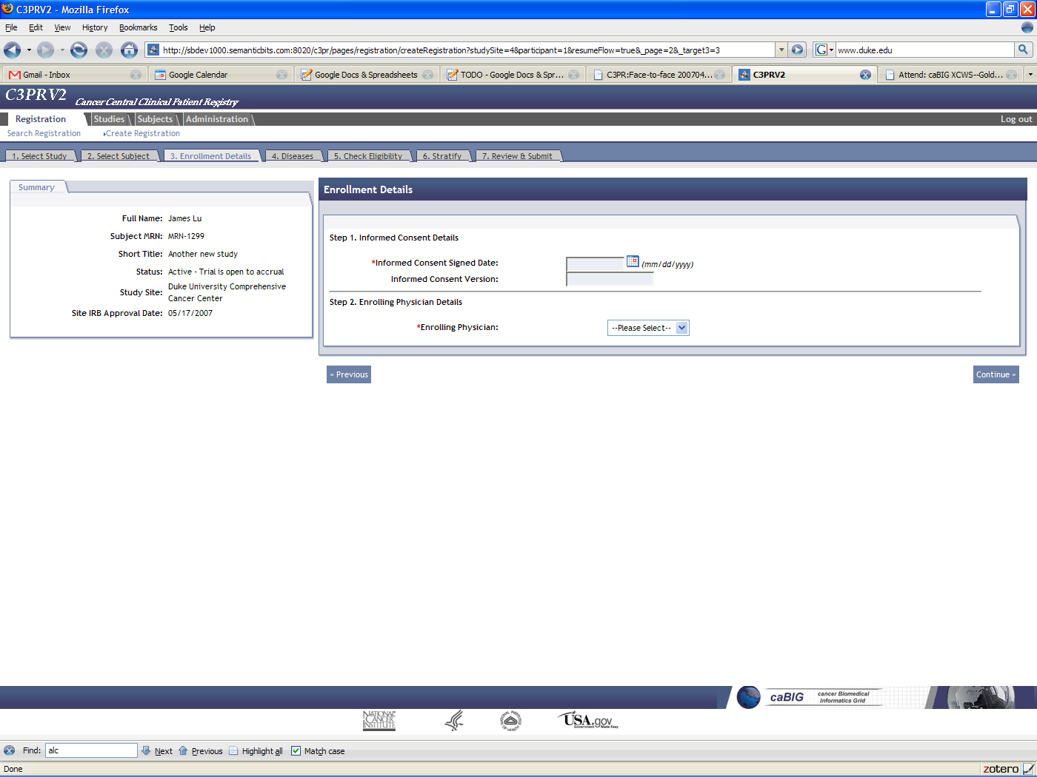
Overview
Multi-site integration
^{Local Site}
^{Coordinating Site}
^{0. Study Definition}
^{1. Add Subject}
^{3. Register Subject}
^{at Coordinating Site}
^{2. Register Subject}
^{5. Registration}
^{Complete}
^{4. Randomize}
^{Randomization}
^{Routine}
^{Study Status Change}
^{Protocol}
^{Amendment}

Slide 12
Technical details
Technology stack
Security: CSM, Acegi (Spring Security), caGrid (Dorian, AuthenticationService, GridGrouper, GTS, etc.)
Web: Spring MVC, Direct Web Remoting (DWR), Scriptaculous, Sitemesh
Object-relational Mapping: Hibernate
Messaging: caGrid, ServiceMix
Database: Postgres, Oracle

Slide 13
Technical details
Architecture
^{User Interface}
^{Database}
^{Java APIs}
^{Business Logic}
^{Grid Services}
^{IndexService}
^{caGrid Security Components}
^{Enterprise}
^{Service Bus}
^{(ESB)}
^{SSO}
^{Webapp}
^{Authentication}
^{Service}
^{Dorian}
^{GridGrouper}
^{Delegation}
^{Service}
^{CSM}
^{GTS}

Slide 14

Technical details
Multi-site trials
^{Affiliate Site}
^{Coordinating Site}
^{C3PR}
^{Grid}
^{Service}
^{Create Subject}
^{Register Subject}
Coordinating site receives registration message and forwards to local services
^{Enterprise}
^{Service}
^{Bus}
^{Enterprise}
^{Service}
^{Bus}
^{C3PR Web Interface}
^{Java Beans}
^{Java Services}
ESB forwards registration message to locally and remotely registered services
^{Java Beans}
^{Java Services}
^{C3PR}
^{DB}
^{C3PR}
^{DB}
^{C3D}
^{Web}
^{Service}
^{PSC}
^{Grid}
^{Service}
^{caAERS}
^{Grid}
^{Service}
^{C3D}
^{Web}
^{Service}
^{PSC}
^{Grid}
^{Service}
^{caAERS}
^{Grid}
^{Service}

Slide 15
Technical details
Multi-site trial workflow
Traditional workflow for multi-site registration
  Register in the coordinating site participant registry
  Repeat at the local site
C3PR workflow for multi-site registration
  Register at the local site, C3PR forwards to the coordinating site
  Important: registration still technically occurs at the coordinating site
Why did we do it this way?
  There is more data at the local site
    Patient information, study personnel, etc.
    Helps to auto-fill fields
  User is familiar with local systems
  User provisioning is easier (local identity provider)
  Keep control over data locally

Slide 16
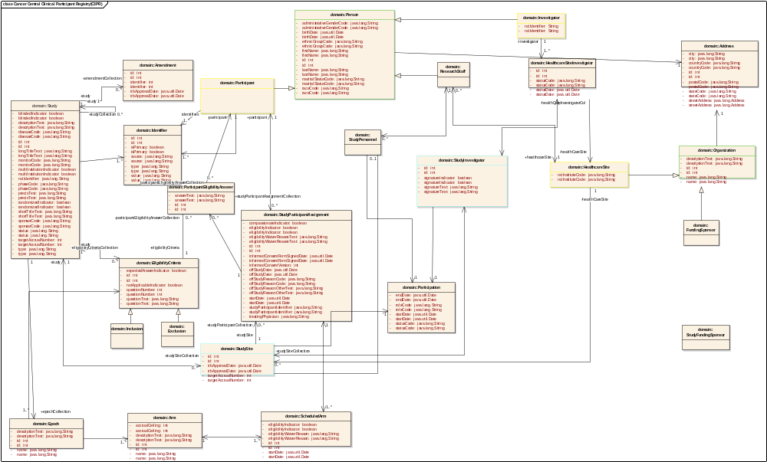
Technical details
BRIDG static harmonization
^{Study}
^{Subject}
^{Study}
^{Personnel}
^{Site}
^{Registration}

Slide 17
Technical details
Data flow
^{Excel}
^{Paper}
^{Firewall}
^{User Interface}
^{Legacy}
^{Participant}
^{Registry}
^{C3PR}
^{XML}
^{File}
^{Loader}
^{Exporter}
^{DeId}
^{APIs}
^{Java}
^{Grid}
^{Java}
^{Custom Program}
^{SQL}

Slide 18
Technical details
Reporting
Summary 3 report
  Which anatomic cancer sites are being treated at the cancer center
  Whether the center is placing these patients onto therapeutic protocols
  Summarizes the clinical research activities of the cancer center
Summary 4 report
  Clinical research studies open at any given time period
Custom reports
  Instructions on adding reports to the user interface
  Open access to backend database (traditional relational data model)

Slide 19
Technical details
Security components
authorization
User Grid
Certificate
authentication
Grid
Service
User
Credentials
SAML
Assertion
Dorian
CSM
Trust Fabric
caGrid
Authentication Service
Grid
Grouper
backend
data
Duke
Authentication Plug-in
Institutional Security

Slide 20
Technical details
User roles
Role | Definition
Subject | Does not participate in C3PR
Study Chair | Overall responsibility for scientific conduct of study
Site Principle Investigator | Conduct of study at a single institution
Enrolling Physician | Treatment and follow-up of patient
Data Manager | Collection and review of data
Study Coordinator | Manages conduct of protocol at site
Registrar | Enters data regarding enrollments
IRB Manager for C3PR | Manages the IRB aspects of a study
Site Coordinator | Manages administrative aspects of study conduct
Security Manager | Assigns access privileges to C3PR system
Technical System Administrator | Manages assignment of privileges to roles
Site Software Developer | Creates reports
Data Analyst/System | Analyzes data

Slide 21
Technical details
User permissions
Role | Study Record | Subject Record | Enrollment Record | Treatment Assignment | Reports Aggregate | Reports PHI
Subject
Study Chair | R | R | R | R | R | R
Site Principle Investigator | R | R | R | R | R | R
Enrolling Physician |  |  |  |  | R | R
Data Manager |  |  |  |  | R | R
Study Coordinator | RUS |  |  |  | R
Registrar | R | CRU | CRU | CRU | R | R
IRB Manager for C3PR | U |  |  |  | R
Site Coordinator | CRD | RD | RD | RD | RD | RD
Security Manager | RO
Tech System Administrator | RLA
Site Software Developer |  |  |  |  | CRUD | CRUD
Data Analyst/System | R | R | R | R | R | R
C=Create R=Read U=Update D=Delete O=Assign Roles
S=Stop Enrollment L=Create Roles A=Assign Site Roles

Slide 22
Technical details
Service stack
Index Service
advertise
caGrid Service
Business logic
Hibernate
domain
model
Object-relational
mapping
database

Slide 23
Technical details
External interfaces
^{Firewall}
^{Firewall}
^{Grid}
^{Local}
^{C3PR}
^{Remote}
^{C3PR}
^{Grid Service}
^{Public Interface}
^{Public Interface}
^{Grid Service}

Slide 24
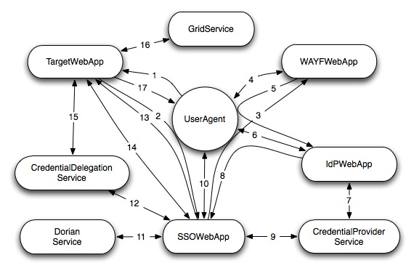
Technical details
Delegation and single-sign-on
^{C3PR acts on the user’s behalf}
^{User interacts with C3PR}
C3PR gets signed user credentials
^{C3PR gets auth stmt}
^{Contacts SSO application}
Designates which users can delegate
^{User logs in}

Slide 25



Technical details
Randomization
^{Randomize}
^{Phone Call}
^{Callout}
^{Select an Arm}
^{Arm A}
^{Arm B}
^{Arm C}
^{AABBCAABBC}
^{AABBCAABBC}
^{AABBCAABBC}
^{Book}

