Slide 1
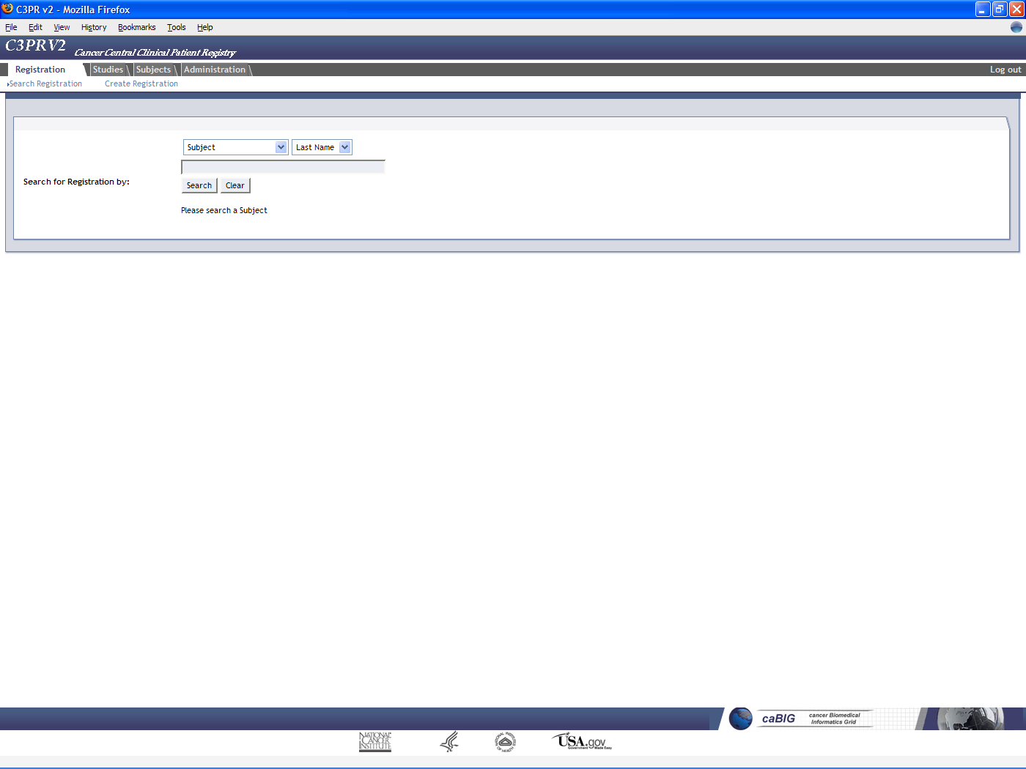

Slide 2
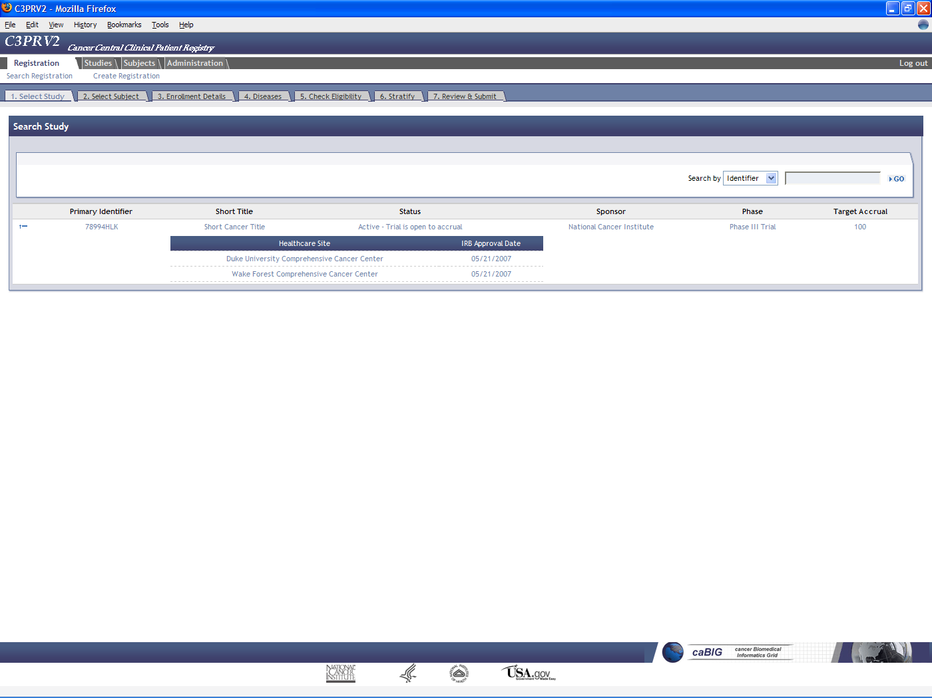

Slide 3
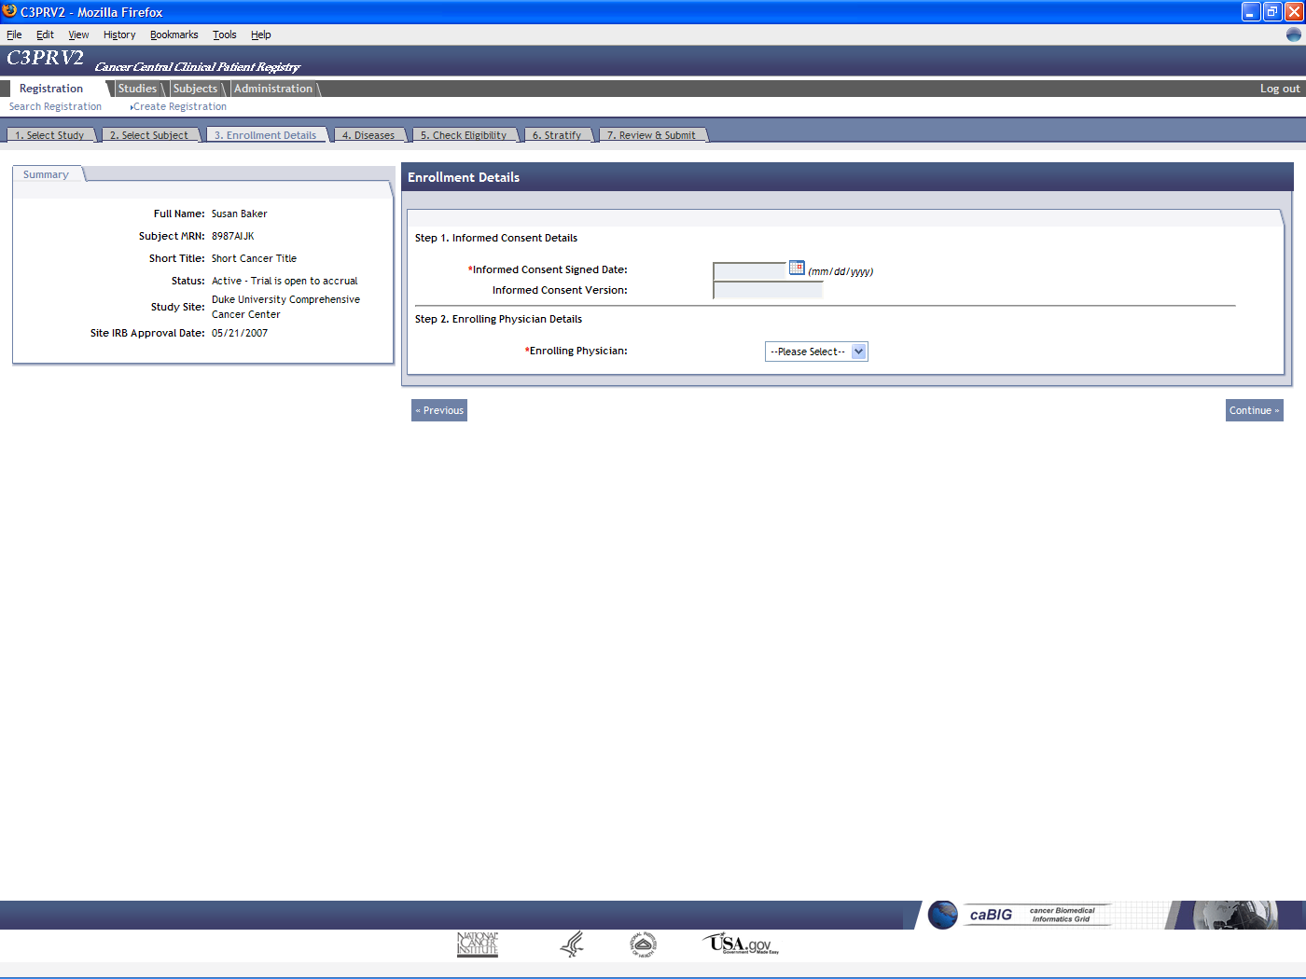

Slide 4
What does a participant registry do?
Tracks subject registrations to clinical trials
  Screening, registration, re-randomization, protocol amendments,
  re-consent, etc.
Ensures that all registration criteria are met
  Trial is still open to accrual
  Consent has been obtained
  Eligibility criteria are met
Stratifies the subject into a stratum group
Randomizes the subject to the trial
Registers the subject on the trial
Handles reporting
  Meets federal regulatory reporting
  Supports local reporting needs

Slide 5
Use cases and features
Study Personnel Management
  Principle investigators
  Study research staff
Study Management
  Adding study investigators and personnel
  Blinded studies
  Multi-institutional studies
  Epochs, strata, arms
  Screening
  Custom eligibility or from the caDSR
  Protocol amendments
Subject Management
  Demographics
  Multiple identifiers
Disease Site
  Study disease sites
  Study subject disease sites
  Custom disease lists
Security
  Role-based
  Scoped (study versus system)
  CSM for local security
  Grid-based security
caBIG Principles
  Open access (APIs and DB)
  Open source
  Federated development
Register Subject
  Consent
  Enrolling physician
  Primary disease site
  Eligibility check
  Stratification
  Randomization (phone, book, callout)
Manage Registration
  Move between epochs
  Re-consent
  Recheck eligibility
  Re-randomization
Multi-site Studies
  Share study definition
  Update study status
  Multi-site registration
  Multi-site protocol amendment
User interface
  Intuitive look-and-feel
  Google-like search boxes
  Support for multiple workflows
  Show summary information when possible
  Dynamic interface controls
Integration
  C3D, PSC, caAERS, LabViewer

Slide 6
Use cases and features available today
Define a study
  Basic details, sites, diseases, eligibility, stratification, randomization
Manage study personnel
  Investigators and staff
Add subjects to C3PR
  Name, identifiers, demographics, etc.
Register subjects to trials
  Consent date, disease site, eligibility, stratification, randomization
Manage multi-site studies
  Define multi-site studies

Slide 7
Use cases and features available in this phase (November release)
Reporting
  Summary 3, summary 4, aggregate, custom
Manage multi-site studies
  Exchange study definitions, multi-site registration
Amend a study
  Re-consent, eligibility checklist update
Enhanced registration
  Blinded studies, automated randomization, screening, re-randomization
Enhanced security
  Security managed through study personnel defined in C3PR
Interoperability with legacy systems
  Data import and export

