Slide 1
C3PR
Multi-site Approaches
Patrick McConnell
patrick.mcconnell@semanticbits.com

Slide 2
Agenda
Background (2 min)
  Multi-site landscape, study exchange, registration
Message Routing (4 min)
  Itinerary based routing
Grid Security (4 min)
  Local grid, central grid, central websso

Slide 3




Background
Multi-site Landscape
Coordinating Site (1)
Runs the trial
Responsible for reporting
Responsible for final enrollments
Affiliate Sites (1 or more)
Accrues patients
Responsible for reporting
Responsible for treating patients
Coordinating site can also be an affiliate site
. . .

Slide 4
Background
Multi-site Study Exchange
Goal: keep the study synchronized between the coordinating site and affiliate site so that registrations can take place
  Note: this use case may drastically change once PA enterprise services are integrated
Coordinating Site
  Defines the study
  Opens the study globally
  Sends the study to the affiliate sites
  Approves affiliate sites
Affiliate Site
  Accepts the study
  Adds minor data (such as identifiers)
  Opens the study locally

Slide 5
Background
Multi-site Registration
Goal: keep registration data locally and at the coordinating site, complete the enrollment at the coordinating site
Affiliate Site
  Enters subject details
  Enters registration details
  Sends the registration record to the coordinating site for enrollment
  Stores registration details
Coordinating Site
  Randomizes the subject
  Enrolls the subject
  Stores registration details

Slide 6
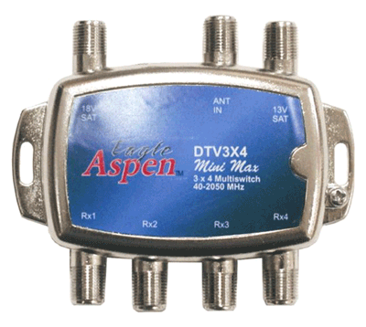
Message Routing
Itinerary-based Routing
caXchange
Problem: communication is 1 to many based on the study definition – need to define itinerary and endpoints
Approach: itinerary and endpoints can be defined at the source or caXchange
Itinerary Solution: itinerary defined by C3PR
Endpoint Solutions:
Defined by C3PR and sent to caXchange
Configured in caXchange (via files)
Fetched from IndexService
. . .

Slide 7







Grid Security
Current Approach: Local Grid
GTS
IdP
WebSSO
Dorian
CDS
IdP
WebSSO
IdP
WebSSO
GTS
IdP
WebSSO
IdP
WebSSO
Dorian
. . .
CDS

Slide 8

Grid Security
Proposed Approach: Central Grid
IdP
WebSSO
IdP
WebSSO
IdP
WebSSO
GTS
Dorian
CDS
IdP
WebSSO
. . .
IdP
WebSSO

Slide 9
Grid Security
Even Better: Central WebSSO
IdP
IdP
IdP
GTS
Dorian
CDS
WebSSO
IdP
. . .
IdP

