Slide 1
Cancer Central Clinical Participant Registry (C3PR)
Implementation at the
Center for Cancer Research (CCR)

Slide 2
Cancer Central Clinical Participant Registry (C3PR)
  Agenda:
  Introduction
  Overview
  Demonstration
  Questions
  Exercises

Slide 3
Cancer Central Clinical Participant Registry (C3PR)
Introduction
What we want to accomplish today
Why CCR is planning on adopting C3PR
Your feedback is important
Questions?

Slide 4
Cancer Central Clinical Participant Registry (C3PR)
Overview
Objectives of caBIG
How C3PR fits in
C3PR Benefits
Questions?

Slide 5
Cancer Central Clinical Participant Registry (C3PR)
Demonstration
Objectives of Demonstration
Explain general use of C3PR
Demonstrate
  Protocol Search
  Patient Search
  Patient Creation
  Patient Registration
  Other Features
Questions?

Slide 6
Cancer Central Clinical Participant Registry (C3PR)
Login:
Type in the following URL:
http://c3pr-stage.nci.nih.gov/c3pr/loginNIH.do
Type in NIH User ID and Password
You are returned to the home page
Based on your role, you will have different capabilities:
CRO can Delete Registration, approve checklist
RN and PI have C3D links
You will be returned to the home page where various links are provided.
Navigation is available via tabs across the top

Slide 7
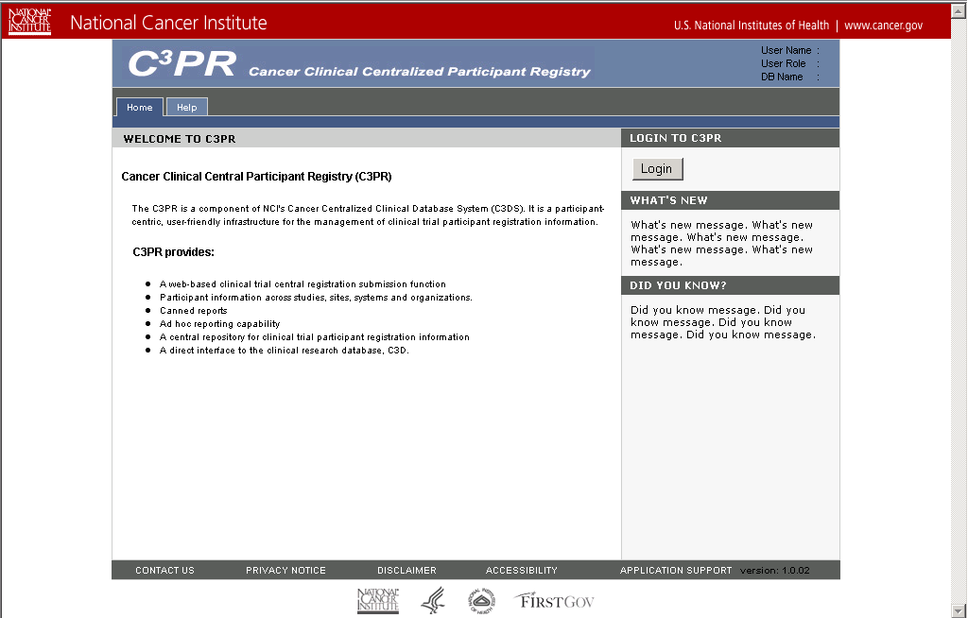
Cancer Central Clinical Participant Registry (C3PR)

Slide 8
Cancer Central Clinical Participant Registry (C3PR)
Viewing Protocols:
Select the Protocol Tab
Enter Search Criteria (protocol status = open) and click search
Click View Registration History
Click View Protocol
Click View Diseases
Click Manage/View PI Associations
Click View Eligibility Checklist

Slide 9
Cancer Central Clinical Participant Registry (C3PR)
Updating or Retrieving Eligibility Checklists (CRO only):
Click Refresh Checklist
Click Save Checklist
Search for the Protocol
Click View Draft Eligibility Checklist
Click Approve Checklist
Click Back to Search

Slide 10
Cancer Central Clinical Participant Registry (C3PR)
Creating Participants:
Click Participant Tab
Enter Criteria (Participation Type = Patient) and Click Search
If your patient is not there, Click Create
Enter Requested Information
Add Address, Contact, Relationships
You Can Edit the Data

Slide 11
Cancer Central Clinical Participant Registry (C3PR)
Registration to a Screening Protocol:
Select a Protocol
Fill Out Registration and Eligibility Checklist
Click Save (Pending Status)
Click Edit
Click Delete
Repeat Process and Click Register
Try the C3D Link (RN & PI Only)
Click the Close Link

Slide 12
Cancer Central Clinical Participant Registry (C3PR)
Registration to a Screening Protocol:
Select a Protocol
Fill Out Registration
Select Arm
Consent Form
Eligibility Checklist
Click Register

Slide 13
Cancer Central Clinical Participant Registry (C3PR)
Reports Tab:
Accrual Ceiling Report
Accrual Status Report
Referral Letter (CRO Only)
Protocol Accrual Status
Protocol Activity
Weekly Patient

Slide 14
Cancer Central Clinical Participant Registry (C3PR)
Other Tabs:
Links Tab
Help Tab
Logout Tab

Slide 15
Cancer Central Clinical Participant Registry (C3PR)
Questions?

Slide 16
Cancer Central Clinical Participant Registry (C3PR)
Exercises

Slide 17
Cancer Central Clinical Participant Registry (C3PR)
C3PR Home: http://trials.nci.nih.gov/projects/trialmanagement/c3ds_project/c3pr?search=c3pr

