Slide 1

The Cancer Trials Support Unit
Overview
and
Interest in C3PR
Steve Riordan
CTSU Project Director
November 7, 2006

Slide 2
Presentation Outline
Background
Current registration and enrollment processes
Randomization Hub
Interest in C3PR
Synergy and differences

Slide 3
Goals and Objectives
Provide a wide choice of clinical trial options to the largest possible number of investigators
Involve a larger number of treating institutions in the clinical trials process
Increase enrollment to cancer clinical trials
Streamline or eliminate redundant processes and procedures
Provide all necessary support services to make working with the CTSU a positive experience

Slide 4
Cancer Cooperative Groups
NCCTG
North Central
Cancer Treatment
Group
NCIC-CTG
National Cancer
Institute of Canada
Clinical Trials Group
NSABP
National Surgical
Adjuvant Breast
and Bowel Project
SWOG
Southwestern
Oncology Group
ECOG
Eastern Cooperative
Oncology Group
GOG
Gynecologic
Oncology Group
CALGB
Cancer and Leukemia
Group B
RTOG
Radiation Therapy
Oncology Group
ACOSOG
American College
of Surgeons
Oncology Group
IBCSG
International Breast Cancer
Study Group
EORTC
European Organization for
Research and Treatment of Cancer

Slide 5
Other Stakeholders
Clinical research sites
  Over 900 enrolling patients through the CTSU
  Over 3,000 submitting regulatory documents
Other NCI organizations
  NCI Division of Cancer Prevention
    Community Clinical Oncology Program
  Cancer Information Service
  Center for Bioinformatics
NCI contractors
  Pharmaceutical companies
  Regulatory agencies

Slide 6
Clinical Trial Options
Protocol access
  60+ active protocols
  Predominantly phase 3 studies, some phase 2 trials that meet certain requirements
Access to trials from all Groups
  11 different sponsoring organizations
Access to trials for many diseases
  9 major and several minor cancer diseases
Nearly 19,000 enrollments since beginning of project
  Enrolling at rate of 500+ patients per month

Slide 7
The Westat Team
Approximately 100 FTEs on the project
Westat (prime contractor)
  Rockville
  Houston
  Durham
  Regional staff
Coalition of Cancer Cooperative Groups
  Philadelphia
CTIS (Option 6 only)
  Rockville

Slide 8
Tasks Organization
(services)
Clinical Trial Management Services
  Clinical database development
  Data management
Customer Service
  Patient Registration Service
  Membership Services
Protocol Implementation
Regulatory Support Services
Site Performance Management

Slide 9
Tasks Organization
(services)
Financial Management
CTSU Independent Clinical Research Site Program
Promotion, Education and Training
Web Site
Informatics
  Systems infrastructure
  Security and disaster planning
  Applications design and development
  Applications support

Slide 10
Information Technology
Continue to develop and maintain the CTSU Enterprise System, including
  CTMS
    DM systems, randomization hub, RDC, and data quality management systems
  Regulatory Support System
  Financial Management System
  Site Performance Management System
  Image Management System
  Web site and Members’ Web portal
  CTSU Enterprise Web Services

Slide 11
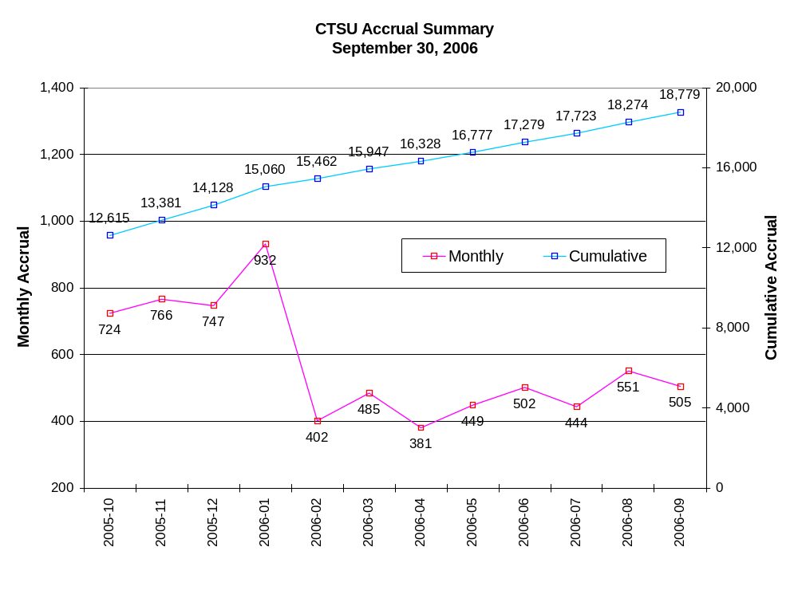

Slide 12
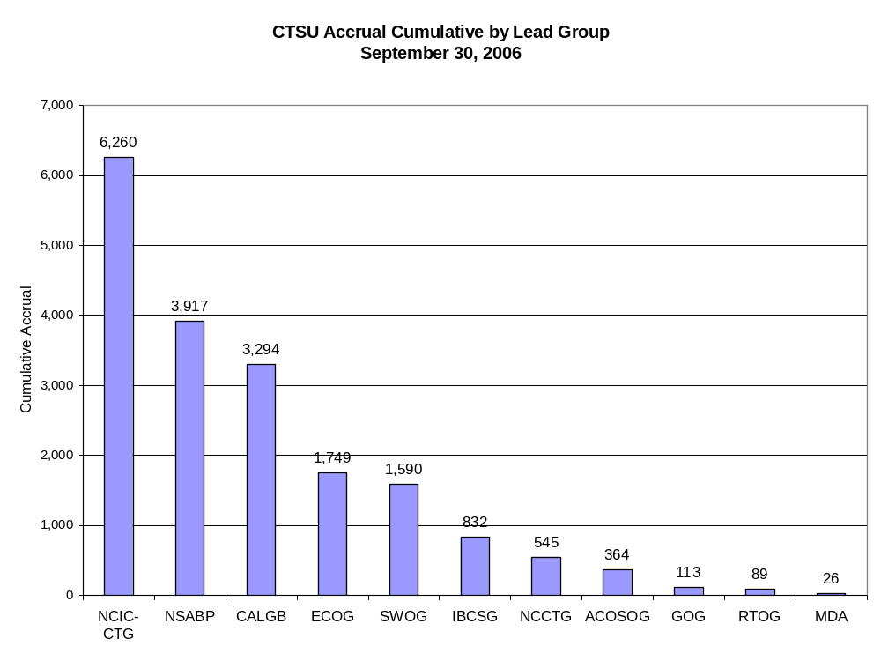

Slide 13
Randomization Hub
System objectives
  Reduce manual intervention in the registration process
  Reduce the training burden on site personnel
  Reduce the programming and administrative workload at participating Cooperative Groups
  Adhere as closely as possible to regulatory guidelines; e.g. GCP, 21 CFR 11
  Make the Randomization Hub available to other organizations
  Offer a standardized format for exchanging patient eligibility data among CTSU and the participating Cooperative Groups

Slide 14
Randomization Hub
The Randomization Hub application system will:
  Enable patient registrars to record and edit checklist data entry and determine patient eligibility for inclusion on a given clinical trial;
  Communicate checklist and related regulatory data (e.g. investigator status on a Group roster, etc.) to Group randomization processes using a data format that complies with industry standards (e.g. CDISC);
  Communicate Group treatment assignments back to the Randomization Hub user.

Slide 15

RH - Architecture
Cooperative Group Systems
Group Web Service
RSS / PECS
Patient data extract
Randomization Hub
Randomization Process
CTEP / AMS
Study
Database
caDSR
Protocol Eligibility Forms Submission
Form Builder

Slide 16
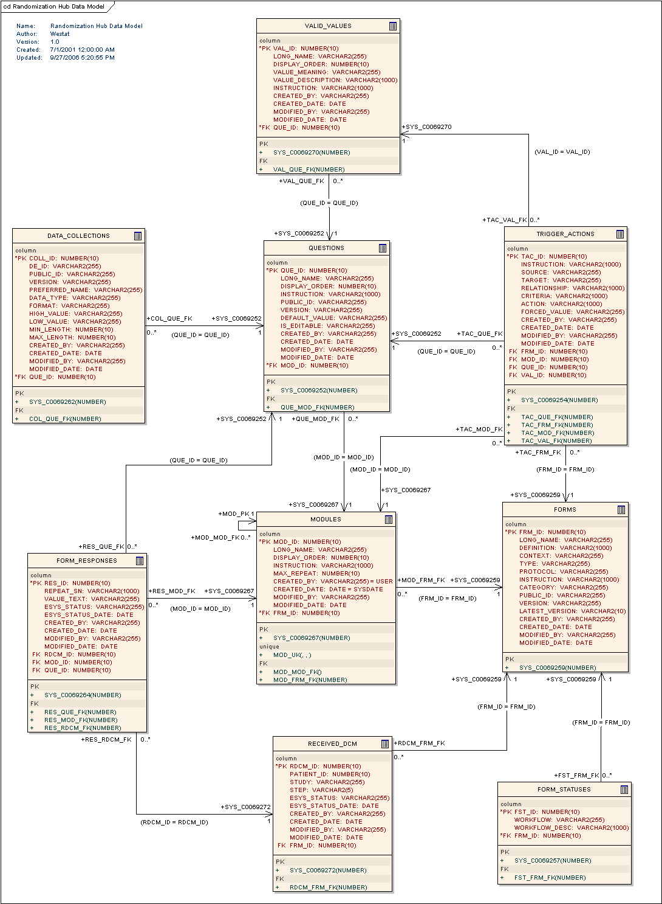
RH - Data Model

Slide 17
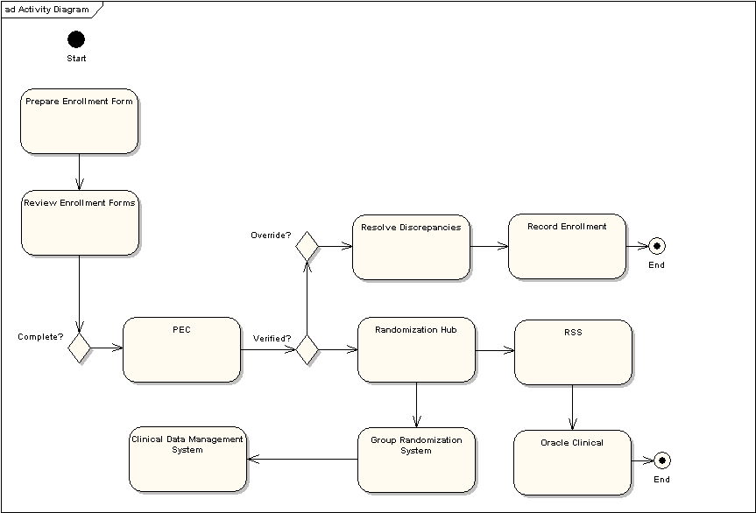
RH – Enrollment Activity Use Case

Slide 18
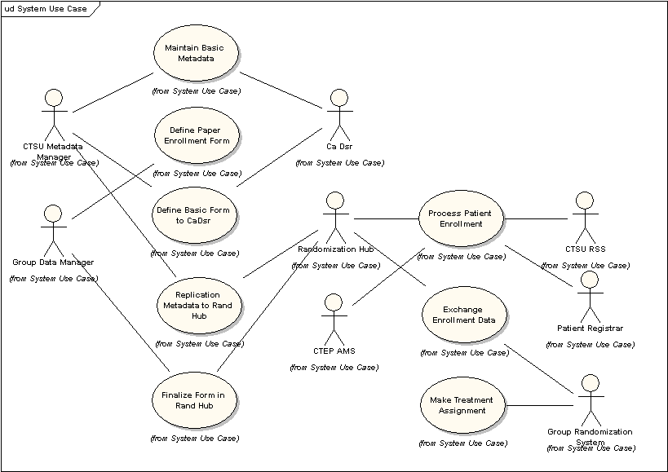
RH – Workflow Use Case

Slide 19
RH - Timeline
Major tasks
  Mini-slice (V0.5) 2/2007
  Involve Groups in development 3/2007
  Beta release (for V1.0) 6/2007
  Production release (V1.0) 7/2007
CTSU dependent on timeline
  Contract activities
  Budget
RH must remain the primary focus

Slide 20
Interest in C3PR
Why is the Westat interested in C3PR?
  Developing system with similar function
  Potentially sharing data and users
  Utilizing similar technology
  Potential project synergy
  Vehicle for involvement of Cooperative Groups

Slide 21
Synergy and Differences
Similar functions
Differences
  Single-institution (C3PR) vs. multi-institution (RH)
  PHI vs. anonymous patient data
  Inclusion of IRB data (RH) vs. assumption about IRB approvals (C3PR)
  Integration points

Slide 22
Common Integration Points
caDSR
(Oracle) Clinical Database
NCI PDQ system (??)
Regulatory Support System (??)

