Slide 1
COPPA Integration
C3PR Design Approach

Slide 2
Requirements
Integrate with COPPA. COPPA will be the source of truth for all persons (investigators and research staffs), organization and protocol data.
C3PR should at no point display stale data for COPPA managed entities.
Need to support standalone mode of C3PR (i.e C3PR deployed without COPPA).

Slide 3
Assumptions
COPPA will not broadcast CRUD messages.
Should not cache COPPA managed entities.

Slide 4
Design Considerations
Very Strict Timelines.
Iterative Development (Agile). COPPA services will be developed over time.
Minimum overhaul in design and implementation. Since C3PR is a matured application and into its 2nd year of active development, it should be ensured that the impact of COPPA integration is minimal in that it should minimizes the refactoring of current codebase.

Slide 5
Possible Approaches
Purist Approach: A C3PR deployed instance will either support COPPA or Standalone.
  Separate versions of C3PR.
  Configurable deployment switch strategy.
Hybrid Approach: A C3PR deployed instance will support both COPPA and Standalone mode.

Slide 6
Separate versions of C3PR
Clear separation of logic, hence much easier to implement.
Will need to maintain two separate codebase. Very non scalable and non maintainable.

Slide 7
Configurable Deployment Switch Strategy
Single codebase hence easier to maintain and scale.
Easier to do interoperability test and yet keep latest application features.
Very high inter-team dependency.
Will need to do conditional spring injections which can be tricky. Although we are doing some conditional injections for webSSO implementation but its neither scalable nor clean.
Since COPPA will provide services iteratively, overall design of the application will be compromised by developing services which will not having a single responsibility. It will directly contradict DDD approach since the domain knowledge will be scattered across different services and repositories.

Slide 8
Hybrid Approach
Proposed by C3PR
Single codebase hence easier to maintain and scale.
Easier to do interoperability test and yet keep latest application features.
All application classes across the DDD will be agnostic of the source of truth. And hence COPPA services can be iteratively incorporated without changing the design of the application.
Once COPPA Interoperability is matured enough a switch can be provided to make the application adopt the purist approach in retrieving data.
Low Inter-team dependency.

Slide 9
Example Use Case
User enters study definition.
User searches for organizations to associate it to a study (creating a study site).
User saves the study.

Slide 10
Current Design
(class diagram)
Study
StudySite
Organization

Slide 11
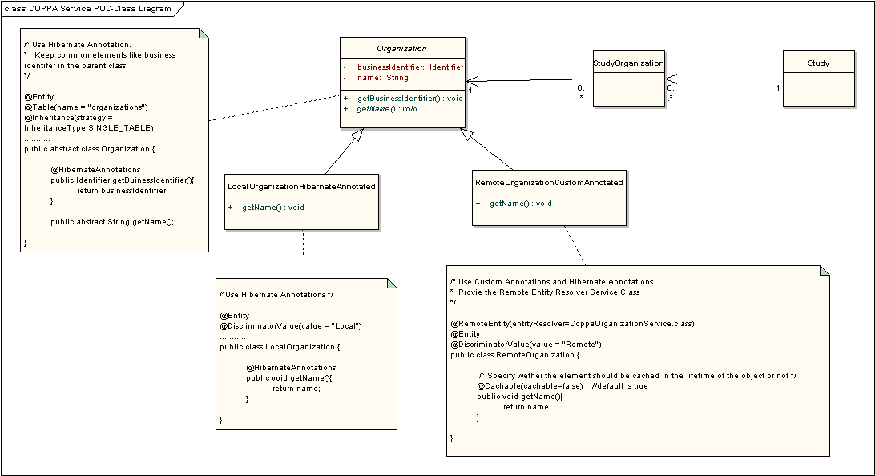
Proposed Design

Slide 13

Search for organizations to create studySite
New Code
Select an organization, create study site and save study
Changes in existing code
Load a study from database for editing.
No change
1
OraganizationAjaxFacade
2
OrganizationDao
3
5
4
6
RemotePropertyCustomBinder
8
COPPA Service
7
9
10
StudyDao
11
23
DB
13
18
12
19
22
14
15
16
Interceptor
StudyController
17
21
Hibernate
20

Slide 14
COPPA Integration Architecture
Database
RemoteEntityManager
SessionCache
RemoteSession
Other Caches
ThreadLocalCache
Application
Hibernate
COPPA
RemoteEntities
RemoteEntityInterceptor
RemoteResolvers

