Slide 1
caGrid Portal
CTMS Use Cases
Patrick McConnell
patrick.mcconnell@semanticbits.com
Joshua Phillips
joshua.phillips@semanticbits.com

Slide 2
Agenda
Background
  Motivation
Use Cases
  Trial summary data, accruals, adverse events
Mockups
  Accrual overview
Services
  Landscape, interfaces, considerations
Next steps

Slide 3
Background
Motivation
Enhance existing caGrid portal work
Provide a set of potentially new opportunities for funding for portal work
Leverage existing work (caAERS, C3PR)
Enhance portal and existing work for potential business opportunity
  Multi-site monitoring in cooperative groups
  Monitoring trials for pharmas

Slide 4















Use Cases
Umbrella use case: summary information about ongoing trials
How many grade 3 adverse events were reported for my study in the last week?
What are the accrual numbers for colorectal cancer patients?
Program
Director
caGrid
Portal
What are the sites accruing in my study in the last month?
Study
Coordinator
What centers have been accruing patients most quickly in the last month?
. . .
caGrid

Slide 5
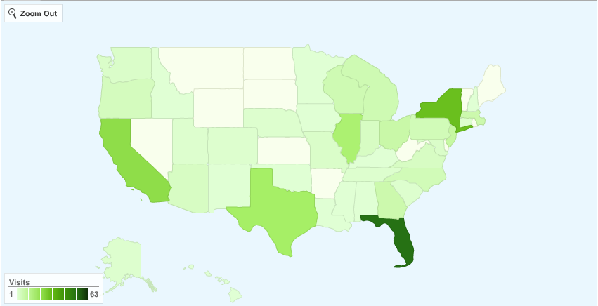
Mockups
Accrual Country Overview
Study: All
Date Start: 4/1/2009
Disease: Colon
Date End: 5/1/2009
State: All
Site: All

Slide 6
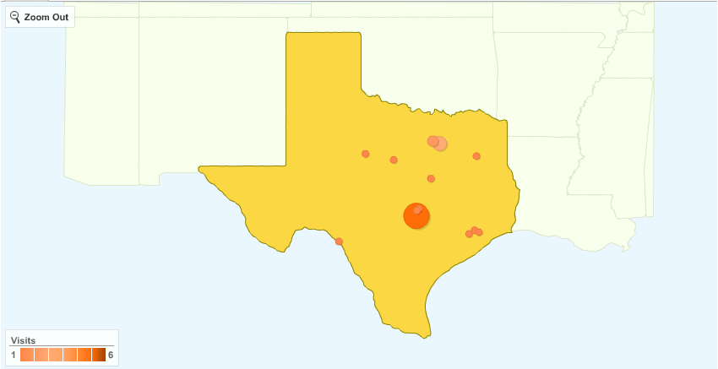
Mockups
Accrual State Overview
Study: All
Date Start: 4/1/2009
Disease: Colon
Date End: 5/1/2009
State: Texas
Site: All

Slide 7
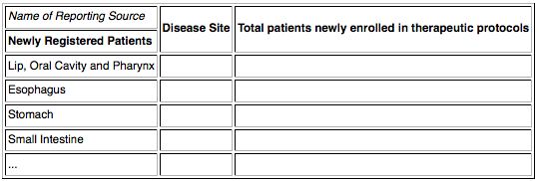
Mockups
Accrual Site Overview
Study: All
Date Start: 4/1/2009
Disease Site: Colon
Date End: 5/1/2009
State: Texas
Site: MD Anderson

Slide 8







Services
Landscape
caGrid
Portal
. . .

Slide 9
Services
Interfaces
C3PR
  Subject[] getAccruals(Study, DiseaseSite)
caAERS
  AdverseEvent[] getAEs(Study, AdverseEvent?)

Slide 10
Services
Considerations
Security
  Data can be considered protected
  Different people have access to different studies and different sites
  Can we leverage applications for authorization?
Test services
  No services available for this (maybe caAERS data service?)
  No sites available for this
  We will have to setup a number of test services that mimic real sites
Test data
  Data is protected – don’t want to get into HIPAA and other issues
  We will have to create test data
  Can we leverage the backends of the applications (which means we can leverage the applications to create data)?

Slide 11

Next Steps
Document use cases more accurately
Build new portal UI components
Build new services
Deploy services in test-bed
Add test data

